Slide 1
Informative priors in scaling & merging
Doeke Hekstra
March 29, 2021
discuss with Randy Read once we’ve tried uni- and bivariate Rice

Slide 2
Test data
1 or 2-variate Rice
HEWL/NaI at BioCARS, constrained by NE-CAT data (Friedel mates for bivariate)
e35/2VWR/SSRL 4C data (on, off | ref) or (up, down | off or ref) and (off | ref)
DHFR e99 & THz (same)
EGFP 4EUL/THz (same)
PYP (same)
HEWL T-jump (on, off | ref) (ask Mike Thompson)
>2-variate
EF-X time series x broken symmetry
PYP time series
“reciprocal panda” (ligand screen)

Slide 3
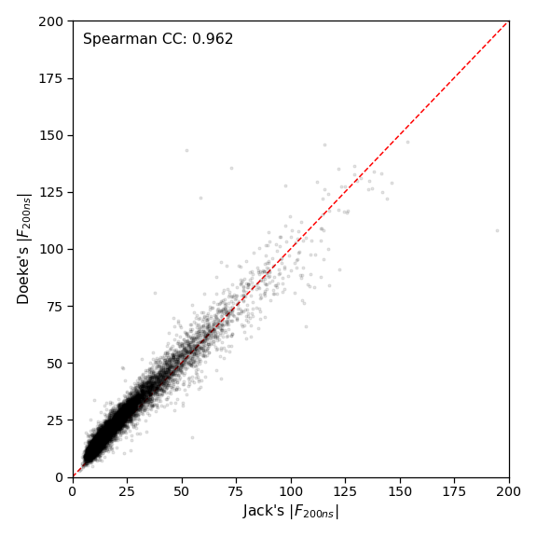
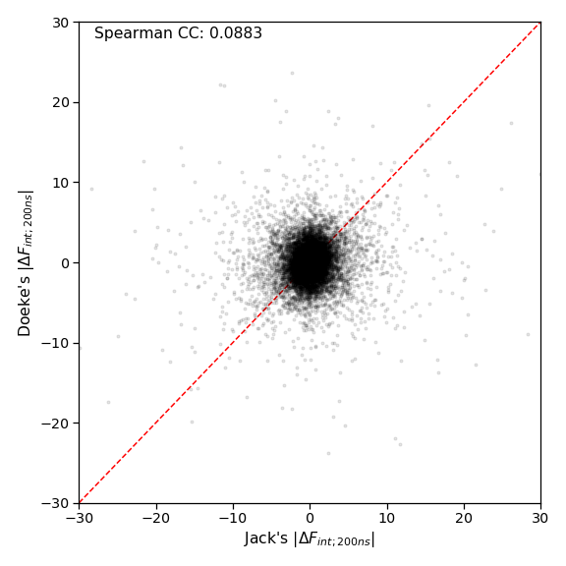
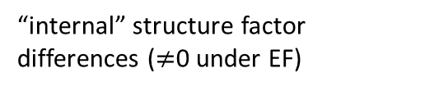
Analysis: the real challenges (1)
Structure Factor Amplitudes
Structure factor changes
“internal” structure factor differences ($≠$0 under EF)
Jack re-analyzed my PDZ domain EF-X data:
Every step was quite reproducible except geometry refinement
This is largely a black box in Precognition.

Slide 4
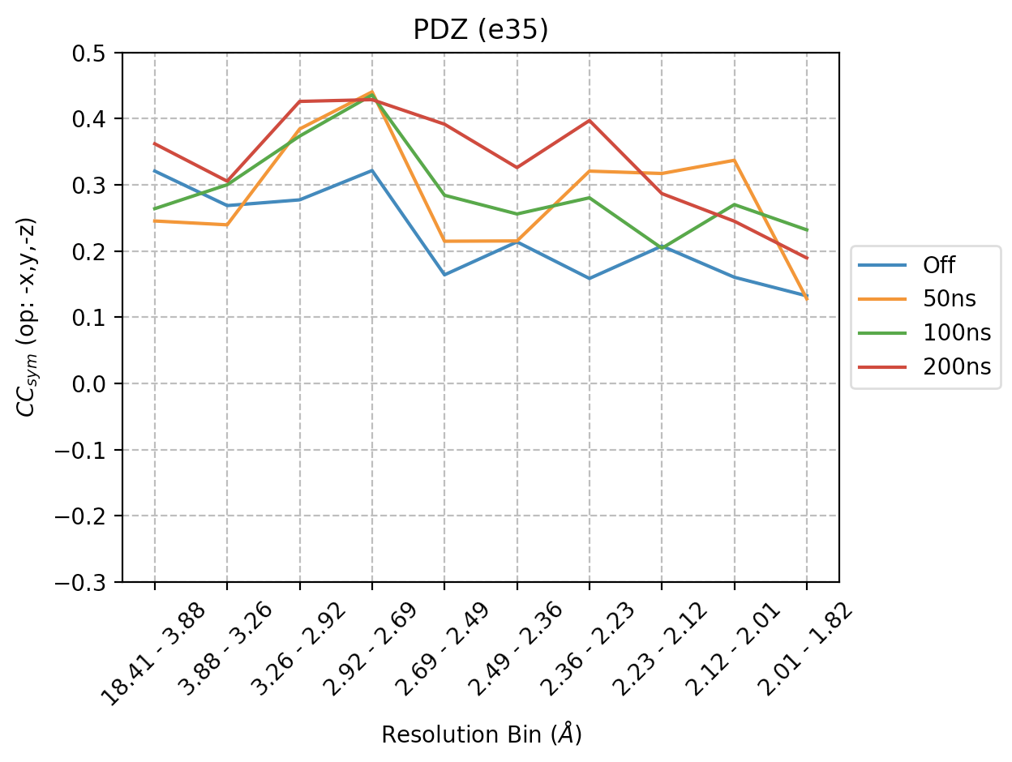
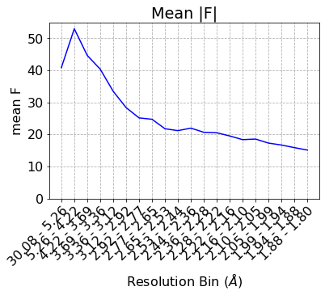

Analysis: the real challenges (2)
$ρ(F_{\overline{h}k\overline{l}}−F_{hkl},F_{\overline{h}k\overline{l}}−F_{hkl}$)
}
}
random half 1
half 2
Measures the correlation between differences in structure factors which are equivalent without electric field
But, they are strongly correlated (blue) without field.
Resolution (Å)
Mean intensity varies by resolution, image number, etc.,
Scaling first needs to put all reflections on the same scale. Inaccurate scaling leads to apparent signal!
$$ΔF=\sqrt{\frac{I_{1}}{Σ_{1}}}−\sqrt{\frac{I_{2}}{Σ_{2}}}$$

Slide 5

Analysis: the real challenges (2)
$ρ(F_{\overline{h}k\overline{l}}−F_{hkl},F_{\overline{h}k\overline{l}}−F_{hkl}$)
}
}
random half 1
half 2
Measures the correlation between differences in structure factors which are equivalent without electric field
But, they are strongly correlated (blue) without field.
Resolution (Å)
Mean intensity varies by resolution, image number, etc.,
Scaling first needs to put all reflections on the same scale. Inaccurate scaling leads to apparent signal!
Key to scaling: comparing redundant observations—a problem for EF-X.

Slide 6
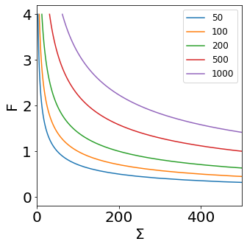
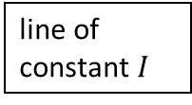
line of constant $I$
If we have just a single accurate observation of an intensity, all points on the line are equally plausible.
Scaling uses
redundant observations
gradual change in scale factor
Can use:
physical modeling
“prior information”

Slide 7
Outline
Single datasets: the Wilson distribution
Careless: Bayesian variational merging
Is the Double-Wilson model realistic?
Better priors with reference data?
Time-resolved crystallography
pairs of structure factors
general case

Slide 8
Outline
Single datasets: the Wilson distribution
Careless:
a Bayesian formalism
with variational inference
using the Wilson distribution as a prior
Better priors with reference data?
Time-resolved crystallography
pairs of structure factors
general case

Slide 9
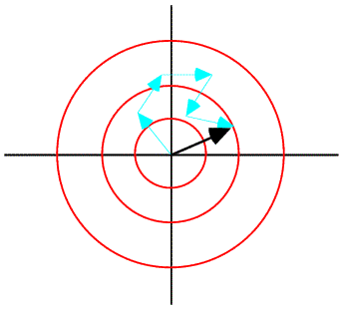
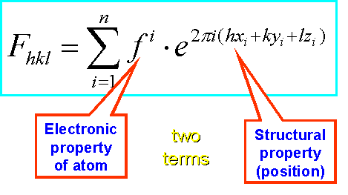
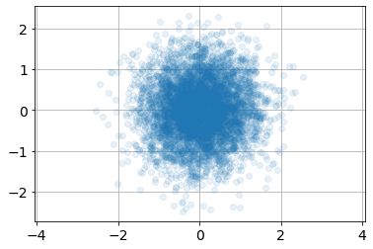


The CLT & the Wilson distribution
$$|F|$$
Building up a structure in real space quickly looks like a random walk in the complex plane!
As a result, the distribution of acentric structure factors looks like a bivariate normal distribution!
$$φ$$
Imag. component →
Real component →
Ruppweb.org

Slide 10
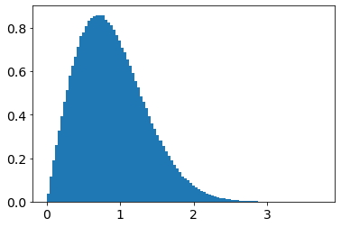
The CLT & the Wilson distribution
Building up a structure in real space quickly looks like a random walk in the complex plane!
The distribution of the amplitude of acentric structure factors is the acentric Wilson distribution
2_Surrogate_data_example

Slide 11
The CLT & the Wilson distribution

Slide 12
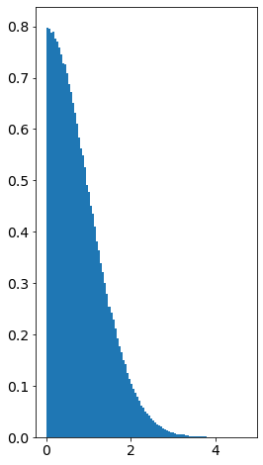
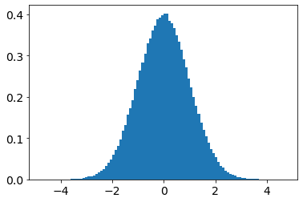
The CLT & the Wilson distribution
Building up a structure in real space quickly looks like a random walk in the complex plane!
As a result, the distribution of centric structure factors looks like a univariate normal distribution!
2_Surrogate_data_example

Slide 13
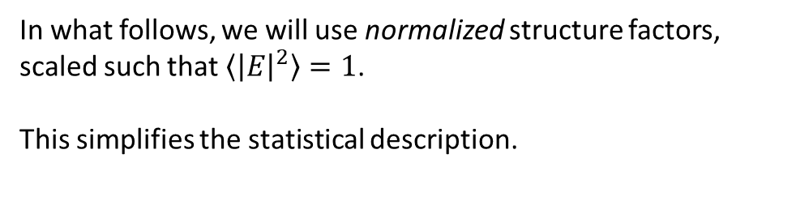
Normalized structure factors
In what follows, we will use normalized structure factors,
scaled such that $\left\langle {\left|E\right|}^{2}\right\rangle =1$.
This simplifies the statistical description.
2_Surrogate_data_example

Slide 14
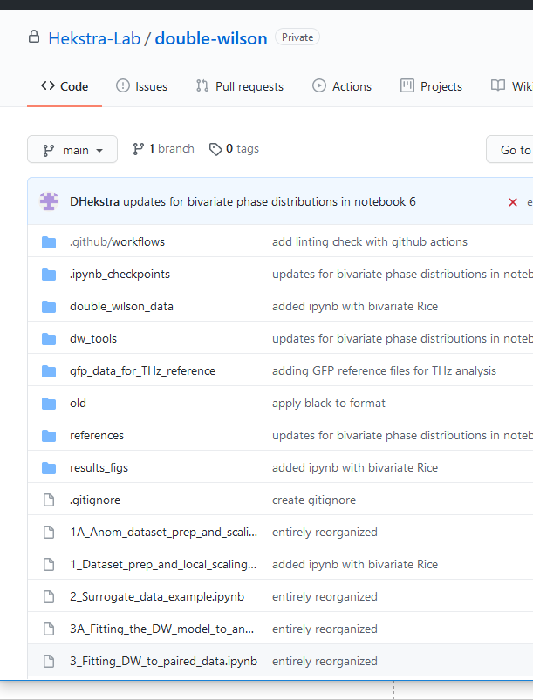
2_Surrogate_data_example

Slide 15
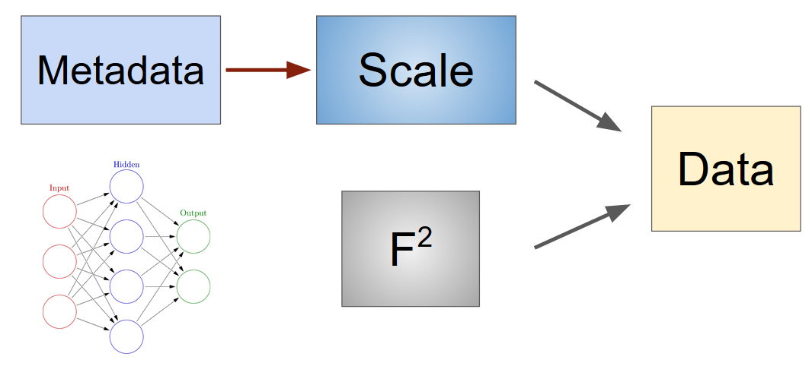


Careless: machine learning to scale & merge X-ray data
$$I_{hm}=Σ_{hm}F_{h}^{2}$$
https://github.com/Hekstra-Lab/careless
https://www.biorxiv.org/content/10.1101/2021.01.05.425510v1

Slide 16
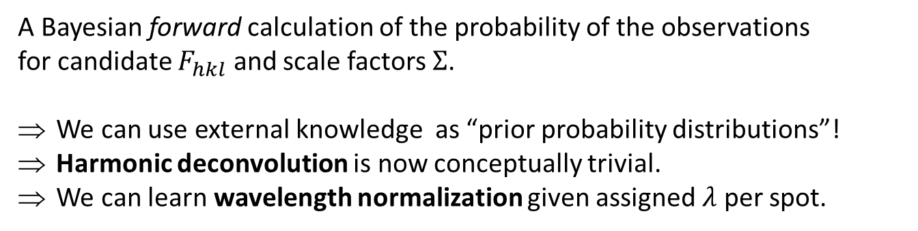
Careless: machine learning to scale & merge X-ray data
A Bayesian forward calculation of the probability of the observations
for candidate $F_{hkl}$ and scale factors $Σ$.
We can use external knowledge as “prior probability distributions”!
Harmonic deconvolution is now conceptually trivial.
We can learn wavelength normalization given assigned $λ$ per spot.
https://github.com/Hekstra-Lab/careless
https://www.biorxiv.org/content/10.1101/2021.01.05.425510v1

Slide 17
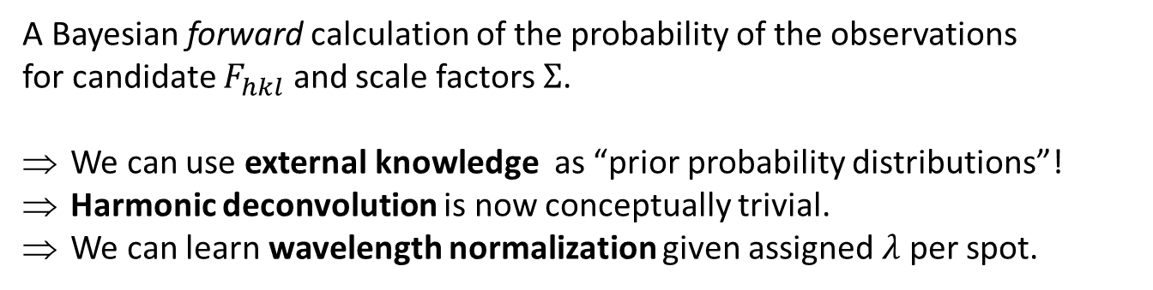
Careless: machine learning to scale & merge X-ray data
A Bayesian forward calculation of the probability of the observations
for candidate $F_{hkl}$ and scale factors $Σ$.
We can use external knowledge as “prior probability distributions”!
Harmonic deconvolution is now conceptually trivial.
We can learn wavelength normalization given assigned $λ$ per spot.
https://github.com/Hekstra-Lab/careless
https://www.biorxiv.org/content/10.1101/2021.01.05.425510v1

Slide 18
Careless: machine learning to scale & merge X-ray data
Currently, the default priors are the (a)centric Wilson distributions.
What if we already have a great dataset from a similar (or the same) crystal? Could we use that?

Slide 19
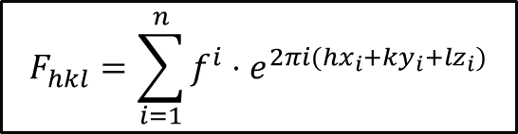
Related structures
$$F_{hkl}^{}=\sum_{i=1}^{n}{f^{i}⋅e^{2πi(hx_{i}+ky_{i}+lz_{i})}}$$
Imag. component →
Real component →
Ruppweb.org

Slide 20
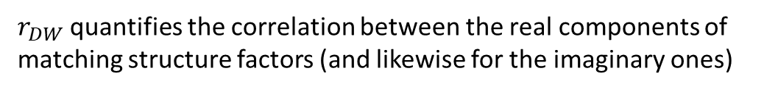
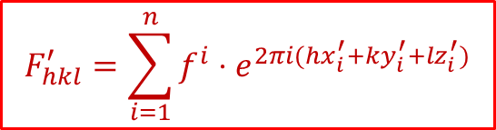

Related structures
$$r_{DW}=0.5$$
$$F_{hkl}^{}=\sum_{i=1}^{n}{f^{i}⋅e^{2πi(hx_{i}+ky_{i}+lz_{i})}}$$
Imag. component →
$$F_{hkl}^{′}=\sum_{i=1}^{n}{f^{i}⋅e^{2πi(hx_{i}^{′}+ky_{i}^{′}+lz_{i}^{′})}}$$
Real component →
$r_{DW}$ quantifies the correlation between the real components of matching structure factors (and likewise for the imaginary ones)
Ruppweb.org

Slide 21

Related structures
$$r_{DW}=0.9$$
$$F_{hkl}^{}=\sum_{i=1}^{n}{f^{i}⋅e^{2πi(hx_{i}+ky_{i}+lz_{i})}}$$
Imag. component →
$$F_{hkl}^{′}=\sum_{i=1}^{n}{f^{i}⋅e^{2πi(hx_{i}^{′}+ky_{i}^{′}+lz_{i}^{′})}}$$
Real component →
$r_{DW}$ quantifies the correlation between the real components of matching structure factors (and likewise for the imaginary ones)
Ruppweb.org

Slide 22

Related structures
$$r_{DW}=0.95$$
$$F_{hkl}^{}=\sum_{i=1}^{n}{f^{i}⋅e^{2πi(hx_{i}+ky_{i}+lz_{i})}}$$
Imag. component →
$$F_{hkl}^{′}=\sum_{i=1}^{n}{f^{i}⋅e^{2πi(hx_{i}^{′}+ky_{i}^{′}+lz_{i}^{′})}}$$
Real component →
$r_{DW}$ quantifies the correlation between the real components of matching structure factors (and likewise for the imaginary ones)
Ruppweb.org

Slide 23

Related structures
$r_{DW}=0.$98
$$F_{hkl}^{}=\sum_{i=1}^{n}{f^{i}⋅e^{2πi(hx_{i}+ky_{i}+lz_{i})}}$$
Imag. component →
$$F_{hkl}^{′}=\sum_{i=1}^{n}{f^{i}⋅e^{2πi(hx_{i}^{′}+ky_{i}^{′}+lz_{i}^{′})}}$$
Real component →
$r_{DW}$ quantifies the correlation between the real components of matching structure factors (and likewise for the imaginary ones)
Ruppweb.org

Slide 24

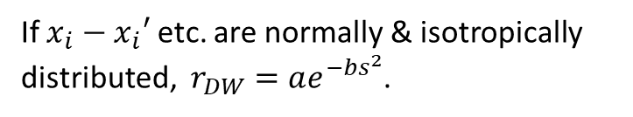
Related structures
$r_{DW}=0.$98
$$F_{hkl}^{}=\sum_{i=1}^{n}{f^{i}⋅e^{2πi(hx_{i}+ky_{i}+lz_{i})}}$$
Imag. component →
$$F_{hkl}^{′}=\sum_{i=1}^{n}{f^{i}⋅e^{2πi(hx_{i}^{′}+ky_{i}^{′}+lz_{i}^{′})}}$$
Real component →
If $x_{i}−x_{i}′$ etc. are normally & isotropically distributed, $r_{DW}=ae^{−bs^{2}}$.
I will call $r_{DW}$ the “Double Wilson parameter”

Slide 25
Outline
Single datasets: the Wilson distribution
Careless:
a Bayesian formalism
with variational inference
using the Wilson distribution as a prior
Is the Double-Wilson model realistic?
Better priors with reference data?
Time-resolved crystallography
pairs of structure factors
general case

Slide 26
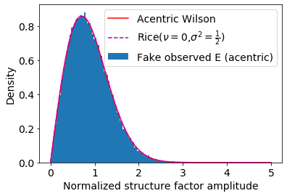
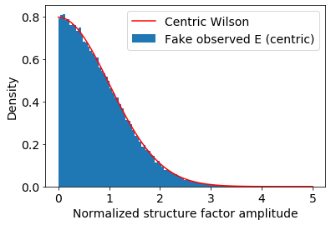
Double-Wilson model
The amplitudes of the centric and acentric reflections follow the Wilson distribution:
2_Surrogate_data_example

Slide 27
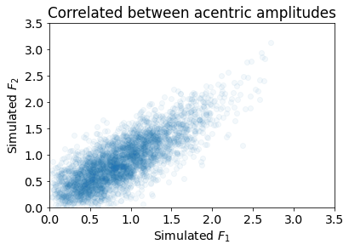

Double-Wilson model
The Double-Wilson model predicts a joint distribution of the structure factor amplitudes:
$$r_{DW}=0.9$$
2_Surrogate_data_example

Slide 28
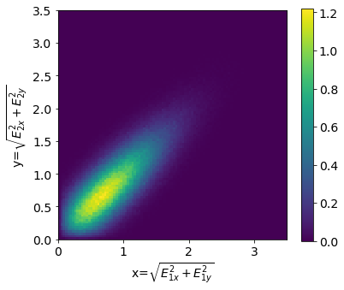
Double-Wilson model
What about conditional distributions?
$$r_{DW}=0.9$$
2_Surrogate_data_example

Slide 29
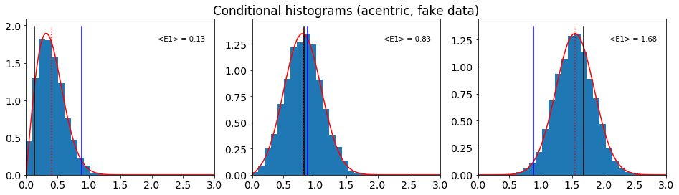
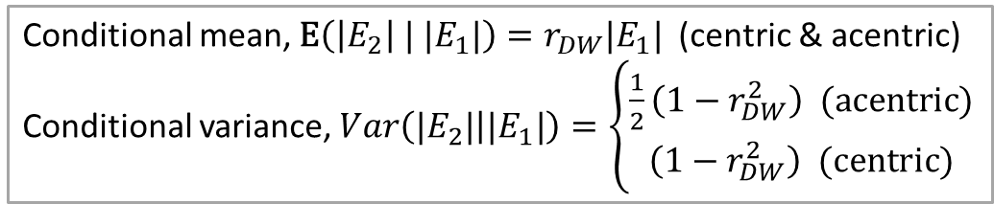
Double-Wilson model
The conditional distributions of structure factor amplitudes of one data set given the other are described by the Rice distribution (acentric) and Folded Normal (centric).
Rice mean
Wilson mean
Conditional mean, $\text{E}\left(\left|E_{2}\right| | |E_{1}|\right)=r_{DW}|E_{1}|$ (centric & acentric)
Conditional variance, $Var\left(|E_{2}| | |E_{1}|\right)=\left\{\begin{matrix}\frac{1}{2}\left(1−r_{DW}^{2}\right) (\text{a}\text{centric}) \\ \left(1−r_{DW}^{2}\right) (\text{centric})\end{matrix}\right.$
2_Surrogate_data_example

Slide 30

Double-Wilson model
The conditional distributions of structure factor amplitudes of one data set given the other are described by the Rice distribution (acentric) and Folded Normal (centric).
Conditional mean, $\text{E}\left(\left|E_{2}\right| | |E_{1}|\right)=r_{DW}|E_{1}|$ (centric & acentric)
Conditional variance, $Var\left(|E_{2}| | |E_{1}|\right)=\left\{\begin{matrix}\frac{1}{2}\left(1−r_{DW}^{2}\right) (\text{a}\text{centric}) \\ \left(1−r_{DW}^{2}\right) (\text{centric})\end{matrix}\right.$
rice.pdf( x, cond_mean/np.sqrt(cond_var), scale=np.sqrt(cond_var))
foldnorm.pdf(x, cond_mean/np.sqrt(cond_var), scale=np.sqrt(cond_var))
2_Surrogate_data_example

Slide 31
Double-Wilson model
The Double-Wilson model predicts a joint distribution of the structure factor amplitudes:
$$r_{DW}=0.9$$
What about the correlation coefficient between amplitudes, rather than between real or between imaginary components?
2_Surrogate_data_example

Slide 32
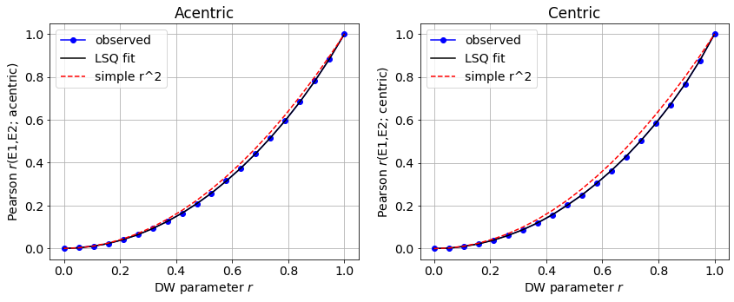

Double-Wilson model
The Pearson correlations between structure factor amplitudes from two correlated data sets almost equal $r_{DW}^{2}$.
2_Surrogate_data_example

Slide 33
Double-Wilson model
But does it work?

Slide 34
Double-Wilson model
We will first look at three PYP datasets
1OTB @ 1.1Å (RT; Anderson et al., Acta Cryst, 2004)
3PYP @ 0.85Å (cryotrapped; Genick et al., Nature, 1998)
1NWZ @ 0.82Å (cryo, dark; Getzoff et al., NSB 2003)

Slide 35
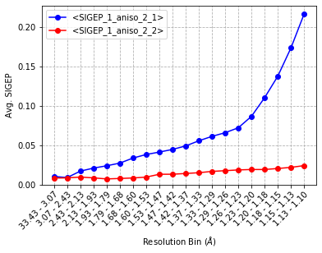
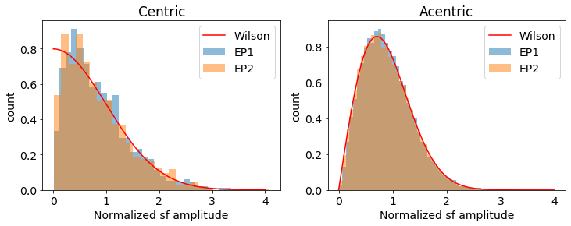
Comparison: 1OTB v 1NWZ
Data quality
Based on Anisotropic + Fourier
For the rest of the analysis, we’ll cut the datasets to 1.2 Å.
dataset 1: 1OTB
dataset 2: 1NWZ
3_Fitting_DW_to_paired_data

Slide 36
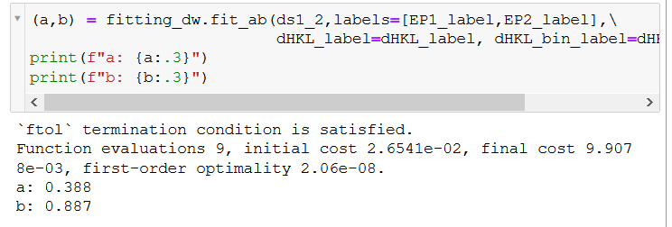
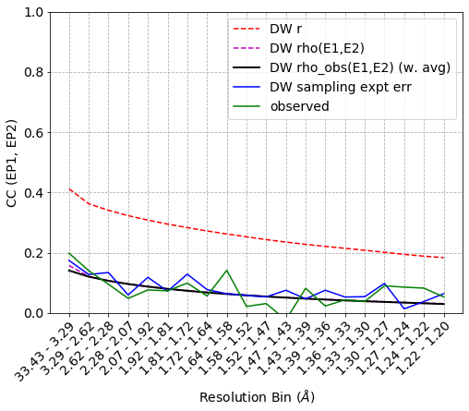
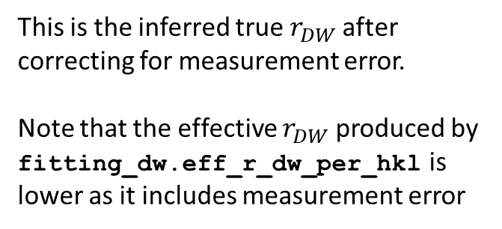

Comparison: 1OTB v 1NWZ
$$r_{DW}=a⋅e^{−bs^{2}}$$
This is the inferred true $r_{DW}$after correcting for measurement error.
Note that the effective $r_{DW}$ produced by fitting_dw.eff_r_dw_per_hkl is lower as it includes measurement error
2_Surrogate_data_example
3_Fitting_DW_to_paired_data

Slide 37
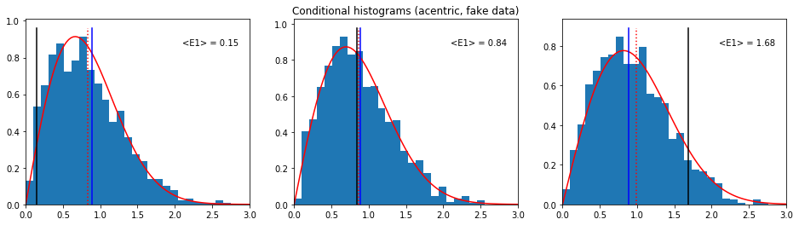
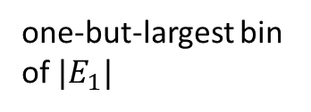

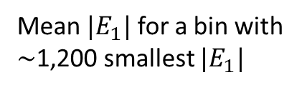
Comparison: 1OTB v 1NWZ
At this low $r_{DW}$, the changes in prior are already quite small!
Rice mean
Wilson mean
Mean $|E_{1}|$ for a bin with $∼$1,200 smallest $|E_{1}|$
middle bin of $|E_{1}|$
one-but-largest bin of $|E_{1}|$
3_Fitting_DW_to_paired_data

Slide 38
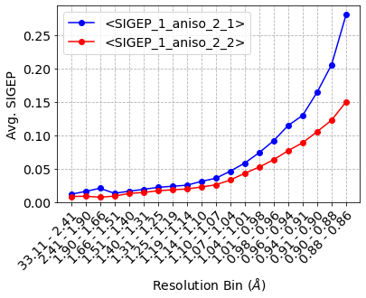
Comparison: 3PYP v 1NWZ
Both are very nice data sets.
We’ll truncate at 1.1Å to keep measurement error very small.

Slide 39
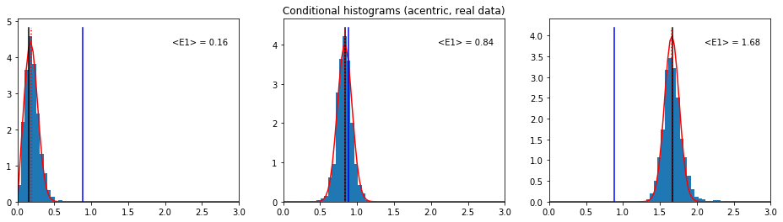
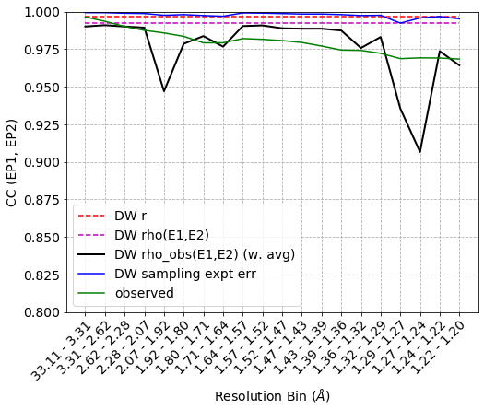
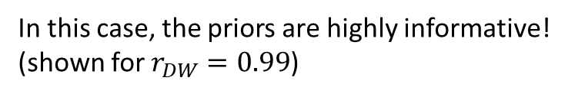
Comparison: 3PYP v 1NWZ
In this case, the priors are highly informative! (shown for $r_{DW}=0.99$)
In this case, the experimental errors dominate the correlation coefficient.
Variability in the black line suggests that expt error estimates are conservative, but not perfect.

Slide 40
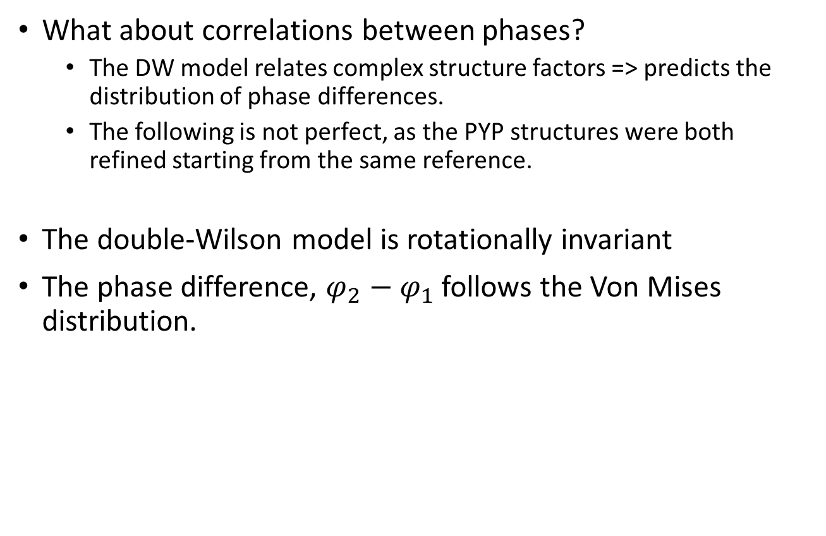
Double-Wilson model
What about correlations between phases?
The DW model relates complex structure factors => predicts the distribution of phase differences.
The following is not perfect, as the PYP structures were both refined starting from the same reference.
The double-Wilson model is rotationally invariant
The phase difference, $φ_{2}−φ_{1}$ follows the Von Mises distribution.

Slide 41
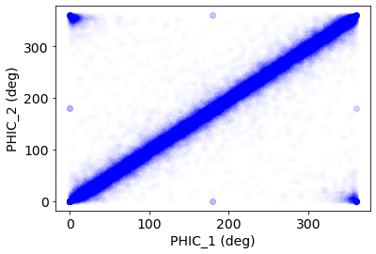
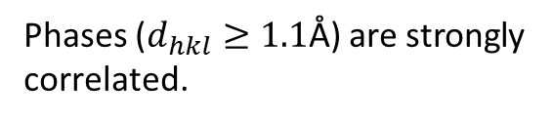
Comparison: 3PYP v 1NWZ
Both are very nice data sets.
We’ll truncate at 1.1Å to keep measurement error very small.
Phases ($d_{hkl}≥1.1$Å) are strongly correlated.

Slide 42
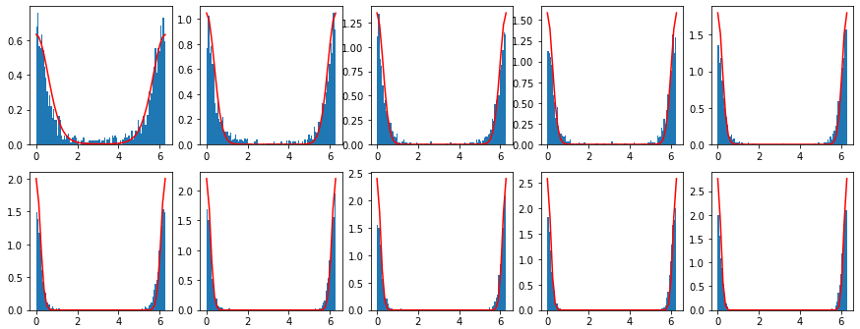
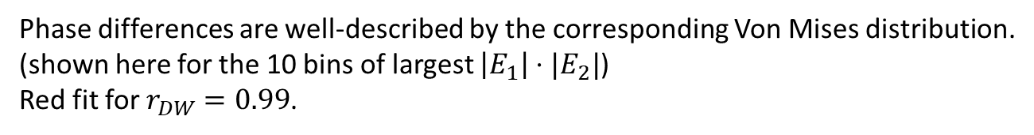
Comparison: 3PYP v 1NWZ
Phase differences are well-described by the corresponding Von Mises distribution.
(shown here for the 10 bins of largest $\left|E_{1}\right|⋅|E_{2}|$)
Red fit for $r_{DW}=0.99$.
vonmises.pdf(x, E1*E2/cond_var)
3_Fitting_DW_to_paired_data

Slide 43
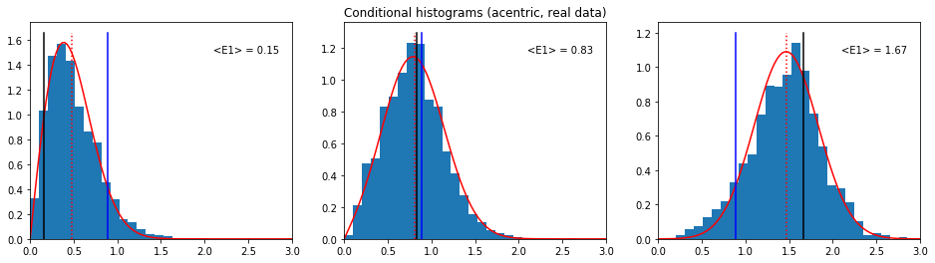


Comparison: DHFR (RT, cryo)
Luzzati $a$ and $b$
 | 4KJK | 4KJJ | 4PST | 4PSS
4KJK | 1,0 | 0.90, 0.43 | 0.95, 0.01 | 0.88, 0.51 | 2013 RT
4KJJ |  | 1,0 | 0.88, 0.26 | 0.93, 0.16 | 2013 cryo
4PST |  |  | 1,0 | 0.89, 0.22 | 2005 RT
4PSS |  |  |  | 1,0 | 2015 cryo
fit using $r_{DW}=0.85$
Keedy, Structure, 2013
https://www.sciencedirect.com/science/article/pii/S0969212614001403
4KJK, 4KJJ cut to 1.5Å
all else cut to 1.2Å

Slide 44
Summary of (a, b) estimates
n | Dataset pair | a | b | Res. range | Details
0 | (5KVX, 5KW3) | 0.94 | 0.79 | Cut to 1.7Å | Thaumatin (100K, 278K)
1 | (2VWR, 5E1Y) | 0.93 | 0.15 | To 1.35Å | LNX2/PDZ2 (100K, 277K)
2 | (3PYP, 1NWZ) | 1.00 | 0.00 | Cut to 1.1Å | PYP (cryotrapped lit, dark, both 100K)
3 | (1NWZ, 1OTB) | 0.39 | 0.89 | Cut to 1.2Å | PYP (100K, 295K)*
4 | (4EUL, GFP_1.37A) (4EUL, GFP_{PHENIX}) | 0.66 0.67 | 0.00 0.4 | Cut to 1.8Å Cut to 1.6Å | GFP (100K, 277K**)
5 | DHFR | ~0.9 | 0-0.5 | Cut to 1.2Å | (see previous slide)
- | HEWL/NaI anom. | 1.00 | 0.00 | To 1.26Å | NECAT_HEWL_RT_NaI_82_XDS
*31.9 v 35.3% solvent (1NWZ/1OTB)
**RT data set looks rather crappy; second row using “Filtered” FPs from PHENIX refinement MTZ
could look at correlation of these a and b with uc’s in Mpro dataset.

Slide 45
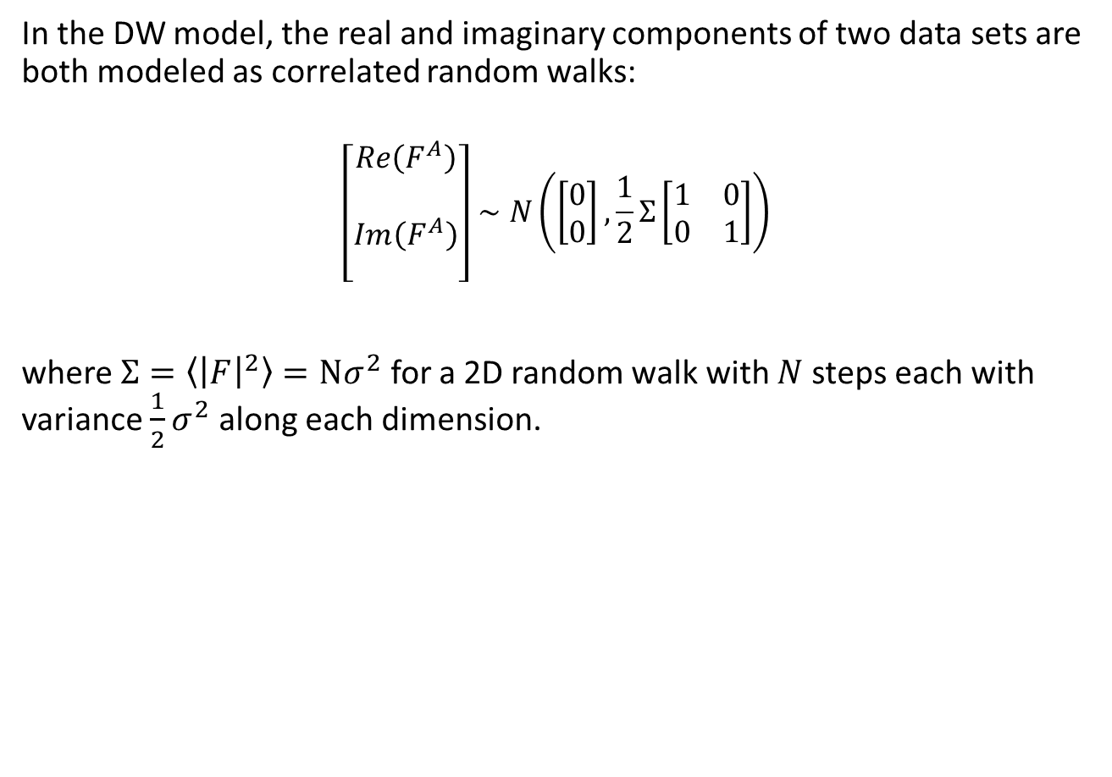
Double-Wilson model—math summary!
In the DW model, the real and imaginary components of two data sets are both modeled as correlated random walks:
$$\left[\begin{matrix}\begin{matrix}Re\left(F^{A}\right) \\ \end{matrix} \\ \begin{matrix}Im\left(F^{A}\right) \\ \end{matrix}\end{matrix}\right]∼N\left(\left[\begin{matrix}0 \\ 0\end{matrix}\right],\frac{1}{2}Σ\left[\begin{matrix}1 & 0 \\ 0 & 1\end{matrix}\right]\right)$$
where $Σ=\left\langle {\left|F\right|}^{2}\right\rangle =Nσ^{2}$ for a 2D random walk with $N$steps each with variance $\frac{1}{2}σ^{2}$ along each dimension.

Slide 46

Double-Wilson model—math summary!
In the DW model, the real and imaginary components of two data sets are both modeled as correlated random walks:
$$\left[\begin{matrix}\begin{matrix}Re\left(F^{A}\right) \\ Re\left(F^{B}\right)\end{matrix} \\ \begin{matrix}Im\left(F^{A}\right) \\ Im(F^{B})\end{matrix}\end{matrix}\right]∼N\left(\left[\begin{matrix}\begin{matrix}0 \\ 0\end{matrix} \\ \begin{matrix}0 \\ 0\end{matrix}\end{matrix}\right],\frac{1}{2}Σ\left[\begin{matrix}\begin{matrix}1 & r \\ r & 1\end{matrix} & \begin{matrix}0 & 0 \\ 0 & 0\end{matrix} \\ \begin{matrix}0 & 0 \\ 0 & 0\end{matrix} & \begin{matrix}1 & r \\ r & 1\end{matrix}\end{matrix}\right]\right)$$
where $Σ=\left\langle {\left|F\right|}^{2}\right\rangle =Nσ^{2}$ for a 2D random walk with $N$steps each with variance $\frac{1}{2}σ^{2}$ along each dimension. $r=r_{DW}$ governs the correlation between datasets.

Slide 47

Double-Wilson model—math summary!
For centric reflections,
$$\left[\begin{matrix}F^{A} \\ F^{B}\end{matrix}\right]∼N\left(\left[\begin{matrix}0 \\ 0\end{matrix}\right], Σ\left[\begin{matrix}1 & r \\ r & 1\end{matrix}\right]\right)$$
Note that the ½ disappears, because $F^{A}$ can be thought of as the sum of a random walk in the complex plane added to its own complex conjugate.

Slide 48

Many-Wilson model
We could arbitrarily expand this, e.g.
$$\left[\begin{matrix}\begin{matrix}Re\left(F^{A}\right) \\ \begin{matrix}Re\left(F^{B}\right) \\ Re\left(F^{C}\right)\end{matrix}\end{matrix} \\ \begin{matrix}Im\left(F^{A}\right) \\ \begin{matrix}Im(F^{B}) \\ Im(F^{C})\end{matrix}\end{matrix}\end{matrix}\right]∼N\left(\left[\begin{matrix}\begin{matrix}0 \\ \begin{aligned}0 \\ 0\end{aligned}\end{matrix} \\ \begin{matrix}0 \\ \begin{aligned}0 \\ 0\end{aligned}\end{matrix}\end{matrix}\right],\frac{1}{2}Σ\left[\begin{matrix}\begin{matrix}1 & r_{ab} & r_{ac} \\ r_{ab} & 1 & r_{bc} \\ r_{ac} & r_{bc} & 1\end{matrix} & \begin{matrix} & & \\ & & \\ & & \end{matrix} \\ & \begin{matrix}1 & r_{ab} & r_{ac} \\ r_{ab} & 1 & r_{bc} \\ r_{ac} & r_{bc} & 1\end{matrix}\end{matrix}\right]\right)$$
etc.
This is a joint distribution, we can calculate the distribution along slices that is, the distribution given the value of a variable.

Slide 49


Many-Wilson model
We could arbitrarily expand this, e.g.
$$\left[\begin{matrix}\begin{matrix}Re\left(F^{A}\right) \\ \begin{matrix}Re\left(F^{B}\right) \\ Re\left(F^{C}\right)\end{matrix}\end{matrix} \\ \begin{matrix}Im\left(F^{A}\right) \\ \begin{matrix}Im(F^{B}) \\ Im(F^{C})\end{matrix}\end{matrix}\end{matrix}\right]∼N\left(\left[\begin{matrix}\begin{matrix}0 \\ \begin{aligned}0 \\ 0\end{aligned}\end{matrix} \\ \begin{matrix}0 \\ \begin{aligned}0 \\ 0\end{aligned}\end{matrix}\end{matrix}\right],\frac{1}{2}Σ\left[\begin{matrix}\begin{matrix}1 & r_{ab} & r_{ac} \\ r_{ab} & 1 & r_{bc} \\ r_{ac} & r_{bc} & 1\end{matrix} & \begin{matrix} & & \\ & & \\ & & \end{matrix} \\ & \begin{matrix}1 & r_{ab} & r_{ac} \\ r_{ab} & 1 & r_{bc} \\ r_{ac} & r_{bc} & 1\end{matrix}\end{matrix}\right]\right)$$
etc.
This is a joint distribution, we can calculate the distribution along slices that is, the distribution given the value of a variable.

Slide 50


For example,
Consider ON and OFF data sets from the same crystal, and a synchrotron reference data sets. Then one can assume:
with $r_{x}≫r$
(note that $r_{x}=r^{2}$ if the only thing relating ON and OFF is their correlation with the reference data set!)

Slide 51


For example,
Consider ON and OFF data sets from the same crystal, and a synchrotron reference data sets. Then one can assume:
Then,
with
$$μ_{1|3}=μ_{2|3}=rE_{3}$$

Slide 52

General EF-X time series
In a general EF-X experiment, we can expect correlations over time and
between broken-symmetry mates.
One can represent that by the following conditional dependences:
Kevin would call this a Directed Acyclic Graph
(Murphy provides the mean and variance of the corresponding multivariate normal)

Slide 53


Fragment screens
Could also model unit cell variation in the OFF structure factors using a stochastic process.
1
https://in.pinterest.com/pin/44473115054533313/

Slide 54
Outline
Single datasets: the Wilson distribution
Careless:
a Bayesian formalism
with variational inference
using the Wilson distribution as a prior
Is the Double-Wilson model realistic?
Better priors with reference data?
Time-resolved crystallography
pairs of structure factors
general case

Slide 55


Careless: machine learning to scale & merge X-ray data
Careless does not optimize point estimates of $F$, but the mean and standard deviation of a probability distribution of $F$ (given the data and the prior).
This distribution is called the variational distribution, $q(F)$.
$$q$$
https://github.com/Hekstra-Lab/careless
https://www.biorxiv.org/content/10.1101/2021.01.05.425510v1

Slide 56
Careless: machine learning to scale & merge X-ray data
Careless does not optimize point estimates of $F$, but the mean and standard deviation of a probability distribution of $F$ (given the data and the prior).
This distribution is called the variational distribution, $q(F)$.
The “ELBO” balances correspondence to the data with correspondence to the prior

Slide 57

Careless: machine learning to scale & merge X-ray data
Careless does not optimize point estimates of $F$, but the mean and standard deviation of a probability distribution of $F$ (given the data and the prior).
This distribution is called the variational distribution, $q(F)$.
Careless approximates expectation values over $q$
by drawing samples from $q$

Slide 58

What do we need?
We need priors $P(F)$ that
optimally represent our prior knowledge.
can calculate $\log{P}$
We need variational distributions $q(F)$ that
resemble possible true posterior distributions
allow for efficient drawing of samples
can calculate $\log{q}$
we can reparametrize samples drawn from a uniform dist to yield the variational distribution
4_Making_Priors
4A_Making_Priors_Anom

Slide 59







Using informative priors
For time-resolved crystallography data, we have two kinds of useful information
High-quality synchrotron reference data, $E_{ref}$
Knowledge that $E_{on}$ and $E_{off}$ tend to be highly correlated
Correlation w\ reference
$$P\left(E_{1}\right)P(E_{2})$$
$$P\left(E_{1}|E_{ref}\right)P(E_{2}|E_{ref})$$
Correlation among on, off
$$P(E_{1},E_{2})$$
$$P(E_{1},E_{2}|E_{ref})$$

Slide 60




Using informative priors in scaling & merging
For time-resolved crystallography data, we have two kinds of useful information
High-quality synchrotron reference data, $E_{ref}$
Knowledge that $E_{on}$ and $E_{off}$ tend to be highly correlated
with $R_{1}=|E_{1}|$ (etc.), $K=R_{3}^{2}/Σ(1−r^{2})$, and ${(1+K)}/β=2/Σ(1−r^{2})$.
This works as long as $\left|E_{1}\right|$ and $|E_{2}|$ have the same variance.
A version exists for unequal variance but is giving me issues.
6 Bivariate_conditional_amplitude_phase_dists

Slide 61
Using informative priors in scaling & merging
For time-resolved crystallography data, we have two kinds of useful information
High-quality synchrotron reference data, $E_{ref}$
Knowledge that $E_{on}$ and $E_{off}$ tend to be highly correlated
Correlation w\ reference
$$P\left(E_{1}\right)P(E_{2})$$
$$P\left(E_{1}|E_{ref}\right)P(E_{2}|E_{ref})$$
Correlation among on, off
$$P(E_{1},E_{2})$$
$$P(E_{1},E_{2}|E_{ref})$$

Slide 62
What if we keep the phases around?
It seems very challenging to extend this Rice distribution framework to larger cases like this one:
Two possible tracks:
Approximate the joint prior on amplitudes
Keep the phases around, the double-Wilson model (or many-Wilson) can act directly as the prior distribution—no complicated math needed.

Slide 63
Plan summary so far…
For inference of one or two structure factors, we can use Rice (and Folded Normal) distribution priors and variational distributions.
For >2 structure factors, we can use the many-Wilson model as a prior, if we do inference directly on complex structure factors.
(or use multivariate approximate priors fit to the full prior)
In that case, what are good variational distributions?

Slide 64

Variational distributions (with phases)
Why is that appealing?
1. We can implement the Coppens model:
(that is, $E^{on}=pE^{es}+\left(1−p\right)E^{gs}$, and, possibly, a global B factor)
2. With a posterior distribution on the complex $(E^{gs}, E^{es})$, we have, in principle, a rigorous way to
a. calculate difference maps
b. refine excited states.
3. Indeed, we could switch to directly refining atomic coordinates against the data! (if we had a good way to navigate conformational space!)
Fournier and Coppens, Acta Cryst. A70: 514-517 (2014)

Slide 65


Variational distributions (with phases)
We do obtain some information on the phases of $E^{gs}$ and $E^{es}$ from measurement of $I_{on}$ and $I_{off}$, but much less than about amplitudes.
The multivariate normal is a poor variational distribution for $(E_{1x}, E_{1y}, E_{2x}, E_{2y})$.
For example, in the limit of poor phase information and excellent amplitude information, the true posterior distribution is a ring!
Naïve approach:
$$Q\left(E^{gs}, E^{es}\right)\text{=}Q_{A}\left(\left|E^{gs}\right|,\left|E^{es}\right|\right)×Q_{φ}\left(φ^{gs},φ^{es}\right)$$
initialize from Careless + Wilson
initialize from prior

Slide 66

Variational distributions for phases
In my experience simulating the double Wilson distribution, conditional bivariate phase distributions
remain zero-centered (zero mean)
are unimodal
retain $≥0$ correlation
note that without a prior based on the DW model, it may be hard to discriminate between width of the phase distribution and correlation between amplitudes. the DW model prescribes both.

Slide 67

Variational distributions for phases
SKIP!
For phasing of single structures, the Hendrickson-Lattman distribution is in common use.
This approach extends the Von Mises distribution:
https://scripts.iucr.org/cgi-bin/paper?s0567740870002078

Slide 68
Variational distributions for phases
SKIP!
There’s a distinct literature on bivariate extensions of the Von Mises distribution.

Slide 69


Variational distributions for phases
SKIP!
Sine Bivariate Von Mises (Sine BVM)
Cosine Bivariate Von Mises (Cos (+) BVM)
6 Bivariate_conditional_amplitude_phase_dists

Slide 70
Variational distributions for phases
SKIP!
Evaluations of both distributions are fast.
Somehow, I can’t get the Cos(+) BVM to integrate to 1.
Cosine Bivariate Von Mises (Cos (+) BVM)
6 Bivariate_conditional_amplitude_phase_dists

Slide 71



Variational distributions for phases
SKIP!
Evaluations of both distributions are fast.
Somehow, I can’t get the Cos(+) BVM to integrate to 1.
A bivariate normal folded onto the ${\left[−2π,π\right)}^{2}$ toroid seems to do just as well and is more intuitive
6 Bivariate_conditional_amplitude_phase_dists

Slide 72


Variational distributions for phases
SKIP!
Evaluations of both distributions are fast.
Somehow, I can’t get the Cos(+) BVM to integrate to 1.
A bivariate normal folded onto the ${\left[−2π,π\right)}^{2}$ toroid seems to do just as well and is more intuitive
Comparison to Von Mises
As long as $σ\left(φ\right)≤0.7 rad$ (40 degrees), the correspondence is very good. The correspondence is again good at large $σ\left(φ\right)$.
6 Bivariate_conditional_amplitude_phase_dists

Slide 73



Variational distributions for phases
bivariate torus-folded normal
Torus-folded Student t
6 Bivariate_conditional_amplitude_phase_dists

Slide 74

Summary (1)
It appears that two cases are readily implemented:
a single $|F_{hkl}|$ or a pair $\left(\left|F_{hkl}^{\left(1\right)}\right|,\left|F_{hkl}^{\left(2\right)}\right|\right)$with correlation and conditioning on a common reference structure ${|F}_{hkl}^{ref}|$.
the general multivariate case, keeping track of phases.

Slide 75
Summary (2): a robust strategy
If our priors are too tight, we push true differences into the scale estimates and suppress our signal (pushing signal into the scale function)
If our priors are too loose, we converge to the current situation, using independent Wilson priors for each structure factor. (i.e. pushing noise into the structure factors)

Slide 77

Parametrizing priors
Ultimately, we do not know a priori the correlation between a reference data set and a target data set which is to be scaled and merged.
To parametrize priors, we need to know:
The normalized structure factor amplitudes of the reference
Initial $(a,b)$ or $r_{DW}$ calculated per structure factor using eff_r_dw_per_hkl (in fitting_dw.py)
5_Parsing_DW_parameters summarizes how to formulate priors based on the provided $r_{DW}$ and $|E|$.
4_Making_Priors
4A_Making_Priors_Anom
5_Parsing_DW_parameters

Slide 78
Implementation details
Initialization as discussed
switches functional form for the phases: parametrize variational distribution up-front by sampling from the prior.
Centric cases: provide expressions
If we do a “multivariate amplitudes-only” approach, I think we should use a multivariate folded normal as the prior for simplicity.
We can parametrize that too upfront using samples from the multivariate normal model for complex structure factors.
Parametrization of the Rice and Folded Normal distributions

Slide 79

Normalizing structure factors
Three steps
Fit $E_{h}=fe^{−s^{T}Bs}\frac{F_{h}}{\sqrt{ε}}$, using the Wilson distributions as the loss function, with $s=1/d_{h}$ and $h$ short for $\left(h,k,l\right)$.
Fit $E_{h}^{′}=E_{h}\left(\sum_{m}{A_{m}\cos\left(2π\tilde{h}⋅m\right)+B_{m}\sin\left(2π\tilde{h}⋅m\right)}\right)$, with $\tilde{h}=\left(\frac{h}{N_{h}},\frac{k}{N_{k}},\frac{l}{N_{l}}\right)$ and $m$ short for $(m,n,p)$, and the same loss function for increasing $m_{max}=n_{max}=p_{max}$. Pick best Fourier order by cross-validation.
Perform $k$-nearest neighbor regression on the ${\left|E^{′}\right|}^{2}$. Obtains $Σ$ as the local estimate of $\left\langle E^{′2}\right\rangle$. Then $E_{knn}=E^{′}/\sqrt{Σ}$.
1_Dataset_prep_and_local_scaling

Slide 80



Example: normalizing 1OTB
After simple anisotropic scaling of 1OTB:
After anisotropic scaling with Fourier corrections of 1OTB:

Slide 81


Example: normalizing 1OTB
Naïve structure factor amplitudes:
After anisotropic scaling with Fourier corrections of 1OTB:

Slide 82



Example: normalizing 1NWZ
After anisotropic scaling with Fourier corrections of 1NWZ:

Slide 83



A troublemaker: GFP@RT
This dataset (here for n = 4) did not scale very well. k-NN may be more appropriate.
Perhaps reflects truncation approach…

Slide 84
Normalizing HEWL anomalous
# For simplicity...
ds1 = ds1[(ds1["I(+)"]>=0) & (ds1["I(-)"]>=0)]
1A_Anom_dataset_prep_and_scaling

Slide 85




Normalizing HEWL anomalous
+
−
+
−
NECAT_HEWL_RT_NaI_82_XDS

Slide 86


Normalizing HEWL anomalous
1A_Anom_dataset_prep_and_scaling

Slide 87

Aim: Using informative priors in scaling & merging
For time-resolved crystallography data, we have two kinds of useful information
High-quality synchrotron reference data, $E_{ref}$
Knowledge that $E_{on}$ and $E_{off}$ tend to be highly correlated
For complex structure factors, these correlations are easily expressed as extensions of the Wilson model. For example,
If ON and OFF are only correlated due to mutual correlation with the reference, $r_{x}=r^{2}$. Otherwise, $r_{x}>r^{2}$.

Slide 88



Aim: Using informative priors in scaling & merging
For time-resolved crystallography data, we have two kinds of useful information
High-quality synchrotron reference data, $E_{ref}$
Knowledge that $E_{on}$ and $E_{off}$ tend to be highly correlated
For complex structure factors, all of these correlations are easily expressed as extensions of the Wilson model. For example,
$r=\frac{Cov(E_{1x},E_{3x})}{\sqrt{Var\left(E_{1x}\right)Var(E_{3x})}}$, etc.
https://en.wikipedia.org/wiki/Multivariate_normal_distribution#Conditional_distributions

Slide 89

Aim: Using informative priors in scaling & merging
For time-resolved crystallography data, we have two kinds of useful information
High-quality synchrotron reference data, $E_{ref}$
Knowledge that $E_{on}$ and $E_{off}$ tend to be highly correlated (the same will apply to now-broken symmetry mates).
Correlation w\ reference
$$P\left(E_{1}\right)P(E_{2})$$
$$P\left(E_{1}|E_{ref}\right)P(E_{2}|E_{ref})$$
Correlation among on, off
$$P(E_{1},E_{2})$$
$$P(E_{1},E_{2}|E_{ref})$$

Slide 90

Aim: Using informative priors in scaling & merging
For now:
Normalization for better $E_{ref}$
Suitability of the Rice and Folded-Normal distributions
Pending
Use of the $\text{Bivariate} \text{Non}\text{−}\text{central} χ^{2}$ distribution (implemented*, but don’t know how to pick parameters).
Acentric
$P\left(E_{1}\right)∼Wilson$
$P\left(E_{1} | E_{2}\right)∼Rice$
$P\left(E_{1} | E_{ref}\right)∼Rice$
$P(\left|E_{1}\right|,\left|E_{2}\right|)$ tbd
$P\left(\left|E_{1}\right|,\left|E_{2}\right| \right| E_{ref})∼Bivariate Rice$ (done!)
$P\left({\left|E_{1}\right|}^{2},{\left|E_{2}\right|}^{2} \right| E_{ref})∼\text{Bivariate} \text{Non}\text{−}\text{central} χ^{2}$ (unfinished)
* https://www.researchgate.net/publication/220557408

Slide 91

Aim: Using informative priors in scaling & merging
One more super-interesting prior: the multivariate normal on the full structure factors $(E_{1x}, E_{1y}, E_{2x}, E_{2y})$.
Conditioning on $E_{3}$ breaks the phase degeneracy, so all phases are relative to the phase of $E_{3}$. Without loss of generality, we can set that one to 0 for now.
We can let $E_{on}=\left(1−p\right)E^{gs}+pE^{es}$ and $E_{off}=E^{gs}$.
Two approaches:
Calculate the posterior analytically per $h$:
$$P\left(E_{1},E_{2} \left|{\{I}_{on,hi},I_{off,hi}\right\},Σ,p\right)=\prod_{i}{P\left(I_{on,hi}|E_{1},E_{2},Σ_{hi},p,σ_{I_{on,hi}}\right)}\prod_{i}{P\left(I_{off,hi}|E_{1},E_{2},Σ_{hi},p,σ_{I_{on,hi}}\right)}$$
$×N({μ=r}_{DW}E_{3},C_{1,2|3})/\iint{dE_{1x}dE_{1y}dE_{2x}dE_{2y}(same)}$
if I’m not mistaken, the integral in the denominator is analytically tractable when $P\left(I_{on,hi}|⋯\right)$ is a multivariate Student t.
https://en.wikipedia.org/wiki/Gaussian_integral#n-dimensional_and_functional_generalization

