Slide 1
to do
illustrator how acentric Wilson follows from bivariate normal
illustrate how conditional histogram arises from 2d histogram as a slice
illustrate folded normal and bivariate Rice

Slide 2
Informative priors in scaling & merging
Doeke Hekstra
February 22, 2021

Slide 3
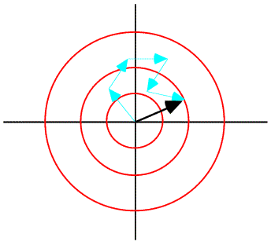
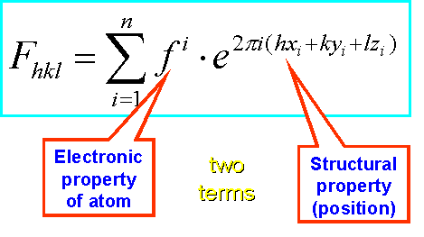
The CLT & the Wilson distribution
Building up a structure in real space quickly looks like a random walk in the complex plane!
As a result, the distribution of acentric structure factors looks like a bivariate normal distribution!
(For centrics, it looks like a univariate normal distribution.)
Ruppweb.org

Slide 4
Related structures
Ruppweb.org

Slide 5
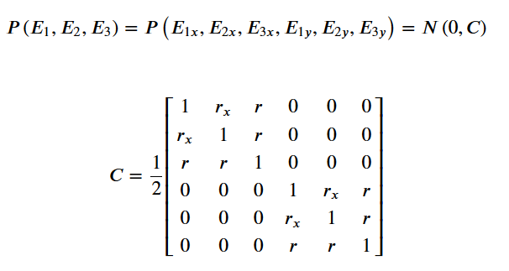
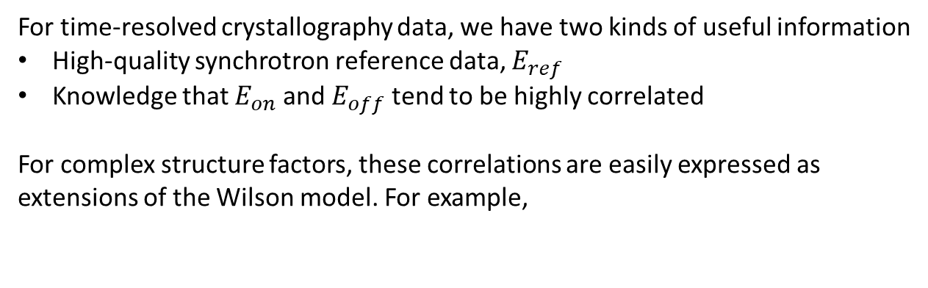
Aim: Using informative priors in scaling & merging
For time-resolved crystallography data, we have two kinds of useful information
High-quality synchrotron reference data, $E_{ref}$
Knowledge that $E_{on}$ and $E_{off}$ tend to be highly correlated
For complex structure factors, these correlations are easily expressed as extensions of the Wilson model. For example,

Slide 6
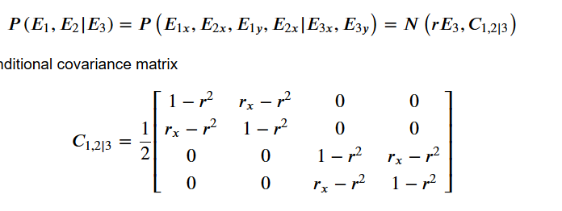
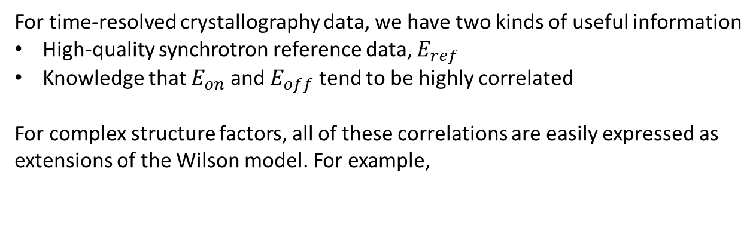

Aim: Using informative priors in scaling & merging
For time-resolved crystallography data, we have two kinds of useful information
High-quality synchrotron reference data, $E_{ref}$
Knowledge that $E_{on}$ and $E_{off}$ tend to be highly correlated
For complex structure factors, all of these correlations are easily expressed as extensions of the Wilson model. For example,
$r=\frac{Cov(E_{1x},E_{3x})}{\sqrt{Var\left(E_{1x}\right)Var(E_{3x})}}$, etc.
https://en.wikipedia.org/wiki/Multivariate_normal_distribution#Conditional_distributions

Slide 7




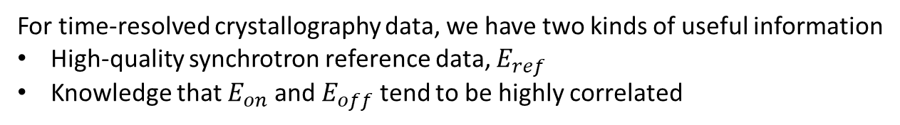


Aim: Using informative priors in scaling & merging
For time-resolved crystallography data, we have two kinds of useful information
High-quality synchrotron reference data, $E_{ref}$
Knowledge that $E_{on}$ and $E_{off}$ tend to be highly correlated
Correlation w\ reference
$$P\left(E_{1}\right)P(E_{2})$$
$$P\left(E_{1}|E_{ref}\right)P(E_{2}|E_{ref})$$
Correlation among on, off
$$P(E_{1},E_{2})$$
$$P(E_{1},E_{2}|E_{ref})$$

Slide 8
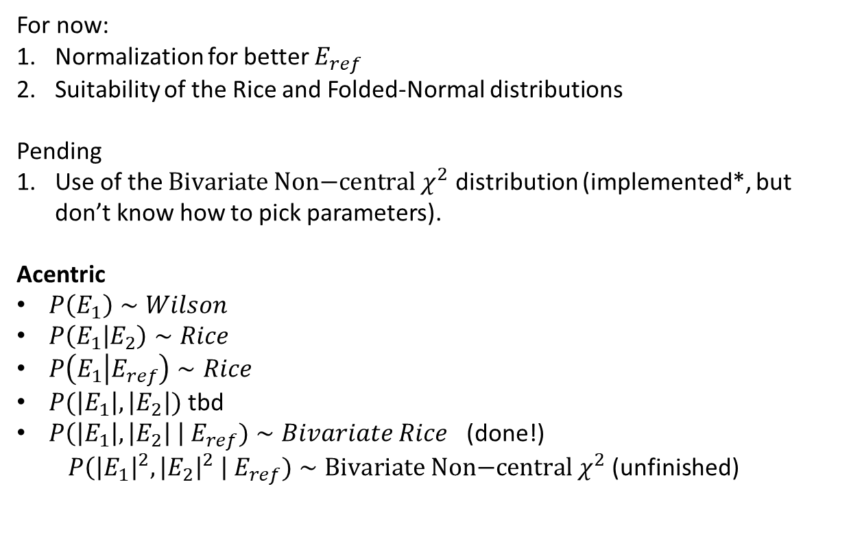
Aim: Using informative priors in scaling & merging
For now:
Normalization for better $E_{ref}$
Suitability of the Rice and Folded-Normal distributions
Pending
Use of the $\text{Bivariate} \text{Non}\text{−}\text{central} χ^{2}$ distribution (implemented*, but don’t know how to pick parameters).
Acentric
$P\left(E_{1}\right)∼Wilson$
$P\left(E_{1} | E_{2}\right)∼Rice$
$P\left(E_{1} | E_{ref}\right)∼Rice$
$P(\left|E_{1}\right|,\left|E_{2}\right|)$ tbd
$P\left(\left|E_{1}\right|,\left|E_{2}\right| \right| E_{ref})∼Bivariate Rice$ (done!)
$P\left({\left|E_{1}\right|}^{2},{\left|E_{2}\right|}^{2} \right| E_{ref})∼\text{Bivariate} \text{Non}\text{−}\text{central} χ^{2}$ (unfinished)
* https://www.researchgate.net/publication/220557408

Slide 9

Aim: Using informative priors in scaling & merging
Sampling for the bivariate Rice dist: draw from
sample as $\sqrt{E_{1x}^{2}}+E_{1y}^{2}$ etc.
https://en.wikipedia.org/wiki/Gaussian_integral#n-dimensional_and_functional_generalization

Slide 10
Aim: Using informative priors in scaling & merging
Sampling for the bivariate Von Mises dist
https://onlinelibrary.wiley.com/doi/epdf/10.1111/j.1541-0420.2006.00682.x

Slide 11
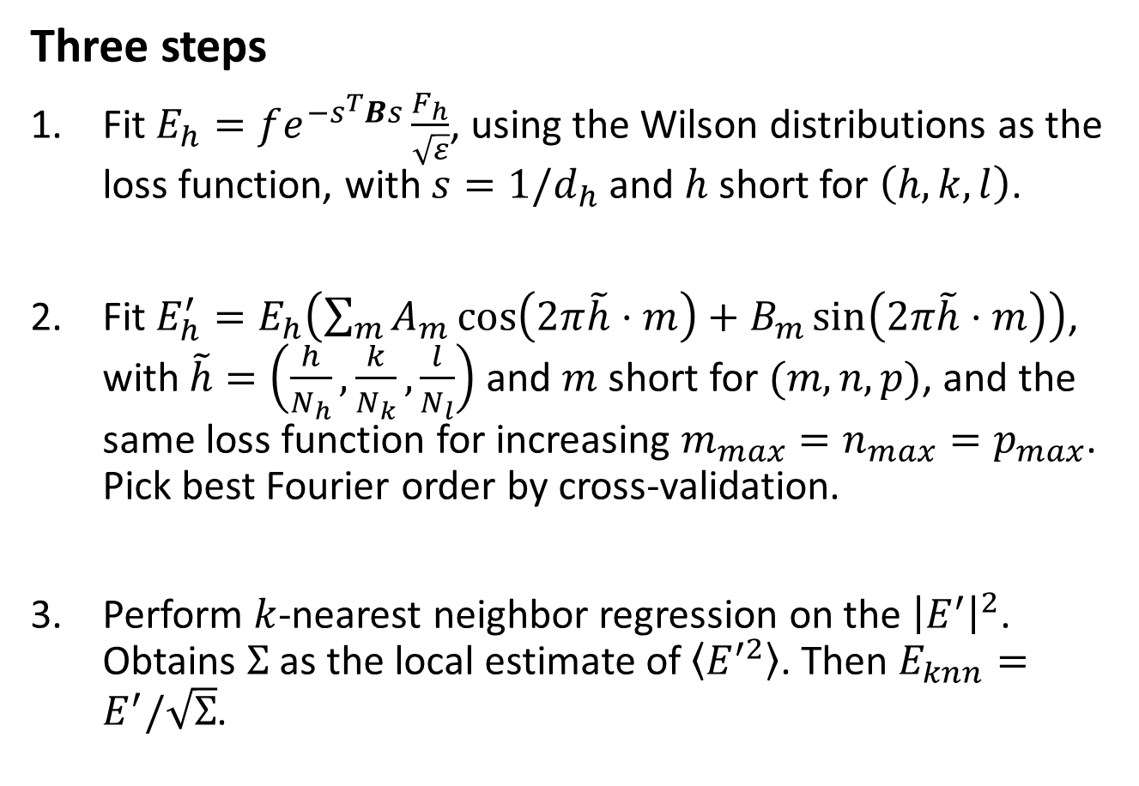
Normalizing structure factors
Three steps
Fit $E_{h}=fe^{−s^{T}Bs}\frac{F_{h}}{\sqrt{ε}}$, using the Wilson distributions as the loss function, with $s=1/d_{h}$ and $h$ short for $\left(h,k,l\right)$.
Fit $E_{h}^{′}=E_{h}\left(\sum_{m}{A_{m}\cos\left(2π\tilde{h}⋅m\right)+B_{m}\sin\left(2π\tilde{h}⋅m\right)}\right)$, with $\tilde{h}=\left(\frac{h}{N_{h}},\frac{k}{N_{k}},\frac{l}{N_{l}}\right)$ and $m$ short for $(m,n,p)$, and the same loss function for increasing $m_{max}=n_{max}=p_{max}$. Pick best Fourier order by cross-validation.
Perform $k$-nearest neighbor regression on the ${\left|E^{′}\right|}^{2}$. Obtains $Σ$ as the local estimate of $\left\langle E^{′2}\right\rangle$. Then $E_{knn}=E^{′}/\sqrt{Σ}$.
1_Dataset_prep_and_local_scaling

Slide 12
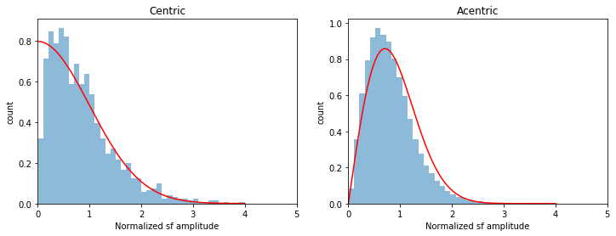
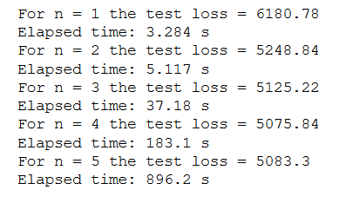
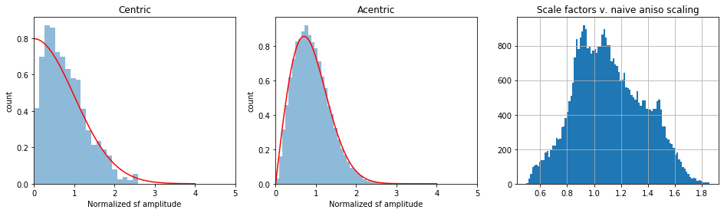
Example: normalizing 1OTB
After simple anisotropic scaling of 1OTB:
After anisotropic scaling with Fourier corrections of 1OTB:

Slide 13
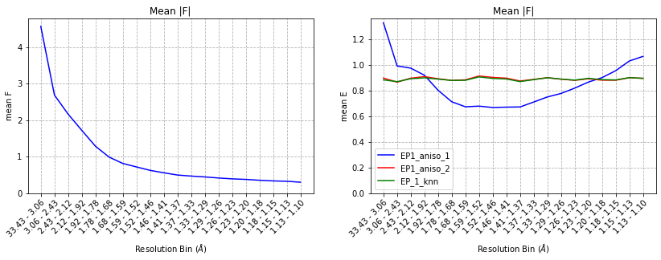
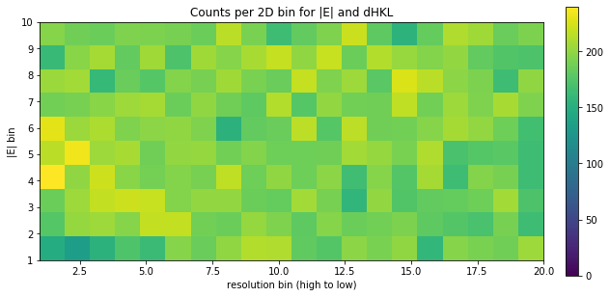
Example: normalizing 1OTB
Naïve structure factor amplitudes:
After anisotropic scaling with Fourier corrections of 1OTB:

Slide 14
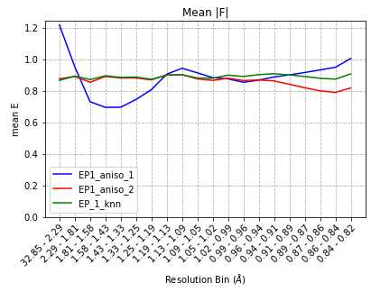
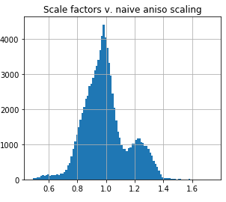
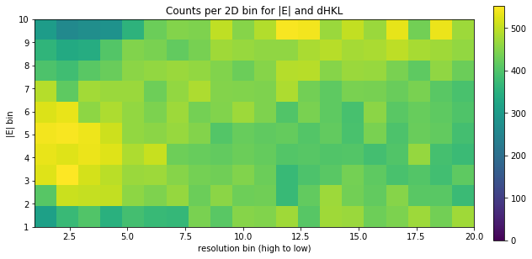
Example: normalizing 1NWZ
After anisotropic scaling with Fourier corrections of 1NWZ:

Slide 15
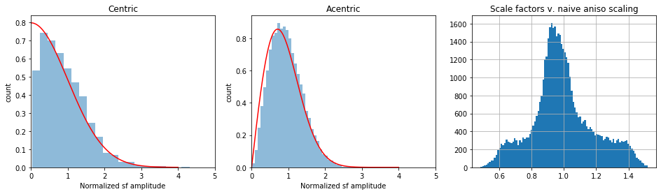
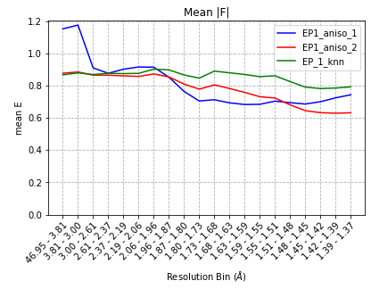
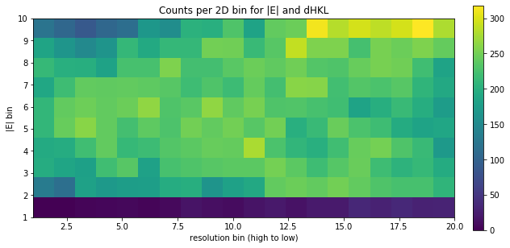
A troublemaker: GFP@RT
This dataset (here for n = 4) did not scale very well. k-NN may be more appropriate.
Perhaps reflects truncation approach…

Slide 16
Normalizing HEWL anomalous
# For simplicity...
ds1 = ds1[(ds1["I(+)"]>=0) & (ds1["I(-)"]>=0)]
1A_Anom_dataset_prep_and_scaling

Slide 17
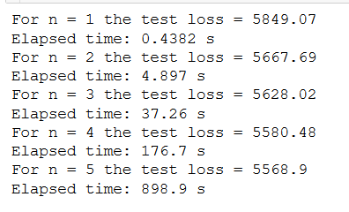
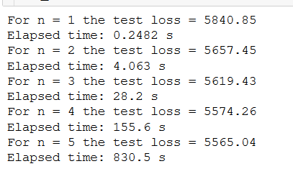
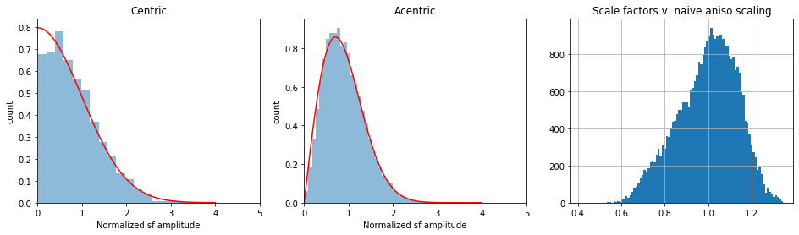

Normalizing HEWL anomalous
+
−
+
−
NECAT_HEWL_RT_NaI_82_XDS

Slide 18
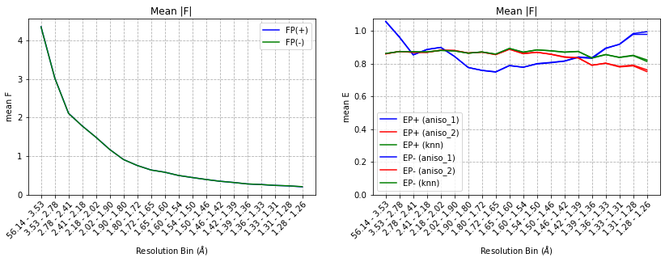
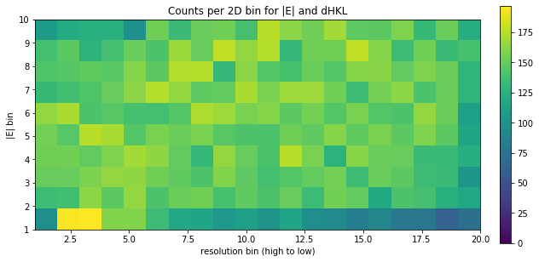
Normalizing HEWL anomalous
1A_Anom_dataset_prep_and_scaling

Slide 19
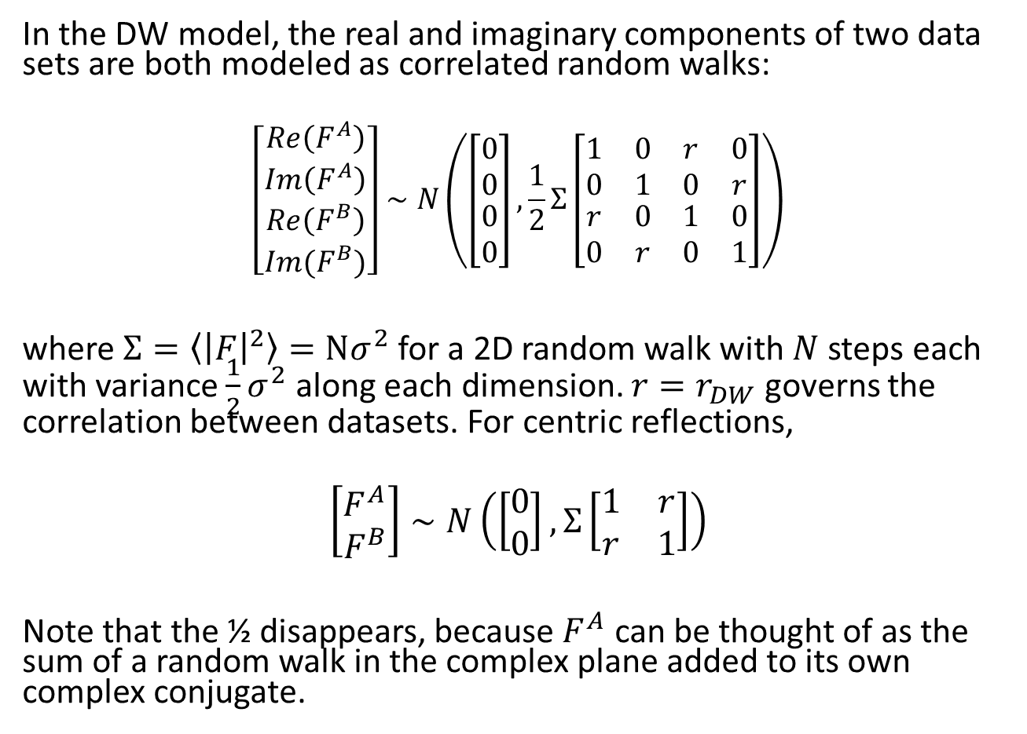
Double-Wilson model
In the DW model, the real and imaginary components of two data sets are both modeled as correlated random walks:
$$\left[\begin{matrix}\begin{matrix}Re\left(F^{A}\right) \\ Im\left(F^{A}\right)\end{matrix} \\ \begin{matrix}Re\left(F^{B}\right) \\ Im(F^{B})\end{matrix}\end{matrix}\right]∼N\left(\left[\begin{matrix}\begin{matrix}0 \\ 0\end{matrix} \\ \begin{matrix}0 \\ 0\end{matrix}\end{matrix}\right],\frac{1}{2}Σ\left[\begin{matrix}\begin{matrix}1 & 0 \\ 0 & 1\end{matrix} & \begin{matrix}r & 0 \\ 0 & r\end{matrix} \\ \begin{matrix}r & 0 \\ 0 & r\end{matrix} & \begin{matrix}1 & 0 \\ 0 & 1\end{matrix}\end{matrix}\right]\right)$$
where $Σ=\left\langle {\left|F\right|}^{2}\right\rangle =Nσ^{2}$ for a 2D random walk with $N$steps each with variance $\frac{1}{2}σ^{2}$ along each dimension. $r=r_{DW}$ governs the correlation between datasets. For centric reflections,
$$\left[\begin{matrix}F^{A} \\ F^{B}\end{matrix}\right]∼N\left(\left[\begin{matrix}0 \\ 0\end{matrix}\right], Σ\left[\begin{matrix}1 & r \\ r & 1\end{matrix}\right]\right)$$
Note that the ½ disappears, because $F^{A}$ can be thought of as the sum of a random walk in the complex plane added to its own complex conjugate.

Slide 20
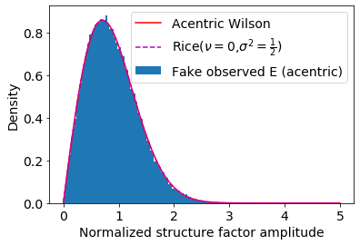
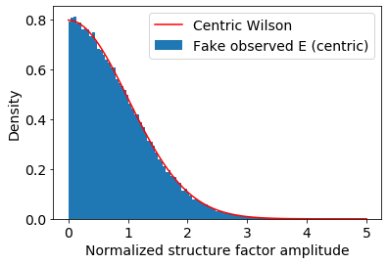
Double-Wilson model
The amplitudes of the centric and acentric reflections follow the Wilson distribution:
2_Surrogate_data_example

Slide 21
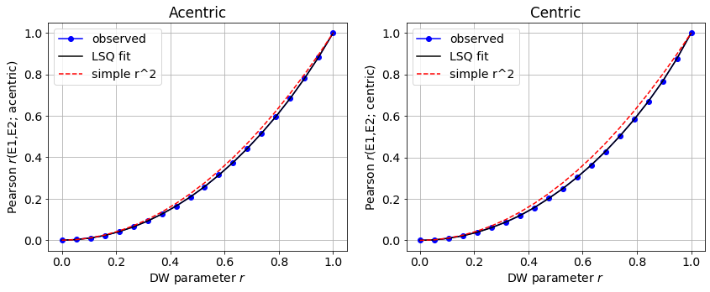

Double-Wilson model
The Pearson correlations between structure factor amplitudes from two correlated data sets almost equal $r_{DW}^{2}$.
2_Surrogate_data_example

Slide 22
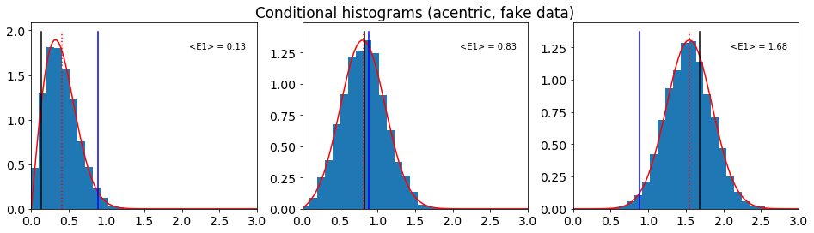
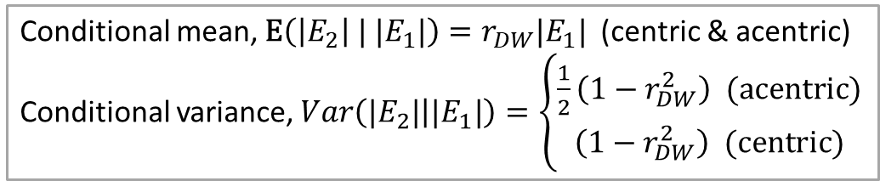
Double-Wilson model
The conditional distributions of structure factor amplitudes of one data set given the other are described by the Rice distribution (acentric) and Folded Normal (centric).
Conditional mean, $\text{E}\left(\left|E_{2}\right| | |E_{1}|\right)=r_{DW}|E_{1}|$ (centric & acentric)
Conditional variance, $Var\left(|E_{2}| | |E_{1}|\right)=\left\{\begin{matrix}\frac{1}{2}\left(1−r_{DW}^{2}\right) (\text{a}\text{centric}) \\ \left(1−r_{DW}^{2}\right) (\text{centric})\end{matrix}\right.$
2_Surrogate_data_example

Slide 23

Double-Wilson model
The conditional distributions of structure factor amplitudes of one data set given the other are described by the Rice distribution (acentric) and Folded Normal (centric).
Conditional mean, $\text{E}\left(\left|E_{2}\right| | |E_{1}|\right)=r_{DW}|E_{1}|$ (centric & acentric)
Conditional variance, $Var\left(|E_{2}| | |E_{1}|\right)=\left\{\begin{matrix}\frac{1}{2}\left(1−r_{DW}^{2}\right) (\text{a}\text{centric}) \\ \left(1−r_{DW}^{2}\right) (\text{centric})\end{matrix}\right.$
rice.pdf( x, cond_mean/np.sqrt(cond_var), scale=np.sqrt(cond_var))
foldnorm.pdf(x, cond_mean/np.sqrt(cond_var), scale=np.sqrt(cond_var))
2_Surrogate_data_example

Slide 24
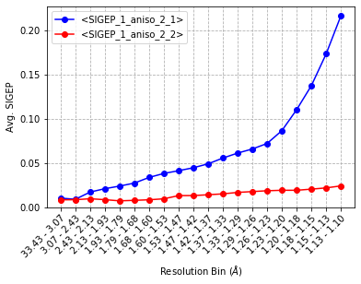
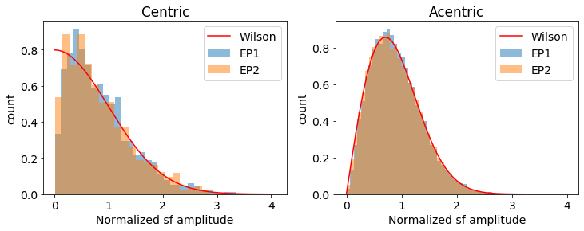
Comparison: 1OTB v 1NWZ
Data quality
Based on Anisotropic + Fourier
For the rest of the analysis, we’ll cut the datasets to 1.2 Å.
dataset 1: 1OTB
dataset 2: 1NWZ
3_Fitting_DW_to_paired_data

Slide 25
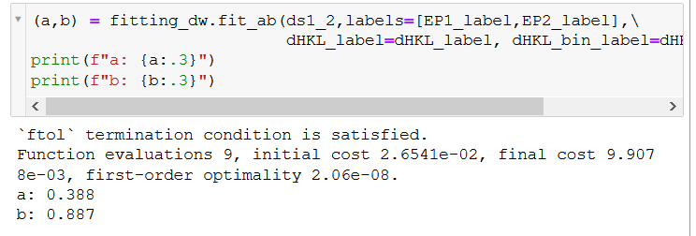
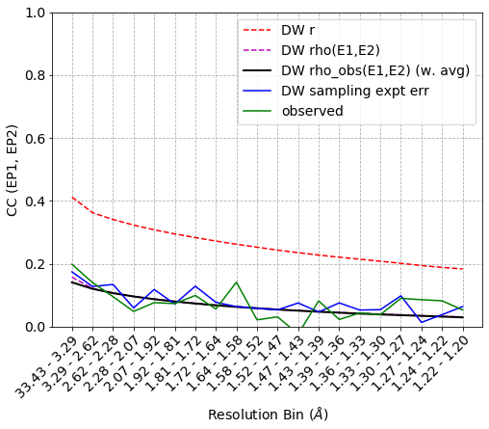
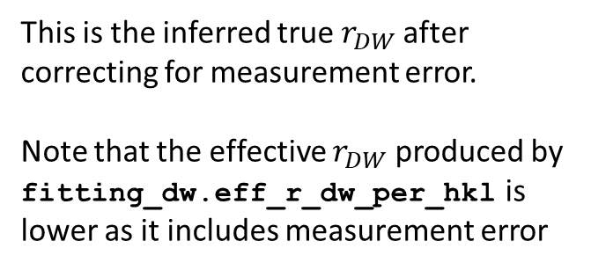

Comparison: 1OTB v 1NWZ
$$r_{DW}=a⋅e^{−bs^{2}}$$
This is the inferred true $r_{DW}$after correcting for measurement error.
Note that the effective $r_{DW}$ produced by fitting_dw.eff_r_dw_per_hkl is lower as it includes measurement error
2_Surrogate_data_example
3_Fitting_DW_to_paired_data

Slide 26
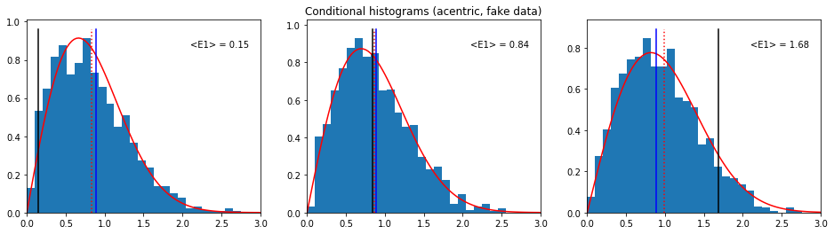
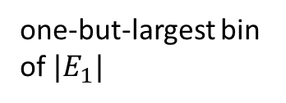

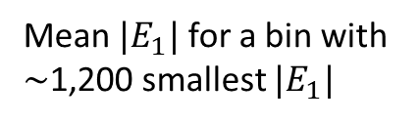
Comparison: 1OTB v 1NWZ
At this low $r_{DW}$, the changes in prior are already quite small!
Rice mean
Wilson mean
Mean $|E_{1}|$ for a bin with $∼$1,200 smallest $|E_{1}|$
middle bin of $|E_{1}|$
one-but-largest bin of $|E_{1}|$
3_Fitting_DW_to_paired_data

Slide 27
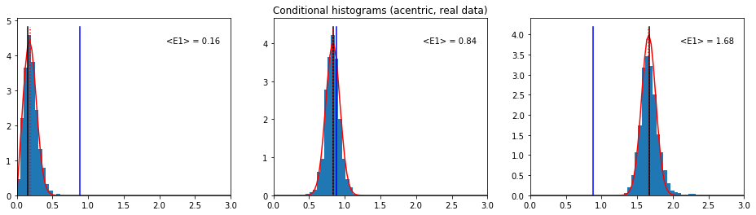
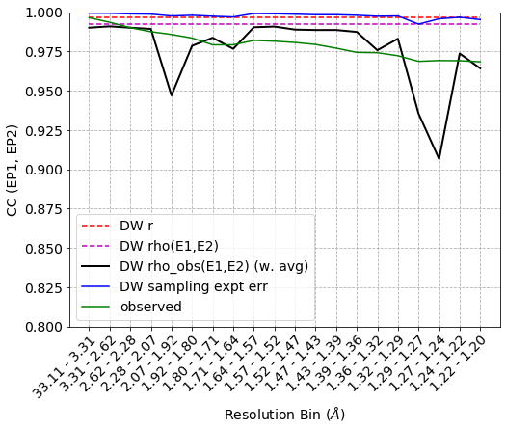
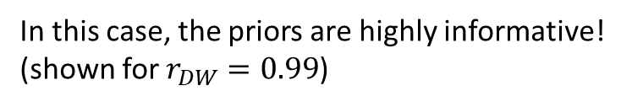
Comparison: 3PYP v 1NWZ
In this case, the priors are highly informative! (shown for $r_{DW}=0.99$)
In this case, the experimental errors dominate the correlation coefficient.
Variability in the black line suggests that expt error estimates are conservative, but not perfect.

Slide 28
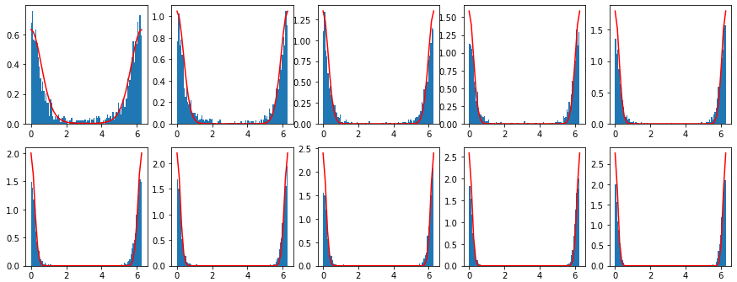
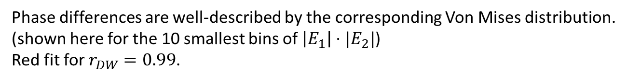
Comparison: 3PYP v 1NWZ
Phase differences are well-described by the corresponding Von Mises distribution.
(shown here for the 10 smallest bins of $\left|E_{1}\right|⋅|E_{2}|$)
Red fit for $r_{DW}=0.99$.
vonmises.pdf(x, E1*E2/cond_var)
3_Fitting_DW_to_paired_data

Slide 29
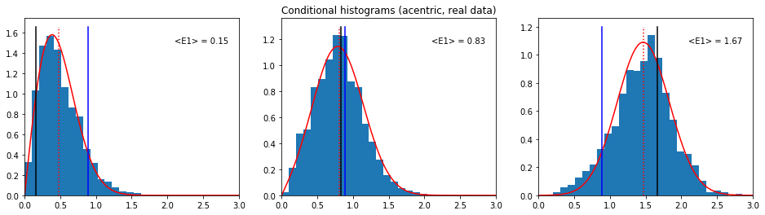

Comparison: DHFR (RT, cryo)
 | 4KJK | 4KJJ | 4PST | 4PSS
4KJK | 1,0 | 0.90, 0.43 | 0.95, 0.01 | 0.88, 0.51 | 2013 RT
4KJJ |  | 1,0 | 0.88, 0.26 | 0.93, 0.16 | 2013 cryo
4PST |  |  | 1,0 | 0.89, 0.22 | 2005 RT
4PSS |  |  |  | 1,0 | 2015 cryo
fit using $r_{DW}=0.85$
Keedy, Structure, 2013
https://www.sciencedirect.com/science/article/pii/S0969212614001403
4KJK, 4KJJ cut to 1.5Å
all else cut to 1.2Å

Slide 30
Summary of (a, b) estimates
n | Dataset pair | a | b | Res. range | Details
0 | (5KVX, 5KW3) | 0.94 | 0.79 | Cut to 1.7Å | Thaumatin (100K, 278K)
1 | (2VWR, 5E1Y) | 0.93 | 0.15 | To 1.35Å | LNX2/PDZ2 (100K, 277K)
2 | (3PYP, 1NWZ) | 1.00 | 0.00 | Cut to 1.1Å | PYP (cryotrapped lit, dark, both 100K)
3 | (1NWZ, 1OTB) | 0.39 | 0.89 | Cut to 1.2Å | PYP (100K, 295K)*
4 | (4EUL, GFP_1.37A) (4EUL, GFP_{PHENIX}) | 0.66 0.67 | 0.00 0.4 | Cut to 1.8Å Cut to 1.6Å | GFP (100K, 277K**)
5 | DHFR | ~0.9 | 0-0.5 | Cut to 1.2Å | (see previous slide)
- | HEWL/NaI anom. | 1.00 | 0.00 | To 1.26Å | NECAT_HEWL_RT_NaI_82_XDS
*31.9 v 35.3% solvent (1NWZ/1OTB)
**RT data set looks rather crappy; second row using “Filtered” FPs from PHENIX refinement MTZ
could look at correlation of these a and b with uc’s in Mpro dataset.

Slide 31
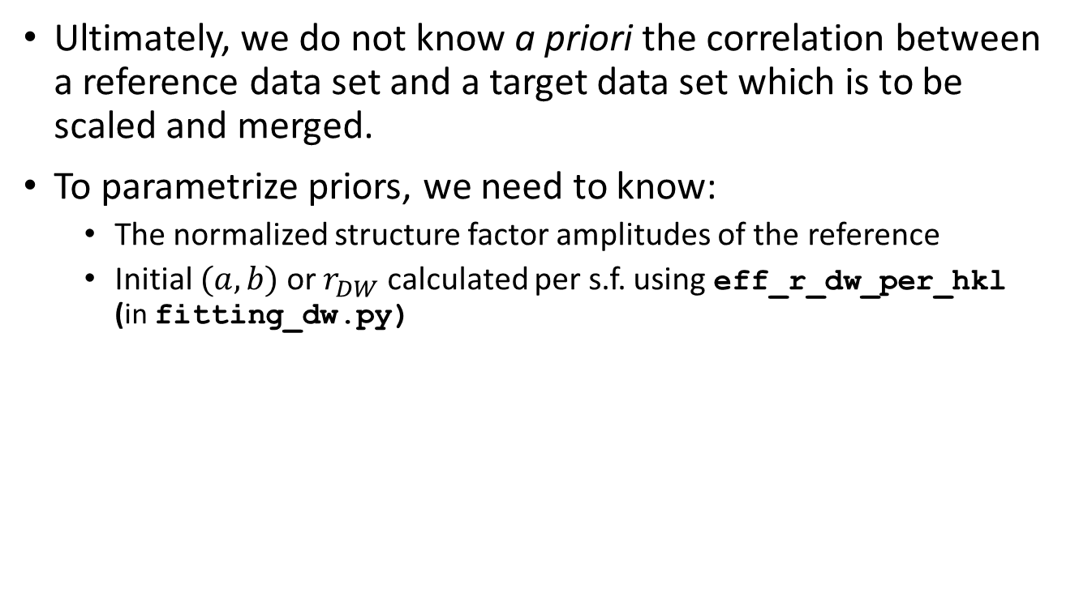
Specifying priors
Ultimately, we do not know a priori the correlation between a reference data set and a target data set which is to be scaled and merged.
To parametrize priors, we need to know:
The normalized structure factor amplitudes of the reference
Initial $(a,b)$ or $r_{DW}$ calculated per s.f. using eff_r_dw_per_hkl (in fitting_dw.py)
4_Making_Priors
4A_Making_Priors_Anom

Slide 32

Specifying priors
5_Parsing_DW_parameters summarizes how to formulate priors based on the provided $r_{DW}$ and $|E|$.
5_Parsing_DW_parameters

Slide 34
Using informative priors in scaling & merging
For time-resolved crystallography data, we have two kinds of useful information
High-quality synchrotron reference data, $E_{ref}$
Knowledge that $E_{on}$ and $E_{off}$ tend to be highly correlated
Correlation w\ reference
$$P\left(E_{1}\right)P(E_{2})$$
$$P\left(E_{1}|E_{ref}\right)P(E_{2}|E_{ref})$$
Correlation among on, off
$$P(E_{1},E_{2})$$
$$P(E_{1},E_{2}|E_{ref})$$

Slide 35
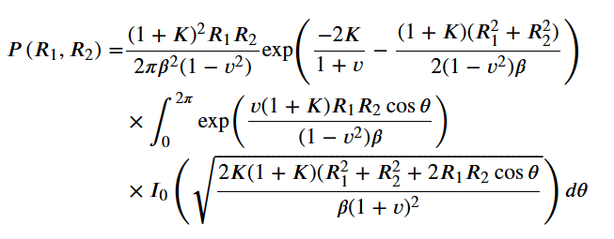


Using informative priors in scaling & merging
For time-resolved crystallography data, we have two kinds of useful information
High-quality synchrotron reference data, $E_{ref}$
Knowledge that $E_{on}$ and $E_{off}$ tend to be highly correlated
with $R_{1}=|E_{1}|$ (etc.), $K=R_{3}^{2}/Σ(1−r^{2})$, and ${(1+K)}/β=2/Σ(1−r^{2})$.
This works as long as $\left|E_{1}\right|$ and $|E_{2}|$ have the same variance.
A version exists for unequal variance but is giving me issues.
6 Bivariate_conditional_amplitude_phase_dists

Slide 36
Using informative priors in scaling & merging
For time-resolved crystallography data, we have two kinds of useful information
High-quality synchrotron reference data, $E_{ref}$
Knowledge that $E_{on}$ and $E_{off}$ tend to be highly correlated
Correlation w\ reference
$$P\left(E_{1}\right)P(E_{2})$$
$$P\left(E_{1}|E_{ref}\right)P(E_{2}|E_{ref})$$
Correlation among on, off
$$P(E_{1},E_{2})$$
$$P(E_{1},E_{2}|E_{ref})$$

Slide 37

Using informative priors in scaling & merging
For time-resolved crystallography data, we have two kinds of useful information
High-quality synchrotron reference data, $E_{ref}$
Knowledge that $E_{on}$ and $E_{off}$ tend to be highly correlated
Correlation w\ reference
$$P\left(E_{1}\right)P(E_{2})$$
$$P\left(E_{1}|E_{ref}\right)P(E_{2}|E_{ref})$$
Correlation among on, off
$$P(E_{1},E_{2})$$
$$P(E_{1},E_{2}|E_{ref})$$

Slide 38

Aim: Using informative priors in scaling & merging
One more super-interesting prior: the multivariate normal on the full structure factors $(E_{1x}, E_{1y}, E_{2x}, E_{2y})$.
Conditioning on $E_{3}$ breaks the phase degeneracy, so all phases are relative to the phase of $E_{3}$. Without loss of generality, we can set that one to 0 for now.
We can let $E_{on}=\left(1−p\right)E^{gs}+pE^{es}$ and $E_{off}=E^{gs}$.
Two approaches:
Calculate the posterior analytically per $h$:
$$P\left(E_{1},E_{2} \left|{\{I}_{on,hi},I_{off,hi}\right\},Σ,p\right)=\prod_{i}{P\left(I_{on,hi}|E_{1},E_{2},Σ_{hi},p,σ_{I_{on,hi}}\right)}\prod_{i}{P\left(I_{off,hi}|E_{1},E_{2},Σ_{hi},p,σ_{I_{on,hi}}\right)}$$
$×N({μ=r}_{DW}E_{3},C_{1,2|3})/\iint{dE_{1x}dE_{1y}dE_{2x}dE_{2y}(same)}$
if I’m not mistaken, the integral in the denominator is analytically tractable when $P\left(I_{on,hi}|⋯\right)$ is a multivariate Student t.
https://en.wikipedia.org/wiki/Gaussian_integral#n-dimensional_and_functional_generalization

Slide 39

Aim: Using informative priors in scaling & merging
The multivariate normal on structure factors $(E_{1x}, E_{1y}, E_{2x}, E_{2y})$ as a prior:
Two approaches:
Variational inference
We do obtain some information on the phases of $E^{gs}$ and $E^{es}$ from measurement of $I_{on}$ and $I_{off}$, but not nearly as much as about their magnitudes. It is not clear that the multivariate normal is a good variational distribution for $(E_{1x}, E_{1y}, E_{2x}, E_{2y})$.
Regardless of approach, if we can calculate a posterior distribution on the complex $(E^{gs}, E^{es})$, we have, in principle, a rigorous way to calculate difference maps and a starting point for more disciplined refinement of excited states.
Naïve approach:
$$P\left(E^{gs}, E^{es}\right)\text{=}P\left(\left|E^{gs}\right|,\left|E^{es}\right|\right)×P\left(φ^{gs},φ^{es}\right)$$

Slide 40

Variational distributions for phases
For phasing of single structures, the Hendrickson-Lattman distribution is in common use.
This approach extends the Von Mises distribution:
https://scripts.iucr.org/cgi-bin/paper?s0567740870002078

Slide 41
Variational distributions for phases
There’s a distinct literature on bivariate extensions of the Von Mises distribution.

Slide 42


Variational distributions for phases
Sine Bivariate Von Mises (Sine BVM)
Cosine Bivariate Von Mises (Cos (+) BVM)
6 Bivariate_conditional_amplitude_phase_dists

Slide 43
Variational distributions for phases
Evaluations of both distributions are fast.
Somehow, I can’t get the Cos(+) BVM to integrate to 1.
Cosine Bivariate Von Mises (Cos (+) BVM)
6 Bivariate_conditional_amplitude_phase_dists

Slide 44



Variational distributions for phases
Evaluations of both distributions are fast.
Somehow, I can’t get the Cos(+) BVM to integrate to 1.
A bivariate normal folded onto the ${\left[−2π,π\right)}^{2}$ toroid seems to do just as well and is more intuitive
6 Bivariate_conditional_amplitude_phase_dists

Slide 45


Variational distributions for phases
Evaluations of both distributions are fast.
Somehow, I can’t get the Cos(+) BVM to integrate to 1.
A bivariate normal folded onto the ${\left[−2π,π\right)}^{2}$ toroid seems to do just as well and is more intuitive
Comparison to Von Mises
As long as $σ\left(φ\right)≤0.7 rad$ (40 degrees), the correspondence is very good. The correspondence is again good at large $σ\left(φ\right)$.
6 Bivariate_conditional_amplitude_phase_dists

Slide 46



Variational distributions for phases
bivariate torus-folded normal
Torus-folded Student t
6 Bivariate_conditional_amplitude_phase_dists

