Slide 1

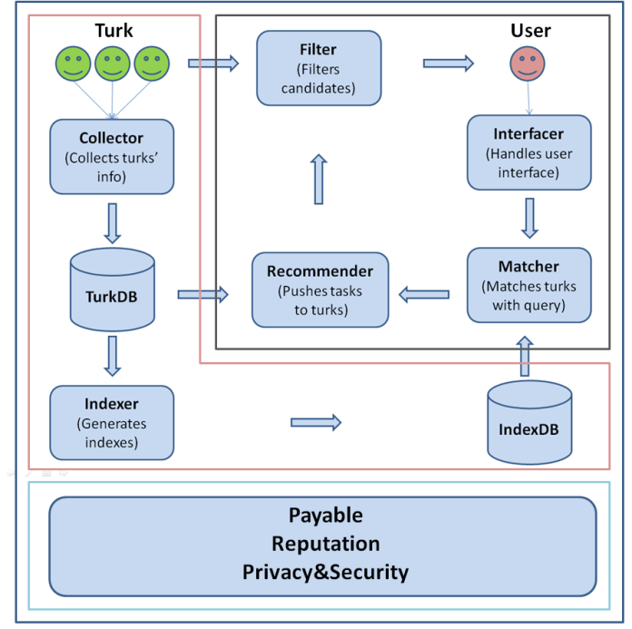
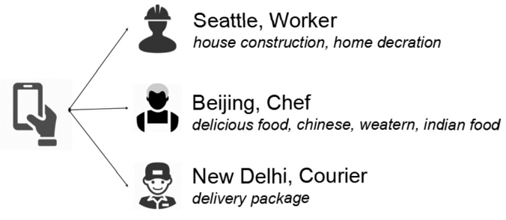
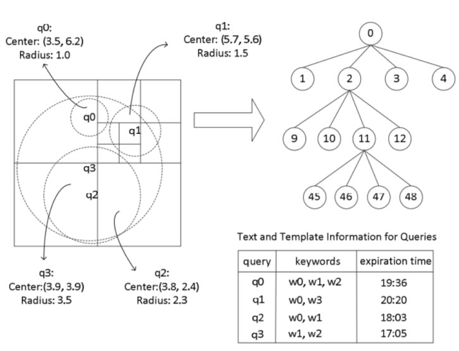
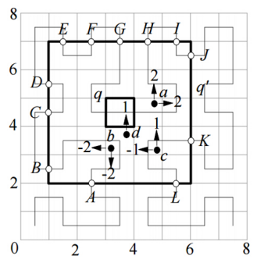
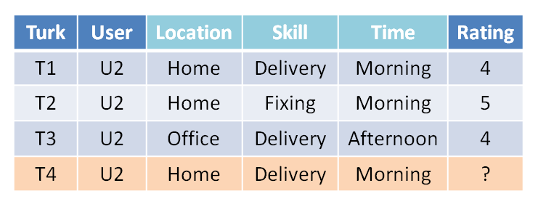
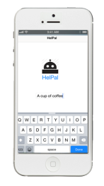
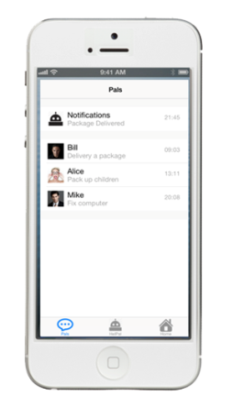
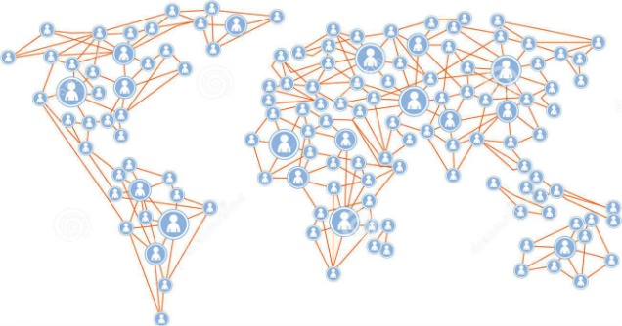
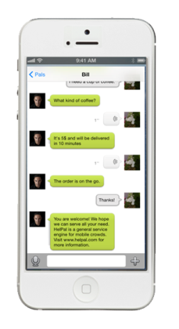
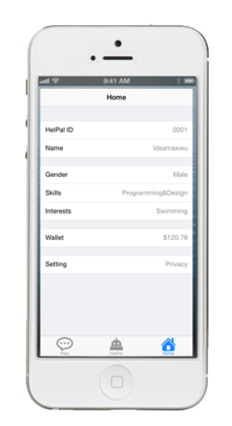

HelPal: Connect the People
A General Service Engine for Mobile Crowds
Wu Yao, Wu Tianzhen, Xiong Ziyi, Wu Yuncheng, Chen Hong*, Li Cuiping, Zhang Xiaoying
INTRODUCTION
ARCHITECTURE
Proliferation of ubiquitous mobile devices makes location based services prevalent as we carry smartphones everyday and everywhere. Mobile users are able to volunteer as providers of specific services and in the meanwhile to search these services. Motivated by these observations, we design and implement a general location based service engine for mobile crowds to provide and enjoy instant and intelligent service, which is called HelPal.
Six core components:
Turk Collector,
Service Indexer,
Query Matcher,
Task Recommender, Candidate Filter,
User Interfacer .
Three systematic modules:
Payable,
Reputation, Privacy&Security
The system supports and guarantees its integrity and robustness.
FEATURES
• Service: available and flexible service provider
• General: everyone can join especially for long-tail users
• Mobile: advantages of mobile devices
• Instant: time-efficiency of service results
• Intelligent: accurately matching based on key techniques
TECHNIQUES
The architecture is built
based on
Indexing,
Matching and
Recommendation
These techniques fulfill
the efficiency, effectiveness and exploration.
CHELLENGES
• Efficiency: results of service query are returned immediately
• Effectiveness: results return qualified users as service query
• Exploration: results return potential turks
DEMONSTRATIONS
数据工程与知识工程教育部重点实验室
KEY LABORATORY OF DATA ENGINEERING AND KNOWLEDGE ENGINEERING

