Slide 1
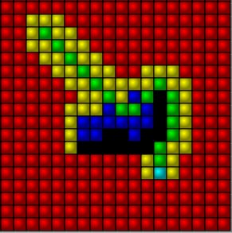
The A* algorithm
By Hélain Schoonjans

Slide 2
Intro
Looking for the best path between two points.
A* an estimation of the shortest distance to destination to take the most promising routes.
Uses a greedy approach of the dijkstra algorithm.

Slide 3
A* reminder
For every encountered node n :
g(n) is the distance from the starting point
h(n) is the estimated distance from destination
A* visites first the nodes with the smallest f(n)=g(n)+h(n)
In a Dijkstra h(n) always return 0
When a node is visited, his neighbour are put in a « encountered list ».

Slide 4
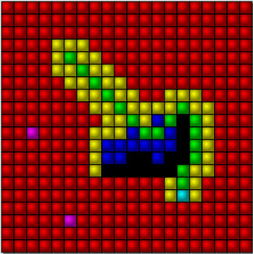
Cells

Slide 5
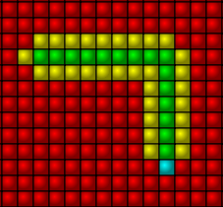
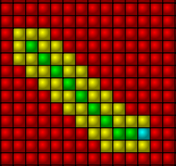
Movement
Diagonal or rectangular

Slide 6
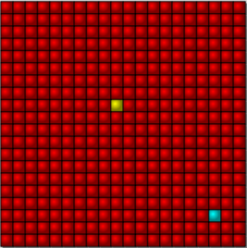
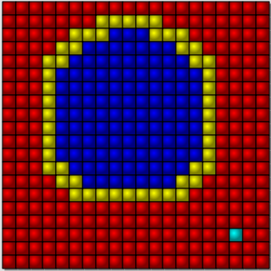
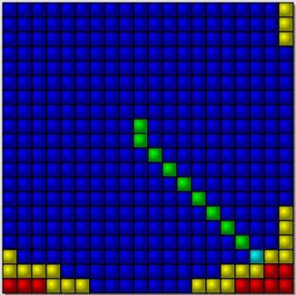
Heuristic estimations : None
None ; the algorithm becomes a dijkstra.
h(n)=0 for all node n

Slide 7
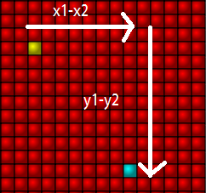
Heuristic estimation : manhattan distance
Takes the sum of the diffence in horizontal and vertical distances.
=|x1-x2|+|y1-y2|
Perfect for the rectangular moves !

Slide 8
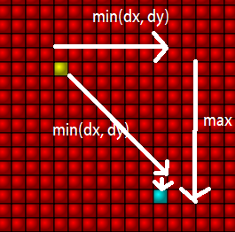
Heuristic estimation:Chebychev
Consider the diagonal moves :
max(|x1-x2|,|y1-y2|)
Can also take into account the different cost of diagonals :
(|x1-x2|+|y1-y2|) + (D2 - 2) * min(|x1-x2|,|y1-y2|)

Slide 9
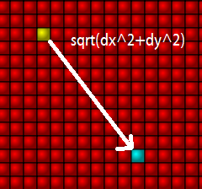
Heuristic estimation : euclidian distance
Calculate the flight distance.
More costly to compute.
Manhattan and chebychev already gives the lowest distance rectangular and diagonal movement.

Slide 10
Heuristic estimation:eucidian squared
Same as euclidian, without the square root
Faster
Overestimates the distance

Slide 11
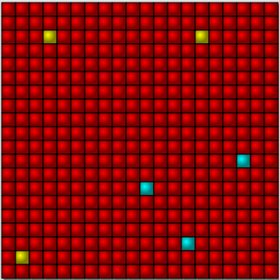
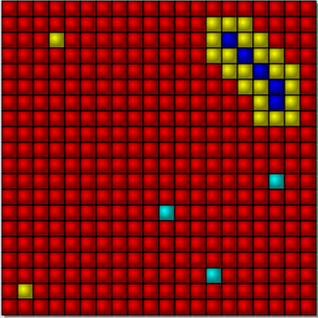
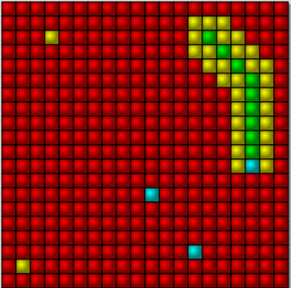
Multiple start points and goals
Strategy : look for the closest destination first :

Slide 12
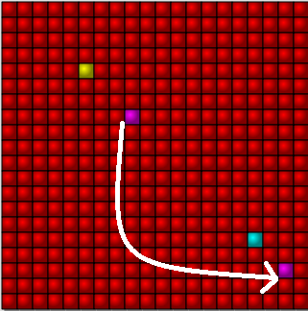
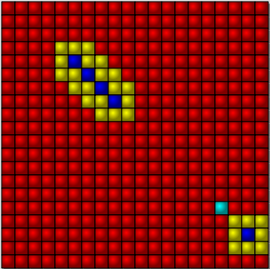
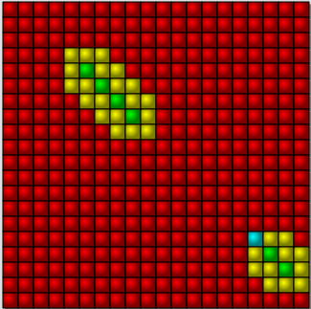
Portals

Slide 13
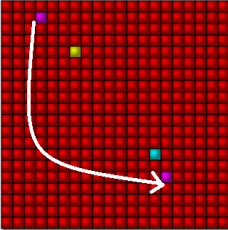
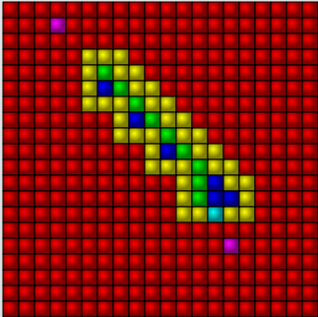
Portal problem
If a very good portal exist, the algorithm will ignore it if it is not on his way !
Optimal paths using portals will not always be found.
A* loose his optimality.

Slide 14
Portal solution
If a very good portal exist, the algorithm will ignore it if it is not on his way !
Optimal paths using portals will not always be found.
A* loose his optimality.
Solution : keeping a list of portals, and trying the portals that are the closest to the destinations.
Use Dijkstra or a similar algorithm to calculate the distance in case of chains of portals

Slide 15
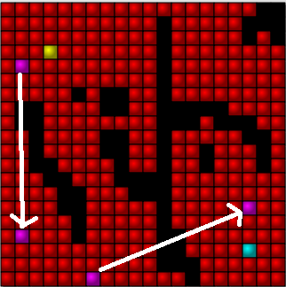
Portal solution

Slide 16
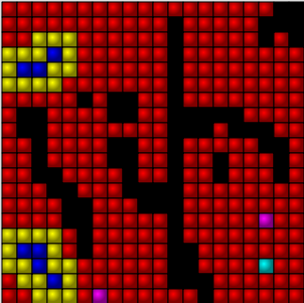
Portal solution

Slide 17
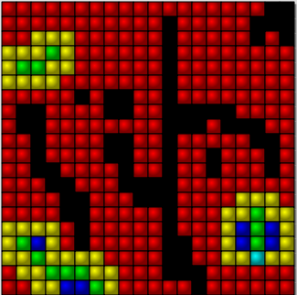
Portal solution

Slide 18
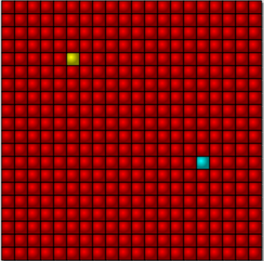
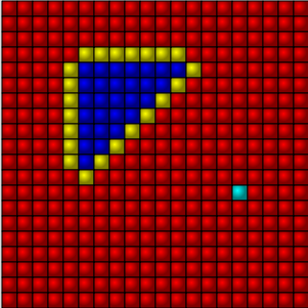
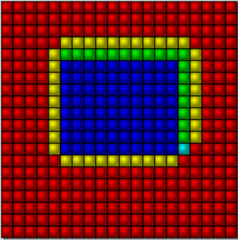
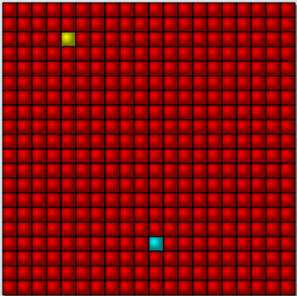
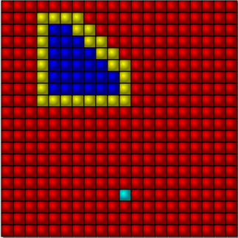
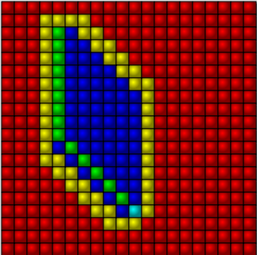
Ties

Slide 19
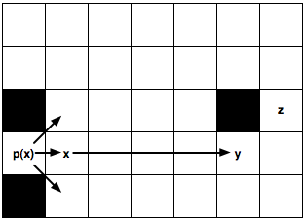
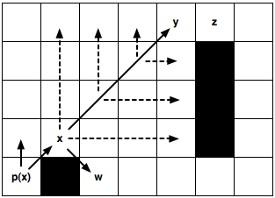
Existing methods to deal with ties and symmetry :
Jump point search

Slide 20
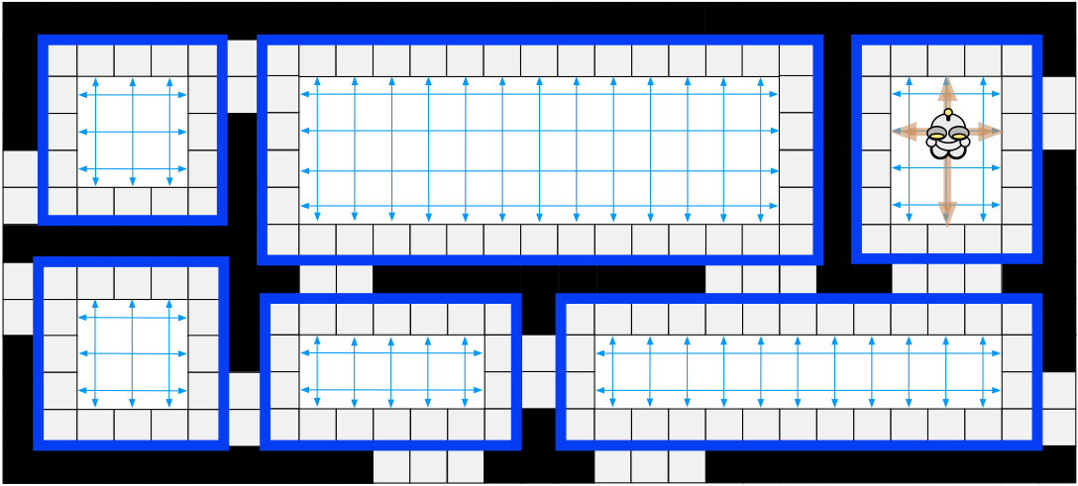
Existing methods to deal with ties and symmetry :
Rectangular symmetry reduction

Slide 21
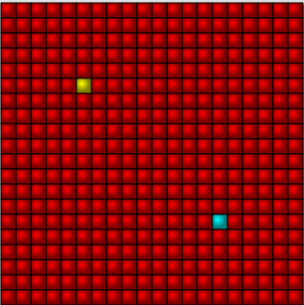
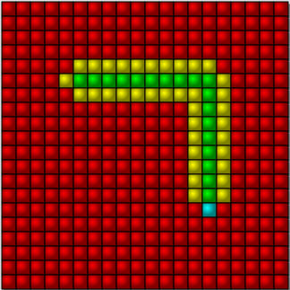
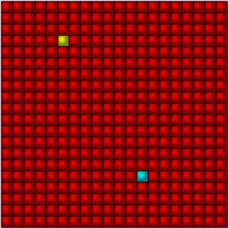
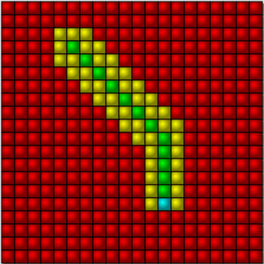
Greedy approach
Choose the closest to desination in priority.
Danger : doesn't garantee to find the best solution : loss of the optimality property of A*.

Slide 22
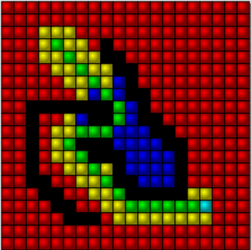
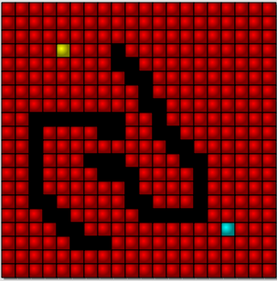
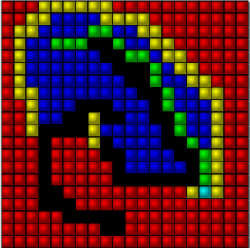
Greedy approach weakness

Slide 23
Cthuluh optimisation
When a node is visited, the adjacent nodes increment their pheromone level.
This level is added to his heuristic estimation.
It allows to prune the neighbours redundant with already visited nodes, creating ties.

Slide 24
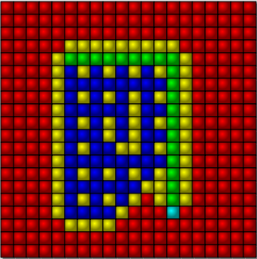
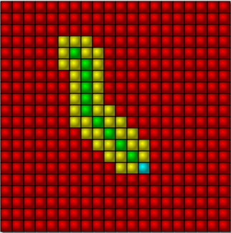
Cthuluh optimisation
Prune efficiently in simple cases, while still finding an optimal solution:
30% gain in the rectangular case.

Slide 25
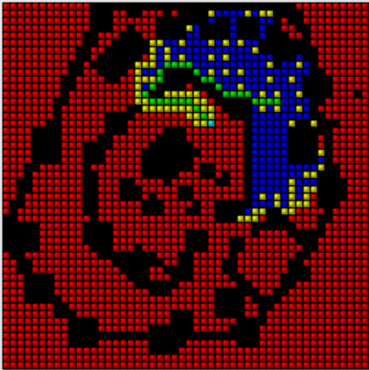
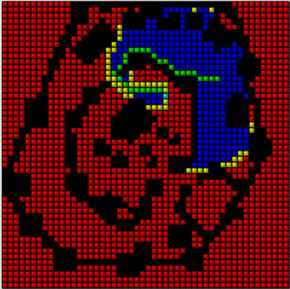
Cthuluh optimisation
In more complex cases :
273 vs 218 nodes visited(-20%)

Slide 26
Comparisons
Greedy is fast, but there is no guarantee to find the best solution.
The A* find the best solution, but examines lots of nodes because of the tie problem.

Slide 27
Conclusions
The A* is simple and optimal with a good metric
Many situationnal optimisations can be added.

Slide 28
Ideas for future works :
Improving the pheromone system of the Cthuluh optimisation could lead to further improvements.
Compare with jump-point search and rectangular symmetry reduction.
If doesn't improve path to destination, change destination in the multiple destination case.

