Slide 1
Inputs
Outputs
(.fa file)
(.txt file)
Reference Genome
Genome Graph
Data Wrangler
(.vcf file)
(.txt file)
Variant Format Call
Haplotype substrings

Slide 2
Threads for creating Alignment graphs in parallel
Variant position +
Haplotype substring
Alignment_graph
Variant position +
Haplotype substring
Alignment_graph
Variant position +
Haplotype substring
Alignment_graph
.
.
.
.
.
.
.
.
.
.
Variant position +
Haplotype substring
Alignment_graph

Slide 3
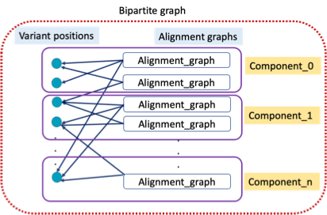
Bipartite graph
Variant positions
Alignment graphs
Analyzer Bipartite graph
Component analysis
(Finds connected components between variant positions and alignment graphs)
Alignment_graph
Component_0
Alignment_graph
Alignment_graph
Component_1
Alignment_graph
.
.
.
.
.
.
Alignment_graph
Component_n

Slide 4
Threads to solve ILP for each component
Thread_0
Component_0
Thread_1
Component_1
Thread_2
Component_2
Final solution Vector
.
.
.
.
.
.
.
.
Thread_n
Component_n

Slide 5
