Slide 1
Employee Performance Analysis Using Excel
PRESENTED BY:B.Helan Kathrin
REGISTERNO:312214601 / asunm1475312214601
DEPARTMENT:COMMERCE Bcom general
COLLEGE:Sri Kanyaka Parameswari Arts & science College For Women

Slide 2
PROJECT TITLE
Employee Performance Analysis Using Excel

Slide 3
AGENDA
1.Problem Statement
2. Project Overview
3.End Users
4.Our Solution and Proposition
5. Dataset Description
6. Modelling Approach
7. Results and Discussion
8.Conclusion

Slide 4
PROBLEM STATEMENT
The problem is to identify the Human Resources (HR) department of ABC Corporation. It aims to identify employment type based on the gender. It calculates the employee working status whether working on Fixed term, permanent or temporary.

Slide 5
PROJECT OVERVIEW
Analyze employee performance metrics to identify strengths, areas for improvement, and overall trends.
Implement PivotTables to summarize and categorize performance data.
Compare individual employee performance.
Share analysis results with management for decision-making.

Slide 6
WHO ARE THE END USERS?
Human Resources Team
Managers
Executives
Training and Development Teams
Compensation and Benefits Teams
6. Performance Review Committees

Slide 7
OUR SOLUTION AND ITS VALUE PROPOSITION
The solution show the employees working status whether they are Fixed, permanent or temporary of the organisation
Which is mandatory to check the employability status of the organisation

Slide 8
DATASET DESCRIPTION
EMPLOYEE ID: Unique identification no for each employee in the organization.
FIRST NAME: The first name of the employee.
GENDER: Male and Female.
DEPARTMENT TYPE: The broader category or type of department the employee's work is associated with.

Slide 9
MODELLING
DATA SET: Kaggle, Employee dataset.
FEATURES COLLECTION:Employee ID,Name,Gender,Department type.
CREATED PIVOT TABLE:Department and employee type.
CHART: Report of Employee working status including fixed, permanent and temporary rating of employees.

Slide 10
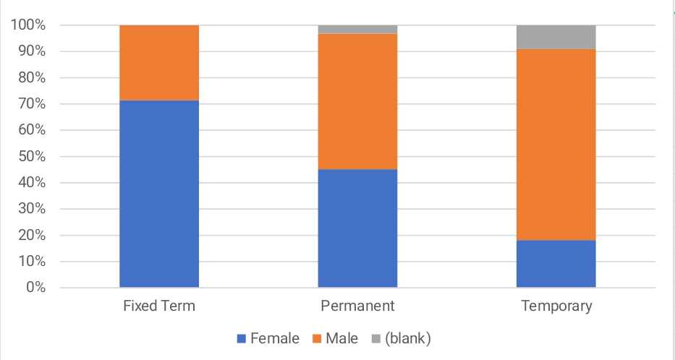
RESULTS

Slide 11
CONCLUSION
In conclusion, conducting an employee working analysis using Excel provides a structured and efficient way to evaluate and track performance metrics. Excel's versatile functions and tools, such as pivot tables, charts, and decision-making.
Under this analysis where the number of male employees are more than compared with other employees.

Slide 12
REFERENCE
Dr.T.Mekala
Assistant Professor
Sri Kanyaka Parameswari Arts and Science College for women Chennai, Tamilnadu

