Slide 1
Exploring parallel enumeration algorithms to improve efficiency to solve the SVP
Integrated Project - Parallel and Distributed Computing
Hélder Gonçalves - PG28505 João Magalhães - PG27762

Slide 2
Agenda
Teoric Introduction
Work Goals
Enumeration (Serial)
Enumeration (Parallel)
Results

Slide 3
Lattice-Based Cryptography
Has been studied for many years
Resistance to quantum computers
Equivalent to solve a Hard Problem

Slide 4

Lattice-Based Cryptography
A Lattice is generated from a basis
Set of vectors
Lattice points are linear combinations

Slide 5
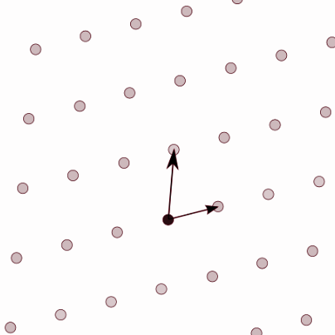
Lattice-Based Cryptography
Assume a Basis with 2 vectors
Same lattice have different Basis

Slide 6
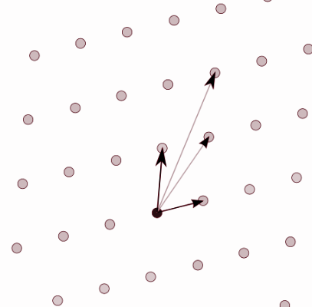
Lattice-Based Cryptography
Assume a Basis with 2 vectors
Same lattice have different Basis

Slide 7
Work Goals
To understand the pb and propose a more efficient implementation of enumeration-based algorithms
Vectorization: feasibility & impact on performance
Data organization issues: cache data locality, L1-L3 miss rate,
Scalability evaluation and probable balance threads
To implement a balanced version of the CPU+GPU enumeration algorithm
GPU code: solve thread divergences and improve mem usage

Slide 8
Enumeration

Slide 9
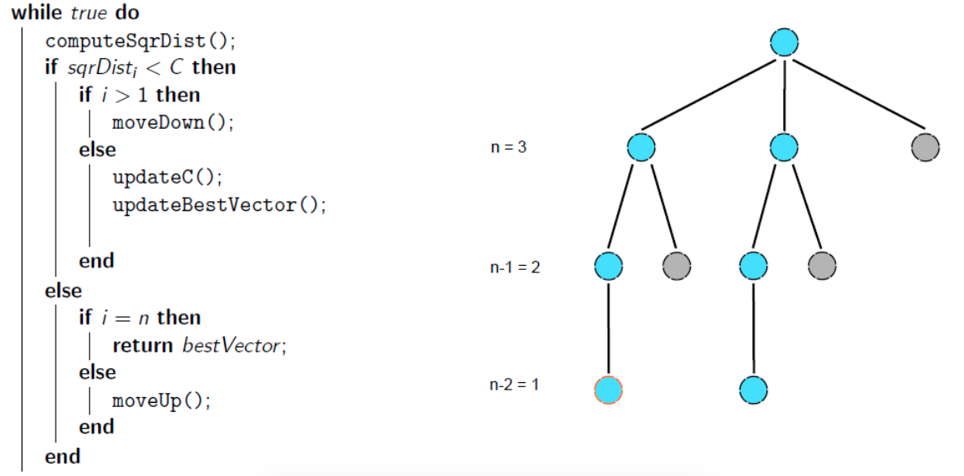
Base Algorithm

Slide 10
Enumeration (Serial)
Main
98.8%
NTL
0.3%
ENUM
98.5%
initEnum
0.4%
Opt: -O3
Total time: 404.70 seconds
Dimension: 55 Basis
moveDown
67.6%
updateVector
0.7%
moveUp
10%

Slide 11
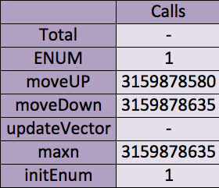
Enumeration (Serial)

Slide 12
Improvements - (1)
Inline all functions
updateVector
moveDown
moveUp
Power Decomposition - (a + b)^2 == aa + 2ab + bb
Memory Copy
Compute cT[t] when moveUp or moveDown

Slide 13

Improvements - (2)
Save and Re-use
Goal: To avoid some computation,
The (y[t])^2 is saved in an array.
This improvement was inefficient.

Slide 14
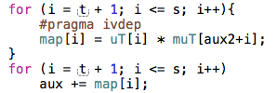
Improvements - (3)
Map-Reduce
Goal: Vectorize ~15 elements in moveDown
Inefficient in sequential mode (reduce…)

Slide 15
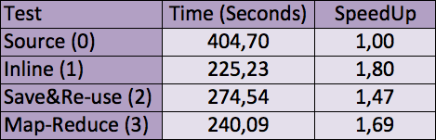
Improvements results
Dimension: 55 Basis

Slide 16
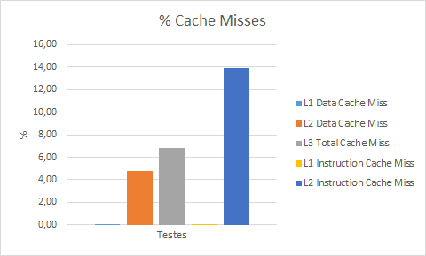
Data Misses

Slide 17
Parallelization of the Enumeration algorithm
We had to prepare the code to make the parallelization possible:
Instead of having one vector for each auxiliar type we have six matrices, with the number of lines equal to the number of threads.

Slide 18
Parallelization of the Enumeration algorithm
A new structure was created, called Enum which tells threads where to start and end their computation. It has different types, that makes threads behave in different ways (more about this later).
With a list of these Enum structures, we can define the division of work between threads.

Slide 19
Parallelization of the Enumeration algorithm
Since we used pthreads to implement the parallelization of the Enumeration algorithm, two mutexes were created.
One mutex is used to protect the access to vector u, which is updated when a better solution is found.
The other mutex is used when threads request a new Enum structure and have to remove that structure from the list.

Slide 20
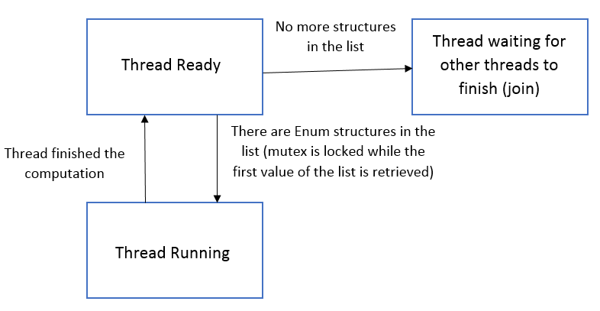
Parallelization of the Enumeration algorithm - Thread behaviour

Slide 21
Parallelization of the Enumeration algorithm - First attempt
For the first attempt of parallelization, we tried to divide the work just by forcing threads to start at a given position, assuming all previous values were 0.

Slide 22
Parallelization of the Enumeration algorithm - First attempt
For example, for a lattice with dimension 55, we would have the following computations:
Enum struct 1: 0 0 0 0 0 0 0 0 0 0 0 0 0 1 <- until dim 55
Enum struct 2: 0 0 0 0 0 0 0 0 0 0 0 0 1 0 <- until dim 54
Enum struct 3: 0 0 0 0 0 0 0 0 0 0 0 1 0 0 <- until dim 53
. . .

Slide 23
Parallelization of the Enumeration algorithm - First attempt
The problem with this division is that the bigger dimensions would take much more time to compute than the smaller ones.
To resolve this problem, we decided to divide the bigger dimensions, using siblings. These siblings (that can be 0, 1, -1 or 2) can help us divide even more the work.

Slide 24
Parallelization of the Enumeration algorithm - Second attempt
First we had, for example:
Enum struct 1: 0 0 0 0 0 0 0 0 0 0 0 0 0 1 <- until dim 55
Now we have:
Enum struct 1: 0 0 0 0 0 0 0 0 0 0 0 0 0 1 <- until dim 53
Enum struct 2: 0 0 0 0 0 0 0 0 0 0 0 0 1 1 <- until dim 53
Enum struct 3: 0 0 0 0 0 0 0 0 0 0 0 0 -1 1 <- until dim 53
Enum struct 4: 0 0 0 0 0 0 0 0 0 0 0 0 2 1 <- until dim 55
As we can see, we had one big struct before and now we have four smaller ones.

Slide 25
Parallelization of the Enumeration algorithm - Types
With the introduction of siblings, we need to have structs that behave in different ways than others. In this case, structs with siblings 0, 1 or -1 stop computing when the sibling is reached.
On the other hand, the struct with sibling 2 has to compute the rest of the values, for example:
0 0 0 0 0 0 0 0 0 0 0 0 -2 1 or
0 0 0 0 0 0 0 0 0 0 0 0 0 2.

Slide 26
Parallelization of the Enumeration algorithm - Types
Because of this, the Enum struct needs a value called type.
The value of type can be:
0 -> Used to group the smaller gammas and compute them all at once, without dividing them.
1 -> Initial division, all computations are done for a gamma.
2 -> Siblings division, special case where the bound is the same as it would be in type 1.
3 -> Siblings division, this type has the bound before its sibling value, not being able to alter it.

Slide 27
Parallelization of the Enumeration algorithm - Still not there
After we tested the second attempt, we found out that the bigger dimensions were still preventing the code from having linear scalability, so we implemented a new kind of division.
Instead of only divide by siblings, we created a vector that fixes a number of values, instead of the one after the dimension, dividing even more the computations.

Slide 28
Parallelization of the Enumeration algorithm - How this vector works
We now have a vector with variable size. Each of the positions in the vector can be 0, 1, -1 or 2. (The last position of the vector is reserved for the sibling).
So, for a given dimension(55 in this case) with a vector with size 4, we have the following vectors (without the sibling position):
[0,0,0], [0,0,1], [0,0,-1], …
[0,1,0], [0,1,1], [0,1,-1], …
...

Slide 29
Parallelization of the Enumeration algorithm - How this vector works
For each vector the siblings are computed, so in the case of vector [1,0,0], we will have the following structs:
Enum struct 1: 0 0 0 0 0 0 0 0 0 0 0 0 1 1 <- until dim 50
Enum struct 2: 0 0 0 0 0 0 0 0 0 1 0 0 1 1 <- until dim 50
Enum struct 3: 0 0 0 0 0 0 0 0 0 -1 0 0 1 1 <- until dim 50
Enum struct 4: 0 0 0 0 0 0 0 0 0 2 0 0 1 1 <- until dim 51
Note that this will happen for every vector that is created, in every dimension.

Slide 30
Parallelization of the Enumeration algorithm - Special type
There is the need of a special type, since the sibling 2 of vector [0,0,1] will have less computations to do than the sibling 2 of vector [0,0,2] (the bound of the second one will be one unit bigger, since the vector ends with a 4).
For this, a type 4 was created. This type behaviour is similar to type 2, but a special computation is needed to know the bounds of each one.

Slide 31
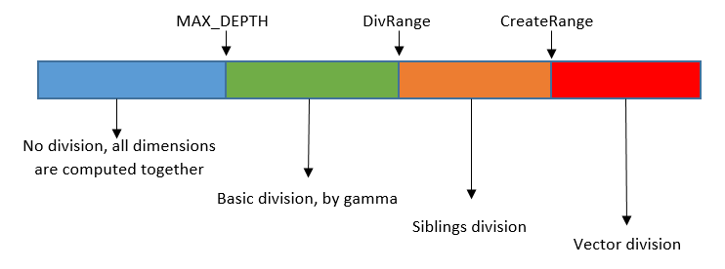
Parallelization of the Enumeration algorithm - Final algorithm
The divisions of the final algorithm look something like this:

Slide 32
Parallelization of the Enumeration algorithm - Times and Speedups
The following tests were done for the following division values:
MAX_DEPTH -> 0.4*dimension;
DivRange -> 0.6*dimension;
CreateRange -> dimension - n_threads;
Vector size -> 4 (including space for sibling).
Note that these values are not the best, so the times and speedups can be much better.

Slide 33
Parallelization of the Enumeration algorithm - Times and Speedups
We used both compute-652 nodes to perform this test, the specifications are:
CPU Device(s) | Dual Xeon E5-2670 v2 @ 2.50GHz
Instruction Set | 64 bit with AVX
Nº of Cores | 2x10
SMT | 2/core Hyperthreading
Clock Base Frequency | 2.5 GHz
Max Mem Bandwidth | 59.7 GB/s
Max # of Mem Channels | 4

Slide 34
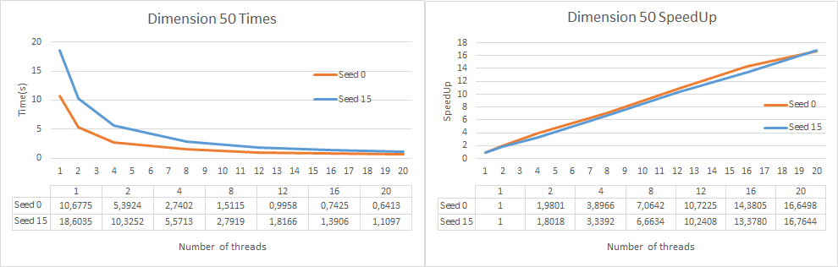
Parallelization of the Enumeration algorithm - Times and Speedups

Slide 35
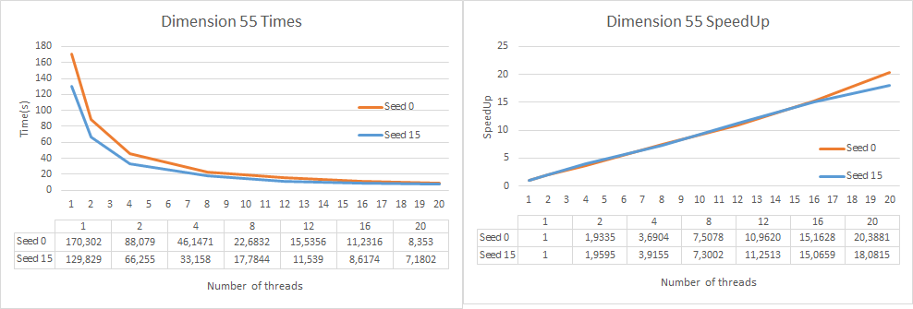
Parallelization of the Enumeration algorithm - Times and Speedups

Slide 36
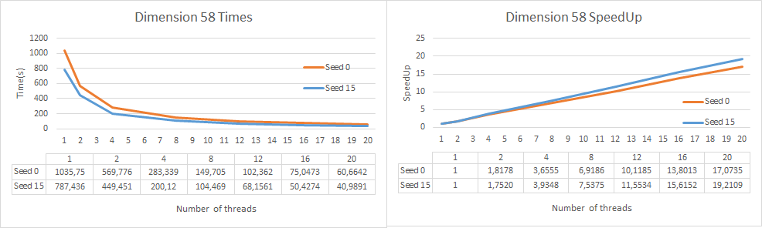
Parallelization of the Enumeration algorithm - Times and Speedups

Slide 37
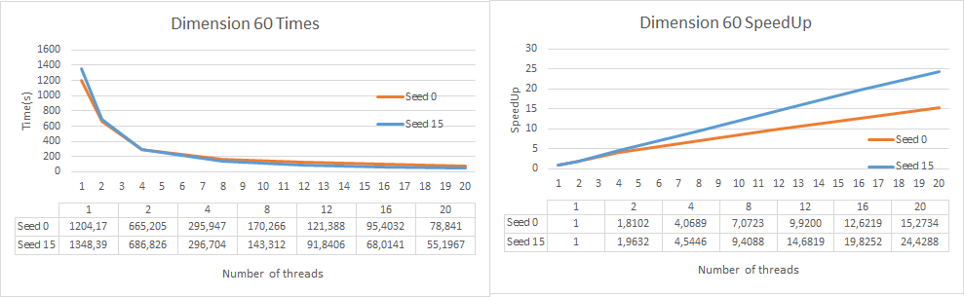
Parallelization of the Enumeration algorithm - Times and Speedups

Slide 38
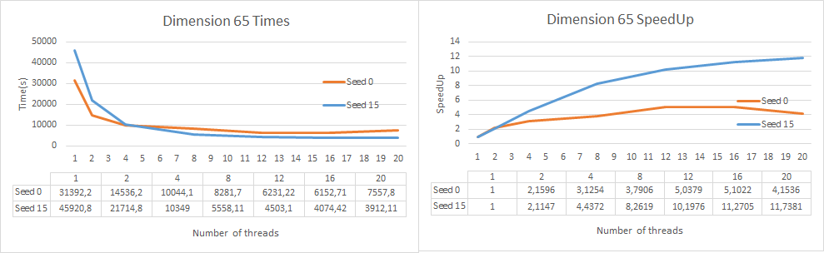
Parallelization of the Enumeration algorithm - Times and Speedups

Slide 39
Conclusion
- We can still improve the parallel algorithm by changing the way parameters are computed.
- The learning curve of the algorithm was not that good, so we did not have time to explore parallel solutions with GPU and Xeon Phi.
- We did not implement the enumeration algorithm with extreme pruning

Slide 40
Contributions
First Version
LLL (Hélder)
BKZ and ENUM (João & Hélder)
Testing (João & Hélder)
Improvements
Code (Hélder)
Testing (João)
https://github.com/HelderGoncalves92/
CPD-Integrated-Project
Parallel Version
Algorithm and Code (Hélder)
Latest Siblings Parallelization (João)
Testing (João)

Slide 41
Exploring parallel enumeration algorithms to improve efficiency to solve the SVP
Integrated Project - Parallel and Distributed Computing
Hélder Gonçalves - PG28505 João Magalhães - PG27762

