Slide 1
RECTIFICATION
HELDON LEO A
-2023510029

Slide 2
Rectification in Computer Vision
Understanding how alignment enables 3D vision
Definition: Rectification is a transformation process applied to a pair of stereo images to align their scanlines, making it easier to perform stereo matching and depth estimation.
Goal: To convert oblique epipolar lines into parallel horizontal lines so that corresponding points appear on the same row in both images.
Importance: This step simplifies complex 2D correspondence problems into 1D line-based searches, which enhances speed and accuracy in 3D vision systems.
Notes:
Rectification in computer vision is essential when working with stereo image pairs. Without it, finding corresponding points would require a two-dimensional search across both images, which is inefficient and computationally intensive. Rectification ensures that the same features lie along the same rows, allowing for efficient comparison. This method plays a key role in applications like 3D reconstruction, augmented reality, and autonomous navigation. In this redesigned version of the presentation, we introduce rectification using visually stylized slides with high contrast backgrounds and glowing text for better readability and engagement.

Slide 3
Why Rectification is Needed
Simplifying stereo image processing
Purpose: Rectification is necessary to make stereo image processing easier. Without it, finding matching features between two images would require comparing entire 2D regions, which is time-consuming and error-prone. Rectified images allow for feature matching along horizontal lines, saving time and improving accuracy.
Impact: By aligning the images, rectification enables depth perception and 3D vision applications. It is a core step in making autonomous systems and robots 'see' the world in three dimensions.
Notes:
In a stereo vision system, two cameras take pictures of the same scene from different angles. However, because of the angle difference, the features in the images do not naturally line up. Rectification solves this by transforming the images so that corresponding points lie on the same horizontal line. This makes it easier to compare the images and find matches.
This step is especially useful in applications like 3D reconstruction, where systems must estimate how far away objects are. Without rectification, depth estimation becomes very hard. With it, the system only needs to compare image rows, which simplifies everything.
So, rectification is not just a useful step—it is essential. It improves both speed and accuracy in many computer vision applications.

Slide 4



How Rectification Works (Basic Steps)
Simple pipeline to transform stereo images
Calibrate the stereo cameras
Determine intrinsic and extrinsic parameters using calibration patterns.
Compute rectification transforms
Use the calibration data to find homographies that align images.
Warp images using transforms
Apply the transforms to reproject images onto a common plane.
Notes:
Let’s explore how the rectification process works in a simplified 3-step pipeline. First, both cameras in a stereo setup must be calibrated. Calibration involves finding the intrinsic parameters (like focal length) and extrinsic parameters (like position and orientation) of each camera, usually by capturing images of a known calibration pattern like a checkerboard.
Next, the system computes rectification transforms—specifically, homographies. These are the mathematical mappings that adjust each image so they appear as if taken from a parallel camera setup. This alignment ensures that corresponding points lie on the same horizontal scan lines.
Finally, these computed transforms are applied to warp the images. The original images are reprojected to new views where the alignment holds, significantly simplifying subsequent processing like depth estimation.

Slide 5
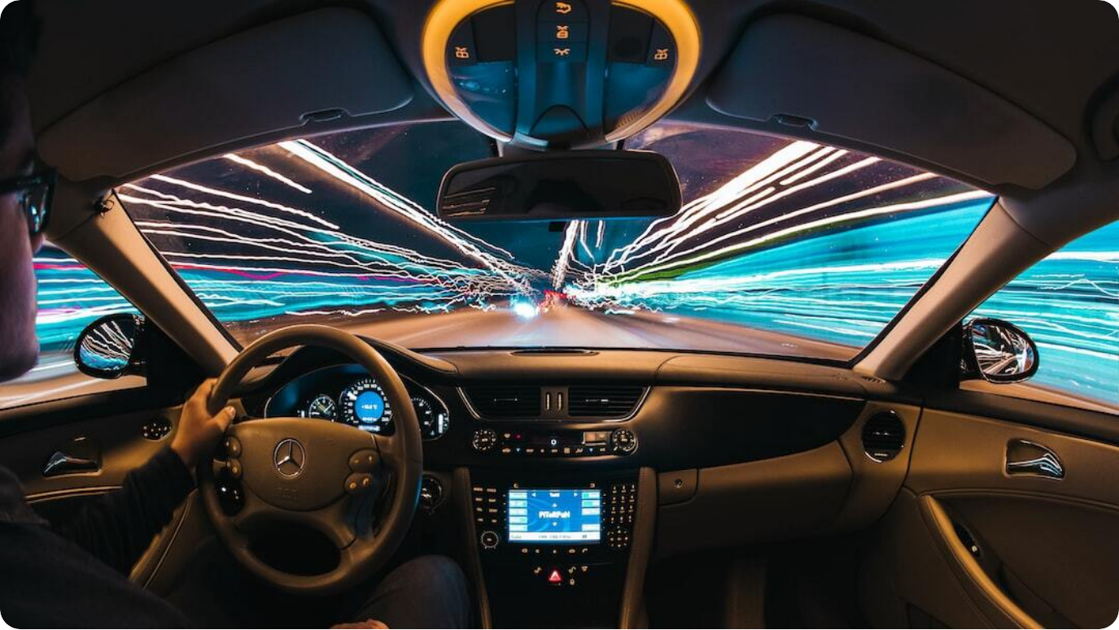
Applications of Rectification
Where and how it is used in the real world
Autonomous driving: Used in stereo camera systems for obstacle detection and depth perception.
3D scene reconstruction: Rectified images simplify generation of accurate 3D models.
Augmented and Virtual Reality: Used in depth-aware rendering and spatial understanding of environments.
Photo by Samuele Errico Piccarini on Unsplash
Notes:
Rectification finds real-world application in a wide range of computer vision tasks. In autonomous driving, rectified stereo images help onboard systems detect obstacles, estimate distances, and make navigation decisions. Without rectification, the image disparity data would be inconsistent and unreliable.
In 3D reconstruction, accurate rectification is crucial. It allows developers to compute dense point clouds and build virtual models of real environments. This is particularly important in fields like architecture, archaeology, and robotics.
Another major area of application is augmented and virtual reality (AR/VR). Rectification allows for more accurate depth perception, essential for creating immersive, spatially aware user experiences.

Slide 6



Epipolar Geometry: Foundation of Rectification
Understanding stereo geometry for precise vision
Defines geometric relationship
Relates positions of points across stereo images via epipolar lines.
Epipolar constraint
Each point in one image maps to a line (not an area) in the other, reducing search space.
Essential for stereo matching
Ensures accurate correspondence and underpins rectification algorithms.
Notes:
Epipolar geometry is the mathematical framework that describes the relationship between two camera views of the same 3D scene. It is foundational to understanding and implementing rectification. At its core is the idea that for any point in one image, its corresponding point in the other image must lie on a specific line—called the epipolar line.
This concept is captured in what's known as the epipolar constraint. It dramatically reduces the complexity of stereo matching. Instead of searching in a full 2D space, we only need to search along a single line. This improves accuracy and speeds up processing, especially in dense stereo applications.
Rectification transforms the stereo image pair so that epipolar lines become perfectly horizontal, further simplifying the task. A solid understanding of epipolar geometry is essential for designing accurate and efficient 3D vision systems.

Slide 7
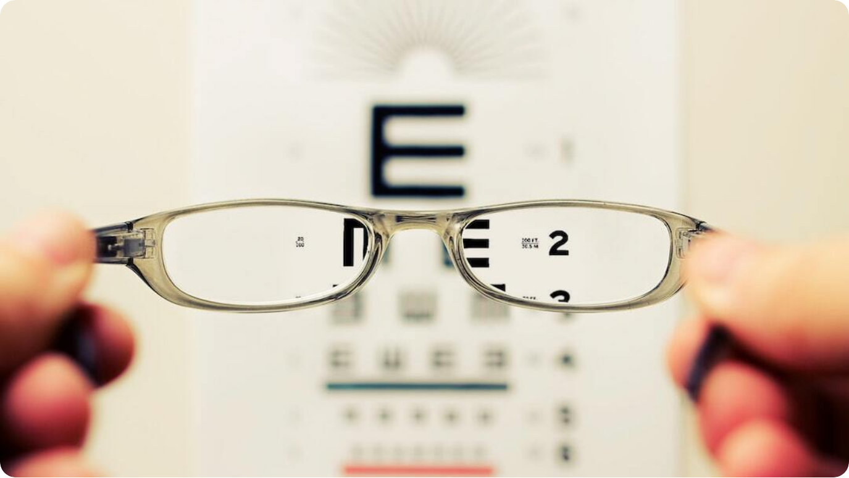
Summary and Final Thoughts
Recap of key concepts in rectification
Rectification aligns stereo images: Key to simplifying depth estimation and stereo matching.
Essential in real-world systems: Used in autonomous vehicles, 3D modeling, AR/VR and robotics.
Foundational for 3D vision: Improves performance and accuracy of computer vision applications.
Photo by David Travis on Unsplash
Notes:
To summarize, rectification is a fundamental concept in computer vision, especially in the domain of stereo vision. By aligning images so that corresponding features lie along the same horizontal lines, it simplifies complex tasks like depth estimation and object localization.
This technique is not just theoretical—it's used extensively in practical systems, from the cameras in self-driving cars to the depth sensors in augmented reality headsets. It's an enabling technology for many 3D-aware applications.
As vision-based systems continue to advance, rectification will remain a critical pre-processing step that ensures high-quality and accurate perception in the digital world.

Slide 8


