Slide 1
Course project
Advanced Topics: Machine Learning

Slide 2
dataset
„Flowers Recognition“ from kaggle.com
4323 images of flowers
5 classes
from all over the web
dataset

Slide 3
dataset

Slide 4
approach
resize all images to 32x32
take only around 700 of each
approach

Slide 5
approach
resize all images to 32x32
take only around 700 of each
(2 conv layers with ReLU + Pooling ) X 3
2 fully-connected layers
output layer
approach

Slide 6
evaluation

Slide 7
evaluation

Slide 8
evaluation

Slide 9
problems?
dandelions can have two different „looks“
dataset

Slide 10
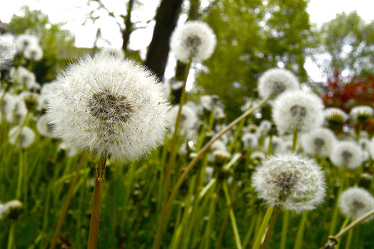
dataset

Slide 11
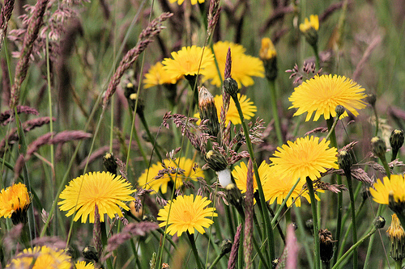
dataset

Slide 12
problems?
dandelions can have two different „looks“
yellow dandelions can look like sunflowers
dataset

Slide 13
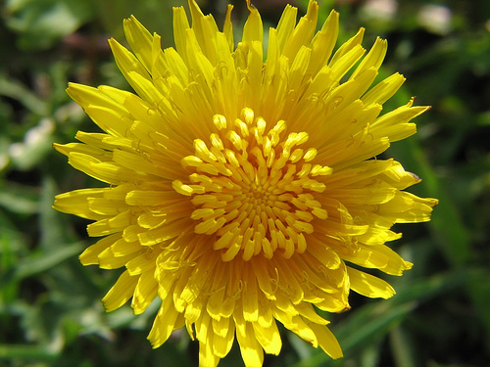
dataset

Slide 14
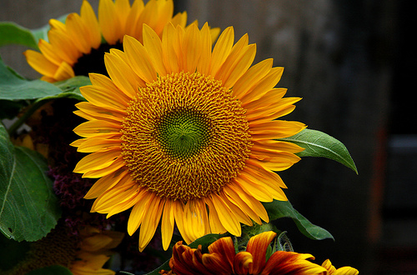
dataset

Slide 15
problems?
dandelions can have two different „looks“
yellow dandelions can look like sunflowers
roses and tulips are pretty similar
dataset

Slide 16

dataset

Slide 17
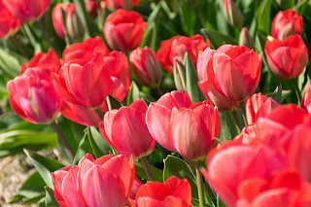
dataset

Slide 18
problems?
dandelions can have two different „looks“
yellow dandelions can look like sunflowers
roses and tulips are pretty similar
weird outliers
dataset

Slide 19

dataset

Slide 20
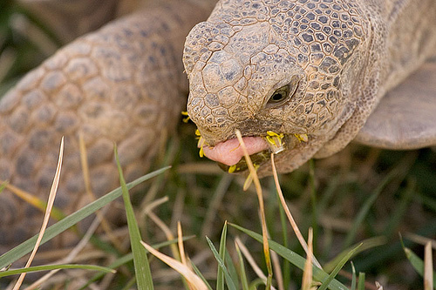
dataset

Slide 21
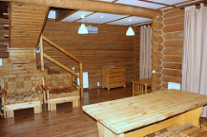
dataset

Slide 22
DEMO
demo

