Slide 1
Queryable

Slide 2
IQueryable<T>
public interface IQueryable : IEnumerable
{
Type ElementType { get; }
Expression Expression { get; }
IQueryProvider Provider { get; }
}
public interface IQueryable<T> : IEnumerable<T>, IQueryable, IEnumerable
{
}

Slide 3
IQueryProvider
public interface IQueryProvider
{
IQueryable CreateQuery(Expression expression);
IQueryable<T> CreateQuery<T>(Expression expression);
object Execute(Expression expression);
T Execute<T>(Expression expression);
}

Slide 4
Create an expression
IQueryable<Record> source = ...; var query = from record in source where record.Id > 100 select record.Title;
var query = source .Where(record => record.Id > 100)
.Select(record => record.Title);
var query = Queryable.Select( Queryable.Where( source, record => record.Id > 100 ), record => record.Title );

Slide 5
Queryable
public static IQueryable<TSource> Where<TSource>(
this IQueryable<TSource> source,
Expression<Func<TSource, bool>> predicate)
{
if (source == null)
throw Error.ArgumentNull("source");
if (predicate == null)
throw Error.ArgumentNull("predicate");
return source.Provider.CreateQuery<TSource>(
Expression.Call(
null,
((MethodInfo) MethodBase.GetCurrentMethod()).MakeGenericMethod(
new Type[] { typeof(TSource) }
),
new Expression[] { source.Expression, Expression.Quote(predicate) }));
}

Slide 6
Queryable
public static int Count<TSource>(this IQueryable<TSource> source)
{
if (source == null)
{
throw Error.ArgumentNull("source");
}
return source.Provider.Execute<int>(
Expression.Call(
null,
((MethodInfo) MethodBase.GetCurrentMethod())
.MakeGenericMethod(new Type[] {
typeof(TSource)
}
),
new Expression[] { source.Expression }));
}

Slide 7
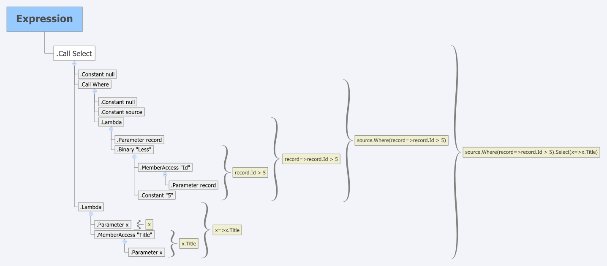
Expression Tree

Slide 8
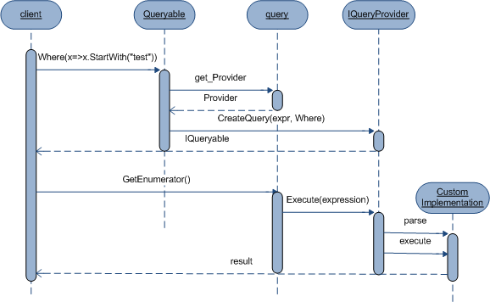
Sequence diagram

Slide 9
Code sample

Slide 10
Links
http://blogs.msdn.com/b/mattwar/archive/2008/11/18/linq-links.aspx

