Slide 1
Office 2010 UI Customization
Office 2010 Client

Slide 2
Outline
Office and Visual Studio 2010
Office UI Customizations
Custom Task Panes
Outlook Form Regions

Slide 3
Agenda
Visual Studio 2010 Support for Office 2010
Ribbons
Designers
Context menus, Backstage View
Custom Task Panes
Windows Presentation Foundation
Windows Communication Foundation
Outlook Form Regions
Outlook
Visual Studio 2010

Slide 4
Office and Visual Studio 2010

Slide 5
Office Development Support in Visual Studio 2010
Visual Studio 2010 provides backward-compatible tooling
Office 2007 project templates are supported
But not Office 2003
Visual Studio 2010 and 2008 work side-by-side
SharePoint Workflow still supported
Click Once deployment supported
Package multiple add-ins deployment also supported
All 2007 supported scenarios persist forward to 2010
Improved deployment support in Office 2010 with Visual Studio 2010
Application life-cycle management through Team Foundation Server
Notes:
Use this slide to go bullet-by-bullet and simply explain everything that’s available in Visual Studio 2010

Slide 6
Customization Sample
demo
Notes:
This demo is a premade scenario that shows all of the pieces in place. Each part will be detailed later.

Slide 7
Office UI Customizations

Slide 8
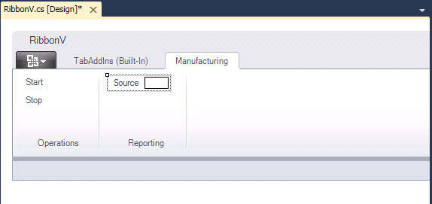
Ribbons in Visual Studio 2010
Ribbon designer for basic applications
Direct XML for more complex applications
Notes:
Use this slide to explain the two ways to create a ribbon. You can use the designer for basic customizations, but the XML is required for more complex things. We’ll see these as the presentation continues.

Slide 9




Ribbons
Ability to programmatically select a tab
Group Scaling
IRibbonUI.ActivateTab(String TabID)
<group id="Wheel" autoScale="true">
Notes:
This slide is pointing out some new capabilities of the ribbon.
Programmatically activating a tab is important because it allows your tab to become visible through context. For example, your tab could come to the front whenever the cursor is inside a table that has a certain style or data.
Group scaling just allows your customizations to scale nicely as the size of the Office client window changes.

Slide 10
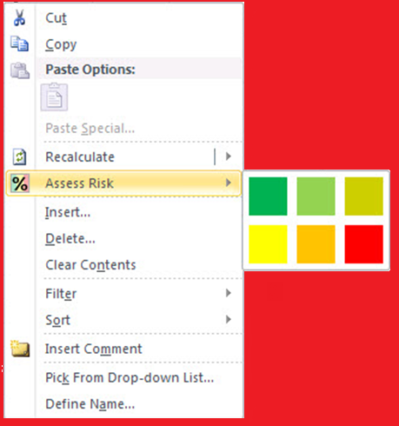
Context Menus
Notes:
Create your own context menu. Here you see a flyout with colors

Slide 11
Context Menus
Create context menus in ribbon XML
<customUI ...>
<ribbon> ... </ribbon>
<contextMenus>
<contextMenu idMso=“ContextMenuCell">
<button id="ButtonRefresh” .../>
</contextMenu>
</contextMenus>
</customUI>
Notes:
Here’s some sample XML for creating a context menu

Slide 12
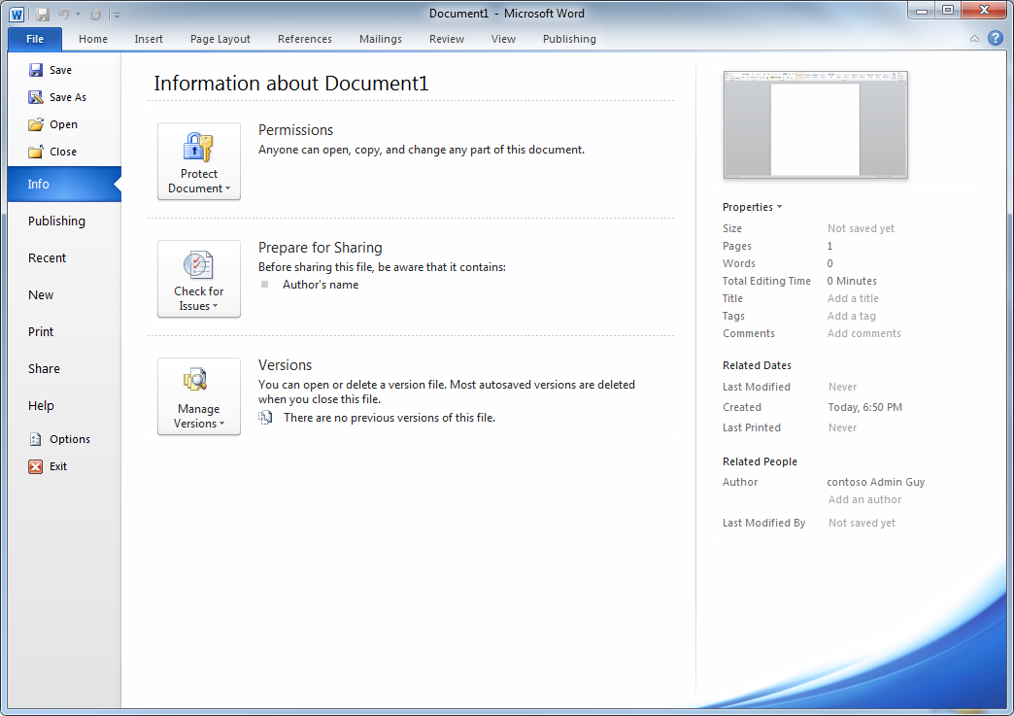
Backstage View
Group
Column
Tab
Fast Command
Notes:
Backstage view is the new view for working with a document. The ribbon is all about the content inside a document. Backstage view is all about operations performed on the document itself. You get here by clicking the Office button.
Also point out the names for the various elements of the Backstage view

Slide 13
Backstage View
Created at the same level as the Ribbon and context menus:
<customUI ...>
<ribbon> ... </ribbon>
<backstage> ... </backstage>
<contextMenus> ... </contextMenus>
</customUI>
Notes:
Here’s the XML to create an extension to the Backstage view – use the outspace element

Slide 14
Backstage View
Add custom tabs to the Backstage view
Add fast commands to built-in/custom tabs
Add custom groups to built-in/custom tabs
Wide variety of control types available for building custom groups
(button, checkBox, editBox, dropDown, radioGroup, comboBox, hyperlink, labelControl, groupBox, layoutContainer, imageControl, etc.)
Notes:
Details on supported things

Slide 15
Customizing Office 2010
demo
Notes:
This demo is a sample add-in that uses many of the customizations presented
Show off a premade demo

Slide 16
Custom Task Panes

Slide 17
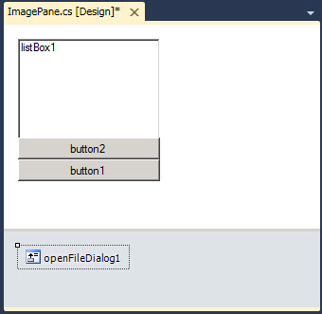
Custom Task Panes
Created with User Controls
Use with a variety of technologies
WPF controls
WCF services
private void ThisAddIn_Startup (…)
{
ImagePane ip = new ImagePane();
Microsoft.Office.Tools.CustomTaskPane pane =
this.CustomTaskPanes.Add(ip, "Images");
pane.Visible = true;
}
Notes:
This slide is used to cover the basic idea of a custom task pane. Not much has changed in this version, but we cover it here to be complete. Emphasize that the CTP can be used with a variety of supporting technologies like WPF controls or WCF services providing data. We’ll also show in another presentation how to get data from cloud services.

Slide 18
Custom Task Panes
demo
Notes:
This demo is a sample add-in that uses many of the customizations presented

Slide 19
Outlook Form Regions

Slide 20
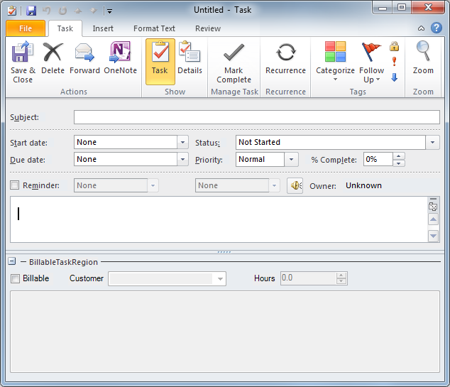
Outlook Form Regions
Creating Form Regions in Outlook
Creating Form Regions in VSTO
Notes:
Outlook is different. It has support for Form regions. These regions may be created in Outlook itself or in Visual Studio.

Slide 21
Outlook Form Regions
demo

Slide 22
Summary
Office and Visual Studio 2010
Office UI Customizations
Custom Task Panes
Outlook Form Regions

