Slide 1
Agent-based model
Spread of disease

Slide 2
1
Background
2
Model 1
3
Model 2
4
Application
5
Simulation

Slide 3
1
Background

Slide 4
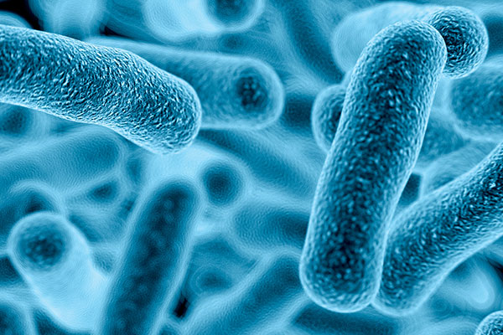

Slide 5
1
Background
Aim
Simplification
Algorithm
predicting the spread of diseases
Epidemic
Fixed amount of people
Certain region
Agent-based model
Agent
Rules
Aggregate level

Slide 6
2
Model 1

Slide 7
2
Model 1
Assumption
The way of infecting
Infection rate
The number of infection sources
Construction
Variables
Determination of whether to stop
Movement of the people
Determine the infection

Slide 8
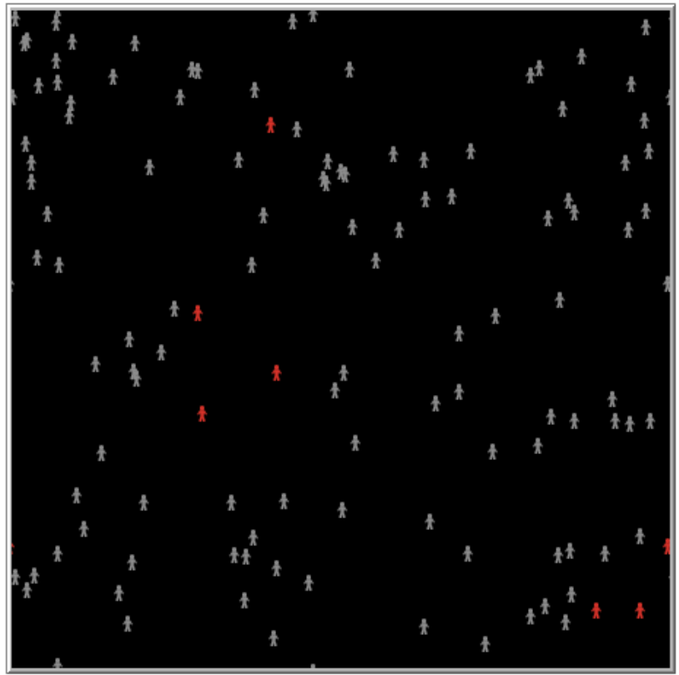
Num of people 122
Num of infected 7

Slide 9
3
Model 2

Slide 10
3
Model 2
Considering the realistic situations, we made several developments based on the first model
Infection rate
The number of infection sources

Slide 11
4
Application

Slide 12
4
Application
To make it more appropriate to real-life situation, we consider the different diseases types, particularly the different ways of infection of different diseases
Intercourse through the network
Environmental infection

Slide 13
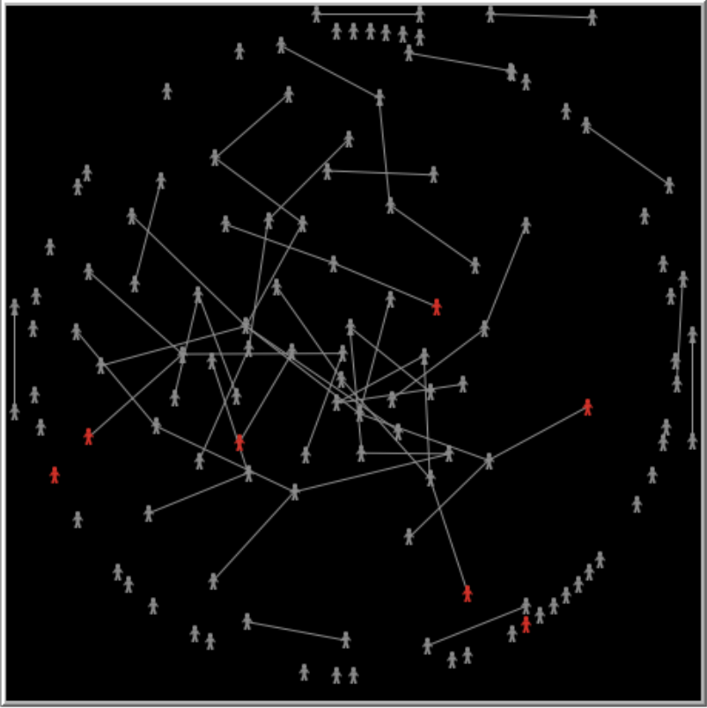
Intercourse through the network

Slide 14
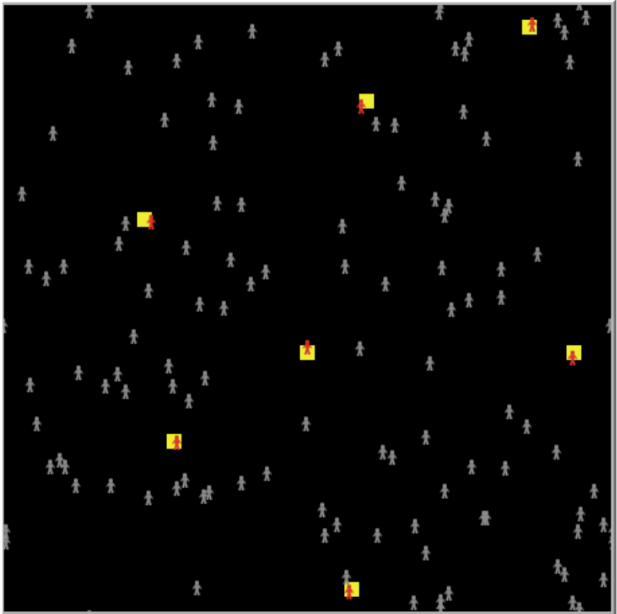
Environmental infection

Slide 15
5
Simulation

Slide 16
A
N
H
K
T
S

