Slide 1
A web about cat

Slide 2
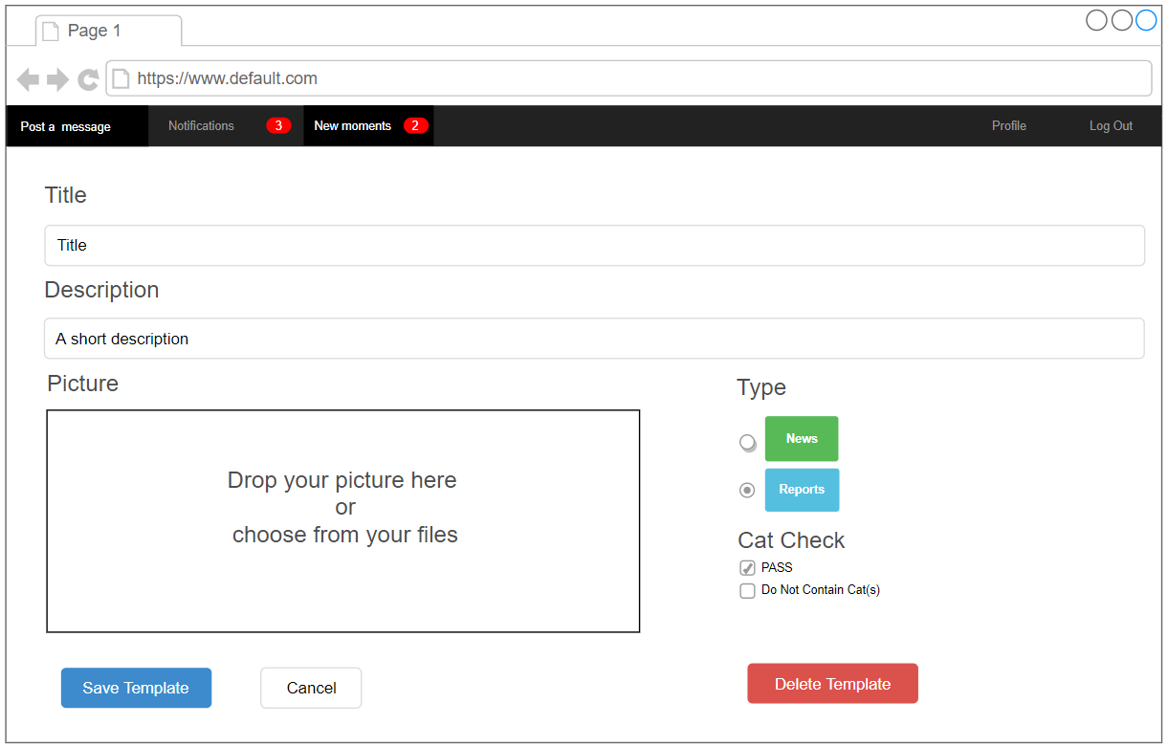
Overall view

