Slide 1
PLAYMAKER
TEAM K
Martynas Buivys - 1007100
Raluca Criste - 1102430
Helen Foster - 0904275
Tomasz Sadowski - 1106113
Vlad Schnakovszki - 1106695

Slide 2
Application Goal
The goal of this application is to provide an engaging online platform where users who are looking for a sports partner can post announcements and offer to take part in games that require two players.

Slide 3
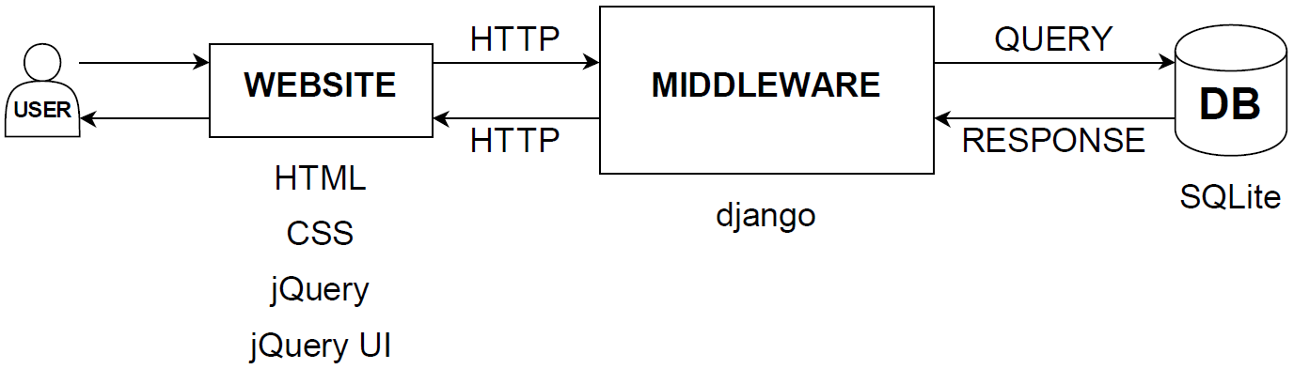
System Architecture

Slide 4
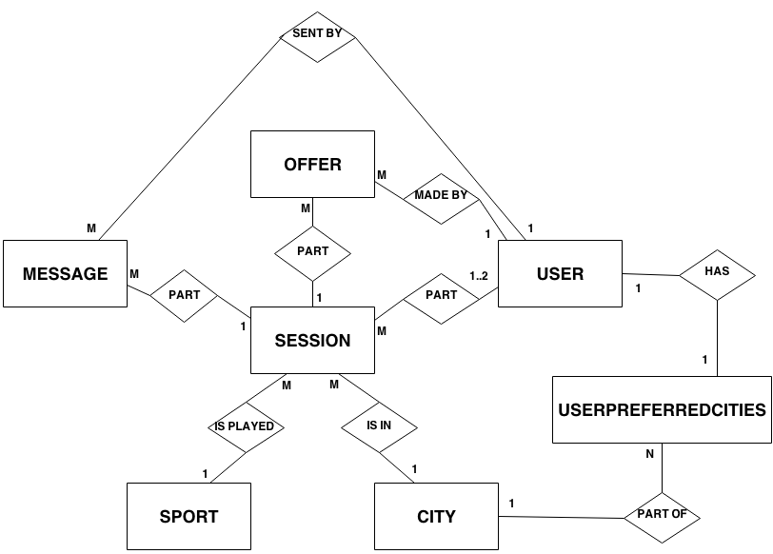
Updated ER Diagram

Slide 5
ER Diagram Attributes – Compressed Chen Notation 1/2
CITY
id: INTEGER
city: VARCHAR
city_slug: VARCHAR
OFFER
id: INTEGER
session_id: INTEGER
guest_id: INTEGER
MESSAGE
id: INTEGER
session_id: INTEGER
user_op_id: INTEGER
user_viewer_id: INTEGER
date: DATE
time: TIME
message: TEXT
MEMBER
username: VARCHAR
email: VARCHAR
firstname: VARCHAR
lastname: VARCHAR
SPORT
id: INTEGER
sport: VARCHAR
sport_slug: VARCHAR

Slide 6
ER Diagram Attributes – Compressed Chen Notation 2/2
USER
id: INTEGER
password: VARCHAR
last_login: DATETIME
is_superuser: BOOLEAN
username: VARCHAR
first_name: VARCHAR
last_name: VARCHAR
email: VARCHAR
is_staff: BOOLEAN
is_active: BOOLEAN
date_joined: DATETIME
SESSION
id: INTEGER
sport_id: VARCHAR
hostplayer_id: INTEGER
guestplayer_id: INTEGER
date: DATE
time: TIME
city_id: VARCHAR
location: VARCHAR
price: FLOAT
details: TEXT
USERPREFERREDCITIES
id: INTEGER
user_id: INTEGER
city_id: VARCHAR

Slide 7
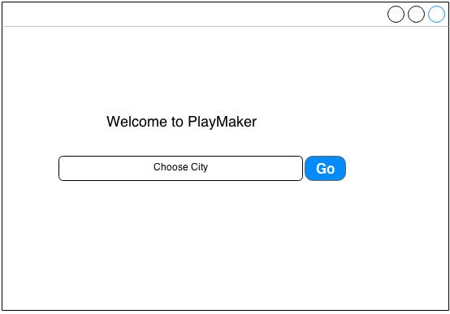
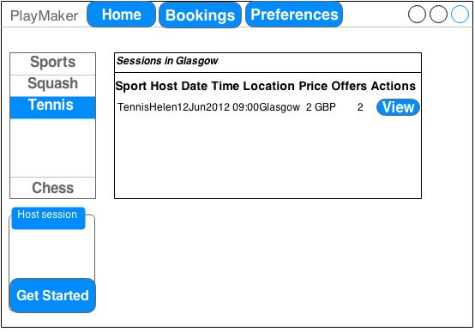
Wireframes – Initial Screen & Welcome Page

Slide 8
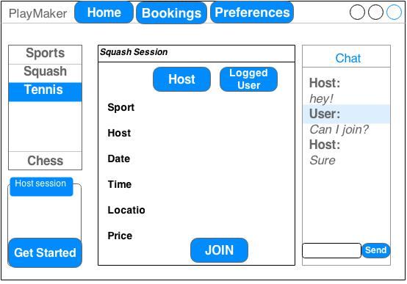
Wireframe – View Session

Slide 9
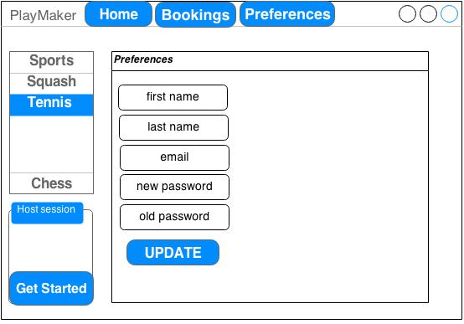
Wireframe – Preferences Page

Slide 10
Specification List
Must have User registers with the system -COMPLETED A host creates a new session –COMPLETED A guest browses the current sessions - COMPLETED The user sees the details of a session - COMPLETED A guest joins a session - COMPLETED A guest withdraws from a session - COMPLETED A host cancels a session - COMPLETED | Should have The host is notified when someone joins a session The guest is notified when the host cancels a session The user takes part in discussion threads - COMPLETED
Could have View host information – COMPLETED The host can offer limited time slots for a session The user can filter current sessions by requirements | Would have The host can accept/decline a guest The guest is notified when he has been accepted to take part of a session The registered user can see his participation history – COMPLETED

Slide 11
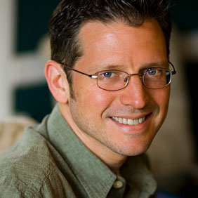
User Personas
Christopher - Software Developer
Christopher Finn is 47 years old and owns a small web design and development studio in Edinburgh. Christopher is not married and has no children. He spends most of his working day in the office sitting in front of a computer.
One of Christopher’s New Year’s resolutions is to take more days off work and get in shape. When he was younger, he was really good at playing squash.

Slide 12
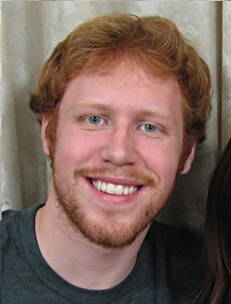
User Personas
Michael - Copywriter
Michael has recently graduated from university and moved to London. He is a 22 year old copywriter in a rapidly growing digital media agency.
Michael knows very few people in London and he would like to make new friends with same interests. One of his passions is playing chess.

Slide 13
Standout features / Functionality
Very simple user interface
Users can filter the events that match their preferences and view the past events they joined
Users can take part in discussion threads after signing in for a session

Slide 14
URLs and Site Map
/register
/accept-offer
/create
/login
/make-offer
/bookings
/preferences
/profile/<username>
/session/<session_id>
/sessions/<session_sport>
/sessions/city/<session_city>
/sendmsg
/getmsgs/<session_id>
/cancel-session
/withdraw-offer

