Slide 1
AEyeAlliance -Braille to Text Converter-
HELEN, TING-YI, WAN-CHUN, YUE, MARIN

Slide 2
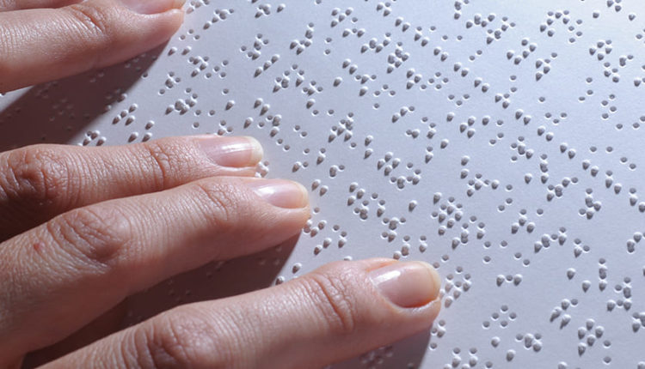
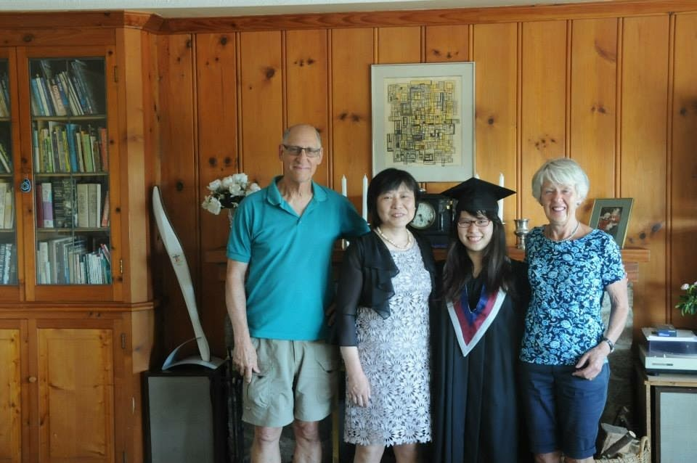
Why braille?

Slide 3
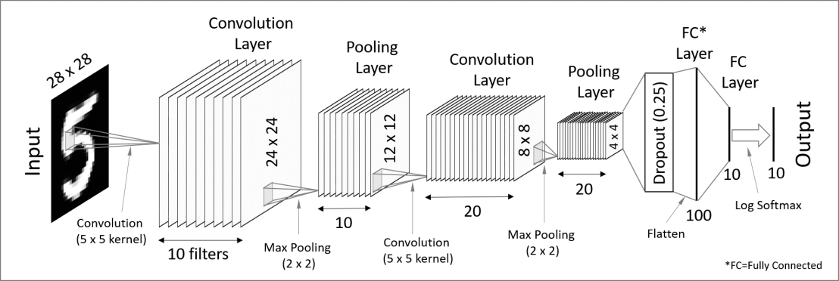
Letter Recognition using CNN

Slide 4




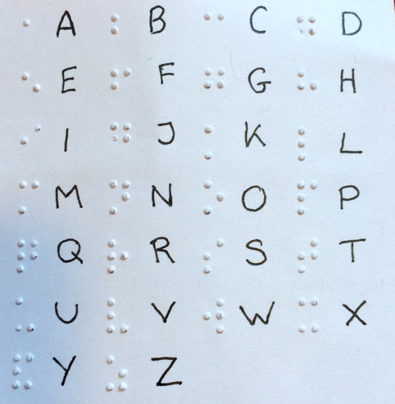
















We need a dataset!

Slide 5
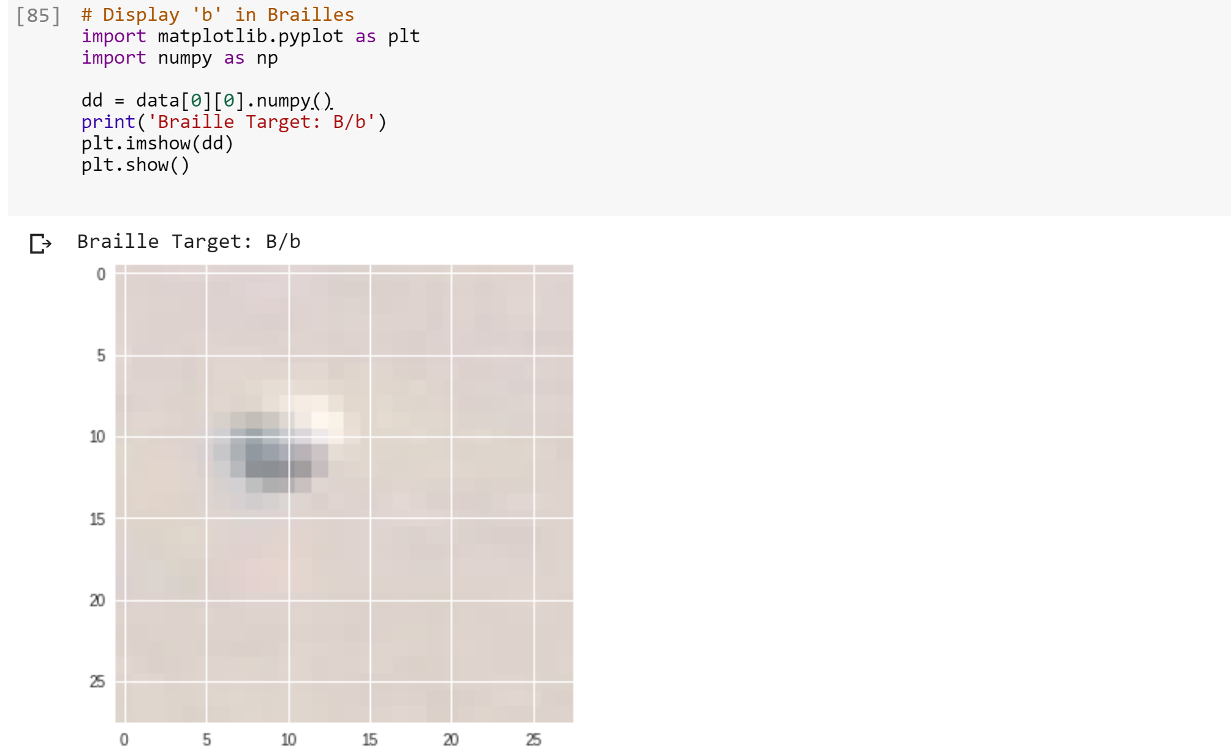
Feed our data to train a model

Slide 6
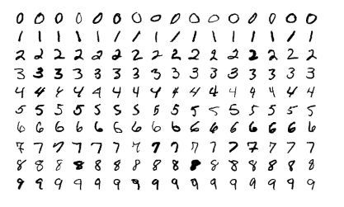
But We decided to Work with MNIST first!

Slide 7
What’s Next?
find/prepare a data set for braille
recognition of letter -> word -> line -> paragraph
Auto-detection of a language that braille is in

