Slide 1
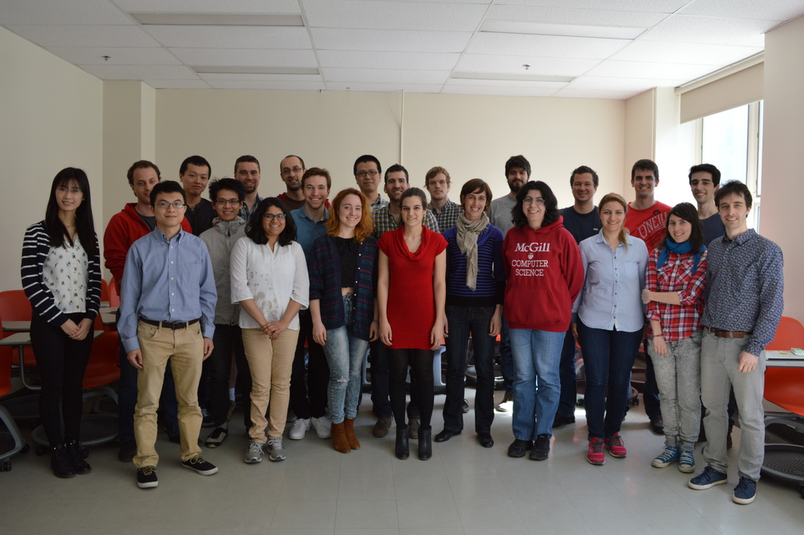
Perspectives on ML
Doina Precup
McGill University

Slide 2
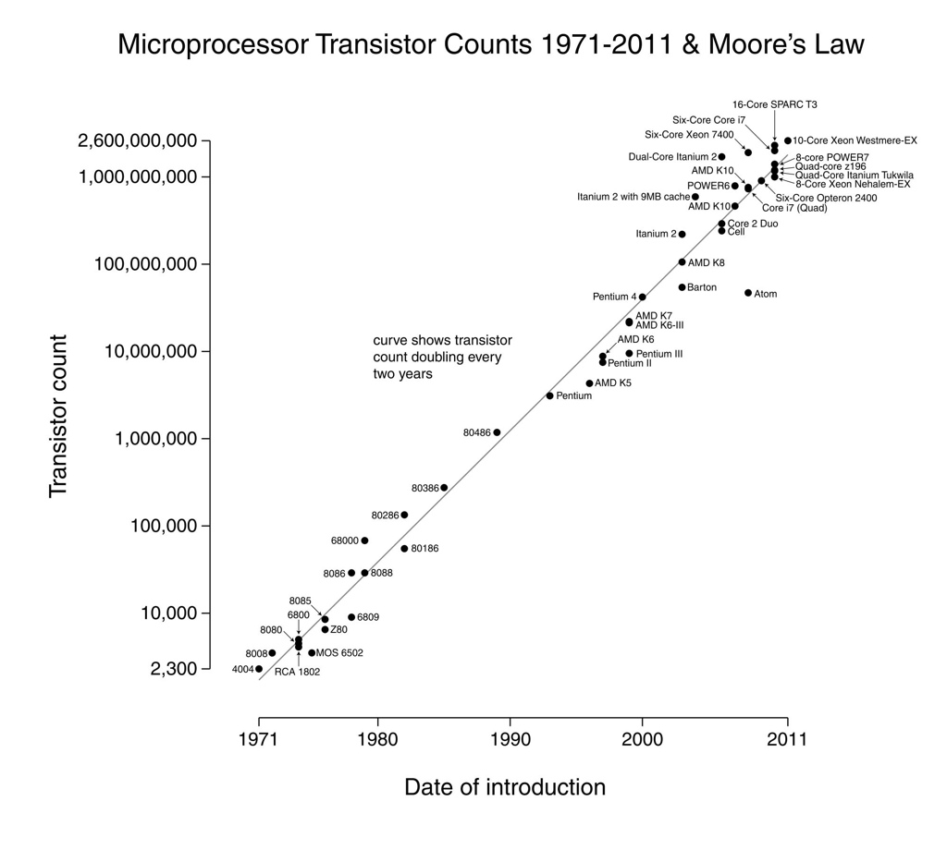
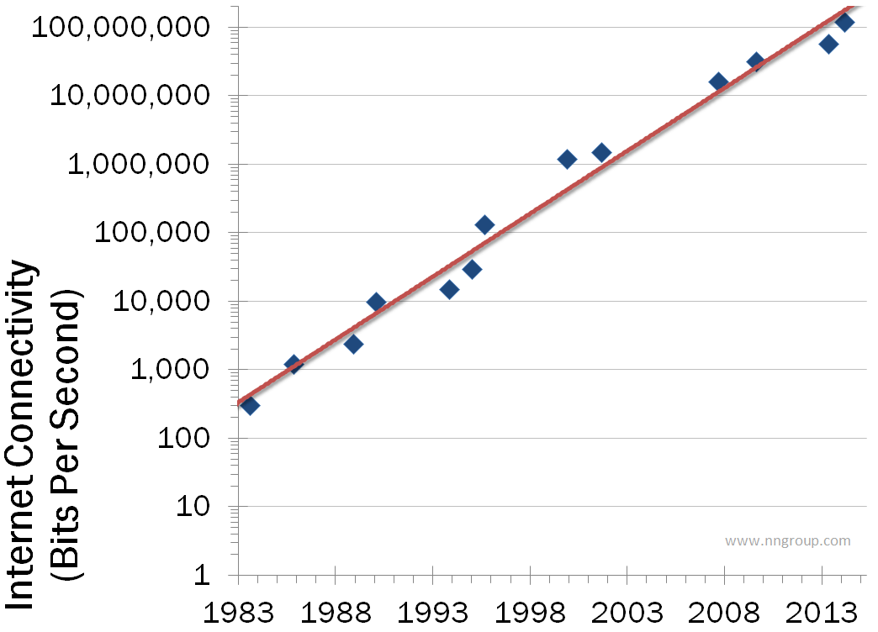
Why now?

Slide 3
A perfect storm
Computation speed is increasing exponentially
Internet size and speed of access is increasing exponentially
Cost per computation and memory unit is rapidly decreasing
Amounts of data generated through new measuring devices (ChipSeq, MRI/fMRI, telescopes, cameras etc) is exploding
Eg. IBM estimates that 90% of all data available today was created in the last 2-3 years

Slide 4
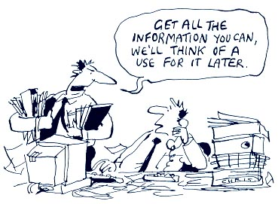
The magic of data
NYTimes: This hot new field promises to revolutionize industries from business to government, from health care to academia
Eg. billion-dollar line item at GE
Eg. More than 100000 datasets available from the US government
Goal: methods that allow understanding the data and using it to make predictions or decisions

Slide 5
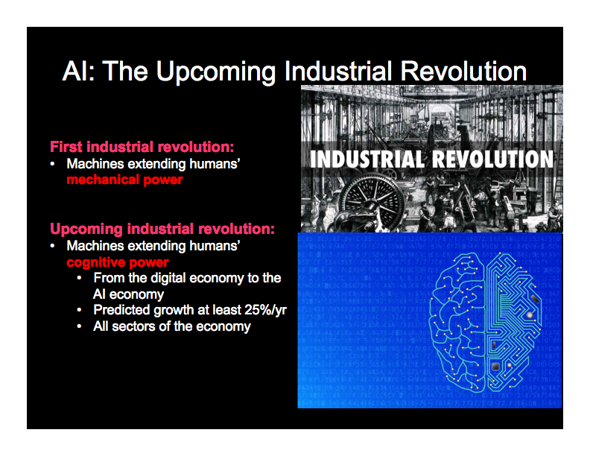

Slide 6
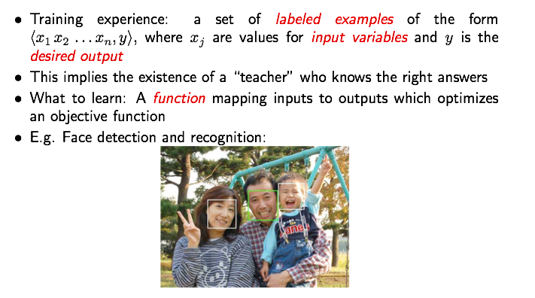
Supervised Learning

Slide 7
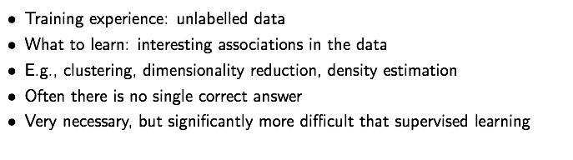
Unsupervised learning

Slide 8
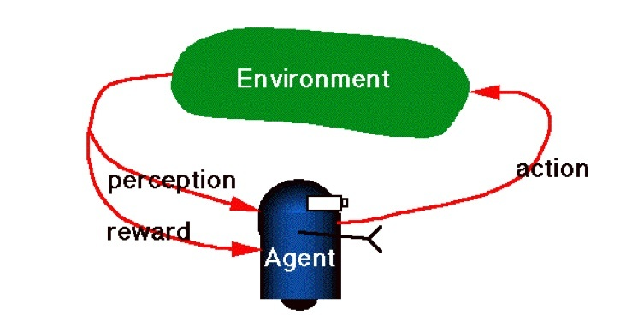
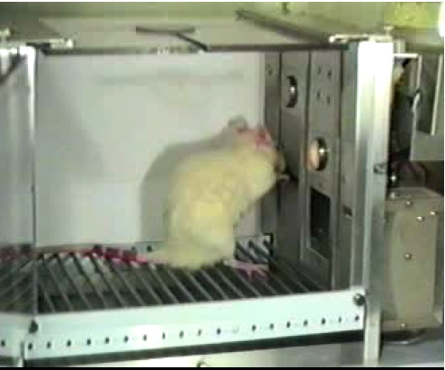
Reinforcement Learning
Reward: Food or electric shock
Reward: Positive and negative numbers
Learning by trial-and-error
Reward is often delayed

Slide 9
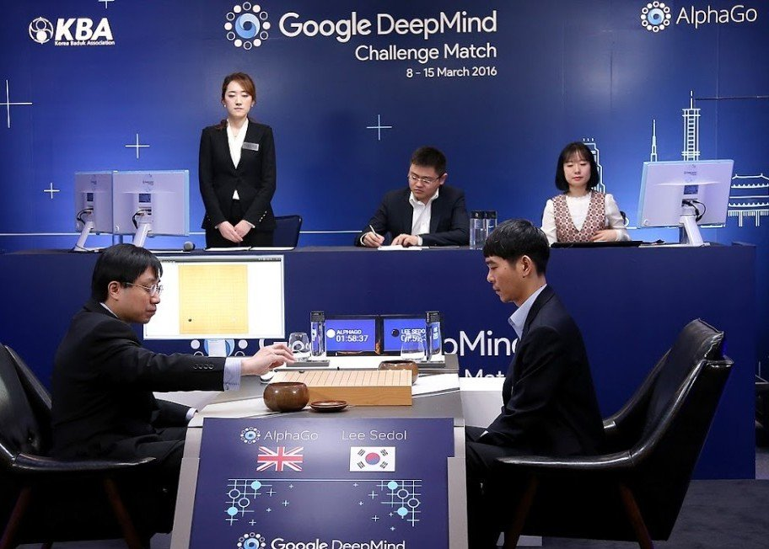
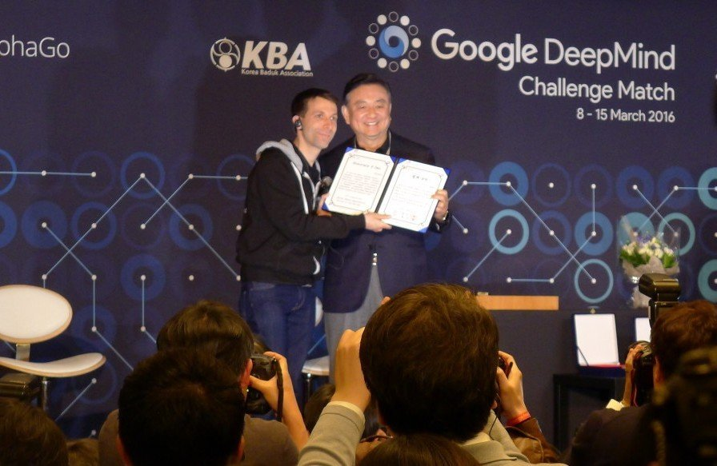
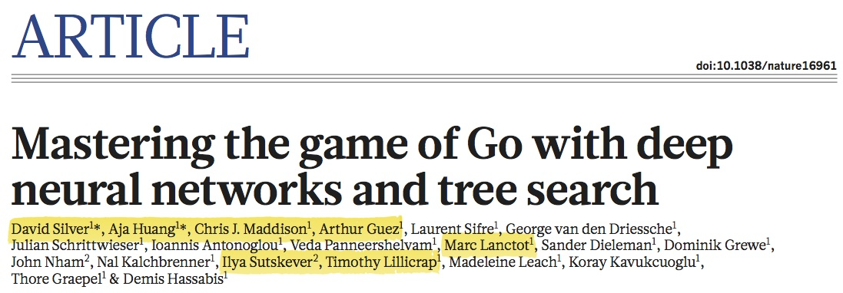
An example: AlphaGo
The first AI
Go player to defeat a human (9 dan) champion

Slide 10
Example: Health care
Very large, disorganized data sets
All kinds of noise and missing information!
Privacy concerns
The need for ``p-value” guarantees
The need for explanatory / causal models that can be picked apart and analyzed

Slide 11
A unique opportunity
Electronic health records, HBHL initiative, new push to mine and integrate ``unstructured” medical data (images, physiological recordings, text, ...) create a unique opportunity to make a large practical impact, while pushing the boundaries of existing computational methods
Applications with very different flavour: real-time monitoring vs patient care vs population studies

Slide 12
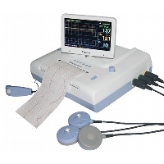
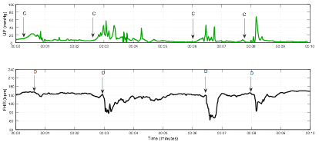
Clinical monitoring
Monitors of vital signs are routinely used in clinical practice (eg. Perigen)
They record a wealth of signals: heart rate, respiration, blood oxygenation, temperature, brain activity, ...
All are sampled at high speed and digitally processed through on-board computing
But physicians and nurses cannot be there all the time to look at the data!

Slide 13
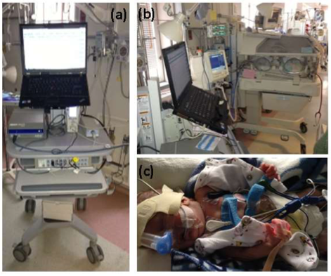
Example: Cardio-respiratory monitoring in NICU
Courtesy of Lara Kanbar, part of APEX project at MUHC

Slide 14
The paradox of physiological clinical monitoring
Sensors have become much more sensitive
On-board computing power and memory are continuously increasing
Yet clinical practice still relies on nurses’ notes and doctors’ instincts to predict risks and patient outcomes!
Can we bring truly continual monitoring to life?

Slide 15
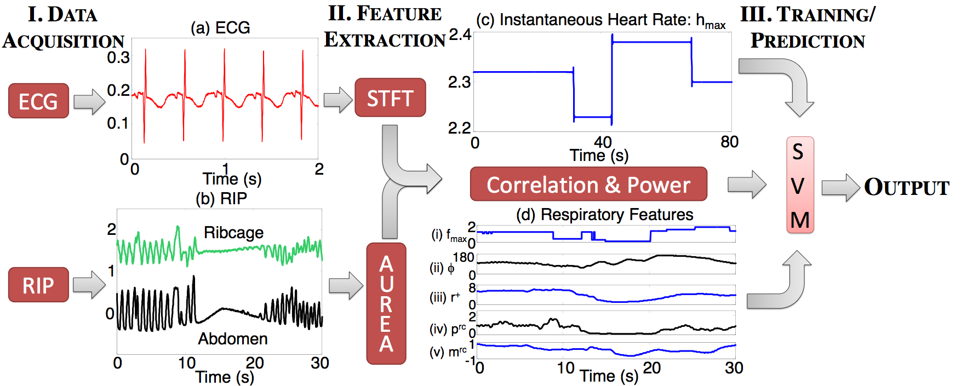
Example: APEX
System for deciding if a premature baby is ready to be taken off a ventilator (Precup et al, 2013); funded by CIHR

Slide 16
APEX: Timing predictions
Rather than feature extraction + classification, can we model the timing of problematic events?
Mix of spectral learning methods and reinforcement learning
Temporal credit assignment: propagate the outcome information back through the time series, to decide when patient ``state” has changed

Slide 17
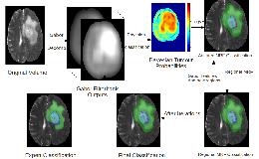
Example: Brain imaging
Collaboration with Tal Arbel, NeuroRX

Slide 18
Moving from imaging to patient care
Can we predict disease progression, based on brain scans and other patient features?
Can we predict disease burden on the patient?
Adaptive treatment design: develop a sequence of drugs best suited to treat a patient
Cf. Reinforcement learning methods

Slide 19
Hottest areas
Health care / precision medicine
Basic science
Bioinformatics
Astrophysics, large particle datasets
Remote sensing
Social science and education
Commercial entities: e-commerce, web analytics,
Individual users: self-quantification
Intelligent devices: cars, smart grid, smart homes...

Slide 20
Commercial perspective
Data itself is viewed as a product
Deliver a package of data + tools to process it
Scalability both in data size, and in terms of user population
Need people with the expertise on-site

