Slide 1
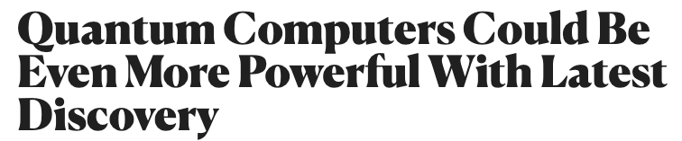
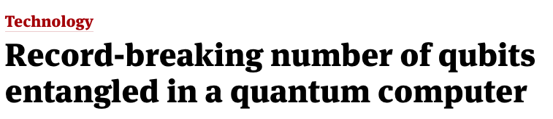



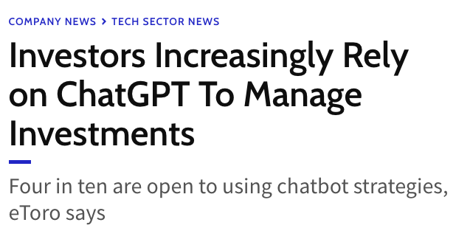
Source: [1-6]
Notes:
Test

Slide 2
Exploring the Feasibility and Practicality of Quantum Machine Learning:
A Study on Quantum Neural Networks
Kolloquium Masterthesis
Helen Marie Rampmeier
17. Juli 2023

Slide 3
Content
Recap: Neural Networks
Recap: Quantum Computing Fundamentals
Quantum Neural Networks
Implementation of Experiments
Comparison of Neural Networks
Conclusion and Outlook

Slide 4
Recap: Neural Networks
Notes:
02:00

Slide 5
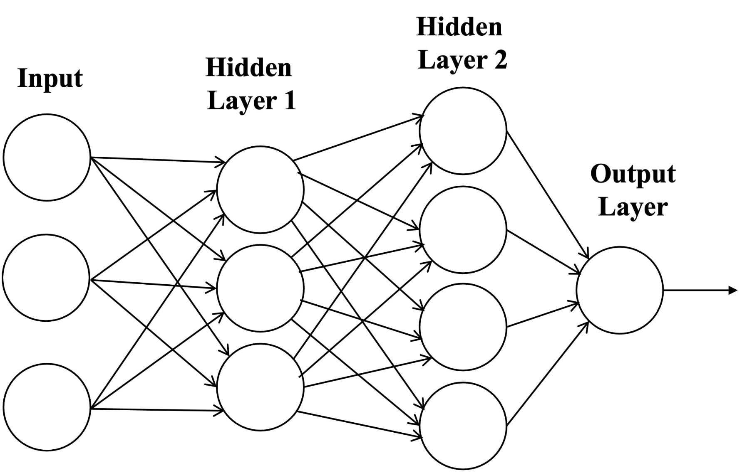
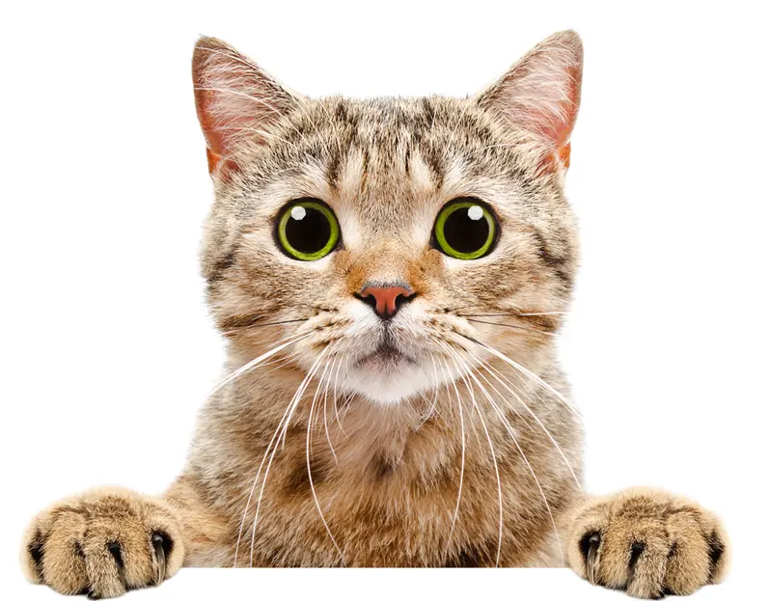
Neural Network
CAT
Source: [7]
Neural Networks
QC Fundamentals
QML
Implementation
Comparison
Conclusion
Notes:
- weight on connection which gives importance to the feature before

Slide 6
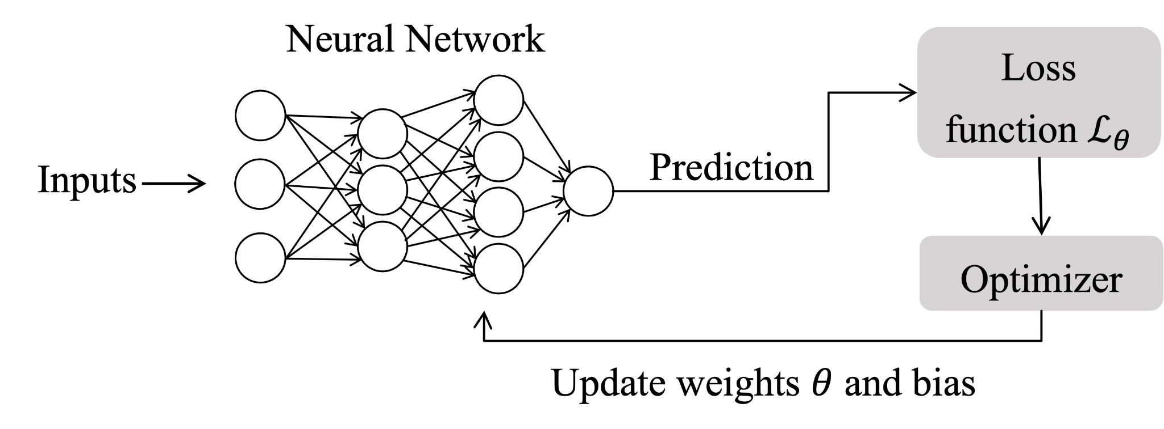
Neural Network Training
Neural Networks
QC Fundamentals
QML
Implementation
Comparison
Conclusion

Slide 7
Recap: Quantum Computing Fundamentals
Notes:
03:30

Slide 8
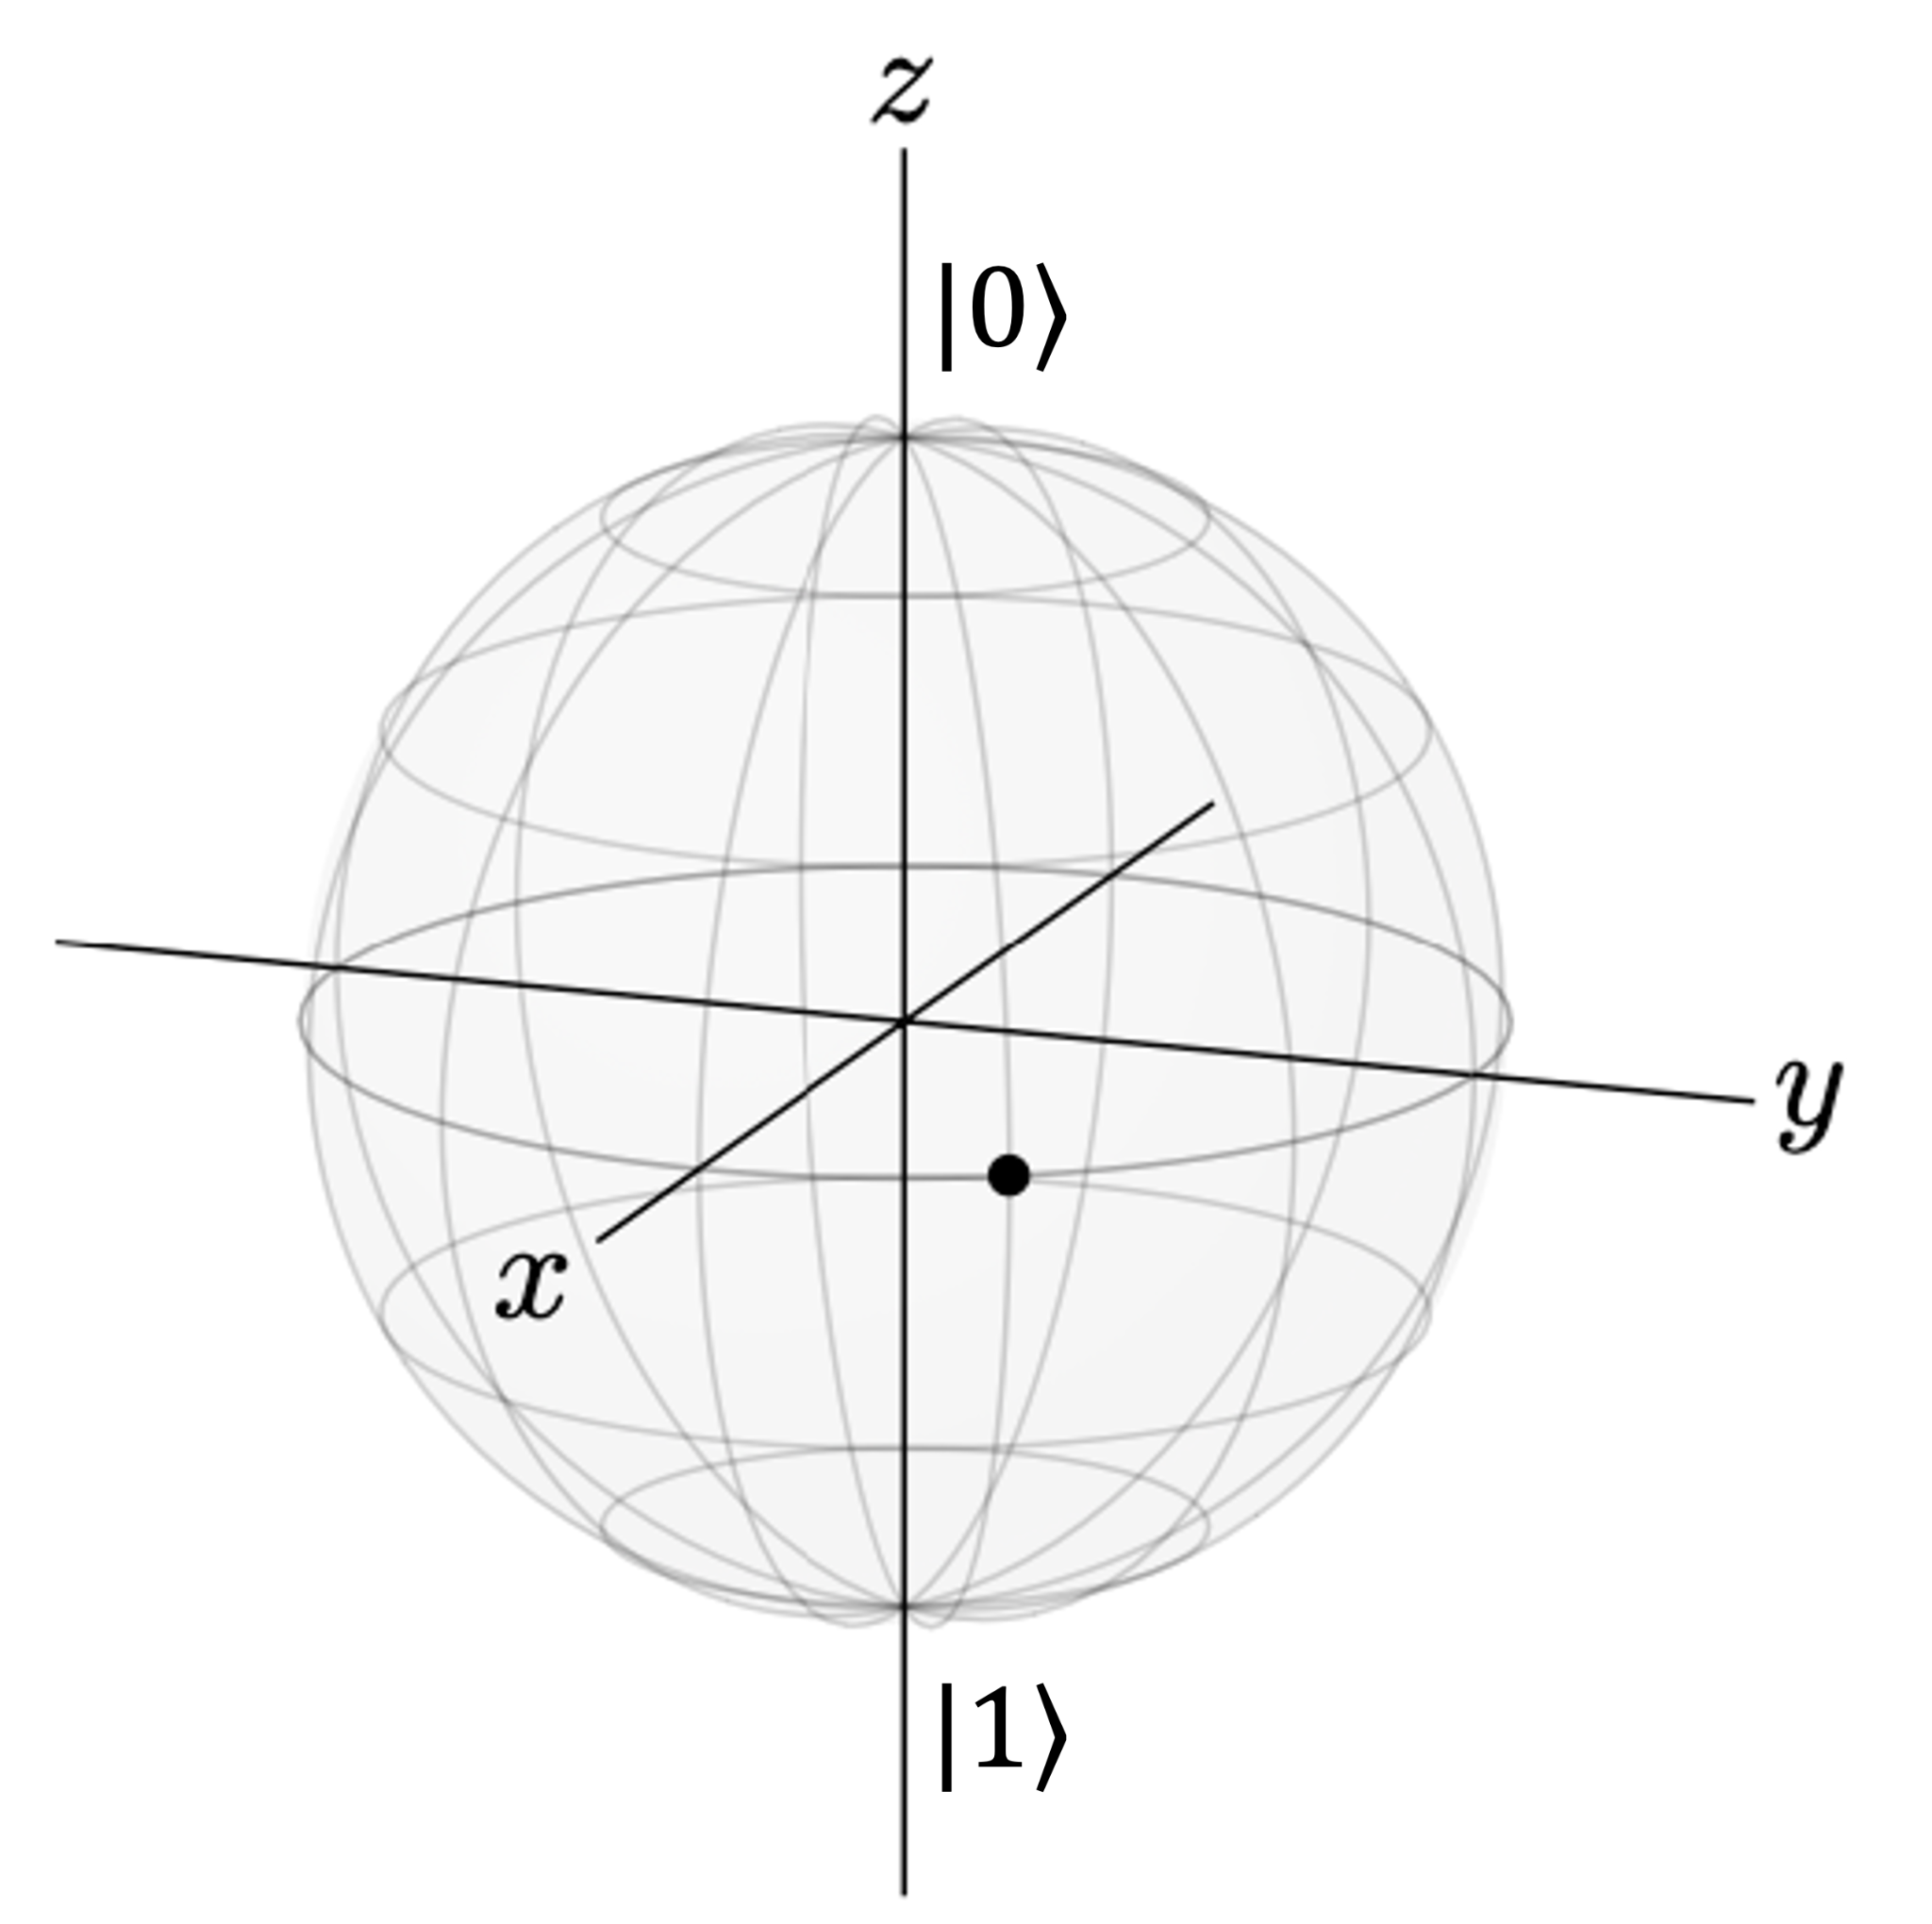
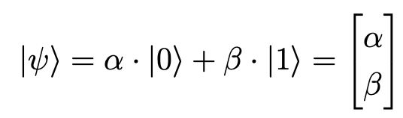
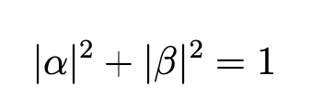
Qubits Visual Representation and Measurement
α and β are complex numbers with
Source: [8]
Measurement: either α = 1 or β = 1 → collapse of the state
Neural Networks
QC Fundamentals
QML
Implementation
Comparison
Conclusion
Notes:
unit ball
squared absolut value

Slide 9
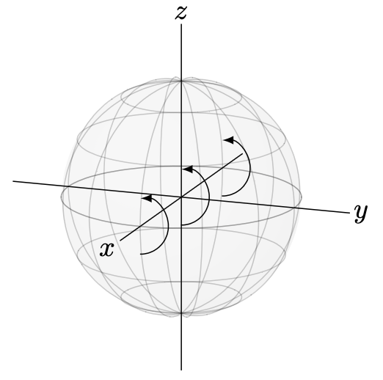
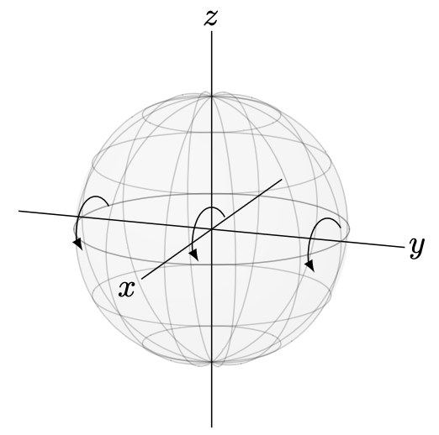
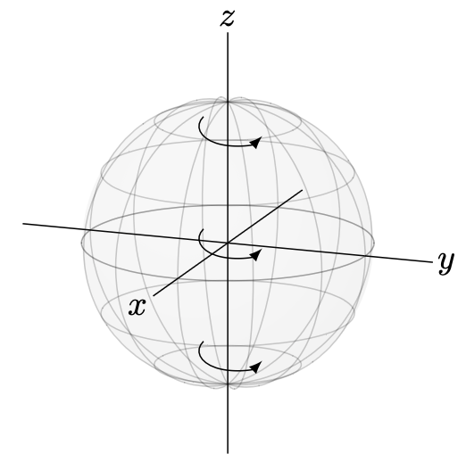
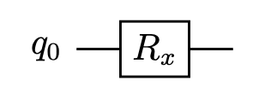
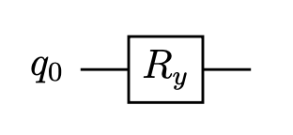
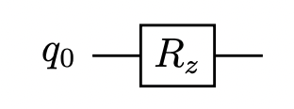
Quantum Gates
Rx-Gate
Ry-Gate
Rz-Gate
Neural Networks
QC Fundamentals
QML
Implementation
Comparison
Conclusion

Slide 10
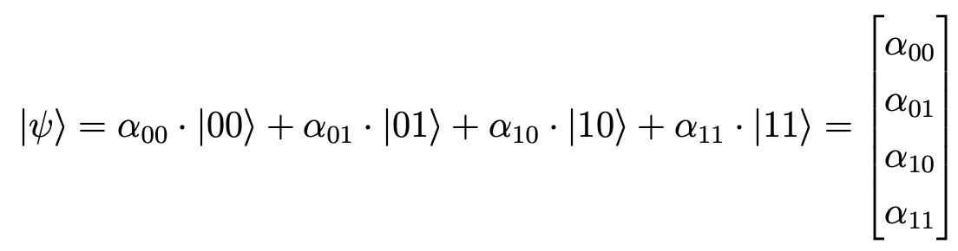
Multiple Qubits and Entanglement
two qubits have four basis states:
entanglement: qubits are not independent, measurement of one will influence the other → cannot be described as tensor product anymore
For Machine Learning: Adds correlation - f.e. what is the relation between two neighbouring pixels?
Neural Networks
QC Fundamentals
QML
Implementation
Comparison
Conclusion

Slide 11
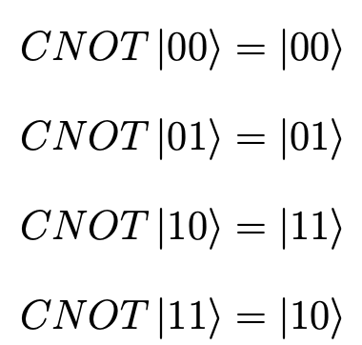
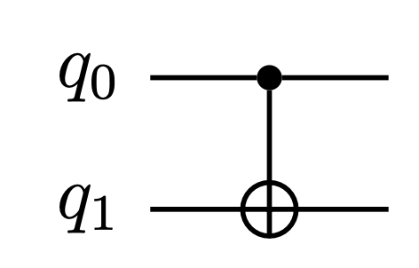
Quantum Gates
control
target
CNOT Gate
creates entanglement
Neural Networks
QC Fundamentals
QML
Implementation
Comparison
Conclusion

Slide 12
Quantum Neural Networks
Notes:
08:50

Slide 13
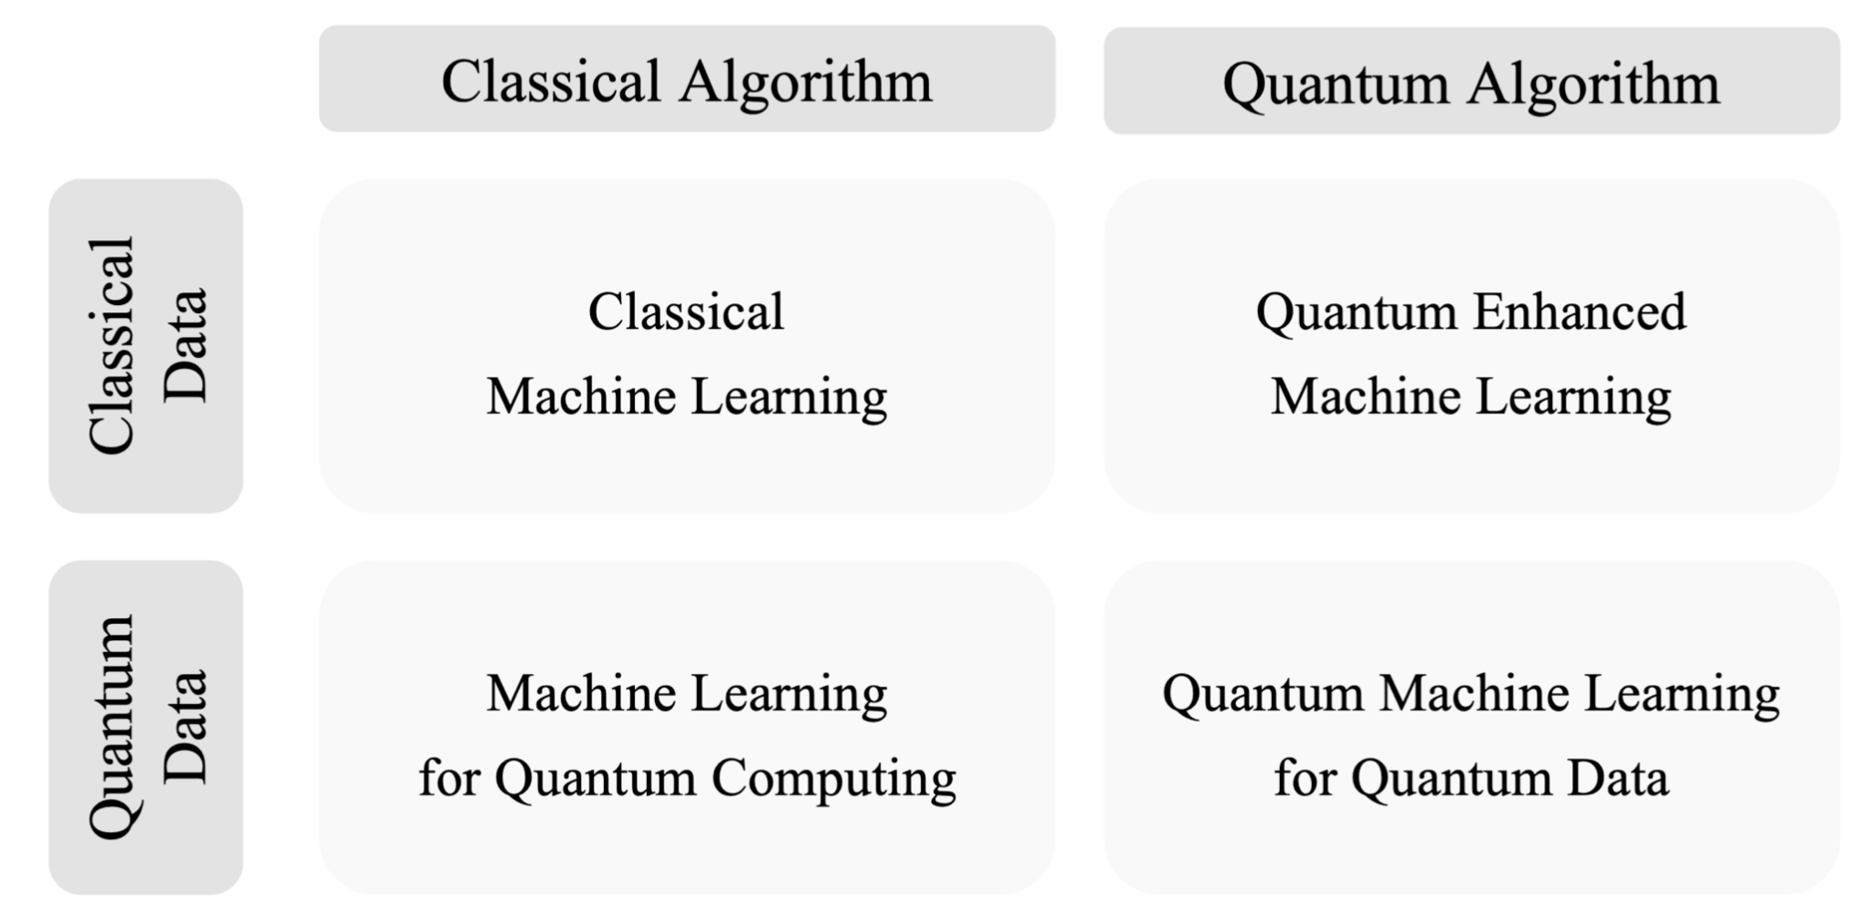
Quantum Machine Learning
Neural Networks
QC Fundamentals
QML
Implementation
Comparison
Conclusion
Notes:
QD + CA -> Create Gates
QD + QA -> Optimizing quantum circuit on quantum device

Slide 14
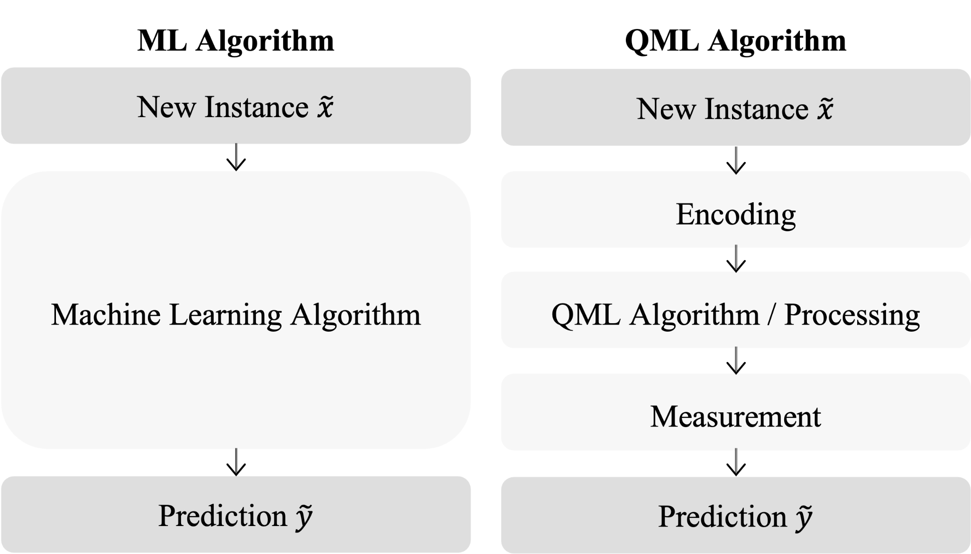
QML Algorithms
Neural Networks
QC Fundamentals
QML
Implementation
Comparison
Conclusion

Slide 15
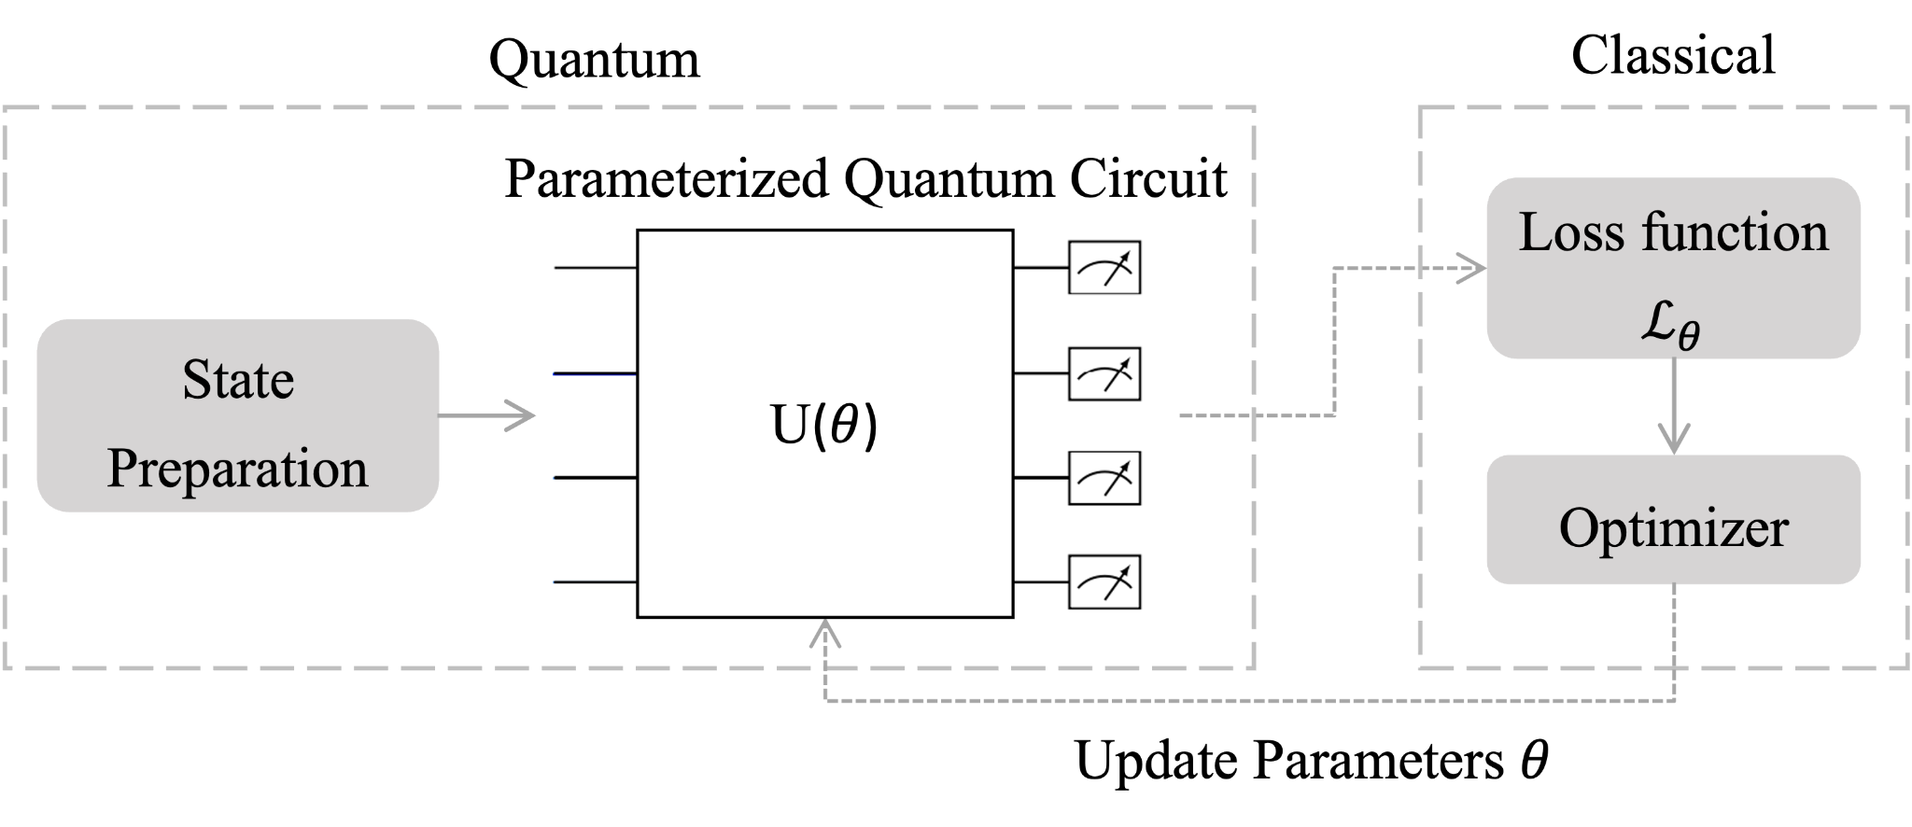
Quantum Neural Networks
Neural Networks
QC Fundamentals
QML
Implementation
Comparison
Conclusion

Slide 16
Is there a future need for Quantum Neural Networks?

Slide 17
Implementation of Experiments
Notes:
12:40

Slide 18
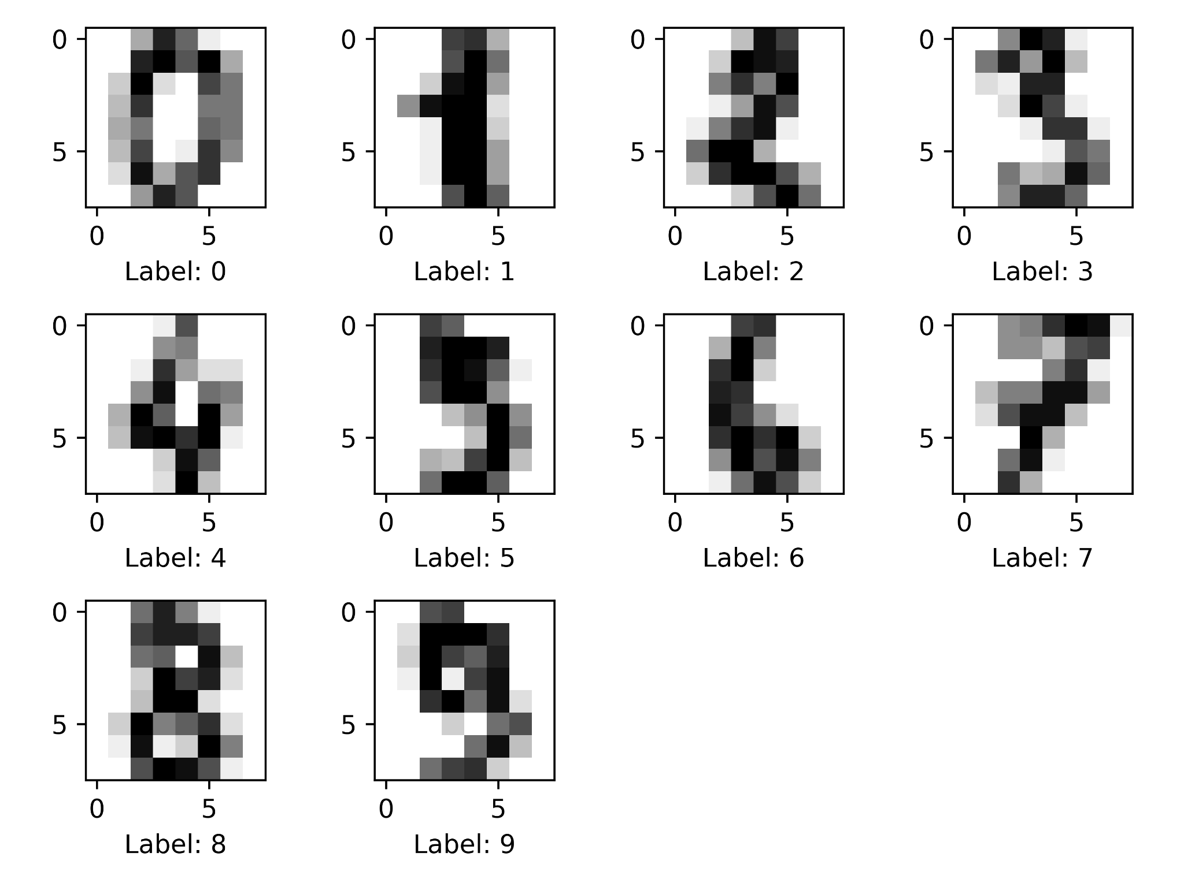
Digits Dataset
1797 handwritten digits
Neural Networks
QC Fundamentals
QML
Implementation
Comparison
Conclusion

Slide 19
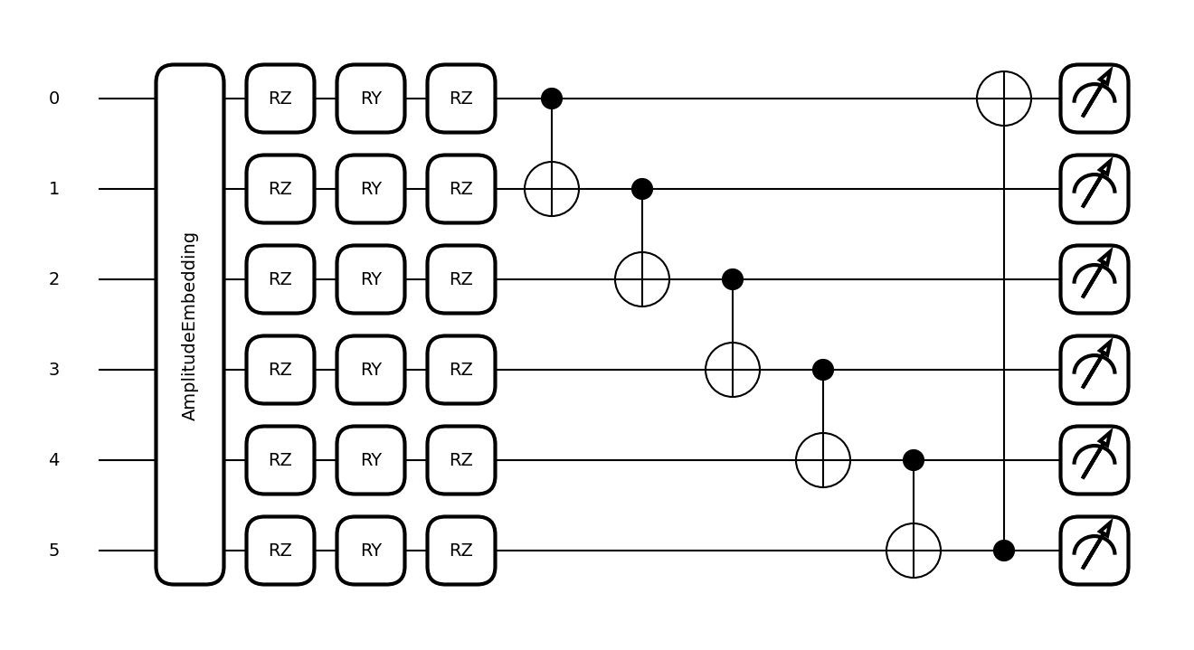
QNN Ansatz and
Trainable Parameters
18 trainable parameters
one layer
Neural Networks
QC Fundamentals
QML
Implementation
Comparison
Conclusion

Slide 20
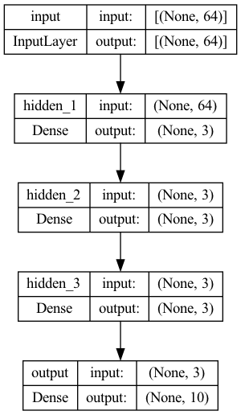
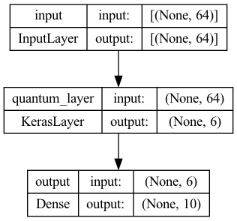
QNN and CNN Architecture
CNN
QNN
between
4-16 layers
between
1-3 layers
Neural Networks
QC Fundamentals
QML
Implementation
Comparison
Conclusion

Slide 21
Comparison of Neural Networks
Notes:
16:30

Slide 22
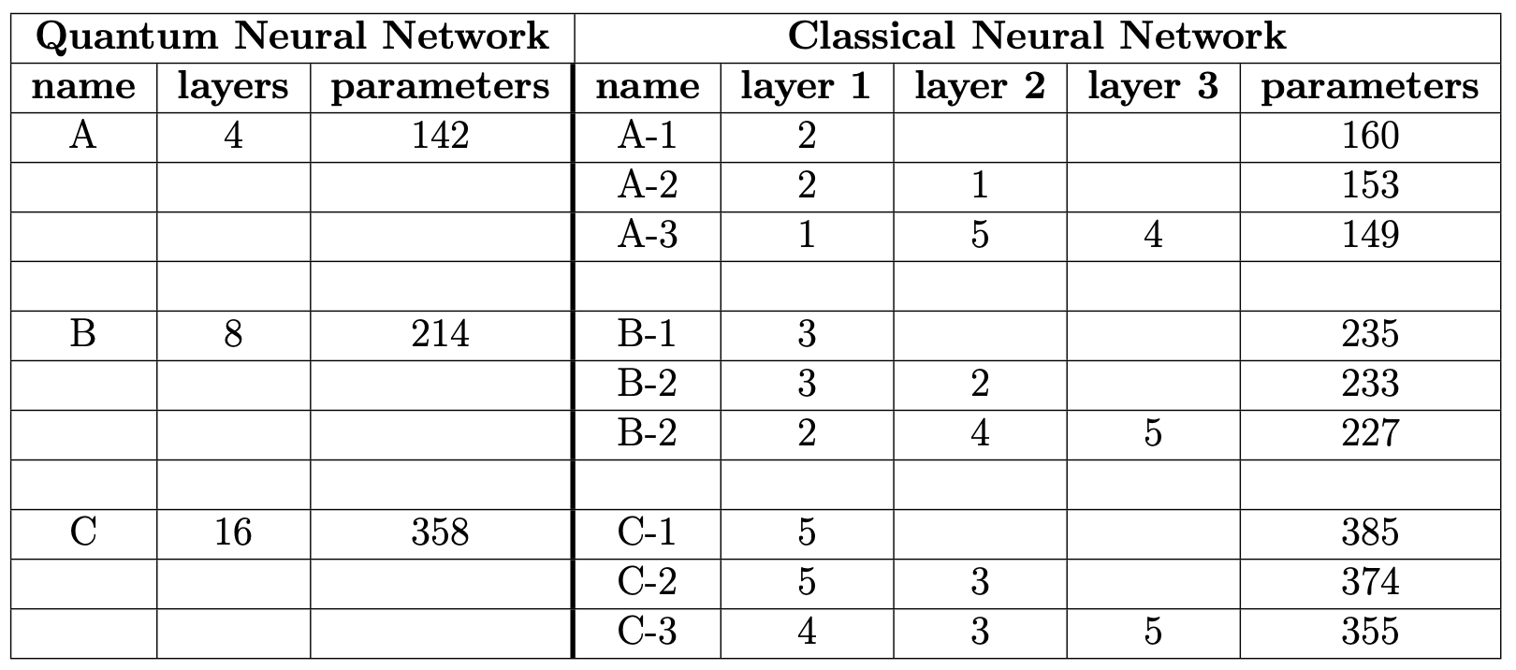
Design of Experiments
Note: Experiments were run on Quantum Simulators only
Neural Networks
QC Fundamentals
QML
Implementation
Comparison
Conclusion
Notes:
RAN ON SIMULATIONS!!!!!

Slide 23
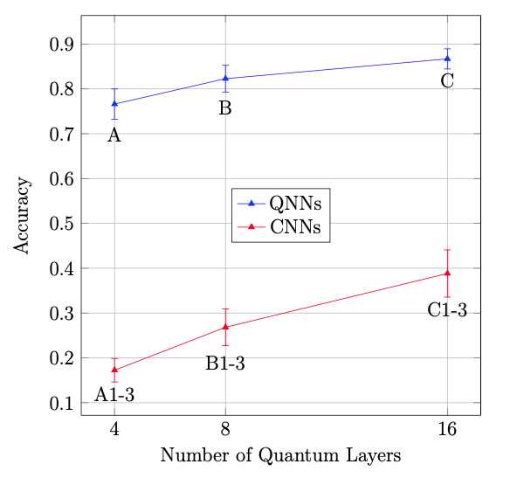
Accuracy
# Correct Predictions
# Total Predictions
Accuracy =
Accuracy of QNNs is higher
Advantage of QNNs might diminish once a higher number of trainable parameters is reached
Neural Networks
QC Fundamentals
QML
Implementation
Comparison
Conclusion
Notes:
Number of Quantum Layers
Indictuive Bias

Slide 24
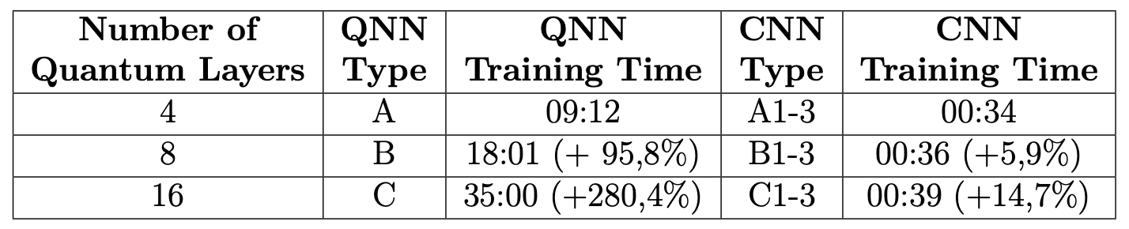
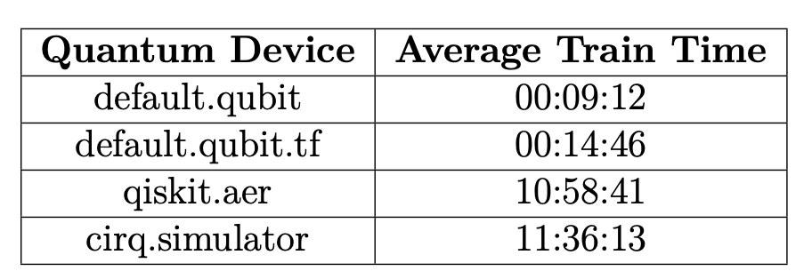
Time
Training time is significantly higher for QNNs
Increase in training time also significantly higher for QNNs
Open question: If compared by time instead of trainable parameters?
Neural Networks
QC Fundamentals
QML
Implementation
Comparison
Conclusion

Slide 25
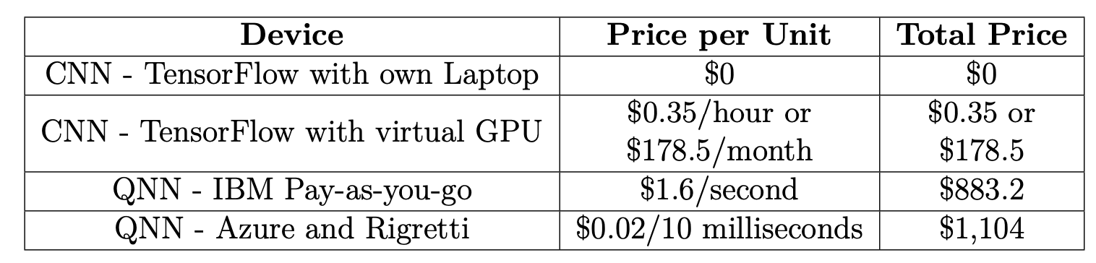
Cost
Runtime = 552 seconds
Quantum devices are currently significantly more expensive
Costs are not fully transparent
Neural Networks
QC Fundamentals
QML
Implementation
Comparison
Conclusion
Notes:
Weil schwer abzuschätzen --> bin ich von BESTER simulationszeit ausgegangen

Slide 26
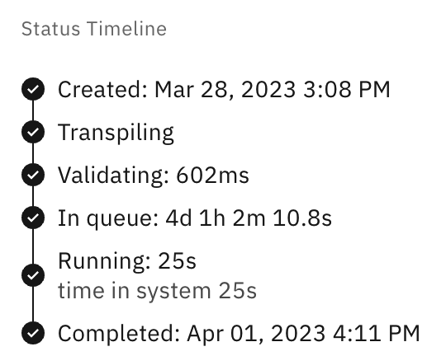
Practicality
Long queuing times with limited availability to quantum hardware
Limited availability of resources online:
Stack Overflow/Xanadu forum:
TensorFlow 82,000 questions
Pennylane (leading QML framework) 1,300 topics/9,800 posts
GitHub:
141,000 TensorFlow Repositories
290 Pennylane Repositories
Neural Networks
QC Fundamentals
QML
Implementation
Comparison
Conclusion

Slide 27
Conclusion and Outlook
Notes:
28:00

Slide 28
Conclusion and Outlook
Is there a future need for Quantum Neural Networks?
Yes - outlook seems promising,
especially once the development of quantum hardware improves
correlation due to entanglement could solve new computational problems
But - current usage should be limited to research interests
widespread adoption will probably take some more time
limited resources and high costs slow down commercial use
clear fields of application will have to be explored
Neural Networks
QC Fundamentals
QML
Implementation
Comparison
Conclusion

Slide 29
Thank you for your attention!

Slide 30
Sources
[1] Decrypt „Quantum Computers Could Be Even More Powerful With Latest Discovery“. (2023), [Online]. Available: https://decrypt.co/148356/quantum-computers-could-be-even-more-powerful-with-latest-discovery (visited on 07/14/2023)
[2] NewScientist „Record-Breaking Number of Qubits Entangled in a Quantum Computer“. (2023), [Online]. Available: https://www.newscientist.com/article/2382022-record-breaking-number-of-qubits-entangled-in-a-quantum-computer/ (visited on 07/14/2023)
[3] Times Now News „Googles Quantum Leap: A Quantum Computer That Outpaces Conventional Computers by 47 Years“. (2023), [Online]. https://www.timesnownews.com/technology-science/googles-quantum-leap-a-quantum-computer-that-outpaces-conventional-supercomputers-by-47-years-article-101668792 (visited on 07/14/2023)
[4] Nanalyze „Quantum Computing Stocks. Meet AI Hype“. (2023), [Online]. https://www.nanalyze.com/2023/07/quantum-computing-stocks-ai-hype/ (visited on 07/14/2023)
[5] Aljazerra „Musk Launches Artificial Intelligence Rival to ChatGPT’s OpenAI“. (2023), [Online]. https://www.aljazeera.com/economy/2023/7/13/musk-launches-artificial-intelligence-rival-to-chatgpts-openai (visited on 07/14/2023)

Slide 31
Sources
[6] Investopia „Investors Increasingly Rely on ChatGPT to Manage Investments“. (2023), [Online]. https://www.investopedia.com/investors-increasingly-relying-on-chatgpt-to-manage-investments-7559052 (visited on 07/14/2023)
[7] The Guardian „What does your cat mean by 'miaow'? Let Japan's pet guru Yuki Hattori explain“ (2020), [Online]. https://www.theguardian.com/lifeandstyle/2020/sep/05/what-cats-mean-by-miaow-japans-pet-guru-knows-just-what-your-feline-friend-wants (visited on 07/14/2023)
[8] T. G. Wong „Introduction to Classical and Quantum Computing“. (2022), [Online]. Available: https://www.thomaswong.net/introduction-to-classical-and-quantum-computing-1e3p.pdf (visited (visited on 07/14/2023)

Slide 32
Backup

Slide 33
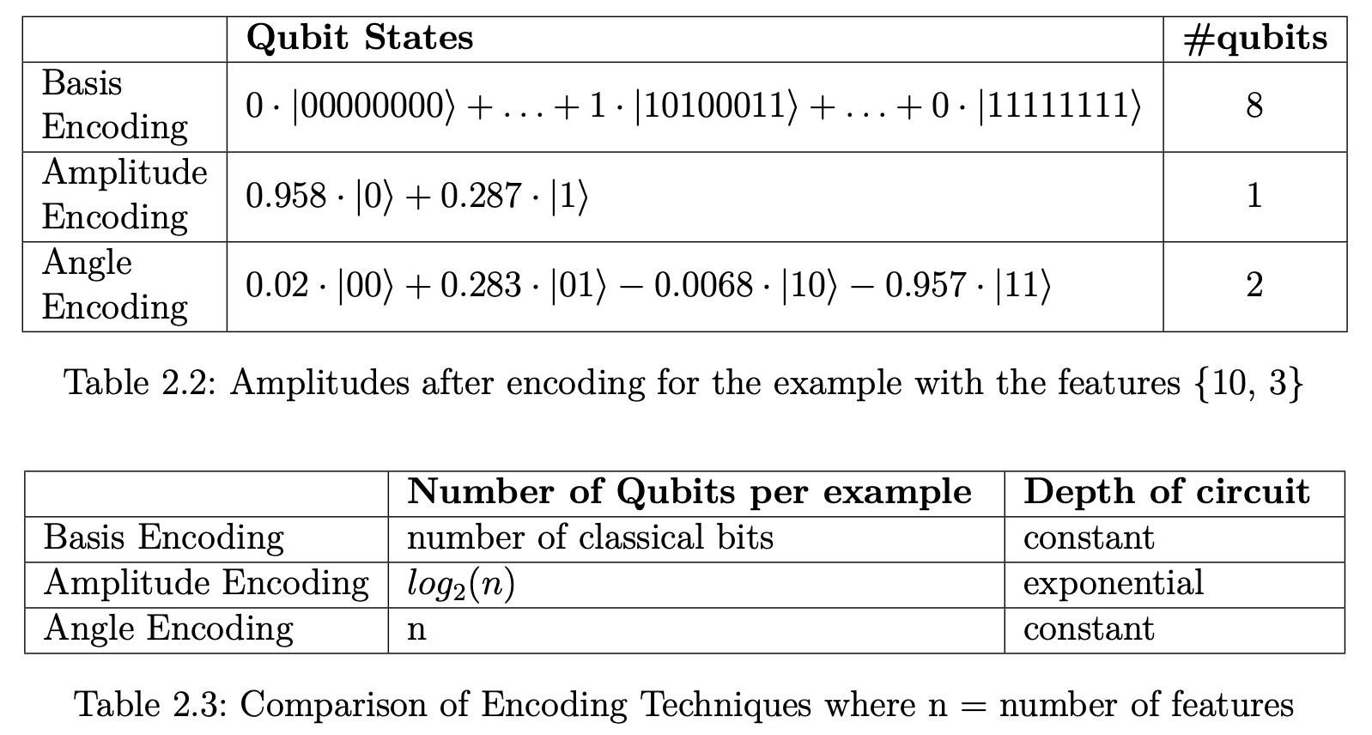
Encoding

Slide 34
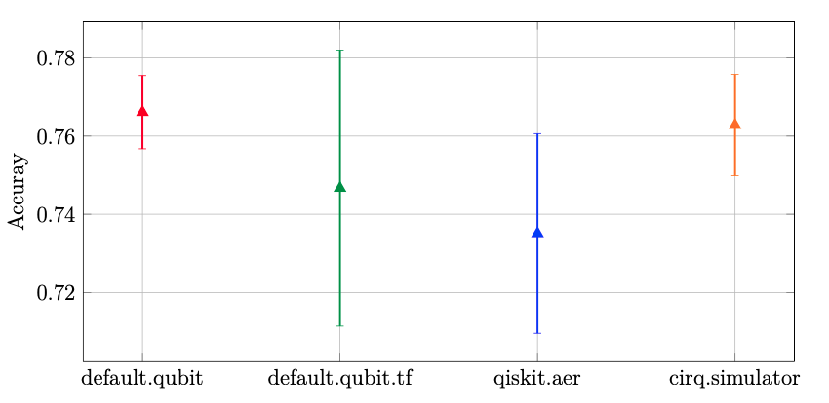
Simulation Devices

Slide 35
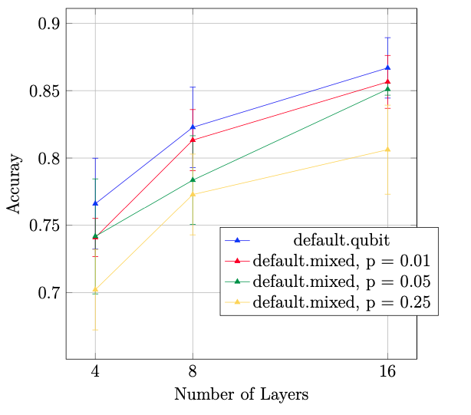
Fault Tolerance

Slide 36
Limitations of Research/
Future Works
Limitations:
Experiments were run on Simulators due to limitations
Number of Experiments
Small dataset with small number of qubits
Future Works:
Trying out different Ansätze
Other forms of neural networks: Convolutions, GANs, Transformers, …

