Slide 1

P peline
The Data
Introductory Statistics: Correlation & Causality
© Jennifer Mankoff
The Data Pipeline; HCII; Spring 2014

Slide 2
Causality
How do we infer causality?
How do we prove it?
Why is it hard to prove causality
Why do we need to prove causality?
Diagram the relationships between variables
Explain the concept of causation

Slide 3
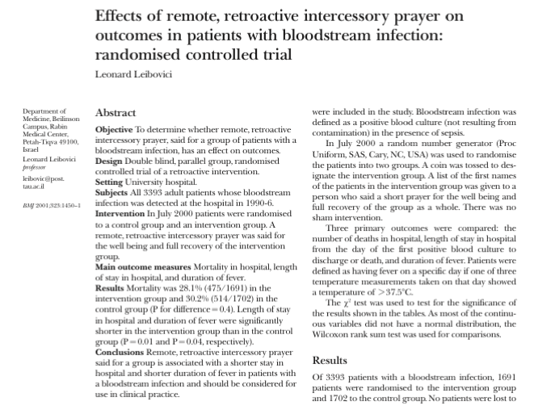
Leibovici, L. (2001). Effects of remote, retroactive intercessory prayer on outcomes in patients with bloodstream infection: Randomised controlled trial. Bmj, 323(7327), 1450-1451.
Notes:
HAND OUT ARTICLE, READ and discuss.
Can you envision a study that would convince you that a cause can lead to something happening in the past?

Slide 4
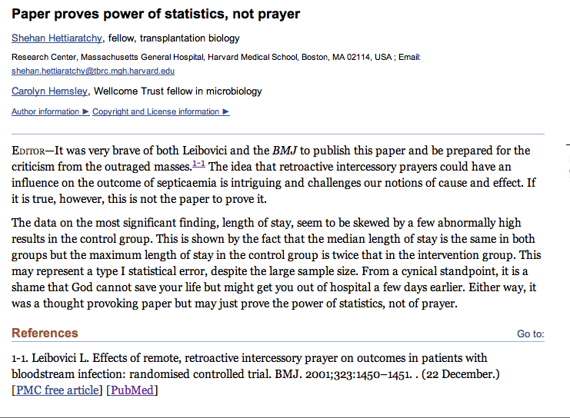
Adapted from class by Samantha Kleinberg

Slide 5
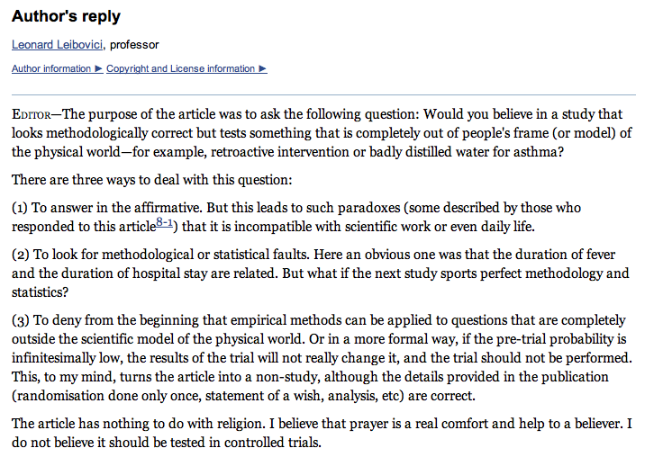
Leibovici’s reply
Adapted from class by Samantha Kleinberg
Notes:
http://www.ncbi.nlm.nih.gov/pmc/articles/PMC1122963/

Slide 6
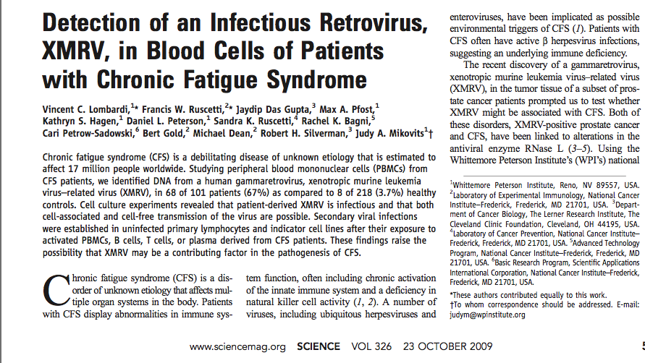
XMRV leads to CFS?
Adapted from class by Samantha Kleinberg

Slide 7
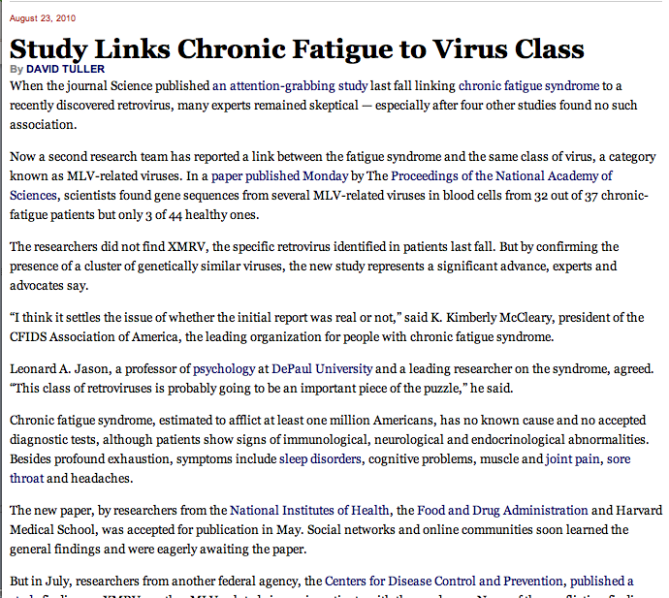
XMRV leads to CFS?
“I think it settles the issue of whether the initial report was real or not”
Adapted from class by Samantha Kleinberg

Slide 8
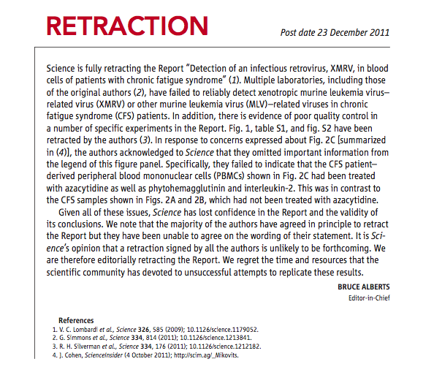
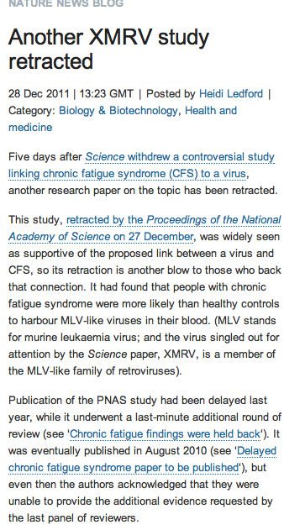
But …
Adapted from class by Samantha Kleinberg
Notes:
http://www.nature.com/news/the-scientist-who-put-the-nail-in-xmrv-s-coffin-1.11444
March 2011
Scientists at NIH present research showing that XMRV emerged from two different mouse viruses in the laboratory during the 1990s. The implication, one author told Nature, is that this virus, born in a laboratory, has probably been infecting laboratory samples for more than a decade, but not people. Meanwhile, a Nature profile of Judy Mikovits highlights growing tensions between Mikovits and her former collaborators on the initial report.

Slide 9
Dependence/independence
Events that are independent
Flipping heads and then tails
Day of week and whether a patient had a heart attack (probably?)
Events that are dependent
Vice presidential candidate and presidential nominee
Diagnostic test being positive and whether patient has a disease
Adapted from class by Samantha Kleinberg

Slide 10

Regularities and experience
Past experience leads to expectation
Hear noise
Go to window
to verify
Prediction was false
Only with empirical evidence, can we make and test predictions
Adapted from class by Samantha Kleinberg

Slide 11
Correlation
Comparing Variables Systematically

Slide 12
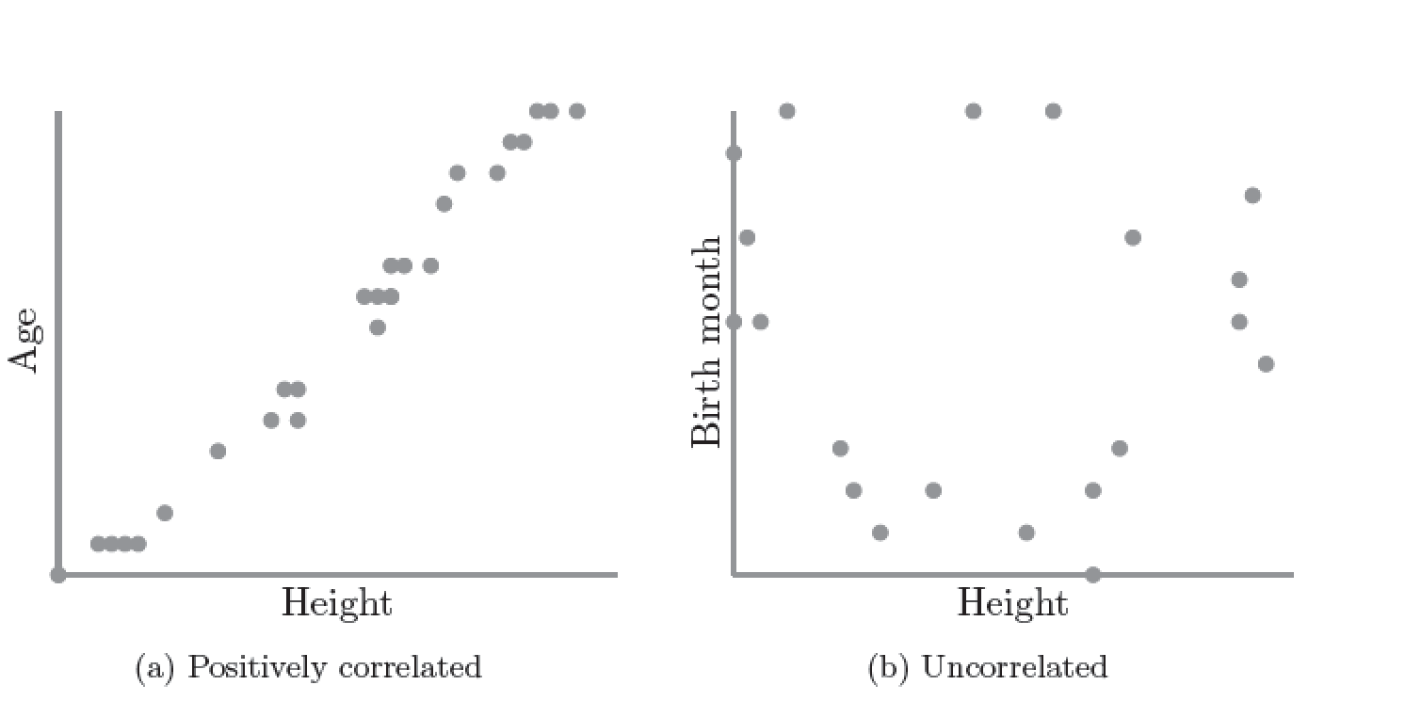
Correlation
S. Kleinberg (2015) Why: A Guide to Finding and Using Causes. O’Reilly Media.

Slide 13
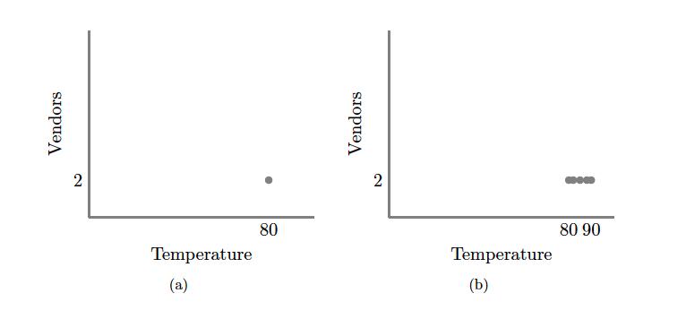
S. Kleinberg (2015) Why: A Guide to Finding and Using Causes. O’Reilly Media.
Notes:
No correlation without variation. Note: this is what happens if you ask only winners why they won

Slide 14
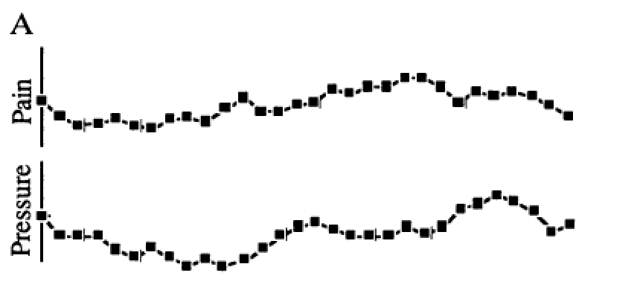
Redelmeier DA, Tversky A (1996) On the belief that arthritis pain is related to the weather. Proceedings of the National Academy of Sciences 93(7):2895-2896.
Notes:
XX look up original ref for this
Fig. 1A were judged as positively related by 87%, as negatively related by 2%, and as unrelated by 11% of participants.
It is correlated

Slide 15
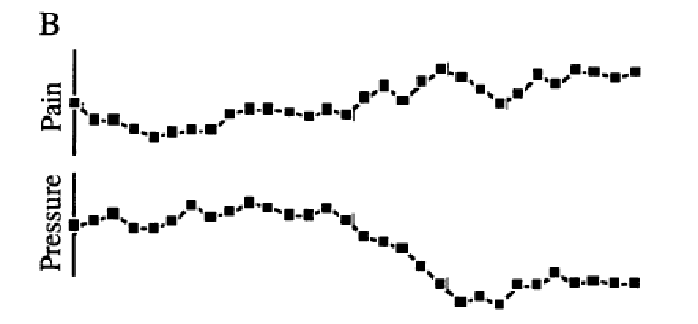
Redelmeier DA, Tversky A (1996) On the belief that arthritis pain is related to the weather. Proceedings of the National Academy of Sciences 93(7):2895-2896.
Notes:
The two uncorrelated sequences in Fig. 1B were judged as positively related by 3%, as negatively related by 79%, and as unrelated by 18% of participants.

Slide 16
Correlation = 0!
Redelmeier DA, Tversky A (1996) On the belief that arthritis pain is related to the weather. Proceedings of the National Academy of Sciences 93(7):2895-2896.
Notes:
XX test students
Cognitive bias
Fig. 1A were judged as positively related by 87%, as negatively related by 2%, and as unrelated by 11% of participants. The two uncorrelated sequences in Fig. 1B were judged as positively related by 3%, as negatively related by 79%, and as unrelated by 18% of participants.

Slide 17
Scatter Plots and Correlation
A correlation analysis measures of association (relationship) between two variables
These variables change together
Usually scale (interval or ratio) variables
Analysis techniques limited to linear relationships

Slide 18
What is “Linear”?
Remember this:
Y=mX+B?
m (slope)
B (intercept)
Adapted from: http://www.sjsu.edu/people/steven.macramalla/courses/stats95/s1/lecture 10
Notes:
A slope of 2 means that every 1-unit change in X yields a 2-unit change in Y.

Slide 19
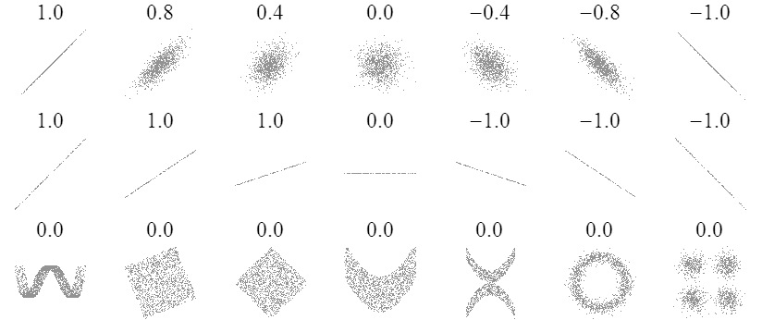
Sample Correlations
Adapted from: http://www.sjsu.edu/people/steven.macramalla/courses/stats95/s1/lecture 10
19

Slide 20
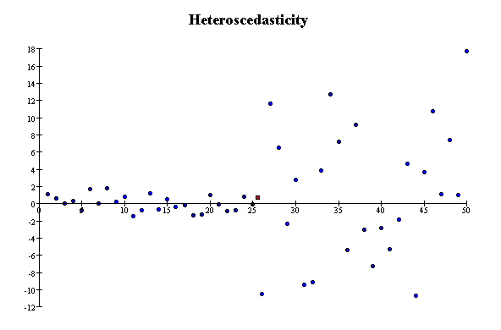
Correlation Assumptions
Key Assumptions:
X values are normally distributed within the population (for each Y)
Y values are normally distributed within the population (for each X)
X and Y have a linear relationship
There are no significant outliers
Scatter doesn’t vary over X or Y

Slide 21
Residual Analysis for Linearity
y
y
x
x
residuals
x
x
residuals
✓
Not Linear
Linear
Slide from: Statistics for Managers Using Microsoft® Excel 4th Edition, 2004 Prentice-Hall

Slide 22
Residual Analysis for Constant Variance (Homoscedasticity)
y
y
x
x
residuals
x
x
residuals
✓
Non-constant variance
Constant variance
Slide from: Statistics for Managers Using Microsoft® Excel 4th Edition, 2004 Prentice-Hall

Slide 23
Residual Analysis for Independence
✓
Not Independent
Independent
residuals
X
residuals
X
residuals
X
Slide from: Statistics for Managers Using Microsoft® Excel 4th Edition, 2004 Prentice-Hall

Slide 24
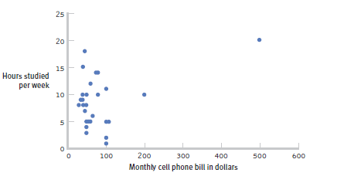
The effect of outliers
One outlier changed the correlation from -0.14 to 0.39!
Adapted from: http://www.sjsu.edu/people/steven.macramalla/courses/stats95/s1/lecture 10
Notes:
Note negative to positive change among other things
----- Meeting Notes (2/19/15 10:00) -----
cook's distance

Slide 25
Pearson Correlation Coefficient
(continued)
The population correlation coefficient ρ (rho) measures the strength of the association between the variables
The sample correlation coefficient r is an estimate of ρ and is used to measure the strength of the linear relationship in the sample observations
Adapted from http://www.fordham.edu/economics/Vinod/correl-regr.ppt

Slide 26
Features of ρ and r
Unit free
Range between -1 and 1
The closer to 0, the weaker the linear relationship
Adapted from http://www.fordham.edu/economics/Vinod/correl-regr.ppt

Slide 27
Calculating the Pearson Correlation Coefficient
Sample correlation coefficient:
or the algebraic equivalent:
where:
r = Sample correlation coefficient
n = Sample size
x = Value of the independent variable
y = Value of the dependent variable
Adapted from http://www.fordham.edu/economics/Vinod/correl-regr.ppt

Slide 28
Measuring correlation
Cups of coffee (X) vs. correct test answers (Y)
X | Y
0 | 1
1 | 1
3 | 3
4 | 5
5 | 5
Notes:
Mean of X 2.6, mean of y 3
Coffee is as related to correct answers as vice versa

Slide 29
Correlation is not Causation
There is a 0.91 correlation between ice cream consumption and drowning deaths.
Does eating ice cream cause drowning?
Does grief cause us to eat more ice cream?
Adapted from: http://www.sjsu.edu/people/steven.macramalla/courses/stats95/s1/lecture 10

Slide 30
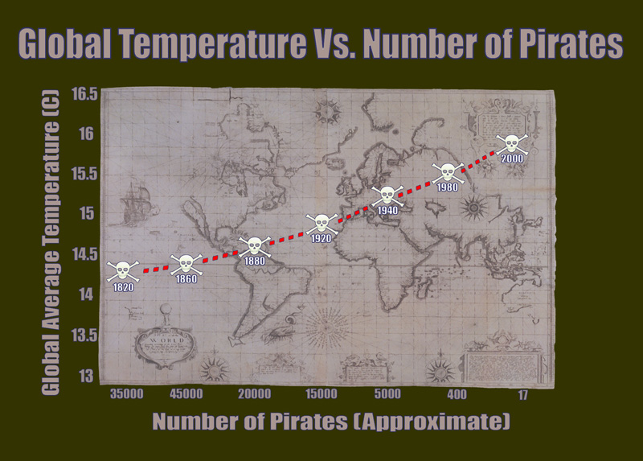
Correlation without causation (1)
http://bama.ua.edu/~sprentic
Notes:
http://bama.ua.edu/~sprentic/101%20Psych%20&%20Life--Correlation-causation.htm
But why shouldn’t we use pirates to predict temperature?
Now, why do we think pirates don’t cause global warming, or global warming doesn’t cause piracy?

Slide 31
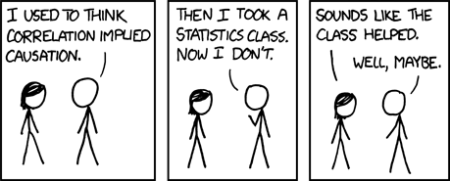
Correlation != Causality
Adapted from http://www.fordham.edu/economics/Vinod/correl-regr.ppt

Slide 32
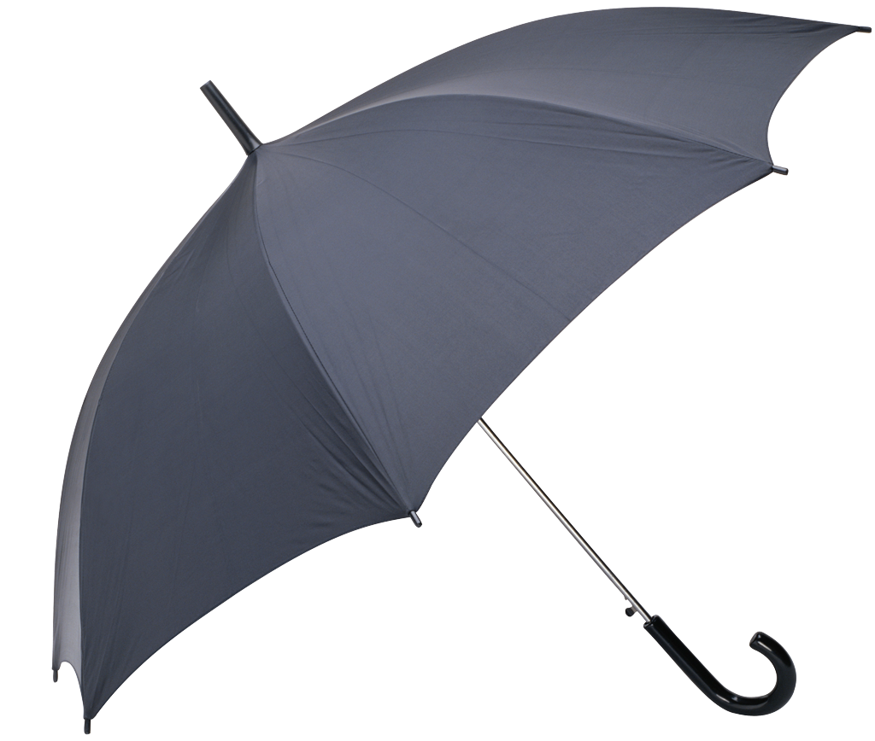
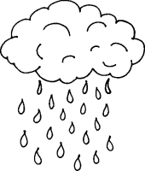
Correlation with some causation
Notes:
Directionality = why we can’t use it for prediction!
Umbrella vendors out before rain
Observe out of order

Slide 33
Correlation Summary
Measures association (linear relationship) between two variables
These variables change together
Usually scale (interval or ratio) variables
Limited in its applicability to normal, linearly related data with consistent scatter and no outliers
Often mistaken for causation
Notes:
changes in a few data-analysis decisions can increase the false-positive rate in a single study to 60%.

Slide 34
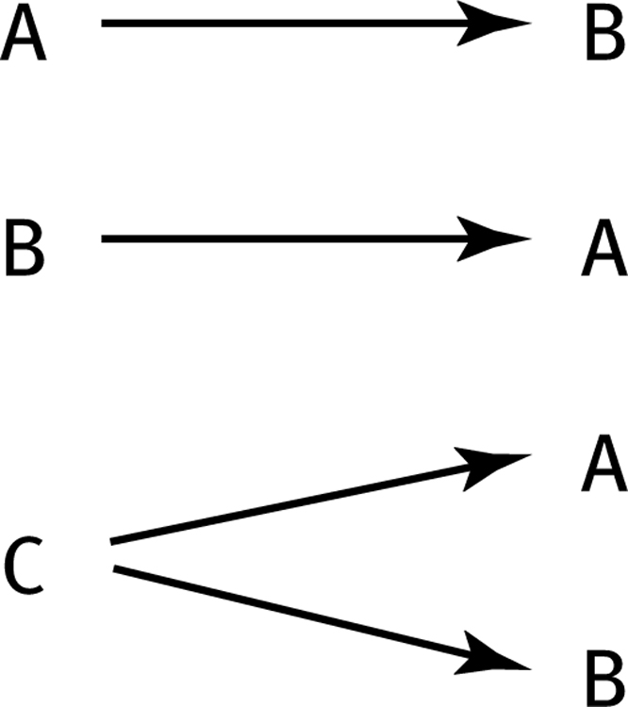
How can we test these associations?
Three Possible Causal Explanations for a Correlation
Adapted from: http://www.sjsu.edu/people/steven.macramalla/courses/stats95/s1/lecture 10

Slide 35
How can we test these associations?
Three Possible Causal Explanations for a Correlation
Adapted from: http://www.sjsu.edu/people/steven.macramalla/courses/stats95/s1/lecture 10
Notes:
Special case for C: C = Time (shared change over time)

Slide 36
Correlation Summary
Measures association (linear relationship) between two variables
These variables change together
Usually scale (interval or ratio) variables
Limited in its applicability to normal, linearly related data with consistent scatter and no outliers
Often mistaken for causation
Cannot easily determine if there is a mediating variable
Notes:
changes in a few data-analysis decisions can increase the false-positive rate in a single study to 60%.

Slide 37
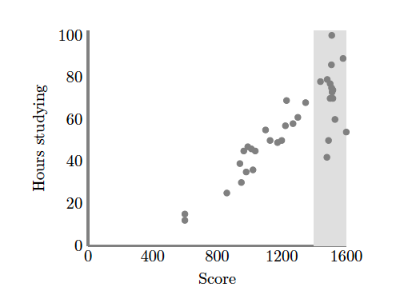
Causation without correlation
S. Kleinberg (2015) Why: A Guide to Finding and Using Causes. O’Reilly Media.
Notes:
Restricted range. Only observing grey area
Illustrate restricted range on board. When else does that happen? Surveying political website users

Slide 38
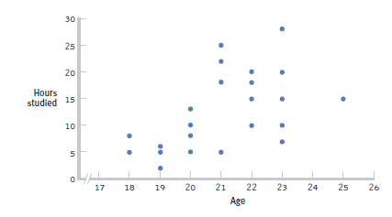
Restricted Range: Sampling Bias
Boys and girls who performed in the top 2% to 3% on standardized
Adapted from: http://www.sjsu.edu/people/steven.macramalla/courses/stats95/s1/lecture 10
Notes:
tests - a much smaller range than the full population from which the researchers could have drawn their sample.

Slide 39
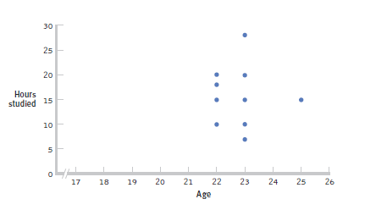
Further Restrictions
Only students between the ages of 22 and 25: r= 0.05.
Adapted from: http://www.sjsu.edu/people/steven.macramalla/courses/stats95/s1/lecture 10

Slide 40
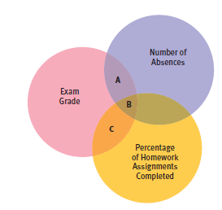
Partial Correlation
Quantifies the degree of association between two variables after statistically removing the association of a third variable with both of those two variables.
e.g., number of absences and exam grade, over and above the correlation of percentage of completed homework assignments with these variables.
Adapted from: http://www.sjsu.edu/people/steven.macramalla/courses/stats95/s1/lecture 10

Slide 41
Simpson’s Paradox
http://en.wikipedia.org/wiki/Simpson's_paradox
Introducing another variable may change our understanding of the data
It may even reverse the initial conclusions

Slide 42
A situation where the subgroups are always the way to go
 | Treatment A | Treatment B
Small Stones | Group 1 93% (81/87) | Group 2 87% (234/270)
Large Stones | Group 3 73% (192/263) | Group 4 69% (55/80)
Both | 78% (273/350) | 83% (289/350)
Notes:
Which data should we consult in choosing an action, the aggregated or the partitioned?
Kidney Stone example above, it is clear that if one is diagnosed with "Small Stones" or "Large Stones" the data for the respective subpopulation should be consulted and Treatment A would be preferred to Treatment B.
what if a patient is not diagnosed, and the size of the stone is not known; would it be appropriate to consult the aggregated data and administer Treatment B? This would stand contrary to common sense; a treatment that is preferred both under one condition and under its negation should also be preferred when the condition is unknown.

Slide 43
Gender Discrimination?
 | Applicants | Admitted
Men | 8442 | 44%
Women | 4321 | 35%
Notes:
On the other hand, if the partitioned data is to be preferred a priori, what prevents one from partitioning the data into arbitrary sub-categories (say based on eye color or post-treatment pain) artificially constructed to yield wrong choices of treatments?
Pearl[2] shows that, indeed, in many cases it is the aggregated, not the partitioned data that gives the correct choice of action.
Worse yet, given the same table, one should sometimes follow the partitioned and sometimes the aggregated data, depending on the story behind the data; with each story dictating its own choice. Pearl[2] considers this to be the real paradox behind Simpson's reversal.

Slide 44
Gender Discrimination?
Dept | Men | Women
A | 825/62% | 108/82%
B | 560/63% | 25/68%
C | 325/37% | 593/34%
D | 417/33% | 375/35%
E | 191/28% | 393/24%
F | 373/6% | 341/7%
Bickel et al.[13]: women tended to apply to competitive departments with low rates of admission (English), men tended to apply to less-competitive departments with high rates of admission engineering and chemistry)

Slide 45
Correlation Summary
Measures association (linear relationship) between two variables
These variables change together
Usually scale (interval or ratio) variables
Limited in its applicability to normal, linearly related data with consistent scatter and no outliers
Often mistaken for causation
Cannot easily determine if there is a mediating variable
Range restriction & other manipulations can affect or even reverse outcomes (Simpson’s paradox)
Notes:
changes in a few data-analysis decisions can increase the false-positive rate in a single study to 60%.

Slide 46
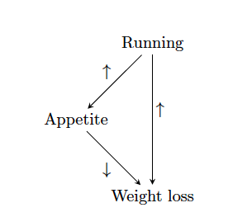
Strangely…
Causation also does not imply correlation
S. Kleinberg (2015) Why: A Guide to Finding and Using Causes. O’Reilly Media.

Slide 47
Causation without correlation
Treatment
 | Dead | Alive
A | 85 | 215 (72%)
B | 59 | 241 (80%)
Total | 144 | 456
Notes:
Treatment B is standard, A is experimental approach
Who wants treatment A and who wants treatment B?

Slide 48
Causation without correlation (2)
Treatment | Men |  | Women |  | Combined
 | Dead | Alive | Dead | Alive | Dead | Alive
A | 80 | 120 (60%) | 5 | 95 (95%) | 85 | 215 (72%)
B | 20 | 20 (50%) | 39 | 221 (85%) | 59 | 241 (80%)
Total | 100 | 140 | 44 | 316 | 144 | 456
Baker SG, Kramer BS (2001) Good for women, good for men, bad for people: Simpson's paradox and the importance of sex-specific analysis in observational studies. Journal of women's health & gender-based medicine 10: 867-872
Notes:
http://www.ncbi.nlm.nih.gov/pubmed/11747681
Ask: so what actually happened?
Levels of granularity matter!!!
Men have higher mortality rate, and more of them got treatment A than B, biasing the sample and vice versa with women.

