Slide 1

P peline
The Data
Proving Causality
© Jennifer Mankoff
The Data Pipeline; HCII; Spring 2014

Slide 2
Causality
How do we infer causality?
How do we prove it?
Why is it hard to prove causality
Why do we need to prove causality?
Diagram the relationships between variables
Explain the concept of causation

Slide 3
Process vs Frequency data
Formulate
hypotheses
(Collect) & Analyze data to test hypotheses
(Bayesian inference) (Statistical inference)

Slide 4
Process vs Frequency Data
Potential for Logical Error
Potential for Systematic Error
Formulate
hypotheses
(Collect) & Analyze data to test hypotheses

Slide 5
Process vs Frequency Data
Formulate
hypotheses
(Collect) & Analyze data to test hypotheses
Potential for
Random Error;
Errors of Interpretatino
Evaluate hypotheses
Notes:
Random error (chance) can be controlled by statistical significance
or by confidence interval

Slide 6
Inference
Blends background knowledge & data
Estimates actual ratio in the population at large of things being tested for
Bayesian in nature
Helps provide grounding for what is expected in your data, lets you judge if there is sample bias, etc.

Slide 7
Theory vs empiricism
Theoretical definition
Empirical definition
Contiguity
Temporal priority
Necessary connection
Contiguity
Temporal priority
Constant conjunction
Adapted from class by Samantha Kleinberg
Notes:
Contiguity: cause and effect are nearby
Temporal priority: cause occurs prior to effect
Constant conjunction: cause regularly followed by effect

Slide 8
INUS condition
A cause is an insufficient (I) but non-redundant (N) part of an unnecessary (U) but sufficient condition (S)
Adapted from class by Samantha Kleinberg

Slide 9
INUS example
Lit match (C) may cause house fire (E)
Many cases where lit match does not cause fire
Many cases of fire without lit match (Y)
For lit match to cause fire, need oxygen, flammable materials, etc. (X)
C
E
y
Adapted from class by Samantha Kleinberg

Slide 10
INUS conditions summary
X are conditions needed for C to cause the effect
Y is a set of sufficient conditions for E
C is INUS condition of E iff:
For some X and some Y (CX or Y) is necessary and sufficient condition of E
C is not a sufficient condition of E
X is not a sufficient condition of E
There are sets of conditions that result in effect, cause is necessary part of one of those sets.
Adapted from class by Samantha Kleinberg

Slide 11
Problems for INUS
Insufficient to rule out spurious relationships
Common cause of two effects
Chance regularities
Strength of contribution
Relative nature
Adapted from class by Samantha Kleinberg

Slide 12
Murder mystery
June 27, 2005: A sleepwalker, Benjamini Adoyo goes to sleep disorder clinic. Had been wandering through house, and sometimes shaking his wife while standing over her and babbling. He had no memory of these episodes.
August 10, 2005: After sleep study, center says he has non-REM parasomnia.
October 17, 2005: Visits clinic again. Medication increased.
October 19, 2005: Adoyo is arrested and charged with killing his wife
In general, parasomniacs can kill people with no intention, awareness or memory of committing the crime
Is it murder or a result of his sleep disorder?
The Case of the Sleeping Slayer. Scientific American, September 2012, p 34-39.

Slide 13
Sleepwalker or murderer?
911 call, 3:41 am October 19, 2005
Confessed, but was confused and asked about wife’s welfare
Core question: parasomnia was known prior to incident, but was it the cause of wife’s murder?
Operator: What’s going on?
Adoyo: You just get here
Operator: You need to tell me what’s going on.
Adoyo: Somebody is dead
Operator: Somebody is dead?
Adoyo: Yes.
Operator: Where are they at?
Adoyo: In their house. Somebody is dead. Get here.
Adapted from class by Samantha Kleinberg

Slide 14
The verdict
Wasn’t nearby wife (proximity is important)
Usually no motive, but had been arguing with wife
Assaulted wife in bedroom with hammer, chased into hall & bathroom, stabbed and strangled her
Unusual to see so many mechanisms at once
Adoyo pled guilty to second degree murder
Adapted from class by Samantha Kleinberg

Slide 15
Another Example (take this home)
Sally Clark’s 1st son died in 1996, as a result of SIDS
Her 2nd son died in 1999, also as a result of SIDS
Prosecutors argued too unlikely to both be SIDS, must be murder.
Chance of SIDS = 1/8,543 so chance of 2 deaths = 1/(8,543*8,543) (approx 1 in 73 million)
What’s wrong with this?
Adapted from class by Samantha Kleinberg
Notes:
Meadow took a report estimating the chance
of SIDS as 1 in 8,543 and then said two would be one in 8,543*8,543 – approximately
73 million.1
Have you ever said it’s too unlikely to be true? Something unlikely has already happened!
Issue #1: may be an underlying comon cause
Issue #2: probability of an event != probability of guilt or innocence. Why not? Any low probability event will eventually occur (e.g. someone winning the lottery).
Need to compare probability of two SIDS against probability of two murders
Clark spent 3 years in prison.

Slide 16
Probabilities from data
How to determine probability of heads/tails from coin flip?
Frequency of event x
#(x) = number of times it is observed
Relative frequency
#(x)/N, where N is number of observations
As N→∞, relative frequency →P(x)
Adapted from class by Samantha Kleinberg

Slide 17
Probabilistic causality: basic idea
C causes E if
P(E|C)>P(E)
Or P(E|C)>P(E|¬C)
Adapted from class by Samantha Kleinberg

Slide 18
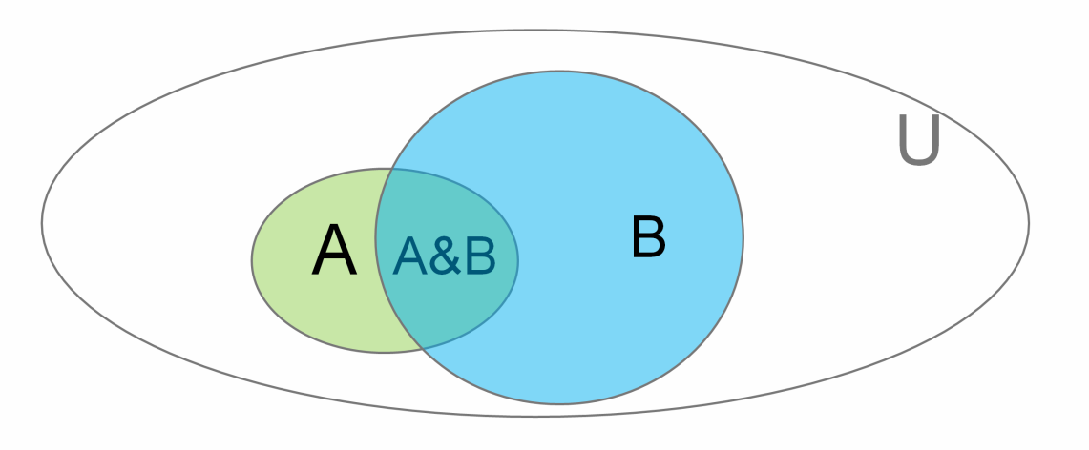
Bayes Rule
We write P(A | B) to denote
“Probability of A given B” (or “… assuming B”)
or
“If we know B is true, what’s the probability of A”

Slide 19
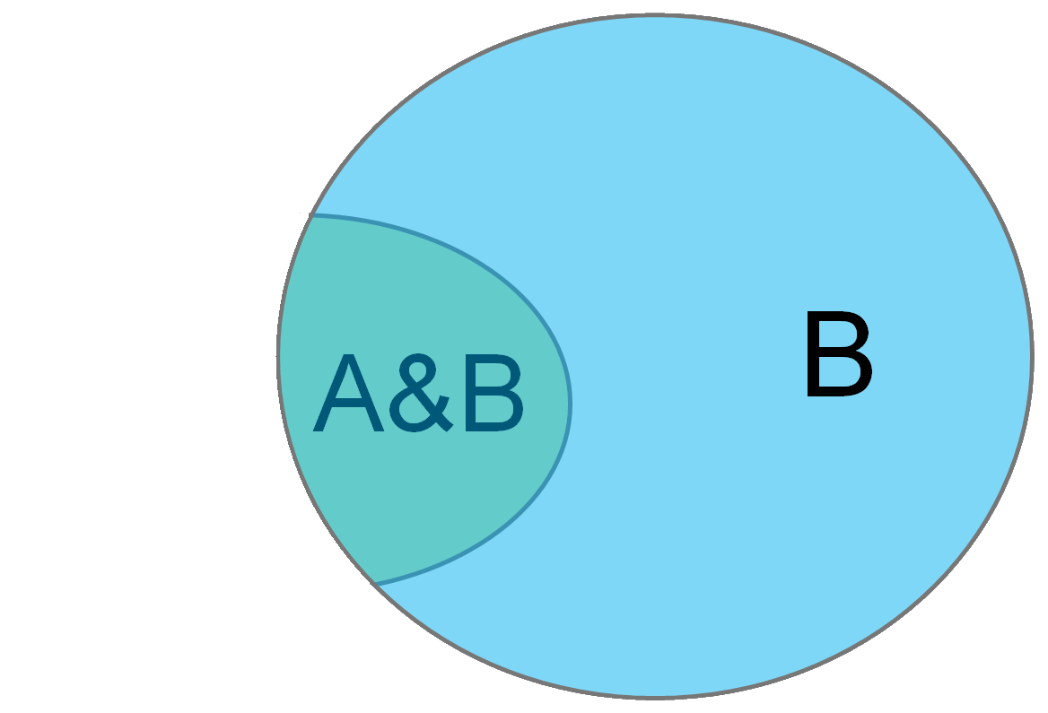
Conditional Probability
P(A | B) - “Probability of A given B”
You can think of this as just a change of universe
Probability of A treating B as the universe
→

Slide 20
Conditional Probability
P(A| B)
= |A&B|
|B|

Slide 21
Conditional Probability
P(A| B)
Divide top and bottom by |U| …
|A&B|
= |U| = P(A&B)
|B| P(B)
|U|

Slide 22
Conditional Probability
P(A| B) = P(A&B)
P(B)
P(B| A) =
P(A&B)
P(A)

Slide 23
Conditional Probability
P(A| B) = P(A&B)
P(B)
P(B| A) =
P(A&B) = P(B|A)*P(A) = P(A|B)*P(B)
So… P(A|B) = P(B|A)*P(A)
P(B)
P(A&B)
P(A)

Slide 24
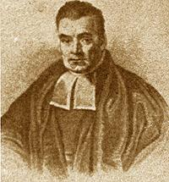
Bayes Law
http://en.wikipedia.org/wiki/Bayes'_theorem
http://yudkowsky.net/rational/bayes
http://oscarbonilla.com/2009/05/visualizing-bayes-theorem/
Bayes Law (AKA Bayes theorem):
Rev. Thomas Bayes 1702-1761
P(B | A) P(A)
P(A | B) =
P(B)

Slide 25
Why is that true?

Slide 26
Why is that true?
P(A | B) = P(A&B)
P(B)

Slide 27
Why is that true?
P(A | B) = P(A&B)
P(B) → P(A | B)P(B)= P(A&B)

Slide 28
Why is that true?
P(A | B) = P(A&B)
P(B) → P(A | B)P(B)= P(A&B)
Now the converse
P(B | A) = P(A&B)
P(A) → P(B | A)P(A)= P(A&B)

Slide 29
Why is that true?
P(A | B) = P(A&B)
P(B) → P(A | B)P(B)= P(A&B)
Now the converse
P(B | A) = P(A&B)
P(A) → P(B | A)P(A)= P(A&B)
P(A | B)P(B) = P(B | A)P(A)

Slide 30
Why is that true?
P(A | B) = P(A&B)
P(B) → P(A | B)P(B)= P(A&B)
Now the converse
P(B | A) = P(A&B)
P(A) → P(B | A)P(A)= P(A&B)
P(A | B)P(B) = P(B | A)P(A) divide by P(B)

Slide 31
Why is that true?
P(A | B) = P(A&B)
P(B) → P(A | B)P(B)= P(A&B)
Now the converse
P(B | A) = P(A&B)
P(A) → P(B | A)P(A)= P(A&B)
P(A | B)P(B) = P(B | A)P(A) divide by P(B)
P(B | A) P(A)
P(A | B) =
P(B)

Slide 32
Bayes Law
Bayes Law (AKA Bayes theorem):
Rev. Thomas Bayes 1702-1761
P(B | A) P(A)
P(A | B) =
P(B)

Slide 33
Bayes rule
Probability of disease (d) is 0.001
But diagnostic test not foolproof
P(+|d) = 0.98
P(+|¬d) = 0.1
Given a positive test, what’s probability patient has disease?
Adapted from class by Samantha Kleinberg

Slide 34
Example continued
Adapted from class by Samantha Kleinberg

Slide 35
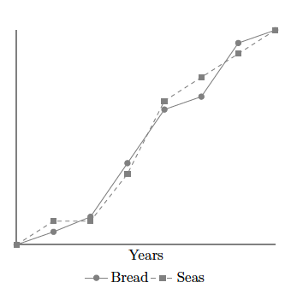
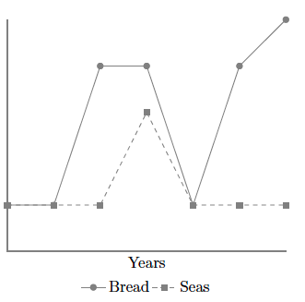
Problem: Nonstationarity
Sober, E. (2001). Venetian sea levels, British bread prices, and the principle of the common cause. The British Journal for the Philosophy of Science, 52(2), 331

Slide 36
Problem: Indeterminism
If lamp on, tv also on, so P(L|T)=1
Does switch screen off L and T?
0.9
lamp
switch
0.9
tv
Adapted from class by Samantha Kleinberg

Slide 37
Problem: Overdetermination
Bob and Susie throwing rocks at glass bottle
Rocks hit simultaneously, but Susie threw first
Susie Aims
Susie Throws
Bob Aims
Bob Throws
Glass Breaks
Time

Slide 38
Problem: Preemption
Bob’s rock arrives first and breaks glass
But Susie still threw first and has perfect aim (breaks glass with P=1)
Susie Aims
Susie Throws
Bob Aims
Bob Throws
Glass Breaks
Time

Slide 39
Seatbelt should prevent death, but causes it

Slide 40

Probability trajectory
Y
P(Y) changes at x
After x P(Y) is high
P is higher than before x
P remains high until y
Was Because Of!
x
Notes:
Eg Seatbelt should prevent death, but causes it
Image from: http://www.springerlink.com/content/vm062877643u8209/fulltext.pdf
http://carsguide.110mb.com/?l=Golf_ball
“A novice golfer swings at a golf ball and the ball begins rolling toward the cup. But a
squirrel comes along and kicks the ball away. Kicks of exactly this kind have a tendency to
prevent balls from making a birdie (reducing the probability of a birdie, say, from 0.5
to 0.1). Improbably enough (since there is only 10% of chance to make a birdie) and
luckily for the golfer, in this particular case, the ball comes off the squirrel’s foot on a
new trajectory (increasing the probability of a birdie to 0.7) to roll into the cup for a birdie
at a later time.”

Slide 41
The probability of death (D) within 30 minutes of poisoning (O) is 0.8
But if an antidote (A) is given within 10 minutes of poisoning, the probability of death is reduced to 0.001
However the antidote has occasional side effects, so the probability of death when an antidote is given in the absence of the poison is still 0.001
Is O a cause of death? Is A?

Slide 42
Poison and antidote
P(D|O)=0.8 in 30 minutes
P(D|A^O)=0.001 if within 10 minutes of O
P(D|A^¬O)=0.001
Are A and O positive, negative, neutral or mixed? Better handled by Suppes or Eells?
Can impact on a specific instance be different than that at type level? When?

Slide 43

Poison and antidote
X X
1
0.8
P(death)
0.001
antidote
t
Notes:
http://en.wikipedia.org/wiki/Poison

Slide 44
Why are background contexts needed?
What if poison and antidote are administered at same time?
What about exposure that provides resistance to later bacteria?

Slide 45
Counterexample (sort of)
C likely to survive until t2 but not a later time
P(death|A)=P(death|disease)
P(death|cure)=0
BUT residual chance of death from A
C
A
B
Patient
Ineffective drug
Cure
t
t1
t2
time

