Slide 1
ECON-UB-232-Data-Bootcamp
Analyzing the Drivers of Yelp Restaurant Ratings
Helen Tu & Siye Li
Data Bootcamp · Midterm Project · Yelp Open Dataset (yelp.com/dataset)

Slide 2
Dataset Overview
67,533
23
200K
20+
Restaurants
Features
Reviews Sampled
Cities Covered
filtered from 150,346 total
numeric & categorical mix
of 6M+ in full dataset
US and Canada
Data Sources
yelp_academic_dataset_business.json
150,346 business records — location, categories, attributes, aggregate ratings
yelp_academic_dataset_review.json
6M+ individual reviews — sampled 200K; 50K used for sentiment analysis
yelp_academic_dataset_checkin.json
131,930 check-in records — used for engagement feature engineering
7 Research Sub-Questions: Price Tier · Review Volume · Cuisine Type · Geography · Operating Hours · Amenities · Review Sentiment

Slide 3
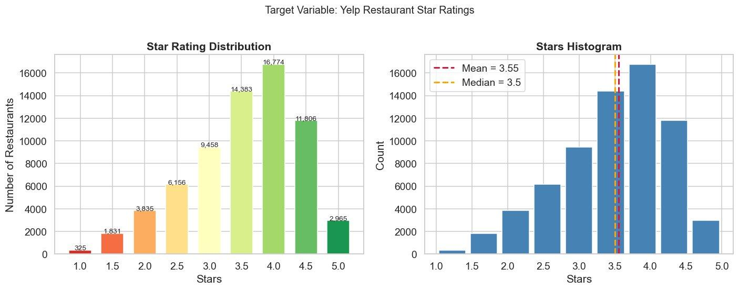
Target Variable: Star Rating Distribution
3.55★ Mean Rating
3.5★ Median Rating
4.0★ Modal Rating
16,774 Restaurants at 4.0★

Slide 4
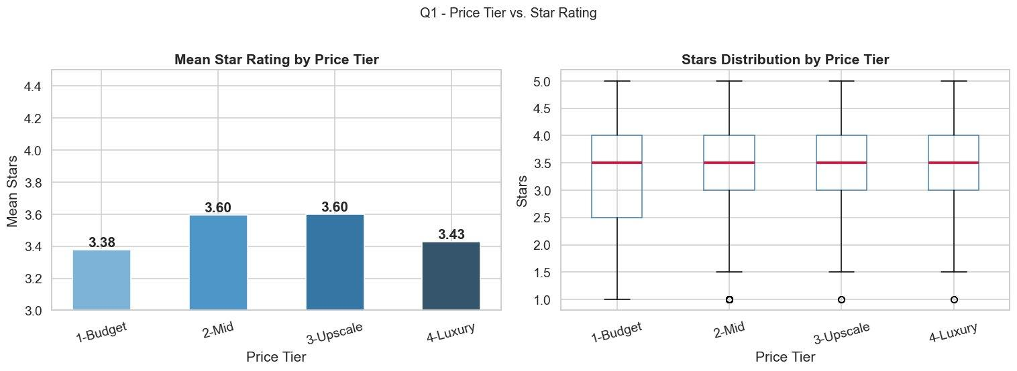
Q1 — Does Price Tier Affect Star Ratings?
Key Finding
ANOVA F = 330.79 p < 0.001 Non-monotonic pattern: $ Budget: 3.38★ $$ Mid: 3.60★ $$$ Upscale: 3.60★ $$$$ Luxury: 3.43★ Mid-range hits the
value-for-money sweet spot.
Insight: Luxury ($$$$) restaurants average lower than mid-range, likely due to higher diner expectations driving stricter ratings.

Slide 5
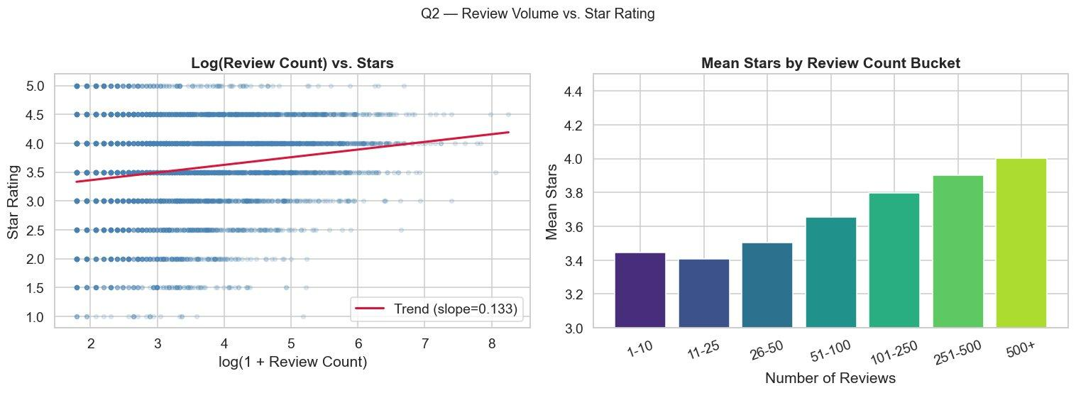
Q2 — Does Review Volume Correlate with Ratings?
Key Finding
Pearson r = +0.180 p < 0.001 Weak but significant positive correlation. 1–10 reviews: 3.45★ 500+ reviews: 4.00★ Slope = +0.133
(log scale)
Insight: Popular restaurants accumulate more reviews — quality drives both popularity and rating (survivorship effect).

Slide 6
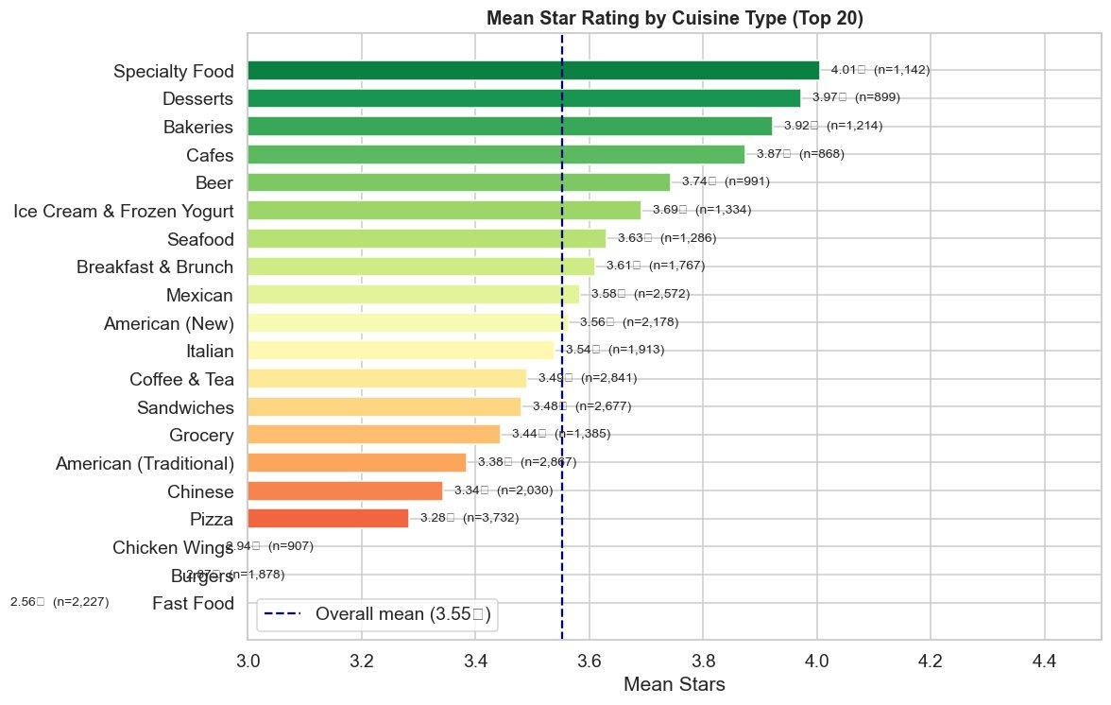
Q3 — Which Cuisine Categories Rate Highest & Lowest?
🏆 Highest
Specialty Food
4.01★ (n=1,142)
Desserts
3.97★ (n=899)
Bakeries
3.92★ (n=1,214)
⚠ Lowest
Fast Food
2.56★ (n=2,227)
Burgers
~3.0★ (n=1,878)
Pizza
3.28★ (n=3,732)
Insight: ≈1.5-star spread between top and bottom cuisines. Artisanal/specialty categories attract enthusiast audiences with lower complaint thresholds.

Slide 7
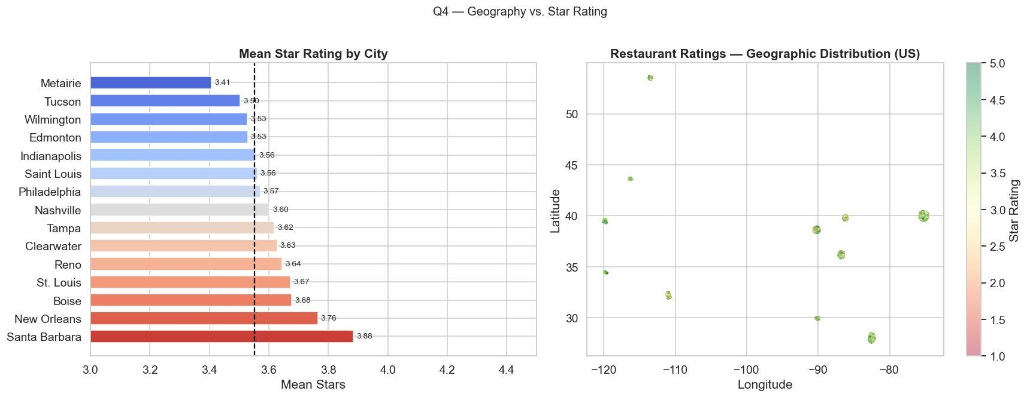
Q4 — Does Geographic Location Explain Ratings?
F = 29.12
p < 0.001
3.88★
3.41★
ANOVA statistic
Significance
Santa Barbara (Highest)
Metairie (Lowest)

Slide 8
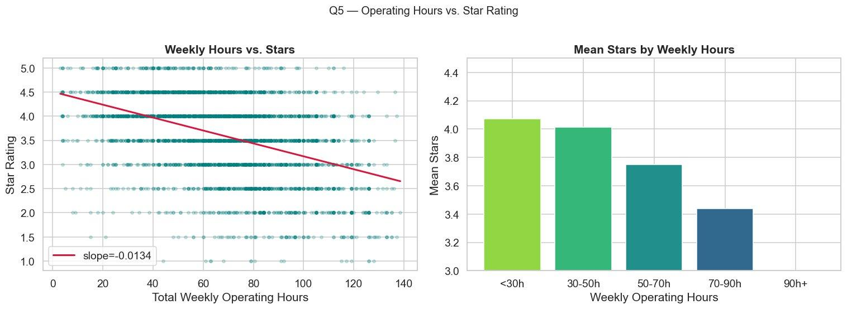
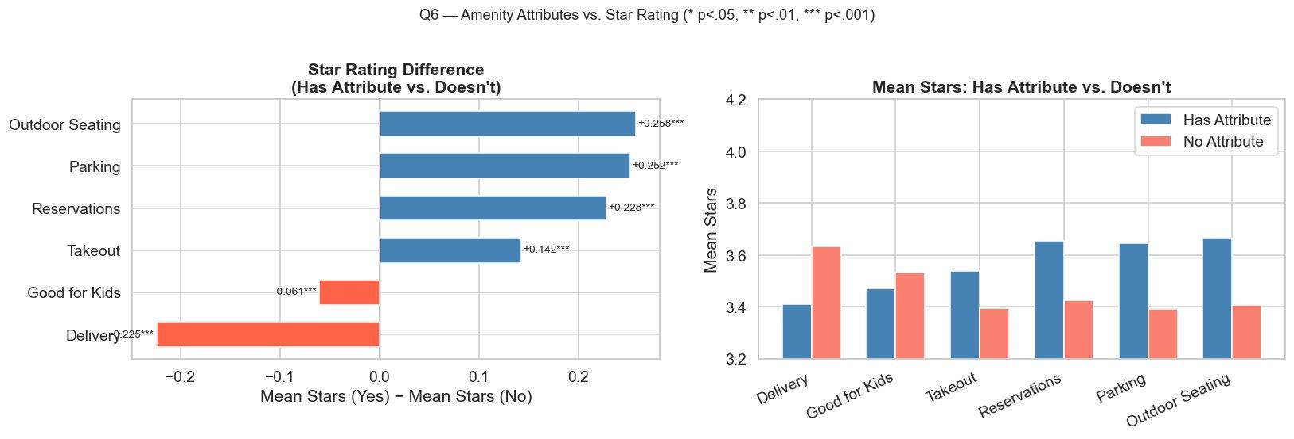
Q5 — Operating Hours & Q6 — Amenity Attributes
Operating Hours vs. Stars
Amenities vs. Stars (Mann-Whitney U)
r = −0.443 (p < 0.001) · Fewer hours = higher ratings
<30h/wk avg 4.07★ vs 70–90h/wk avg 3.44★
Outdoor Seating +0.258★ · Parking +0.252★ · Reservations +0.228★
Delivery −0.225★ (signals fast-food/chain establishments)
Insight: Shorter hours & upscale amenities both proxy for specialty/fine-dining venues, which consistently rate higher.

Slide 9
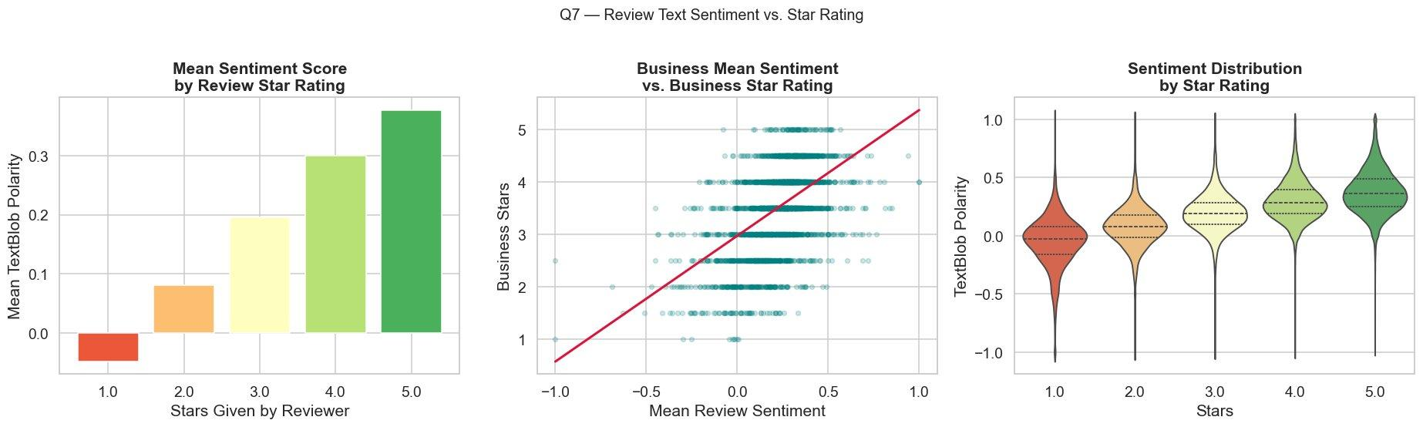
Q7 — Does Review Sentiment Align with Star Ratings?
Sentiment
by Star Tier
1★: −0.04
2★: +0.08
3★: +0.20
4★: +0.30
5★: +0.36
TextBlob polarity
(−1 to +1)
Insight: Sentiment rises monotonically with stars — validating that review text and numeric ratings capture consistent signals.

Slide 10
Multivariate Analysis — Regression & Correlation
Feature | Effect on Stars
Weekly Hours (r = −0.443) | ⬇ Strongest negative predictor
Outdoor Seating (+0.258★) | ⬆ Largest positive amenity effect
Parking (+0.252★) | ⬆ Strong positive amenity
Reservations (+0.228★) | ⬆ Signals upscale dining
Delivery (−0.225★) | ⬇ Signals fast-food/chain
Log Review Count (r = +0.180) | ⬆ Weak positive (survivorship)
R² = 0.248
9 features explain
~25% of rating variance
(n = 23,516)
Structural features explain ~25% of variance in star ratings. The remaining ~75% reflects idiosyncratic reviewer behavior, food quality, service, and factors not captured in business metadata. Operating hours emerged as the single strongest predictor (r = −0.443), acting as a proxy for restaurant type — specialty venues operate fewer hours and rate higher.
OLS Regression with StandardScaler normalization · 9 predictors · complete-case analysis

Slide 11
Key Conclusions
1
Price isn't everything
4
Fewer hours → better ratings
Mid-range ($$/$$$) hits the value-for-money sweet spot. Luxury ($$$$) disappoints relative to expectations.
r = −0.443: specialty/artisanal restaurants work shorter hours and rate much higher than long-hours chains.
2
Popular = higher-rated
5
Amenities signal quality tier
Restaurants with 500+ reviews average 4.0★ vs 3.45★ for low-review places — survivorship bias at work.
Outdoor seating & reservations = higher ratings. Delivery = lower. The attribute reveals the restaurant type.
3
Cuisine type matters most visually
6
Sentiment validates stars
≈1.5-star spread from Specialty Food (4.01★) to Fast Food (2.56★). Audience composition drives this gap.
TextBlob polarity rises monotonically from −0.04 (1★) to +0.36 (5★), confirming internal consistency.

Slide 12
ECON-UB-232-Data-Bootcamp
Thank You!
Helen Tu & Siye Li
Data Bootcamp · Midterm Project · Yelp Open Dataset (yelp.com/dataset)

