Slide 1
Testing the "Ringl" application
Completed:
Batura Kseniya
Vezhnavets Alina
Vlasik Ilona
Voitovich Helen

Slide 2
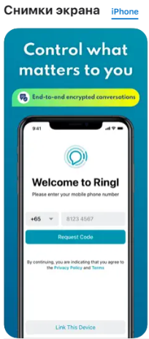
About the app
Ringl is a secure platform for all your communication needs. Users can exchange end-to-end encrypted messages, share files, make free voice, and video calls.
Your communication belongs to you:
- Secure free high-quality voice and video calls with no time limit.
- End-to-end encrypted conversations by default ensure data privacy and security.
- Additional protection and privacy in Secure Groups with unique encryption keys.

Slide 3
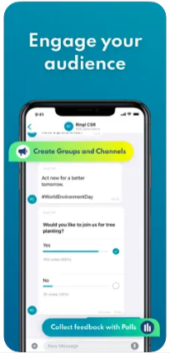
Streamline all communication with messaging, voice and video calls, files sharing
- Host online communities and reach an unlimited audience with public/ private groups and channels.
- Synchronize all messages across mobile and desktop (up to 3 linked devices).
- Easily share large videos & documents of any type up to 100 MB.
- Remove language barriers with real-time offline translation of chats
Flexible and powerful privacy features help protect your personal data
- Protect sensitive information with Confidential Content.
- Hide your conversations with Hidden Chats.
- Receive screenshot notifications.
- Enhance your online privacy and protect your data on unsecured networks with our in-app VPN that works throughout your device.

Slide 4
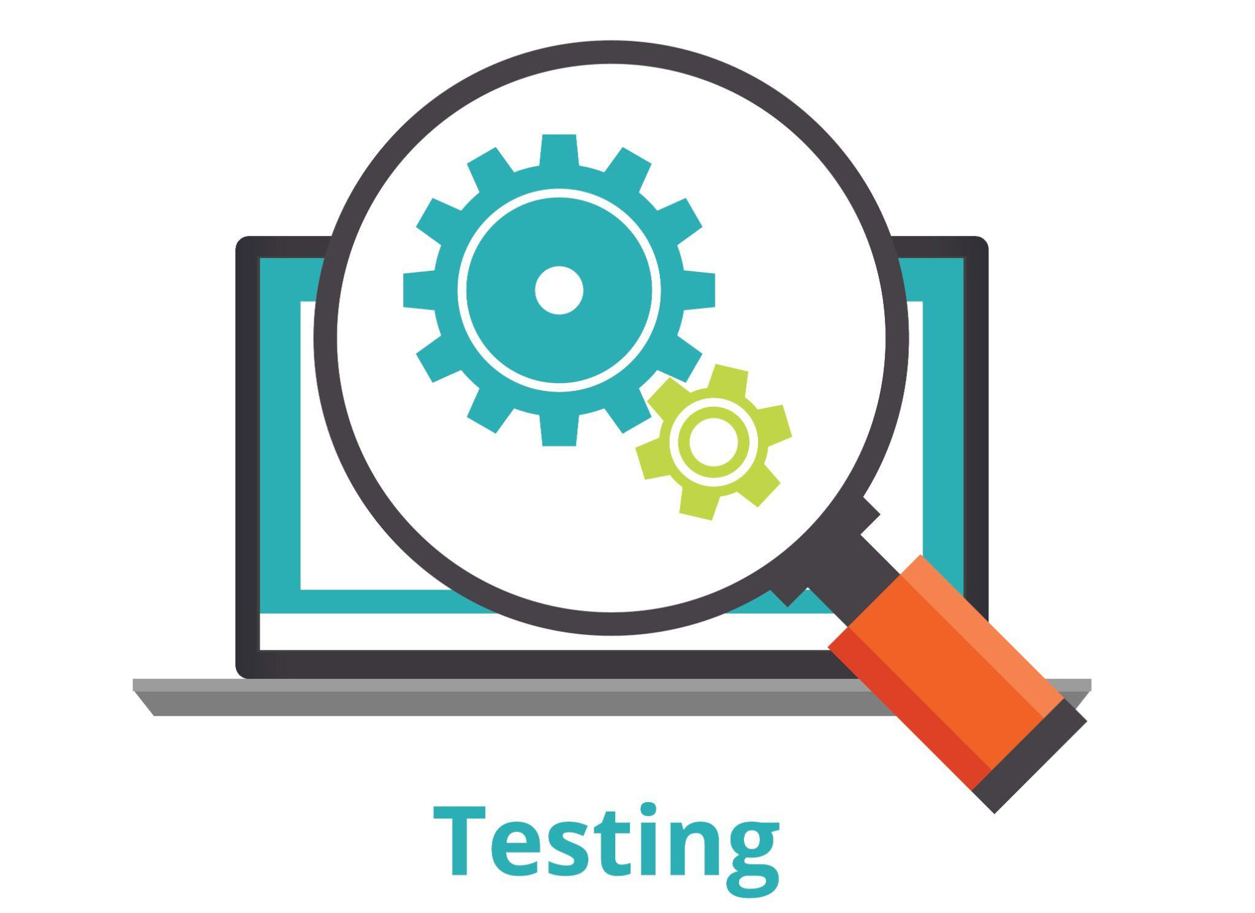

Method and types of testing
Test methods - manual
Test types:
- component testing;
- integration testing;
- system testing;
- functional testing;
- non-functional testing;
- compatibility testing.
Test levels:
- smoke test;
- critical path test.

Slide 5
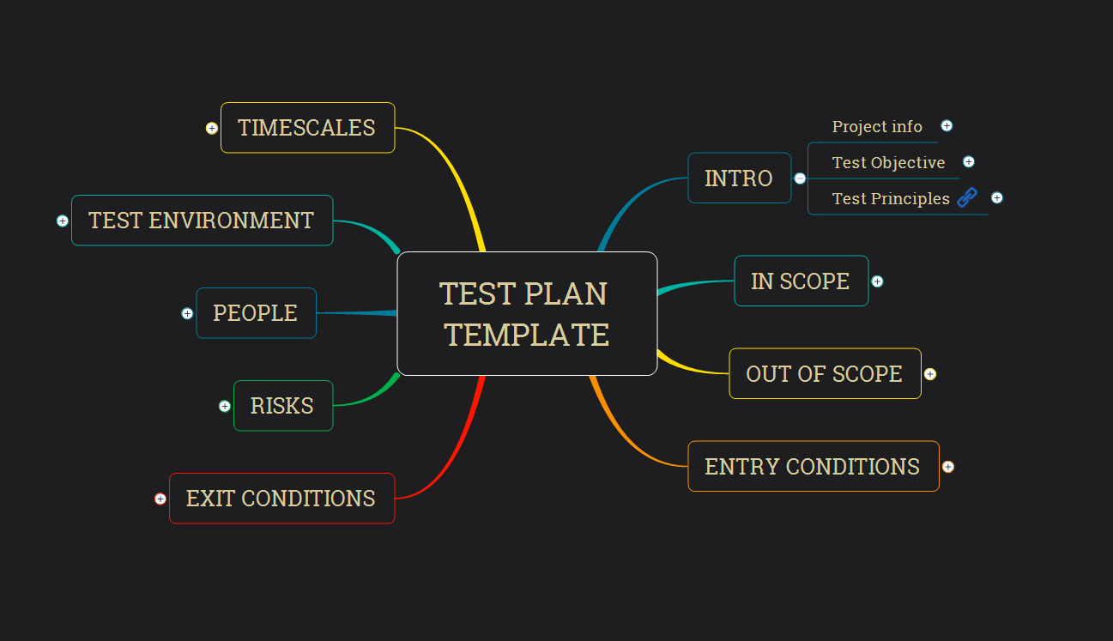

Test documentation
Test plan
Check lists
Test cases
Bug reports
Test result report

Slide 6
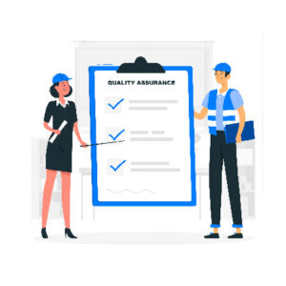
Test team
Batura Kseniya - QA Lead (coordinating the work of the team, test plan development, checking test scenarios, bug reports, preparing a presentation on the results of the work performed, writing a report on the test results)
Vezhnavets Alina - QA engineer (test-plan development, functional and non-functional testing)
Vlasik Ilona - QA engineer (test-plan development, functional and non-functional testing)
Voitovich Helen - QA engineer (test plan-development, functional and non-functional testing, writing a report on the test results)

Slide 7
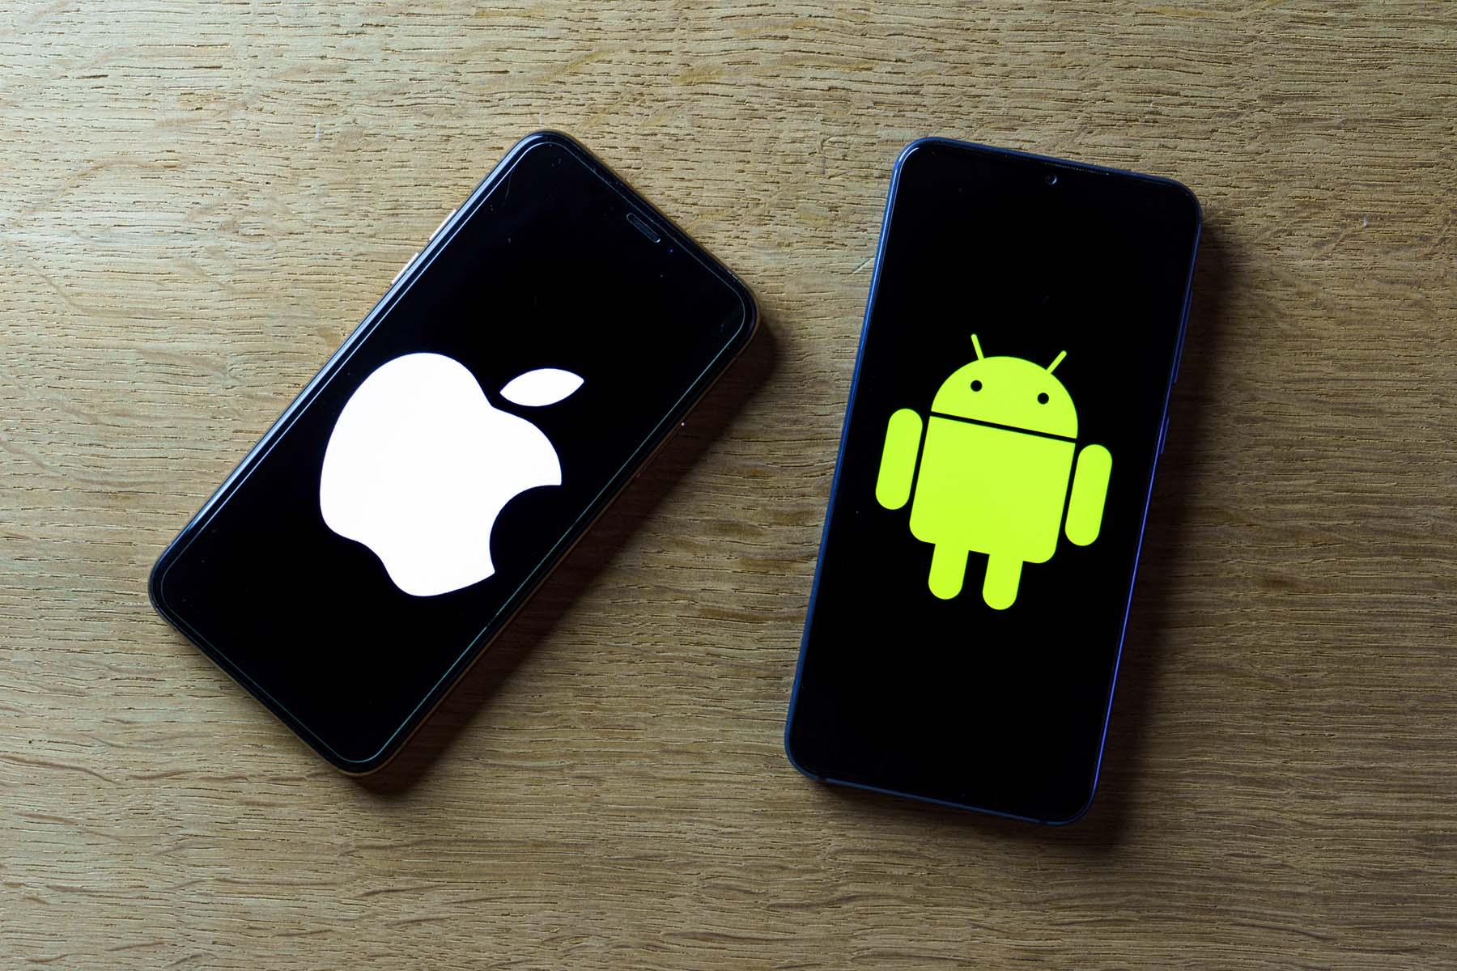
Test Hardware
Samsung Galaxy A51 4/64 (Android 12)
Iphone 11 4/64 (iOS 16.1.1)
Xiaomi Poco X3 Pro 8/256 (Android 12)
Iphone 7 2/32 (iOS 14.7.1)

Slide 8

Smoke test
Android - 47
Registration module - 1
User profile module - 17
p2p chat module - 5
Call module - 4
Secure group module - 9
Community module - 5
Channel module - 5
iOS - 24
Registration module - 4
User profile module - 1
Chats module - 16
Call module - 3

Slide 9

Critical path test
Android - 192
Registration module - 1
User profile module - 25
Background module - 3
Net module - 2
p2p chat module - 35
Call module - 4
Secure group module - 43
Community module - 39
Channel module - 40
iOS - 46
Registration module - 1
User profile module - 6
Chats module - 34
Call module - 7

Slide 10
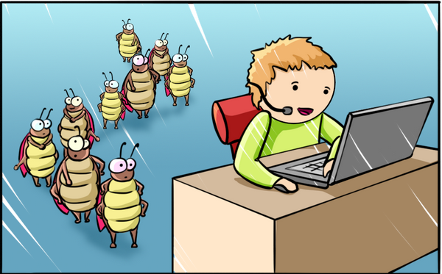
Bug reports
Android - 48
iOS - 9

Slide 11
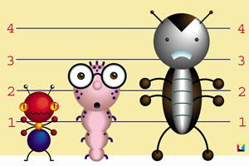
Bug reports
Android Severity:
Minor - 15
Medium - 19
Major - 14
Critical - 0
Priority:
Low - 13
Normal - 27
High - 8
ASAP - 0

Slide 12

Bug reports
iOS
Severity
Minor - 9
Medium - 0
Major - 0
Critical - 0
Priority
Low - 1
Normal - 8
High - 0
ASAP - 0

Slide 13

Spent time
Batura Kseniya (QA Lead) - 23 days/171 hours
Vezhnavets Alina (QA engineer) - 23 days/ 157 hours
Vlasik Ilona (QA engineer) - 23 days/ 157 hours
Voitovich Helen (QA engineer) - 23 days/ 171 hours

Slide 14
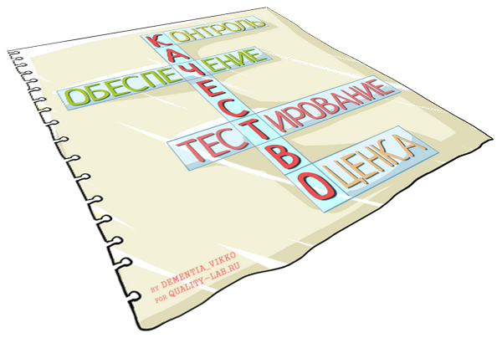
Product evaluation
The main functionality of the application works.
No critical bugs found.
The number of detected bugs is small, most of them are ranked low in importance and priority. It is recommended to fix Major bugs for subsequent releases.

