Slide 1




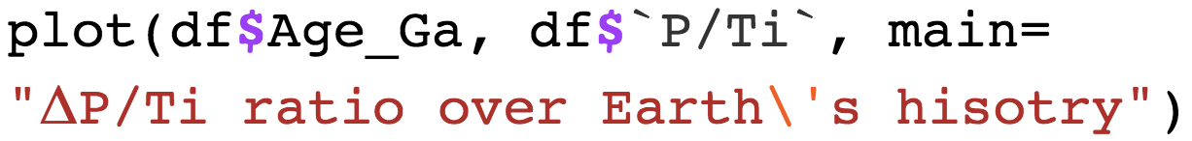
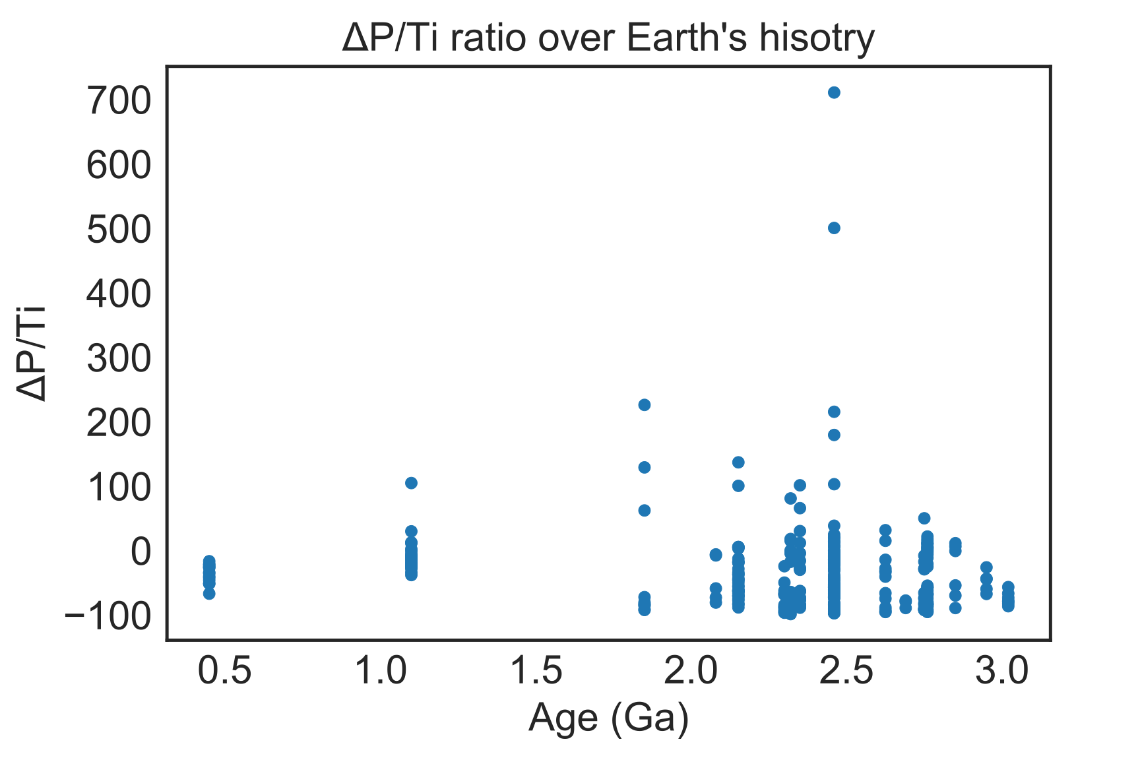
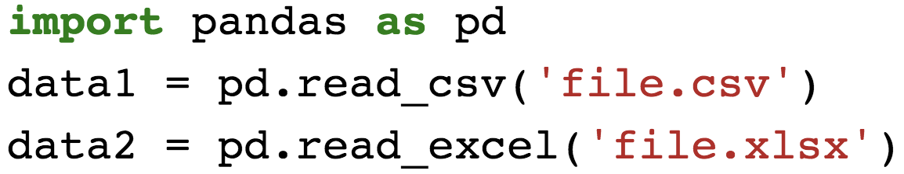
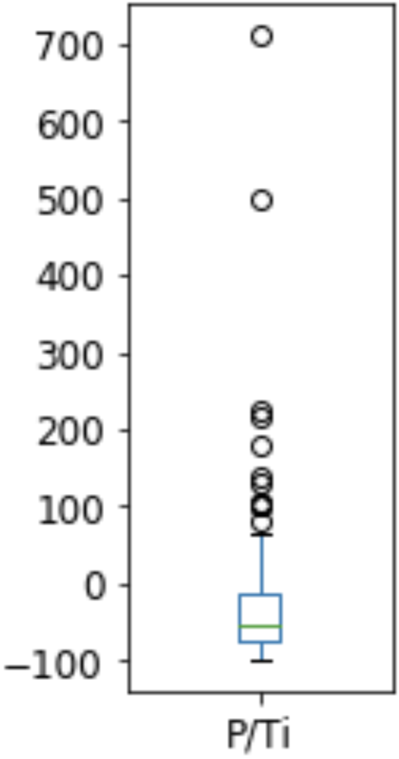
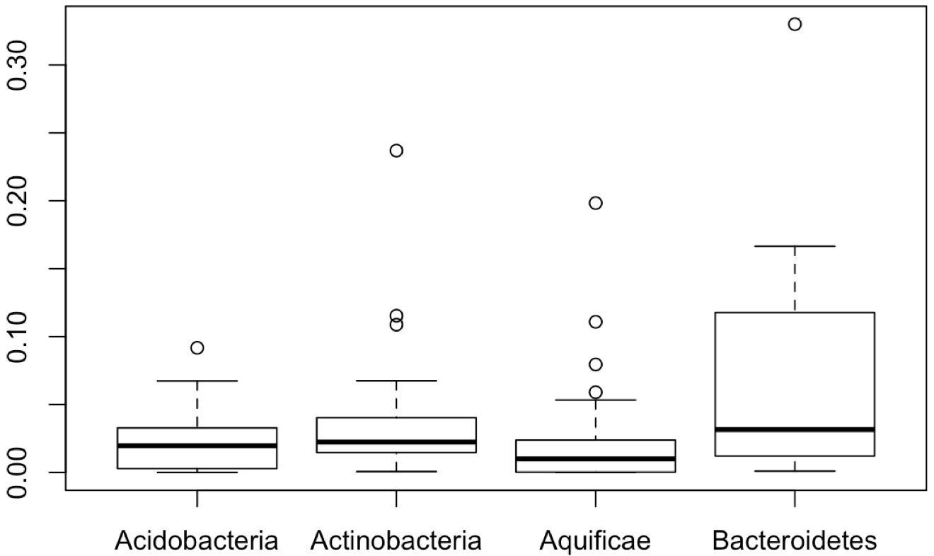
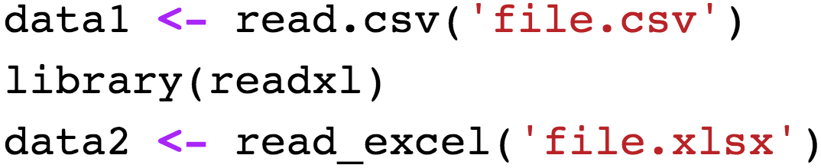
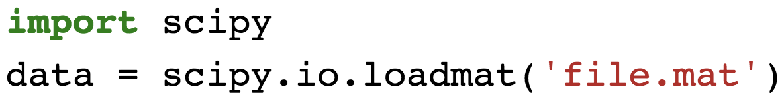
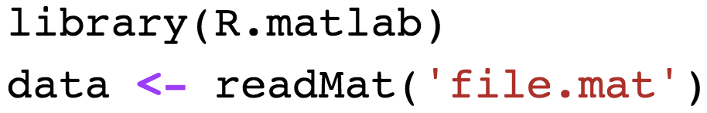
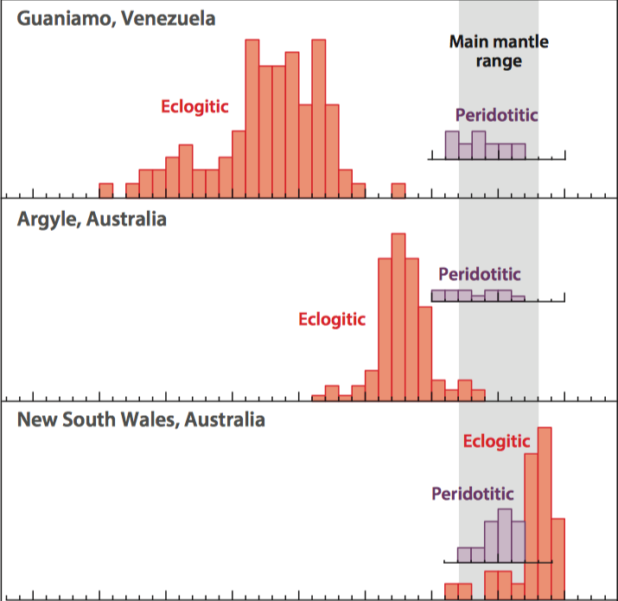
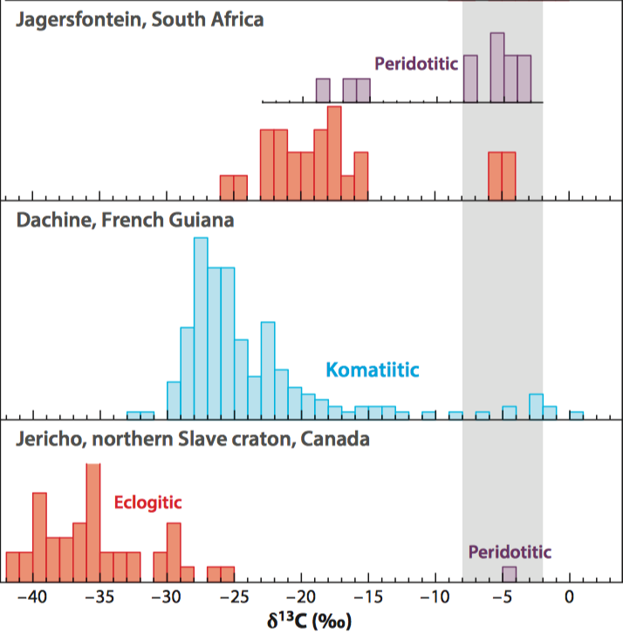
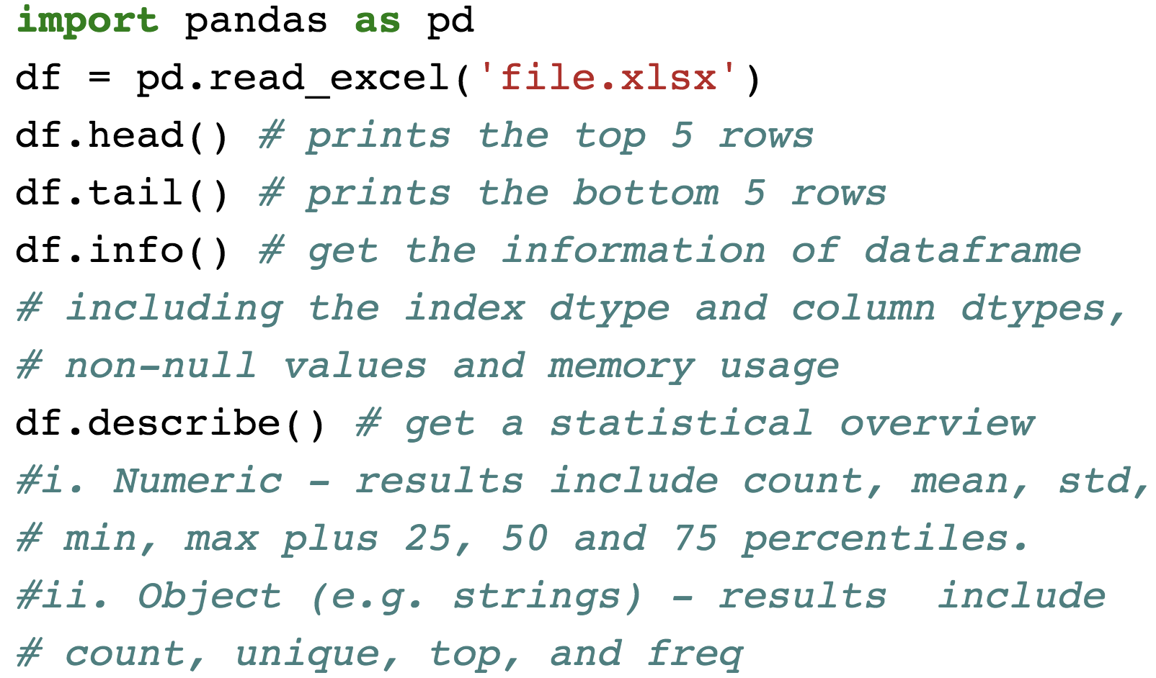
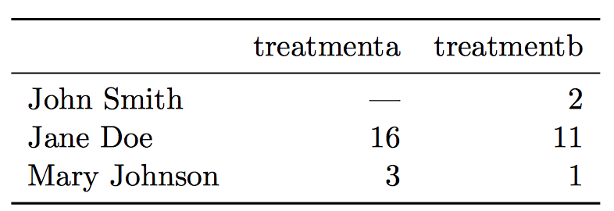
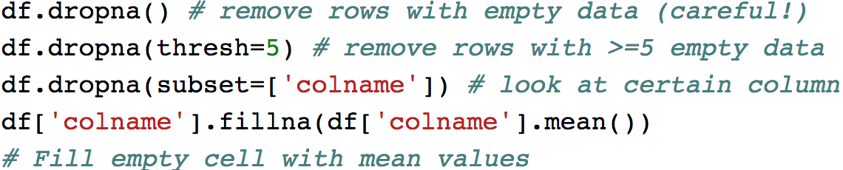
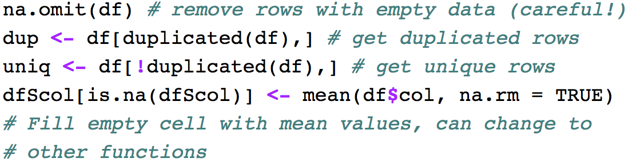
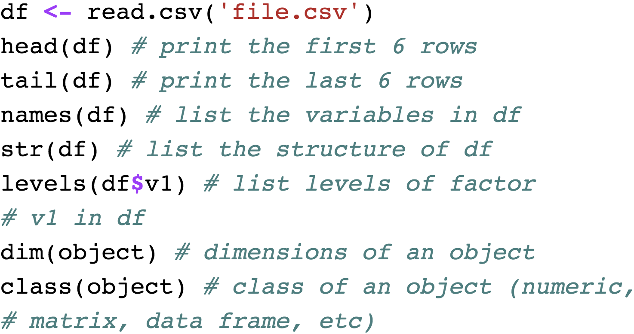

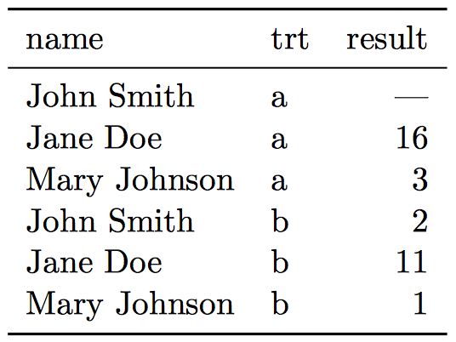
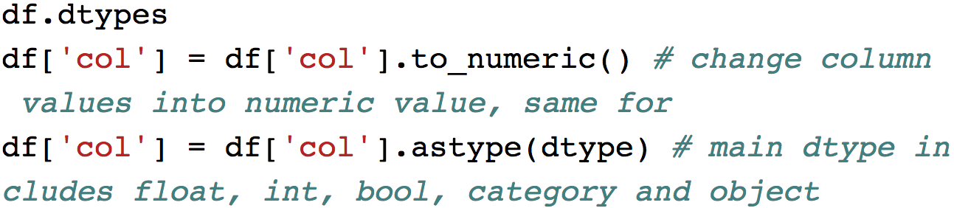


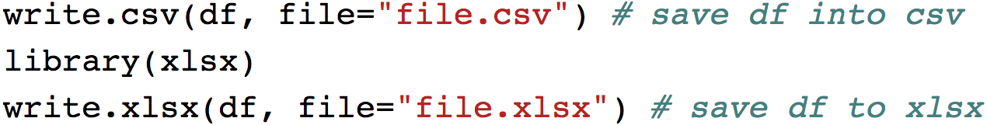
The Analysis Pipeline: Data Processing and Preparation
Your Name and RPI email
¹Rensselaer Polytechnic Institute, Tetherless World Constellation, Troy, NY, United States,
Abstract
Tidying Messy Datasets
Due to the development of experimental and analytic equipment, large amounts of scientific data are being produced all over the world. The rapidly increasing volume and variety of geoscience-related data give researchers opportunities to answer scientific questions that are hard to solve using traditional methods. However, most of the time, raw data are not directly usable because of their hierarchical structures, missing values, inaccuracy, duplication, and so on. Also the data format needs to be adapted to different analytic techniques. It is often said that 80% time of data analytics is spent on data cleaning and preparing. Therefore, data processing is a crucial part of the data analytics pipeline, and iterative processing is needed when new problems emerge or secondary data are generated, throughout the whole analytics procedure.
This poster will mainly focus on data processing and preparation. We start by introducing the principles for cleaning datasets, followed by some quick data exploration methods. Then we demonstrate some ways of dealing with various problems, such as missing values or duplication, in the datasets. The last part of the presentation show applications in real geoscientific datasets. Following good data processing practices can save time by avoiding repetition, and get more accurate results in analyses to help solve scientific problems.
Common workflow for data processing
i. Scatter plot
P:
R:
Import
From spreadsheet files
From Matlab data file
Inspect
Explore the dataset to get descriptive results
Find out data features and outliers
Process
Deal with the problems in datasets
From online sources or other formats
Save the dataset
Manipulate data
Import
From spreadsheet files
From Matlab data file
Inspect
Explore the dataset to get descriptive results
Find out data features and outliers
Process
Deal with the problems in datasets
From online sources or other formats
Save the dataset
Manipulate data
1. Import data:
Python (P) and R language (R)
A. Spreadsheet files
P:
R:
B. MATLAB data files
P:
R:
C. Online sources
We can use the BeautifulSoup (P) or scrapeR (R) packages to parse HTML documents.
D. Databases and others
Python and R both support data from SQL databases, SAS, STATA, SPSS and other formats.
2. Inspect data:
Several methods are used to inspect the dataset.
A. Get an overview of the dataframe (df):
P:
R:
B. Explore the dataset:
Three commonly used exploratory plots are scatter, box, and histograms.
ii. Box plot
P:
R:
Motivation
iii. Histogram plot
P:
R:
It is often said that 80% time of data analytics is spent on data cleaning and preparing, but there has been little research on how to make data cleaning as easy and eﬀective as possible.
The current presentation is to clarify good some good principles for data processing, followed by some quick data exploration methods. Hope this presentation could serve as a cheatsheet for data processing.
The Principles
(Cartigny et al. 2014*)
Each variable forms a column
Each observation forms a row
Each type of observational unit forms a table
*Cartigny, Pierre, et al. Diamond formation: a
stable isotope perspective. Annual Review of Earth and Planetary Sciences 42 (2014): 699-732.
3. Process data:
Clean the dataset
P:
R:
B. Manipulate data types
P:
R:
C. Save data
P:
R:
Untidy table
Better for
reporting
Better for
analysis
Tidy table
Sponsors:
Glossary:
Python – A programming language, capable of processing data/statistical analysis
R – A program to process data and perform statistical analysis
Package (P) or Library (R): software package to be loaded to perform extra tasks
Pandas – An useful data manipulation package in python
Df, dataframe – Data manipulation structure in R & python pandas
Levels in R dataframe – for factor data, the possible number of choices are levels
Resources:
Beautifulsoup package in python: https://www.crummy.com/software/BeautifulSoup/
Python pandas visualization: https://pandas.pydata.org/pandas-docs/stable/visualization.html#visualization-hist
Python clean dataset: http://www.developintelligence.com/blog/2017/08/data-cleaning-pandas-python/
ScrapeR Package in R: https://cran.r-project.org/web/packages/scrapeR/scrapeR.pdf
Read excel files in R: https://www.datacamp.com/community/tutorials/r-tutorial-read-excel-into-r
R deal with missing data: https://www.statmethods.net/input/missingdata.html
R visualization: https://www.analyticsvidhya.com/blog/2015/07/guide-data-visualization-r/

