Slide 1






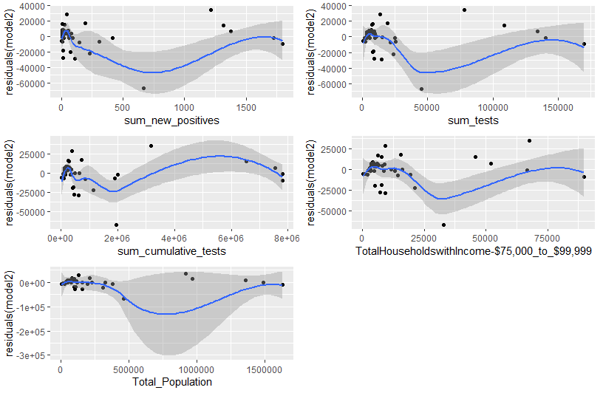
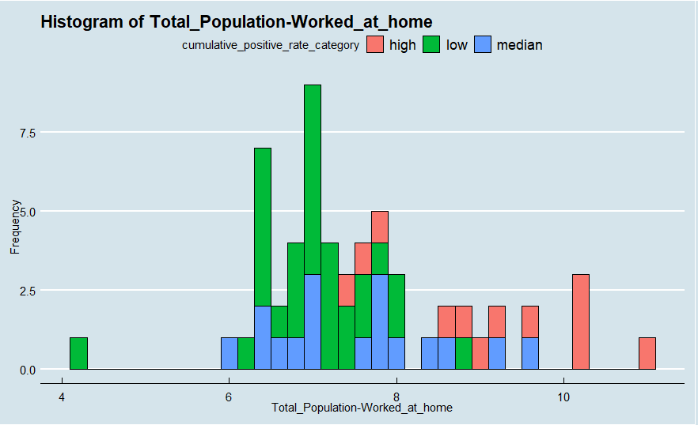
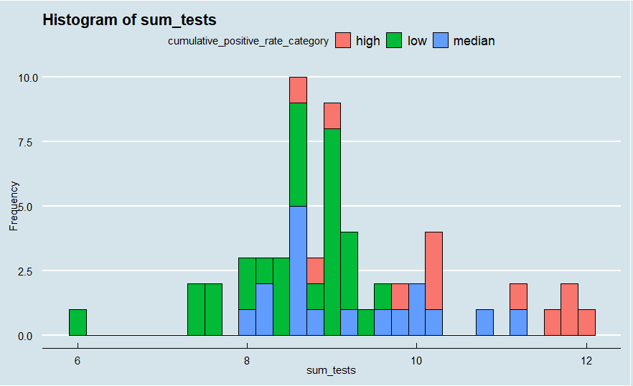
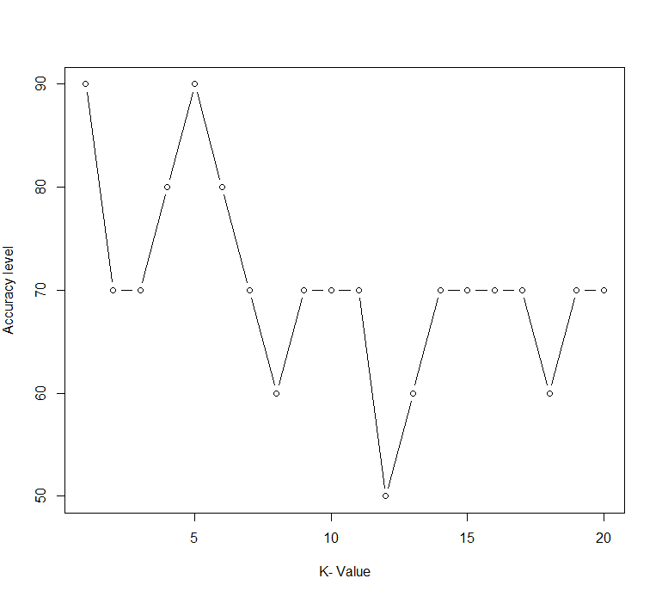
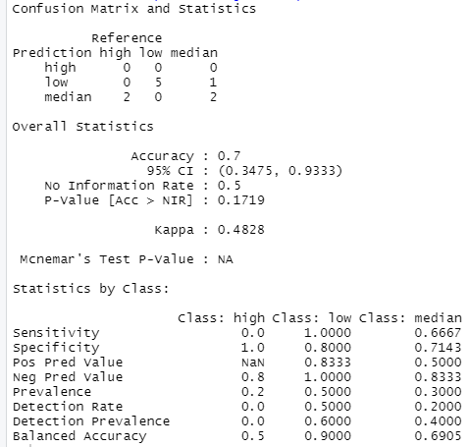

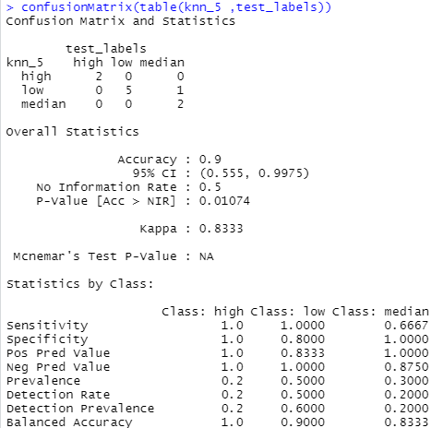
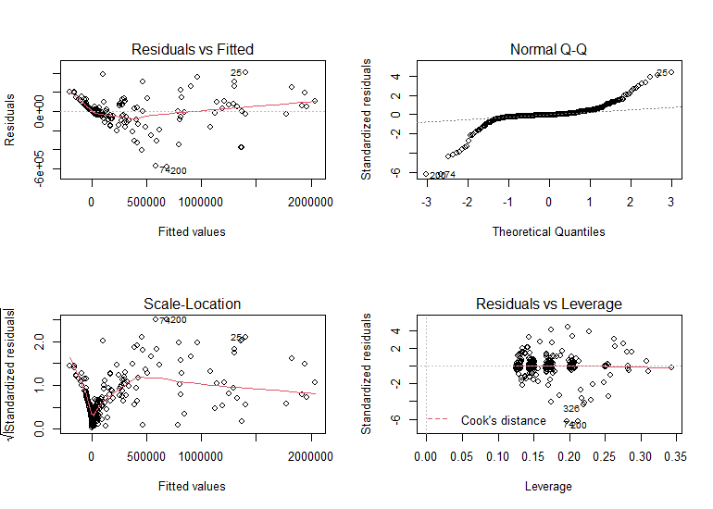

Data Analytics of COVID-19 in New York State
Ruoyan Wu wur7@rpi.edu
¹Rensselaer Polytechnic Institute, Tetherless World Constellation, Troy, NY, United States,
EDA Processes
2. Linear Regression Model
Abstract
Import
Read in csv files
Inspect
Identify data types
Filtering based on conditions
Graph
Histogram
Extracting columns
Renaming columns
Summary of numeric variables
Find and remove null values
Box plots
Count plots
Point plots
I am going to focus on one place, specifically New York State in the United States. The main dataset my project based on is the New York State Statewide COVID-19 Testing which contains data of each County in New York State from March to October. Based on these data, I make mainly three hypotheses about there exist relationships between the cumulative positive cases number of each County and some other features such as work from home population of each County etc.
Problem Area
3.1 Decision Tree Classifier Model
I want to explore what features may affect the COVID-19 infection rate. For example, higher test performed rate will also lead to higher positive cases rate.
In this project, I make three hypotheses.
The first one is there existed relationship between the monthly cumulative positive cases and monthly tests performed among all counties in the New York State.
The second hypothesis is there existed relationship between the cumulative positive cases rate in June for each county, work from home proportion, specific age range proportion, and specific income range proportion.
The third hypothesis is the cumulative positive cases rate of each County can be separated into different level of groups based on different features such as work from home proportion, specific age range proportion, and so on.
If the first hypothesis is true, I can build a model based on the relationship and use it to predict a County next month’s cumulative positive cases based on the tests performed;
If the second hypothesis is true, I can build a model based on the relationship and use it to predict a County’s cumulative positive cases of a month based on number of other features;
If the third hypothesis is true, I can predict if a County has serious infection rate or not depends on which level a County’s cumulative positive rate belongs.
Conduct Analysis
Linear Regression
Point plots between dependent variable and independent variables
Linear Regression
Point plots between dependent variable and independent variables
Classification
Use geom_point() and histogram to plot
Use lm() function to apply
Use summary() function to evaluate
Use lm() function to apply
Use summary() function to evaluate
Use rpart() to build Decision Tree Classifier model
Use knn() to build KNN Classifier model
Use confusionMatrix() and accuracy to evaluate models
Figure2.1.1-plot of residuals of five independent variables of model2
Figure3.1.1-histogram plot of Total_Population-Worked_at_home and cumulative_positive_rate_category
3.2 KNN Classifier Model
1. Linear Regression Model
Figure3.1.1-histogram plot of sum_tests and cumulative_positive_rate_category
Model Summary:
Figure3.2.1-plot of accuracy with different k-value
The Data
From the output of the summary of this regression model, it shows that it has F-stat value equals to 73.07 which is far greater than 1. Therefore, there is a relationship between the dependent variable and independent variables. The Adjusted R-squared is equal to 0.9222 which shows that this model fit.:
Primary Dataset:
New_York_State_Statewide_COVID-19_Testing.csv:
https://health.data.ny.gov/
Supplement Dataset :
The New York Times Coronavirus (Covid-19) Cases and Deaths in the United States：
https://data.humdata.org/dataset/nyt-covid-19-data?force_layout=desktop
Population by Age and Sex – Counties:
https://covid19.census.gov/datasets/population-by-age-and-sex-counties
Income and Benefits – Counties:
https://covid19.census.gov/datasets/income-and-benefits-counties
Worked at Home - Counties:
https://covid19.census.gov/datasets/worked-at-home-counties/data
Why they are applicable?
These datasets are all from regular official dataset, so they
are all accurate and timely statistical data that can be used.
All these datasets are related to New State Counties, and
they are all published or updated in year 2020. Therefore,
they can be used or combined to build model or do
prediction.
Figure3.1.2-confusionMatrix of Decision Tree Classifier Model
Figure3.2.2-confusionMatrix of KNN Classifier Model with k=5
Conclusion
From all these work, it can be concluded that there does exist some relationship between the monthly cumulative positive cases and monthly tests performed among all counties in the New York State, and relationship between the cumulative positive cases rate in June for each county, work for home proportion, specific age range proportion, and specific income range proportion. Moreover, the cumulative_positive_rate can be grouped into different levels based on different aspects.
Figure 1.1-Residual plots
Use model to predict on test dataset:
Resources:
GitHub Link to code: https://github.com/HelenWu11/DataAnalytics2020_RuoyanWu_FinalProject
Understanding Diagnostic Plots for Linear Regression Analysis: https://data.library.virginia.edu/diagnostic-plots/
How to apply Linear Regression in R: https://datascienceplus.com/how-to-apply-linear-regression-in-r/
New York State Statewide COVID-19 Testing: https://health.data.ny.gov/Health/New-York-State-Statewide-COVID-19-Testing/xdss-u53e
The New York Times Coronavirus (Covid-19) Cases and Deaths in the United States: https://data.humdata.org/dataset/nyt-covid-19-data?force_layout=desktop
Population by Age and Sex – Counties: https://covid19.census.gov/datasets/population-by-age-and-sex-counties
Income and Benefits – Counties: https://covid19.census.gov/datasets/income-and-benefits-counties
Worked at Home – Counties: https://covid19.census.gov/datasets/worked-at-home-counties/data
Glossary:
Python – A programming language, capable of processing data/statistical analysis
R – A program to process data and perform statistical analysis

