Slide 1

Helen Yunes
Shilo Ben Nathan
Aviv Danino

Slide 2

Designed to be generic and compatible as possible so it can be used and implemented fast by every restaurant and by all costumers
Owner side - Help business owners that struggles with hiring waiters to use app that can fill this gap or alternatively cut costs of waiter.
Costumer Side – When the restaurant isn’t use waiters the prices can only be lower, or the staff can be better. The costumer is also can manage his time getting to the restaurant and not wait for waiter to fill up an order and spend time over waiting to order.

Slide 3

The corona virus hurt badly in restaurant owners, and it can be noticed that after we got back to “routine” we can still see shortage of workers in restaurants and mainly shortage of waiters.

Slide 4

AllEat goal is to save time and have multiple purposes such as order reservations, planning our takeaway and even can save to the owner the waiters when using this app.

Slide 5

Our competitors

Slide 6
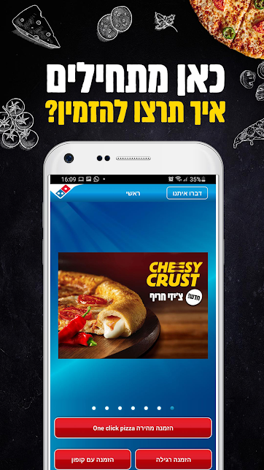
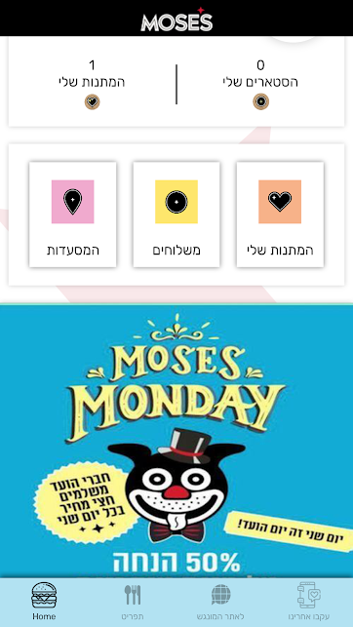
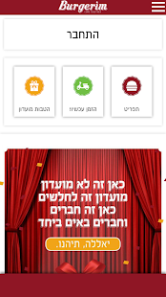

Apps of Big fast-food chains are having their own apps that we can used to order takeaway, delivery and have some features that unique to them, but our app does not need to be threatened from those because our market target is restaurants that cannot afford unique app for their only restaurant.

Slide 7




Wolt and 10bis? More of delivery apps That having monopoly and new app can do good with small restaurant owners.

Slide 8
Owner side

Slide 9
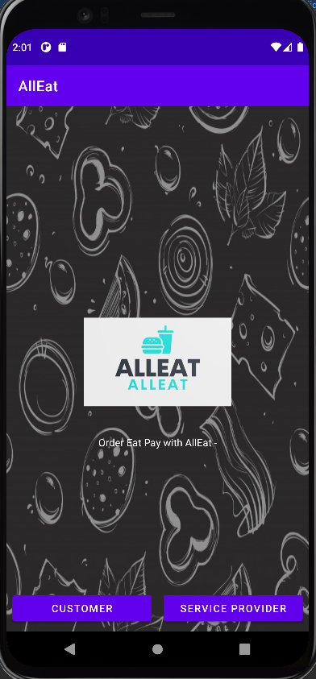
First page
This screen is shared by both sides.
Here we can choose our role at the app

Slide 10
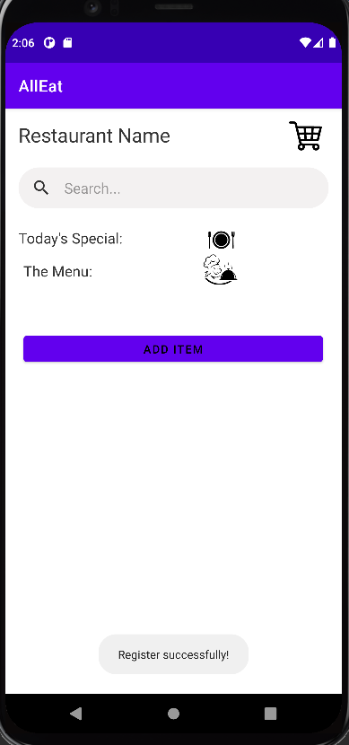
Add your items
Here we can add items to the owner user by click the button and redirect to the page

Slide 11
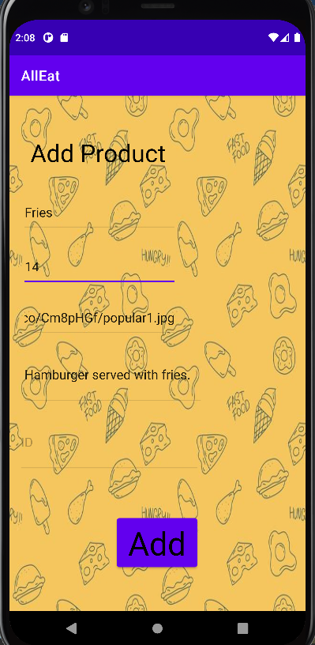
Add page
We can’t see that now but the user having helpful placeholder hints to help him add the information in the right data fields.
Name
Price
Photo URL’s
description
Onclick function that saves all to app firebase

Slide 12
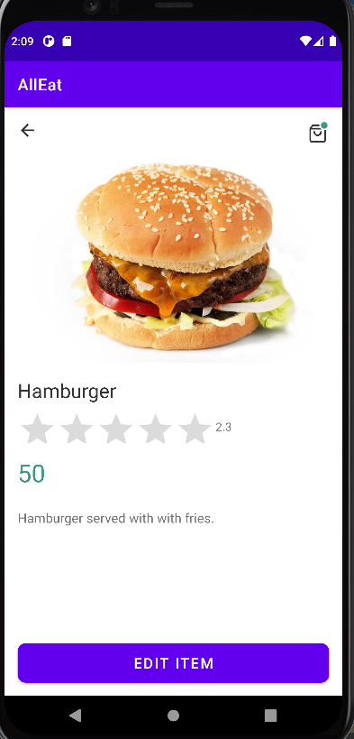
Item page
This item page is what we get after we adding the last fields, in addition to the fields that were added we having rating bar that will be used in the User side.
Photo
Name
Rating
Price
Description
Onclick function that will edit item in app firebase

Slide 13
User side

Slide 14
First page
We need to choose the role in the app

Slide 15
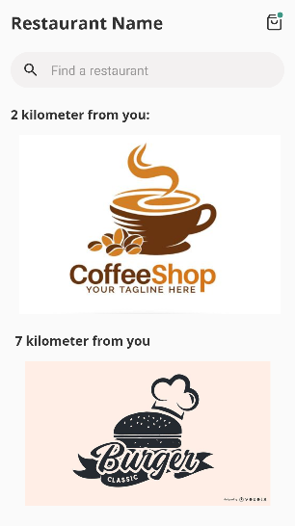
Restaurants around us
We can see the restaurants around us in this page and pick restaurants that are not around.

Slide 16
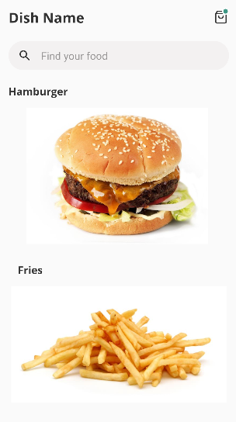
Restaurant menu
The restaurant menu in scroll View and search bar to find wanted dish

Slide 17
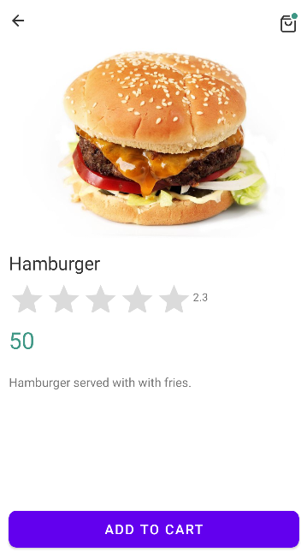
dish page
The user can view the dish details such as price, photo and description and rate the dish to his opinion
Onclick that will add item to user cart

Slide 18
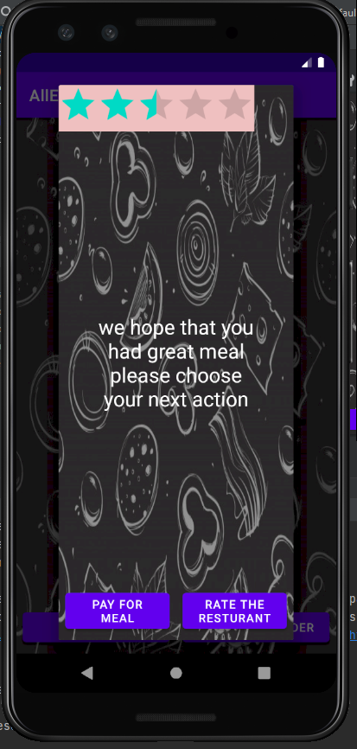
Dialog payment
Dialog page allow us to rate the restaurant and go to out of app payment page

Slide 19
Diagrams

Slide 20
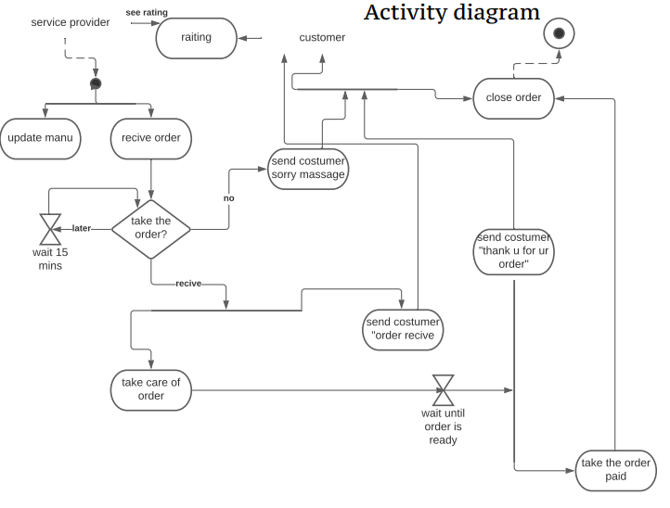

Slide 21
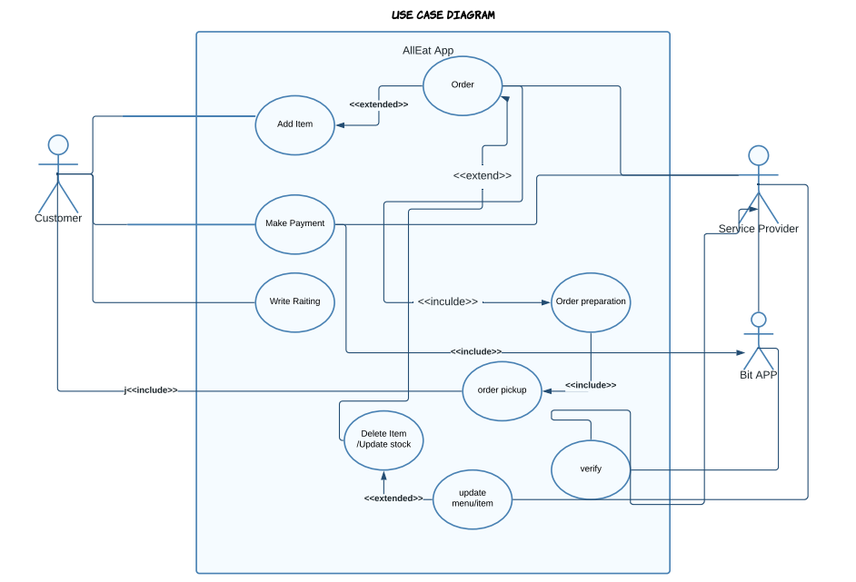

Slide 22
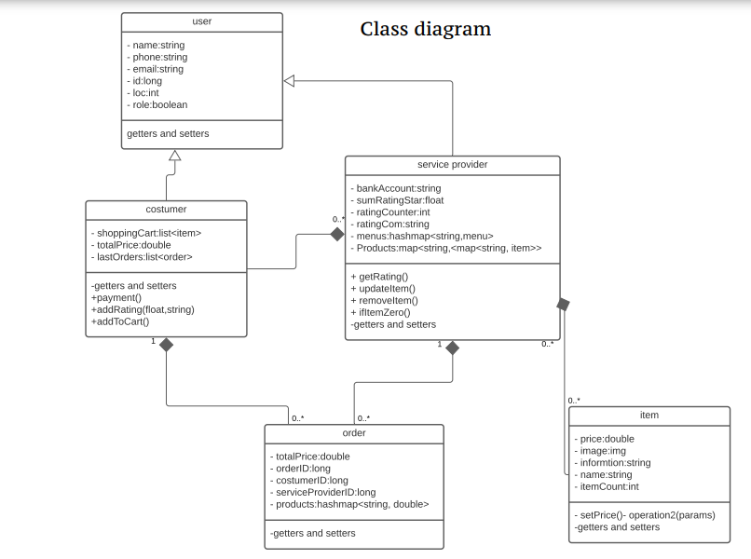

Slide 23
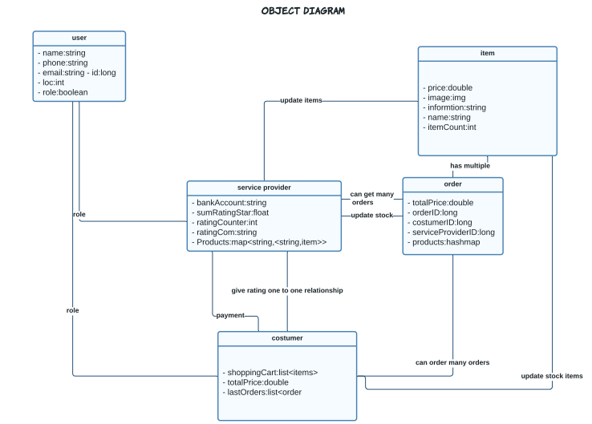

Slide 24
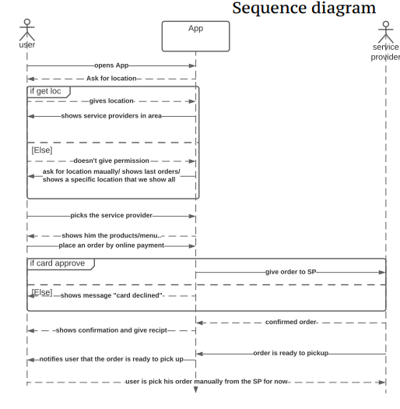

Slide 25
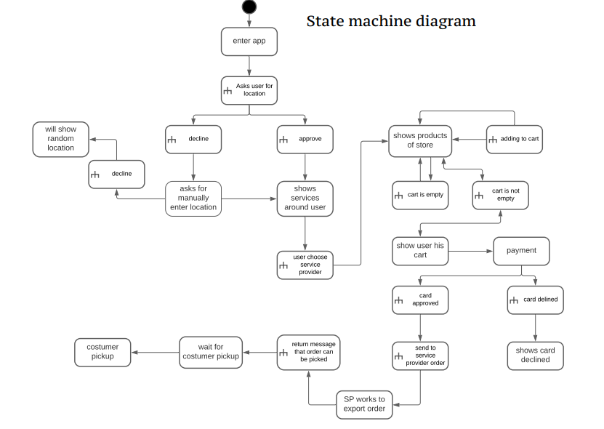

Slide 26
