Slide 1

United States

Slide 2
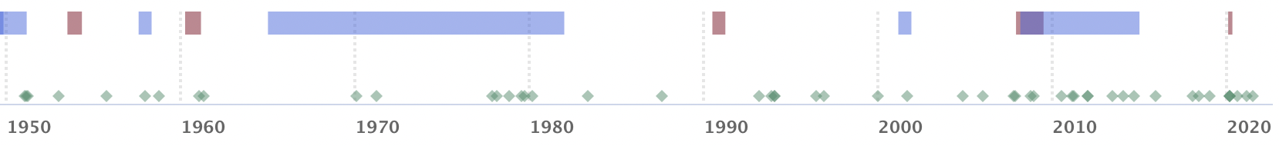


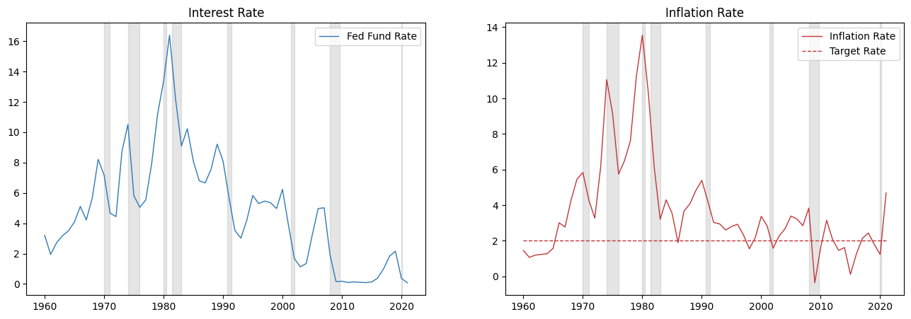
Monetary Anchor
High inflation
End of Gold Standard (1971)
High Inflation Fighting Period (1965-1982): Paul Volcker(1979)
Informally Inflation Targeting (1993-2012)
Inflation Targeting (2012-2020)
Flexible Average Inflation Targeting (2020-Present)
Recession
Source: FRED
Source: FRED
Notes:
Fed Chairman Paul Volcker dramatically increased interest rates
contributed to act
stable growth and low inflation
The Fed began to emphasize transparency

Slide 3
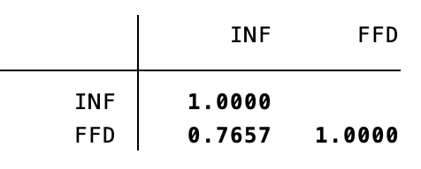
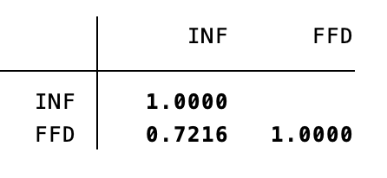
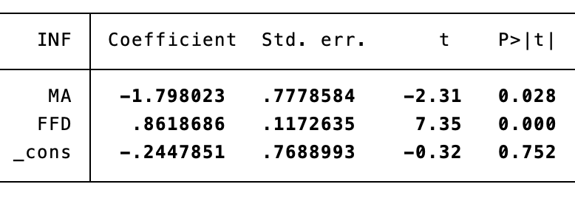
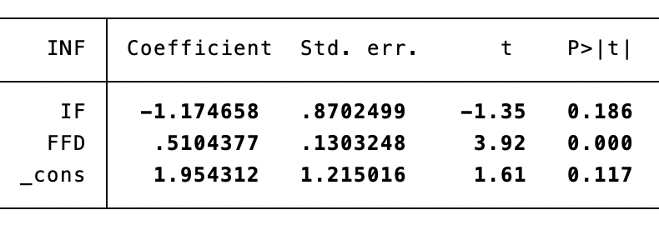
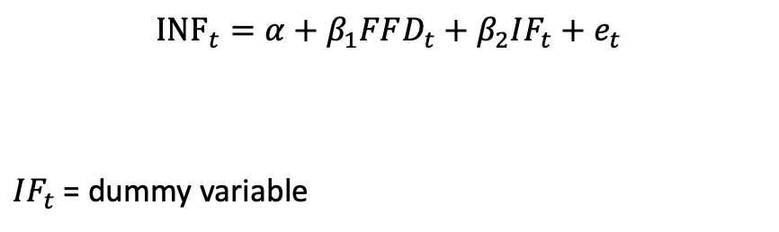
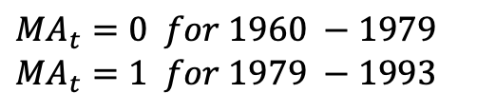
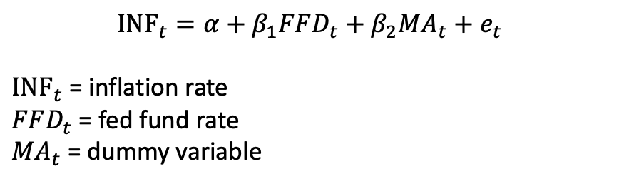
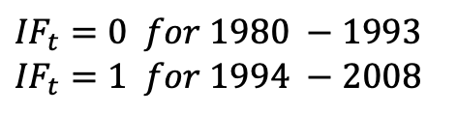
Policy Performance
Period 1: monetary control act
Period 2: inflation targeting
$${INF}_{t}=α+β_{1}FFD_{t}+β_{2}{MA}_{t}+e_{t}$$
${INF}_{t}$ = inflation rate
$FFD_{t}$ = fed fund rate
${MA}_{t}$ = dummy variable
$${INF}_{t}=α+β_{1}FFD_{t}+β_{2}{IF}_{t}+e_{t}$$
${IF}_{t}$ = dummy variable
$${MA}_{t}=0 for 1960 −1979$$
$${MA}_{t}=1 for 1979 −1993$$
$${IF}_{t}=0 for 1980 −1993$$
$${IF}_{t}=1 for 1994 −2008$$
*yearly data
Notes:
Regressing interest rate and a dummy variable on inflation
Monetary CA has more impact on inflation control than
Significant coefficient of -1.8 whereas inflation targeting
Both policy changes helped address inflation problem.

Slide 4

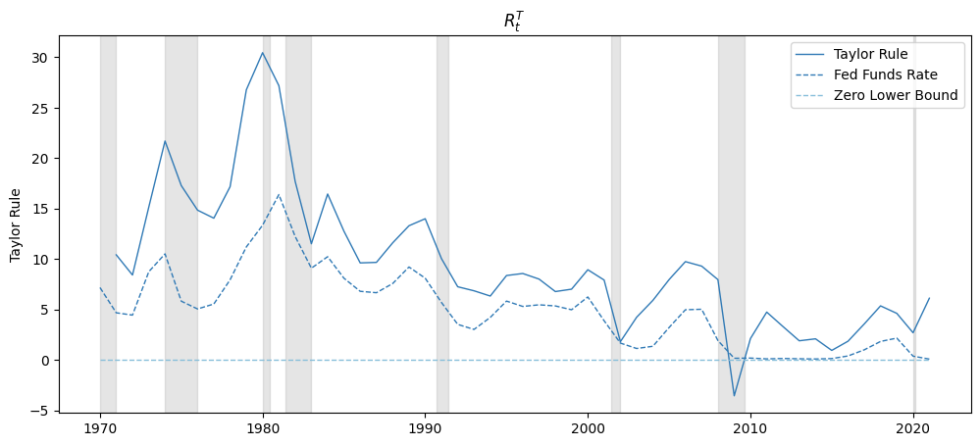
Taylor Rule
Source: FRED
Notes:
Similar with other 3 countries, the real interest rate is lower than taylor rule,
When hiting ZLB, TR bounce back quickly, while in reality, it need more time to recover.

Slide 5
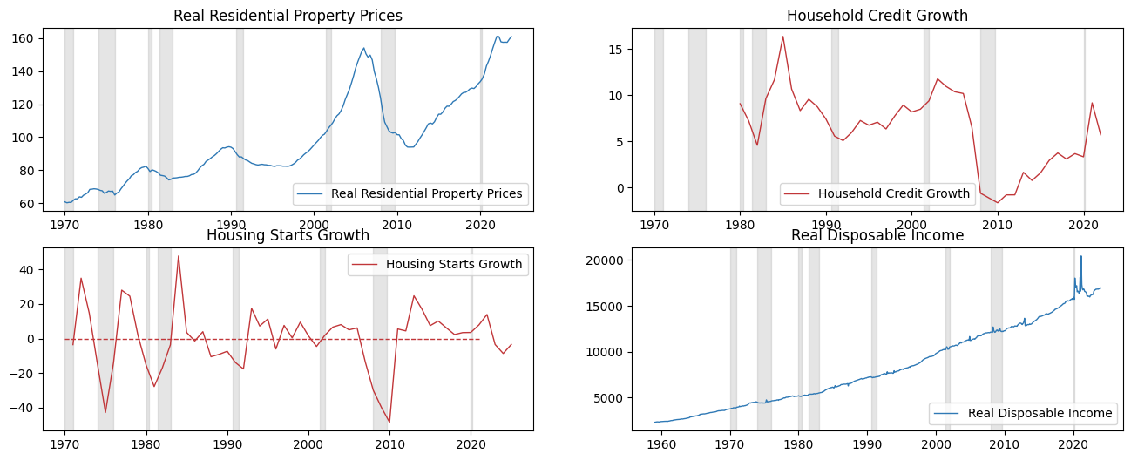
Housing Driver and Constraints
Demand side
Short run
Interest Rates
Credit Availability
Long run
Income Growth
Demographic Trends
Supply side
Short run
Construction Delays
Land Availability
Long run
Regulatory Environment
Source: FRED
Source: BIS
Source: FRED
Source: FRED
Notes:
Demand
supply
After great recession, house price decreased
Before the plunge of house price, credit and housing starts started to drop sharply.
Before the gradual rebound of hp, -- started to recover
House price to rent/house price to income ratio – long run anchor
Volume of New loans to households
Nominal policy interest rate
Amplification effect/ expectation channel
Some channels are stronger in some countries
e.g. countries rely on bank – credit chanel stronger
Rising interest rate will lead to a reset of expectation channel
Hc,t = alpha + betaic,t+gamma ic,tFRMc + other factors
Deltahp = it –
test robustness
2equation system
Policy rulet = f(output gap, inflation driving from target)+”shock”
Deltahp = alpha + beta”interest rate”shock
Deltahp = it – it^forecast

Slide 6
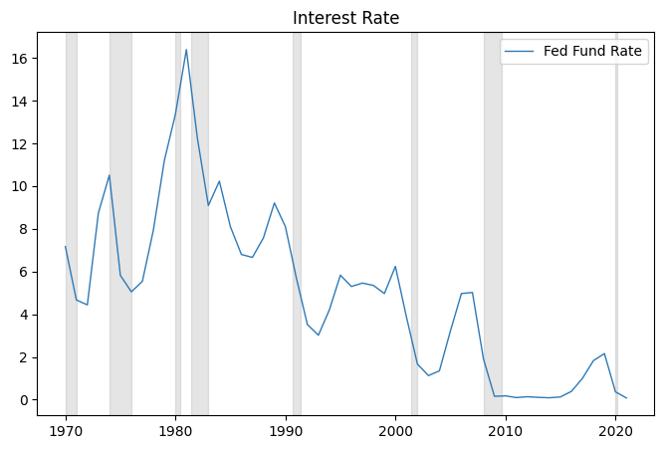
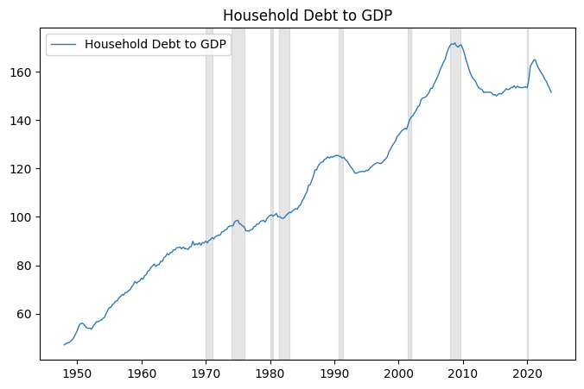
Monetary and Macroprudential Policies
Monetary Policy
Interest Rate
Quantitative Easing
Inflation Forecast Targeting
Macroprudential Policy
Capital Requirements
Basel III Regulations
Stress Testing
Regulations on Mortgage Lending
Loan-to-Value (LTV) and Debt-to-Income (DTI) Ratios
Source: FRED
Source: BIS
Notes:
Nominal policy interest rate
Ratio of Household debt to GDP
Easier monetary conditions often lead to increased credit availability
Macroprudential policies are designed to ensure the stability of the financial system and make sure no housing bubble

Slide 7
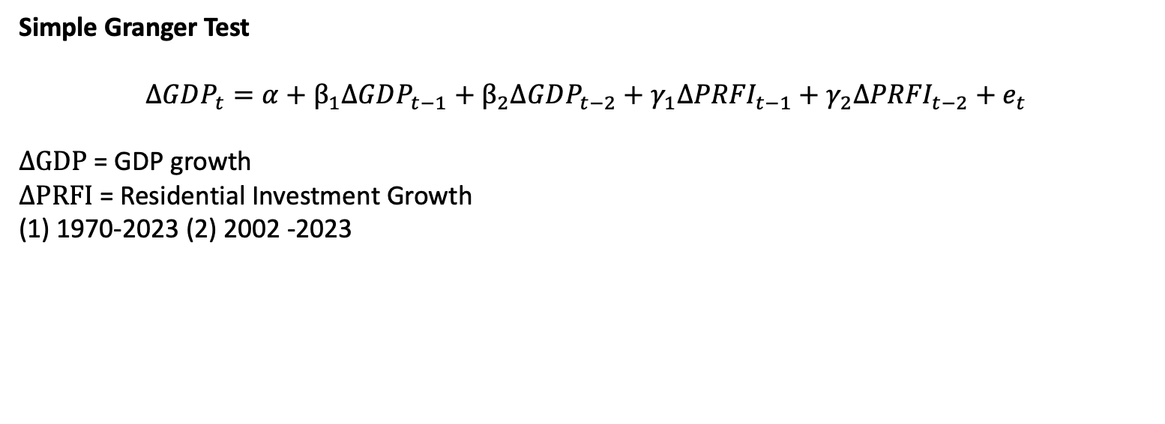
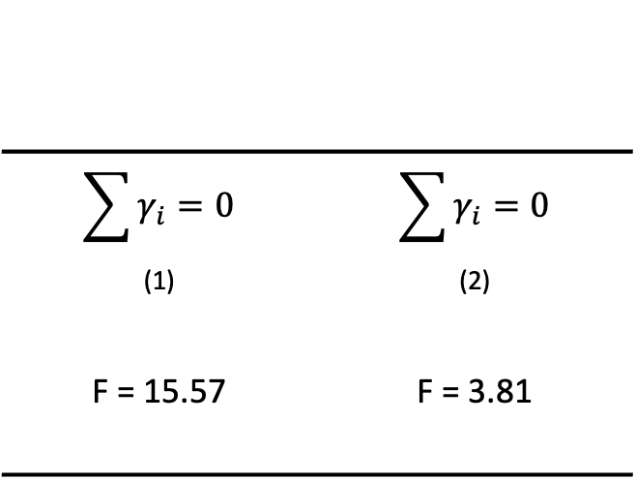
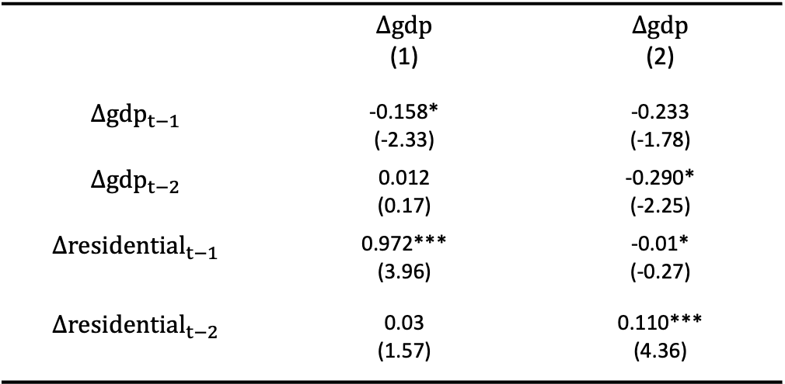
Housing and the Business Cycle
Simple Granger Test
$$ΔGDP_{t}=α+β_{1}ΔGDP_{t−1}+β_{2}ΔGDP_{t−2}+γ_{1}Δ{PRFI}_{t−1}+γ_{2}Δ{PRFI}_{t−2}+e_{t}$$
$ΔGDP$ = GDP growth
$ΔPRFI$ = Residential Investment Growth
(1) 1970-2023 (2) 2002 -2023
 | $$Δgdp$$ (1) | $$Δgdp$$ (2)
$$Δ{gdp}_{t−1}$$ | -0.158* (-2.33) | -0.233 (-1.78)
$$Δ{gdp}_{t−2}$$ | 0.012 (0.17) | -0.290* (-2.25)
$$Δ{residential}_{t−1}$$ | 0.972*** (3.96) | -0.01* (-0.27)
$$Δ{residential}_{t−2}$$ | 0.03 (1.57) | 0.110*** (4.36)
$$\sum{γ_{i}=0}$$ (1) | $$\sum{γ_{i}=0}$$ (2)
F = 15.57 | F = 3.81
Inside brackets: t statistics
<0.05, ** p<0.01, *** p<0.001
*quarterly data

Slide 8
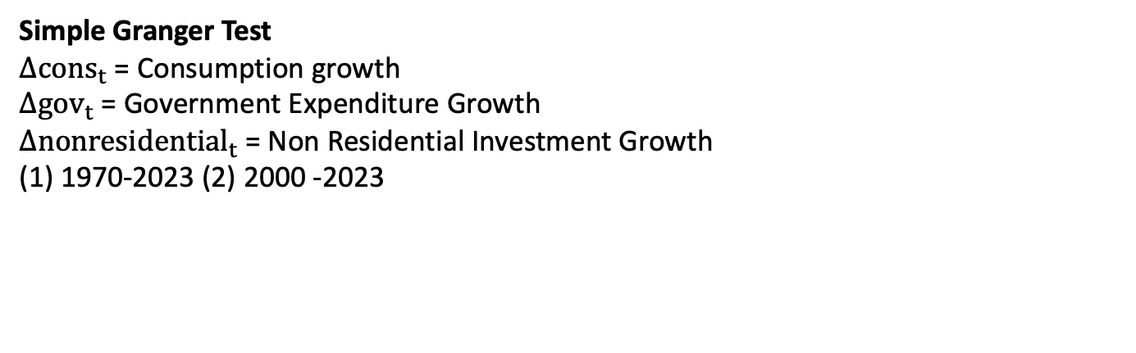

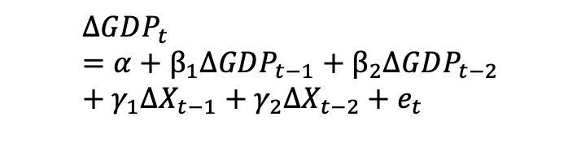
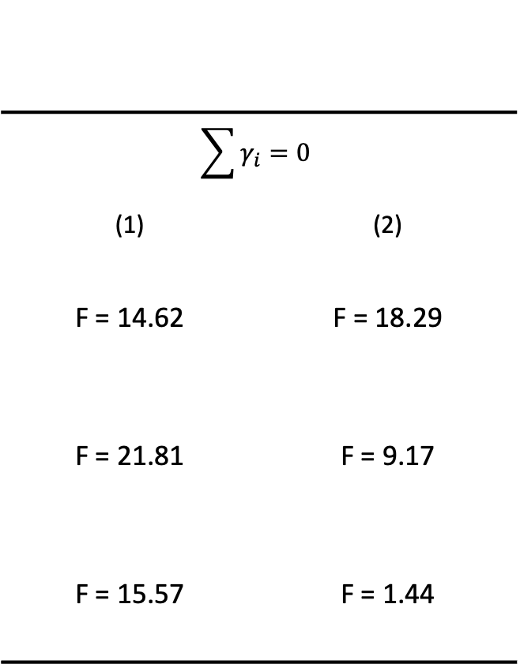
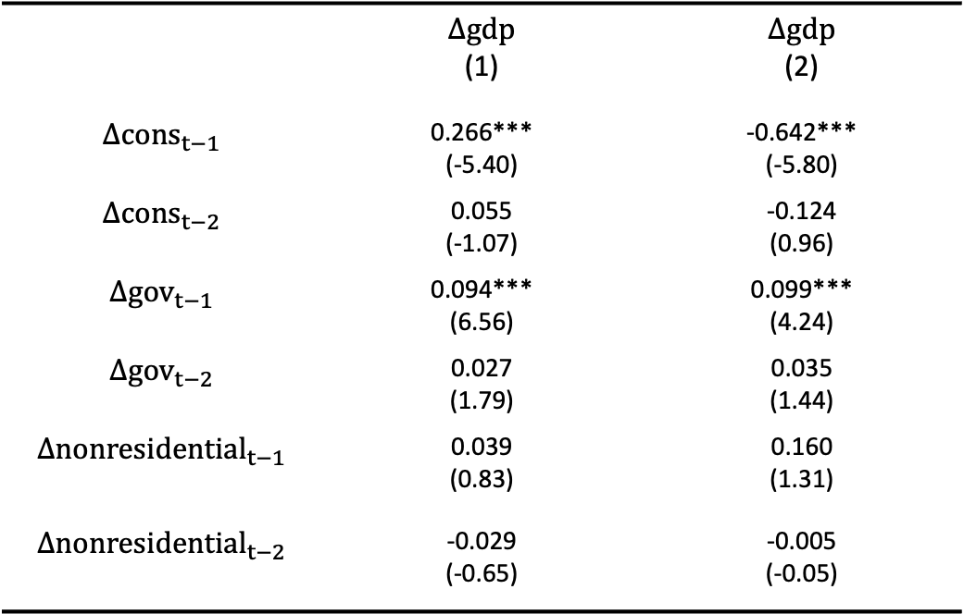
Other factors and the Business Cycle
Simple Granger Test
$Δ{cons}_{t}$= Consumption growth
$Δ{gov}_{t}$ = Government Expenditure Growth
$Δ{nonresidential}_{t}$ = Non Residential Investment Growth
(1) 1970-2023 (2) 2000 -2023
$$ΔGDP_{t}=α+β_{1}ΔGDP_{t−1}+β_{2}ΔGDP_{t−2}+γ_{1}ΔX_{t−1}+γ_{2}ΔX_{t−2}+e_{t}$$
$$ΔX_{t}$$
$$\sum{γ_{i}=0}$$
(1) | (2)
F = 14.62 | F = 18.29
F = 21.81 | F = 9.17
F = 15.57 | F = 1.44
 | $$Δgdp$$ (1) | $$Δgdp$$ (2)
$$Δ{cons}_{t−1}$$ | 0.266*** (-5.40) | -0.642*** (-5.80)
$$Δ{cons}_{t−2}$$ | 0.055 (-1.07) | -0.124 (0.96)
$$Δ{gov}_{t−1}$$ | 0.094*** (6.56) | 0.099*** (4.24)
$$Δ{gov}_{t−2}$$ | 0.027 (1.79) | 0.035 (1.44)
$$Δ{nonresidential}_{t−1}$$ | 0.039 (0.83) | 0.160 (1.31)
$$Δ{nonresidential}_{t−2}$$ | -0.029 (-0.65) | -0.005 (-0.05)
Inside brackets: t statistics
<0.05, ** p<0.01, *** p<0.001
*quarterly data

Slide 9
Housing Price Dynamics
Real Housing Index= β0 + β1 (Short term Int Rate) + β2 (Credit to Household Sector) + β3 (Working Age Population) + β4 (Per Capita GDP) + β5 (Lagged Real Housing Price Index)
Country | Constant | STIR | Credit | Working Age Population | Per Capita Real GDP | Lagged House Prices Growth
USA | -0.50 | -0.42* | 0.43 | -0.10 | 0.82* | 0.52***
AUS | 4.75 | -0.04* | 0.17** | -3.07 | 0.51 | 0.20*
CAN | 3.70 | -0.60 | 0.97*** | -9.24*** | 0.43 | 0.23
UK | -0.44 | 0.10 | 0.10 | 1.69 | 0.82** | 0.40*
Panel | 0.96 | -0.47 | 0.15 | -0.94 | 0.74* | 0.30
Dependent Variable: Change in Log House Prices at time t.
STIR: Changes in Log STIR at time t.
Credit: Changes in Credit to households at time t.
Working Age Population: Changes in working age population at time t.
Per Capita Real GDP: Per Capita Real GDP Growth Rate at time t.
Lagged House Prices Growth: Change in Log House Prices at time t-1.
* p<0.05, ** p<0.01, *** p<0.001
Notes:
Regress these 5 variables on house price index
Hp are affected by different channels

Slide 10
Interest Rate Coefficient

Slide 11
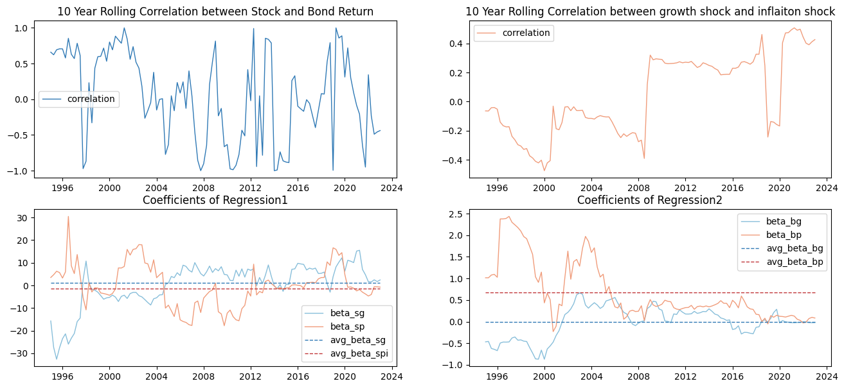
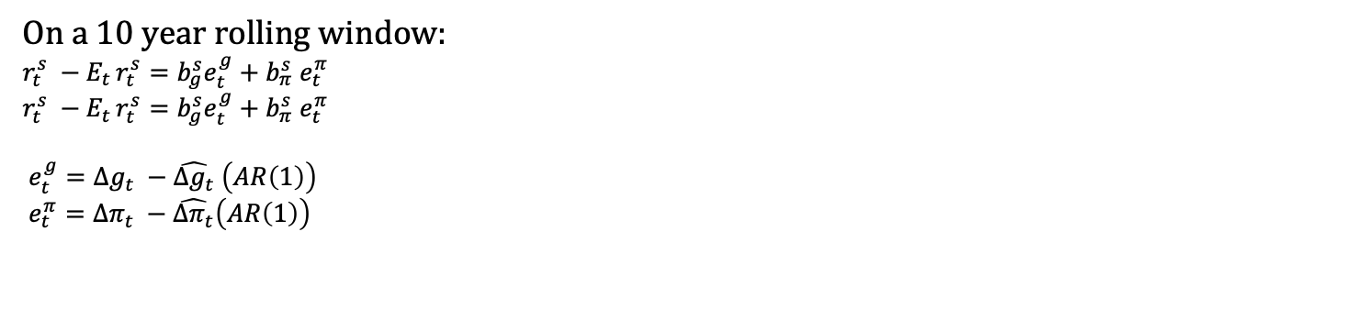
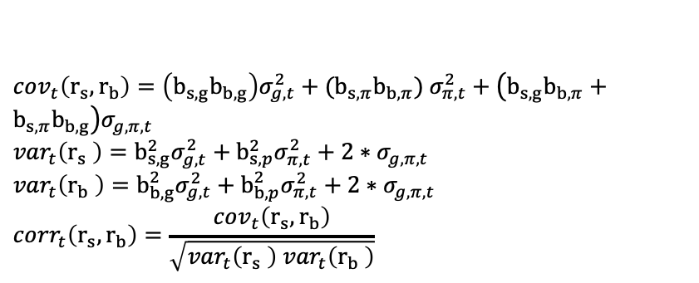
Correlation between Stock and Bond Return
On a 10 year rolling window:
$$r_{t}^{s} −E_{t }r_{t}^{s}=b_{g}^{s}e_{t}^{g}+b_{π}^{s} e_{t}^{π}$$
$r_{t}^{s} −E_{t }r_{t}^{s}=b_{g}^{s}e_{t}^{g}+b_{π}^{s} e_{t}^{π}$
$$e_{t}^{g}=Δg_{t} −\hat{Δg_{t}} \left(AR\left(1\right)\right)$$
$$e_{t}^{π}=Δπ_{t} −\hat{Δπ_{t}}\left(AR\left(1\right)\right)$$
$cov_{t}\left(r_{s},r_{b}\right)=\left(b_{s,g}b_{b,g}\right)σ_{g,t}^{2}+(b_{s,π}b_{b,π})$ $σ_{π,t}^{2}+\left(b_{s,g}b_{b,π}+b_{s,π}b_{b,g}\right)σ_{g,π,t}$
$${var}_{t}\left(r_{s} \right)=b_{s,g}^{2}σ_{g,t}^{2}+b_{s,p}^{2}σ_{π,t}^{2}+2∗σ_{g,π,t}$$
$${var}_{t}\left(r_{b} \right)=b_{b,g}^{2}σ_{g,t}^{2}+b_{b,p}^{2}σ_{π,t}^{2}+2∗σ_{g,π,t}$$
$$co{rr}_{t}\left(r_{s},r_{b}\right)=\frac{cov_{t}\left(r_{s},r_{b}\right)}{\sqrt{{var}_{t}\left(r_{s} \right) {var}_{t}\left(r_{b} \right)}}$$
regression1&2
regression3&4
predict inflation/output shock using AR(1)
*quarterly data
Notes:
Fluctuate a lot
important to explain
Rolling correlation reveal a positive trend
Demand pull inflation
First estimate
Then

Slide 12
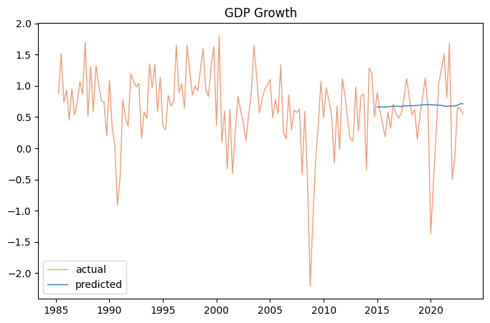
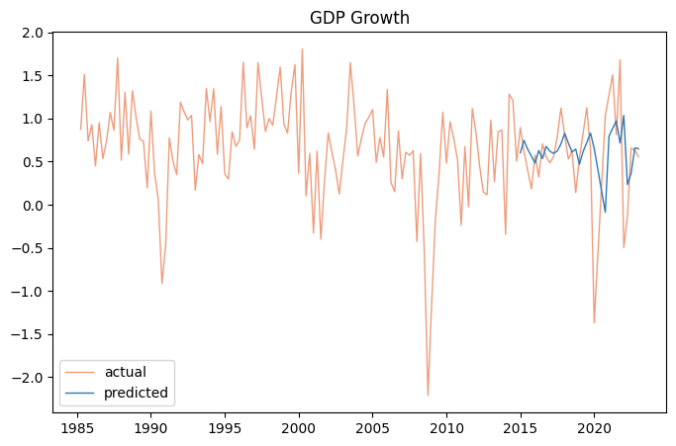
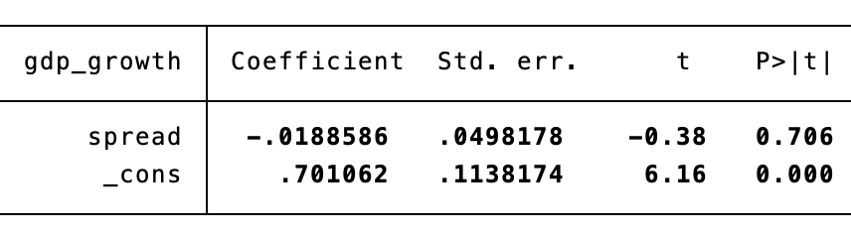
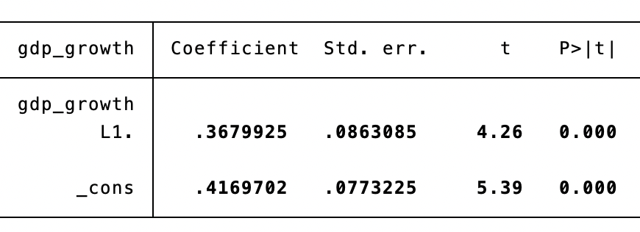
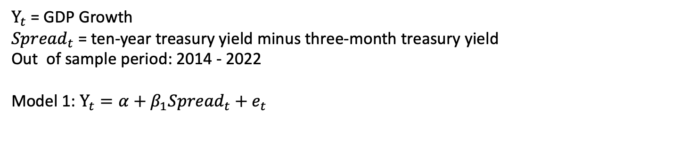

Yield Curve Prediction
$Y_{t}$ = GDP Growth
${Spread}_{t}$ = ten-year treasury yield minus three-month treasury yield
Out of sample period: 2014 - 2022
Model 1: $Y_{t}=α+β_{1}{Spread}_{t}+e_{t}$
Model 2: $Y_{t}=α+β_{1}Y_{t−1}+e_{t}$
*quarterly data

Slide 13
In all these 4 countries: United States, Canada, Australia, United Kingdom
Monetary Policy
Inflation Targeting are effective to defend high inflation.
Taylor rules are higher than real policy interest rates.
House Market
Interest rate, income growth are crucial drivers, while land availability and regulations are main constraints in housing market.
House price can be used as leading indicators for the Canada, Australia, UK’s business cycle. Other leading factors such as consumption, non-residential investment, government spending vary across different countries.
Stock Market
Hard to predict output using yield spread.
Negative correlation between stock and bond return in UK, Australia.

