Slide 1
The ORMS system
by Li Huiling(21802493)​
Supervised by ROHINI GAUR​

Slide 2
contents
introduction
Structure of the project
UML diagram
Structure of the project layers
Function flows
Key concepts
OOP features
Interface
Abstract
Event handlers
Delegate
Design patterns
Data storage
Exception handlers
Report
Issues Faced & Future Work

Slide 3
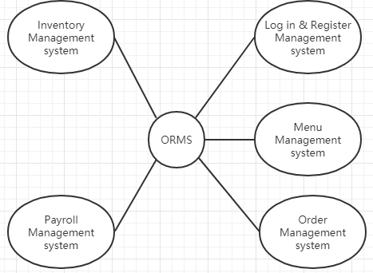
Introduction
Scope and functional requirements
The purpose of the project is to design an internal restaurant management system for Olive’s Restaurant.

Slide 4
Introduction
Technical Requirements
Visual studio
Microsoft SQL server
Computer

Slide 5
contents
introduction
Structure of the project
UML diagram
Structure of the project layers
Function flows
Key concepts
OOP features
Interface
Abstract
Event handlers
Delegate
Design patterns
Data storage
Exception handlers
Report
Issues Faced & Future Work

Slide 6
UML diagram – version 1

Slide 7
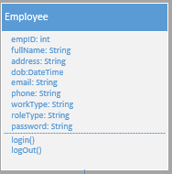
UML diagram – changes
Changes
use concrete class of Employee instead of the abstract class and four different role type
Justification
Add field of role type and it is easier to design and use database
Changes
Change the customer class to table class
Justification
No customer class are required in the assignment

Slide 8
UML diagram – changes
Changes
Add an interface for all the CURD operation
Justification
Use a standard signature and it is flexible to expand new functions and maintain the project.

Slide 9
UML diagram – changes
Changes
Use a controller for most methods instead of putting methods in each classes
Justification
Through ADO.Net, the classes are given without methods
It reduces the number of generating objects by putting methods together

Slide 10
contents
introduction
Structure of the project
UML diagram
Structure of the project layers
Function flows
Key concepts
OOP features
Interface
Abstract
Event handlers
Delegate
Design patterns
Data storage
Exception handlers
Report
Issues Faced & Future Work

Slide 11
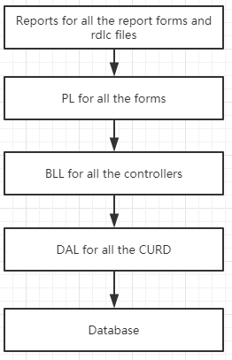
Structure of the project
Design Pattern: SOC
Changes:
Use SOC pattern
Reason:
SOC pattern: Separate sections.

Slide 12
contents
introduction
Structure of the project
UML diagram
Structure of the project layers
Function flows
Key concepts
OOP features
Interface
Abstract
Event handlers
Delegate
Design patterns
Data storage
Exception handlers
Report
Issues Faced & Future Work

Slide 13
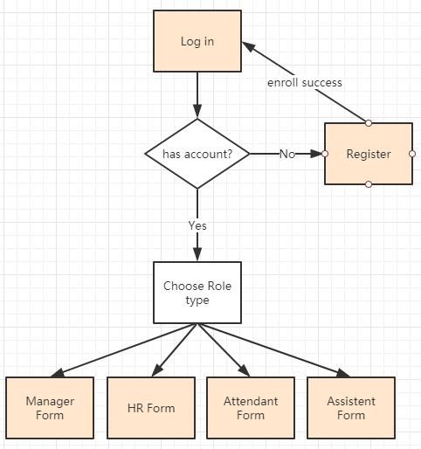
Function Flow – Log in & register
Key concepts:
Abstract class: NA
Interface: NA
Polymorphism: NA
Self-define Event handler: NA
Design patterns: NA
Changes:
Cancel the inheritance of the Employee abstract class.
Reason: No need and easier.

Slide 14
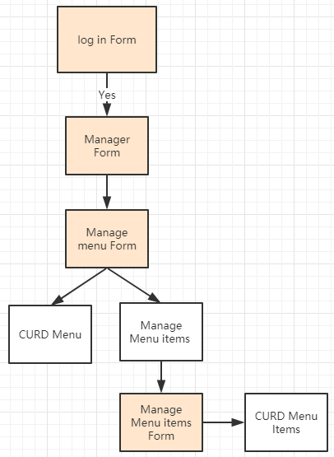
Function Flow – Menu
Key concepts:
Abstract class: NA
Interface: NA
Polymorphism: NA
Self-define Event handler: NA
Design patterns: NA
Changes: NA.

Slide 15
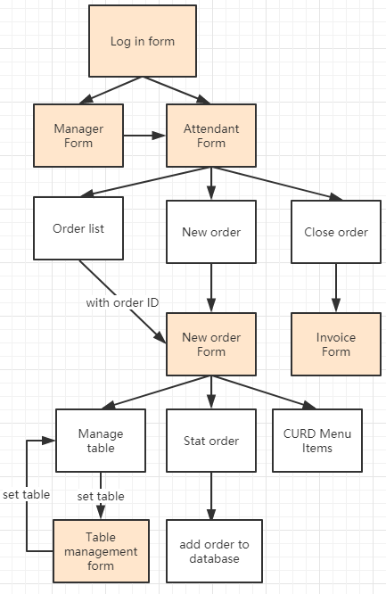
Function Flow – Order
Key concepts:
Abstract class: NA
Interface: NA
Polymorphism: NA
Self-define Event handler: Table management
Delegate: table & order
Design patterns: Observer
Changes: NA.

Slide 16
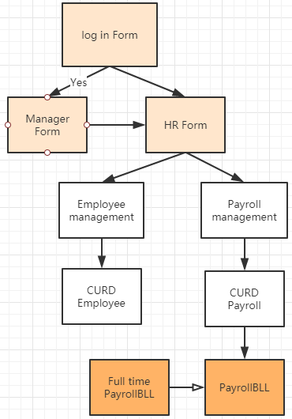
Function Flow – Payroll
Key concepts:
Abstract class: Yes
Interface: NA
Polymorphism: Yes
Self-define Event handler: NA
Design patterns: NA
Changes: NA.

Slide 17
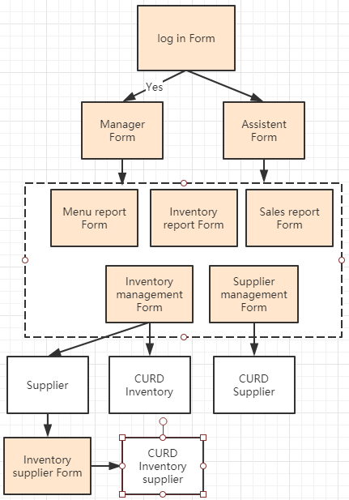
Function Flow – Inventory & supplier
Key concepts:
Abstract class: NA
Interface: NA
Polymorphism: NA
Self-define Event handler: NA
Design patterns: Observer
Changes: NA.

Slide 18
contents
introduction
Structure of the project
UML diagram
Structure of the project layers
Function flows
Key points
OOP features
Interface
Abstract
Event handlers
Delegate
Design patterns
Data storage
Exception handlers
Report
Issues Faced & Future Work

Slide 19
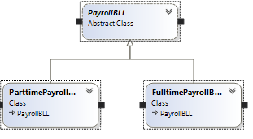
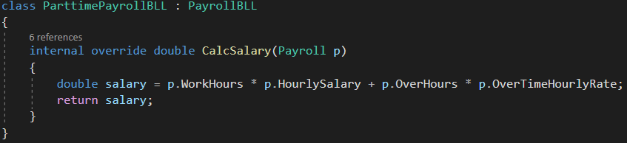
Key point– OOP features Polymorphism
Current status: calculate salary for different work type
Changes: NA.

Slide 20
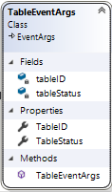
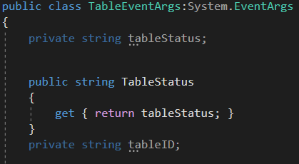
Key point– OOP features Encapsulation
Current status: keep fields as private
Changes: NA.

Slide 21
Key point– OOP features Inheritance
Current status: use inheritance in each form and the payrollBLL class
Changes: NA.

Slide 22
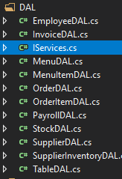
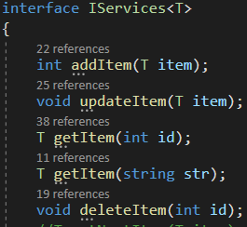
Key point– interface
Current status: use Iservices<T> in Iterator Pattern
All the CRUD operation implement it.
Changes:
Two interfaces are not used in the system: IObserver and Icommand.
Reason:
Using a delegate replaces the Iobserve.
Command Pattern is not very suitable for this system.
Use an interface to access database is more helpful for maintainability for the system. maintainability

Slide 23
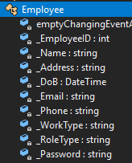
Key point– Abstract
Current status: use PayrollBLL class as abstract class
Changes:
Employee abstract class is not used in the system.
Reason:
Using Employee abstract class is insignificant, use role type can distinguish different roles.

Slide 24
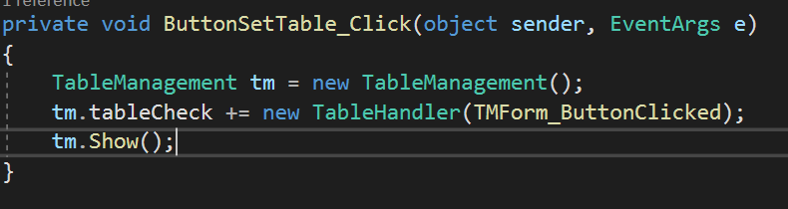
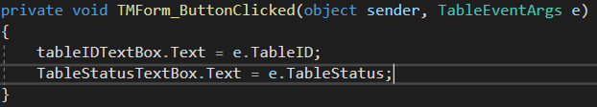
Key point– Event handlers
Current status: use plenty of event handlers for buttons and forms as well as self-defined event handlers.
Use self-defined event handler in observer pattern in order system.
Changes:
Did not used self-defined event handler when creating invoice.
Reason:
It happens in a button click event, which is easier.

Slide 25

Key point– Delegates
Current status: use delegate in observer Pattern
Transfer table status to the order form.
Replace the interface for observers.
Changes:
NA.
Reason:
NA.

Slide 26

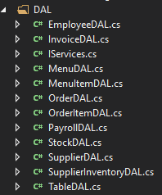
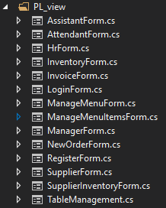
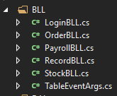
Key point– Design pattern SOC

Slide 27
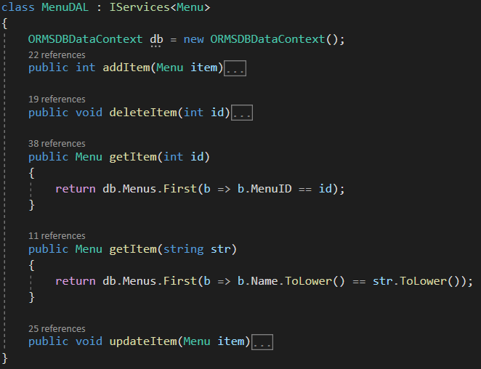
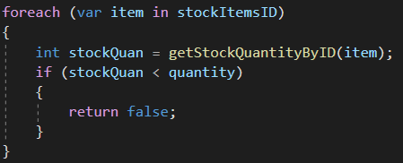
Key point– Design pattern Iterator

Slide 28
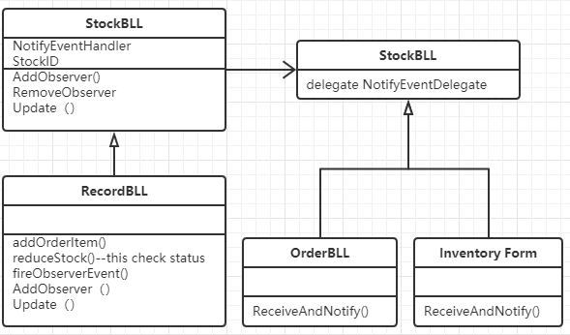
Key point– Design pattern Observer
Current status: table and order function use this pattern

Slide 29
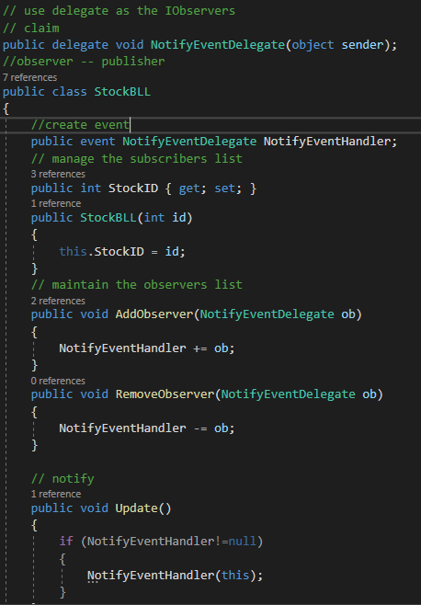
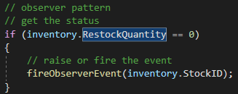
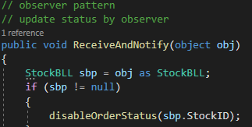
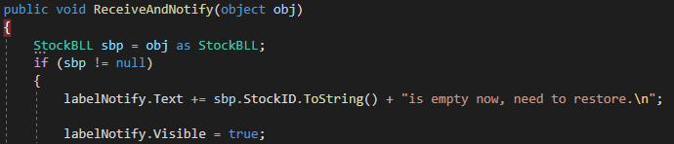
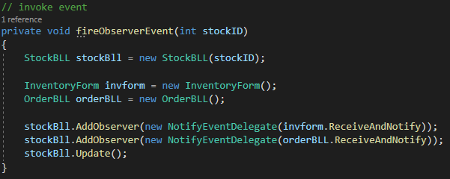
Key point– Design pattern Observer

Slide 30


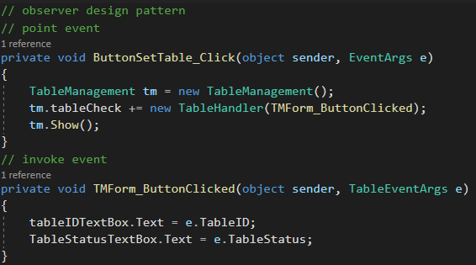
Key point– Design pattern Observer
Current status: table and order function use this pattern

Slide 31
contents
introduction
Structure of the project
UML diagram
Structure of the project layers
Function flows
Key points
OOP features
Interface
Abstract
Event handlers
Delegate
Design patterns
Data storage
Exception handlers
Report
Issues Faced & Future Work

Slide 32
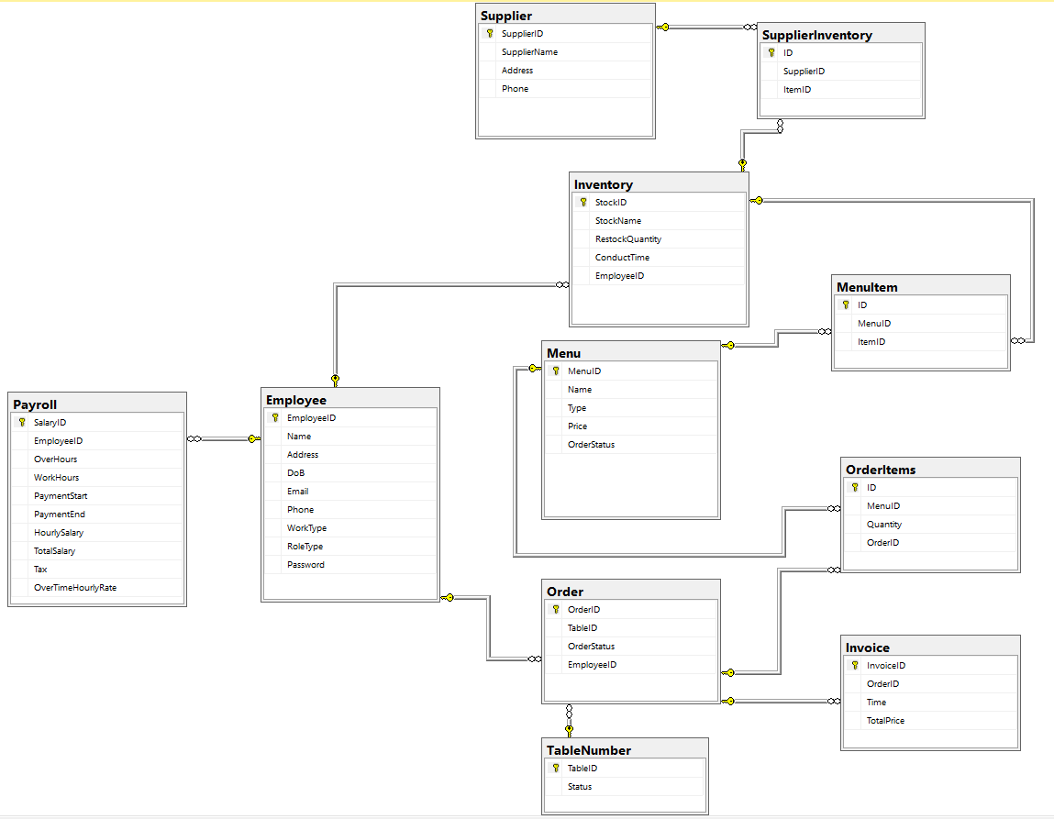
Data storage

Slide 33
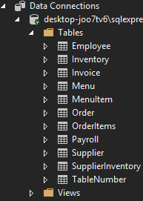
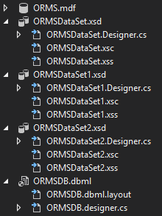
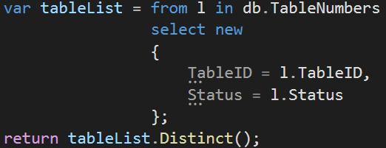
Data storage
Used LINQ to query data
Used ADO.net to manipulate database
Used a .dbml file to store data as classes
Used .xsd files to transfer data to reportviewer.

Slide 34
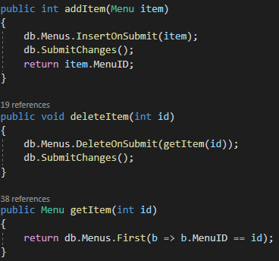
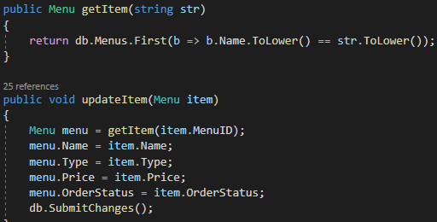
Data storage

Slide 35
contents
introduction
Structure of the project
UML diagram
Structure of the project layers
Function flows
Key points
OOP features
Interface
Abstract
Event handlers
Delegate
Design patterns
Data storage
Exception handlers
Report
Issues Faced & Future Work

Slide 36
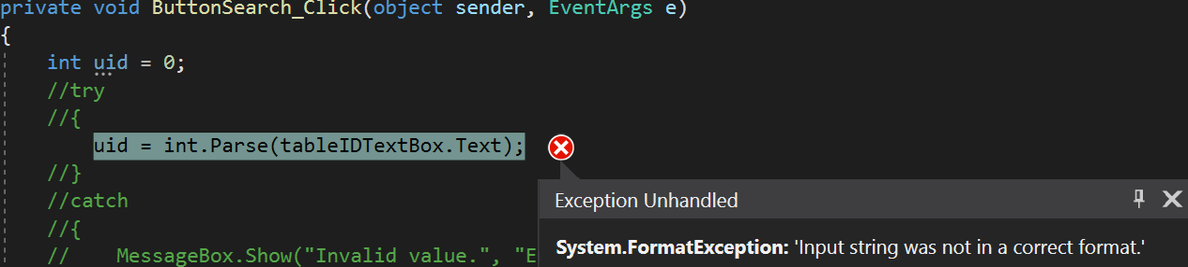
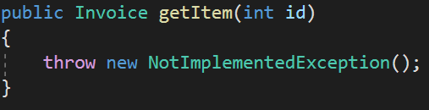
Exception handles
FormatException
While search by ID, if the input is null, it will throw this exception.
NotImplementedException
Sometimes forgot to implement a method.

Slide 37
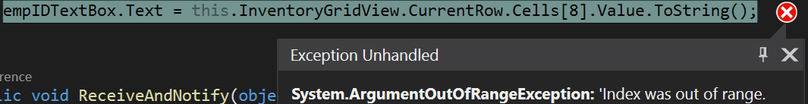
Exception handles
ArgumentOutOfRangeException
While handling the GridViews, if the indexer of cells is out of range, it will throw this exception.
StackOverflowException
If two classes try to create a new object in their classes, it might occur this exception.

Slide 38
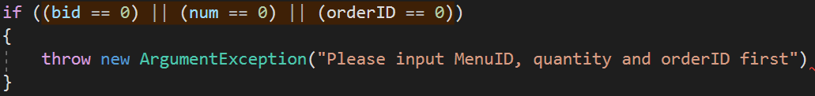
Exception handles
ArgumentException
While handling the input items, if the input is null, it will throw this exception.

Slide 39
contents
introduction
Structure of the project
UML diagram
Structure of the project layers
Function flows
Key points
OOP features
Interface
Abstract
Event handlers
Delegate
Design patterns
Data storage
Exception handlers
Report
Issues Faced & Future Work

Slide 40
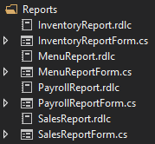
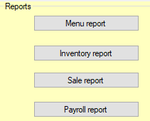
Report

Slide 41
Contents
introduction
Structure of the project
UML diagram
Structure of the project layers
Function flows
Key points
OOP features
Interface
Abstract
Event handlers
Delegate
Design patterns
Data storage
Exception handlers
Report
Issues Faced & Future Work

Slide 42
Issues Faced & Future Work
Issues
Before using the system, employees need to be trained.
Future work
Customer membership
Reserve table
Waiting Queue
Specials
Waiting game
Customer self-order system
Customer self-payment

Slide 43
Thank you!

