Slide 1
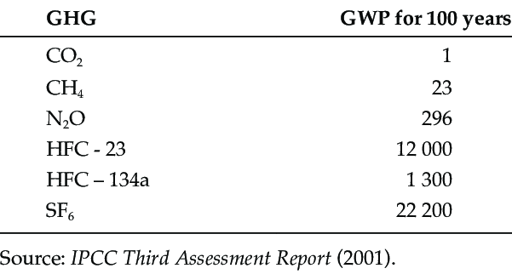
CARBON DIOXIDE EQUIVALENT
CO₂ EQUIVALENT
CO₂-EQ
= metric measure used to compare the emissions from various greenhouse gases on the basis of their global warming potential (GWP)

