Slide 1
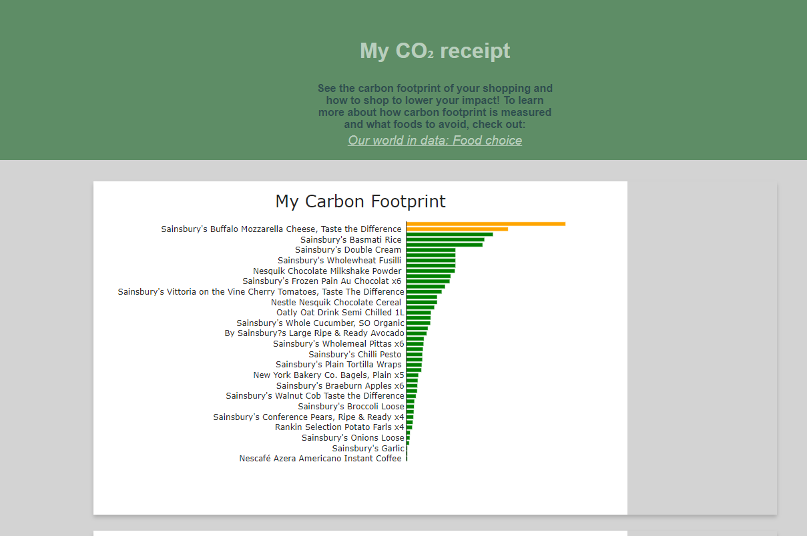
Dropdown
(per item
per kg)

Slide 2
The impact of your shopping is equivalent to XYZ kg of CO₂ This is like driving xxx miles in an a average sized car.
You bought PRODUCT A. Product B has similar protein but XX % lower (compared to PRODUCT A) impact on our planet?
Making this swap could reduce the carbon footprint of your shop by Y kg.

