Slide 1
Investigating the Spanish to English Metamorphosis of Amadís de Gaula with TEI
Stacey Triplette
University of Pittsburgh at Greensburg
Elisa Beshero-Bondar
University of Pittsburgh at Greensburg
Helena Bermúdez Sabel
University of Santiago de Compostela

Slide 2
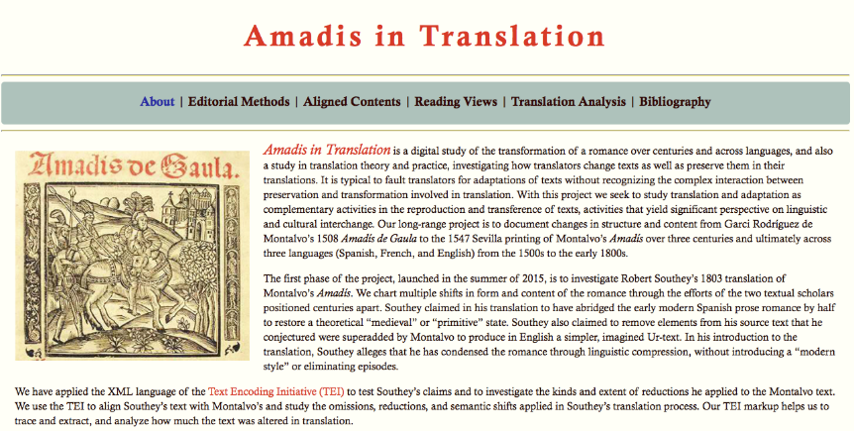
amadis.newtfire.org
https://github.com/ebeshero/Amadis-in-Translation
Notes:
About page from our website, which we are currently building

Slide 3
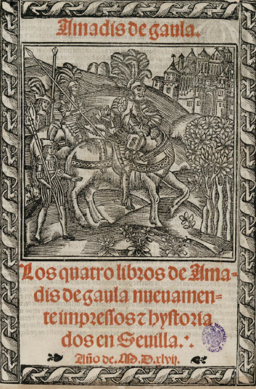
Texts:
15th c fragment
Garci Rodríguez de Montalvo, Amadís de Gaula (1508)
Spanish editions (1526, 1533)
Nicolas de Herberay, French translation (1540)
Anthony Munday, English translation (1590)
Louis-Élisabeth de la Vergne, Conte de Tressan, French translation (1779)
Robert Southey, English translation (1803)
Edwin Place, English translation (1974)
Notes:
Title age
(nb: this is not a frontispiece, not common with libros de caballerías, would be the verso facing the recto title page)

Slide 4
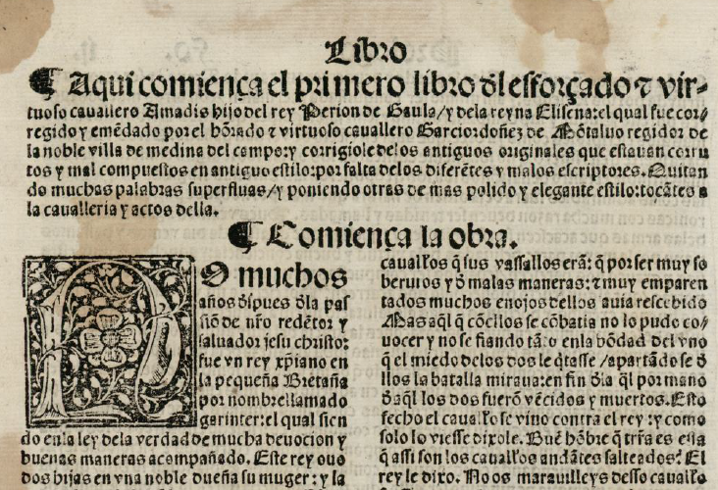
Notes:
Beginning of Montalvo’s book one. Notable features: chapter summary, whitespace to introduce it, chapter heading, large initial letter, differences in type size. Folio size, two-column format.

Slide 5


The calderón,
paragraph symbol
The tironian sign symbol for “and” (y or et)
Notes:
Special symbols

Slide 6
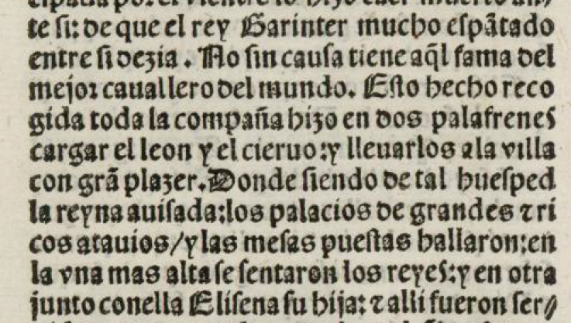
Punctuation
/ : .
Notes:
Punctuation
Afterward: Editorial declaration: https://github.com/ebeshero/Amadis-in-Translation/wiki/Editing-Methods-for-Amadis-in-Translation

Slide 7
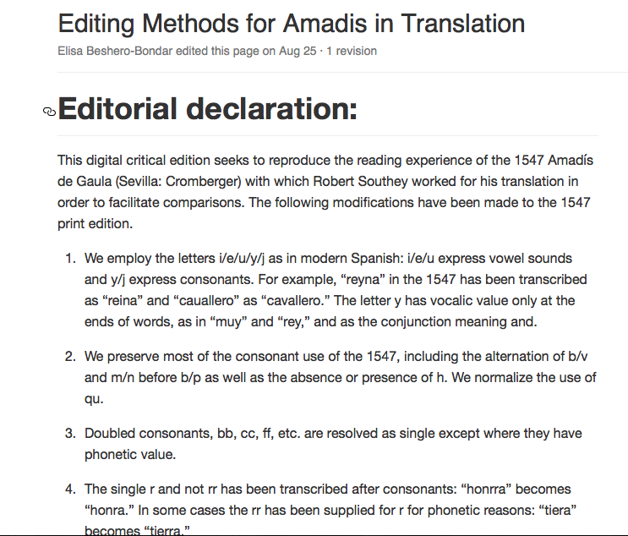
Notes:
Influenced by Pedro Sánchez-Prieto Borja, Cómo editar los textos medievales

Slide 8
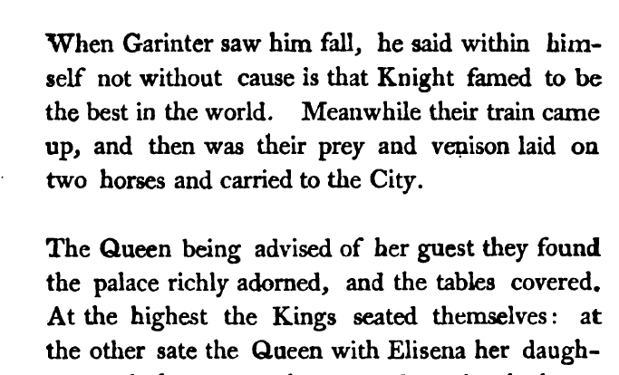
Notes:
From Southey’s 1803 edition of Amadís, sourced from Hathi Trust. Shows Southey’s internal divisions. From Chapter 1, in a place with no paragraph division in the Montalvo. Go back to slide 6: we can see how Southey has taken into account, at least as a baseline, the 1547 punctuation.

Slide 9
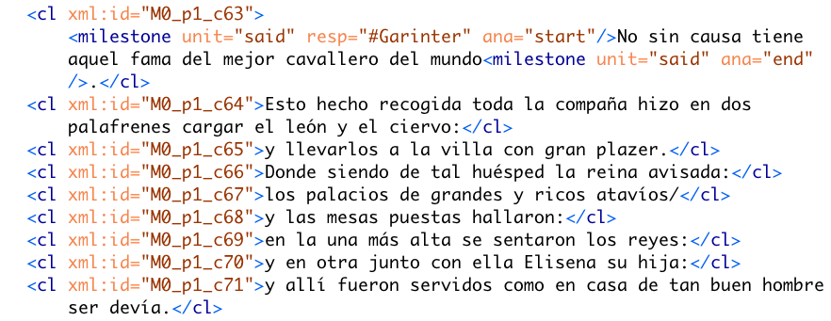
Notes:
Corresponds to the same passage of text as in the previous Southey slide. Elisa: We had a difficult decision to make about this clause markup when we started this project. We would often see dependent clauses within Montalvo that we wanted to nest, but we decided to AVOID generating nested hierarchies here: We sacrificed the preparation of accurate syntactical markup for our research question in favor of aligning the two texts. So each “clause-like” unit is a sibling in the XML hierarchy is a sort of geocoordinate reference to which we can map portions of Southey’s text. This makes it easier for us to reveal when Southey reverses clause order, weaves two of Montalvo’s units together, or jumps ahead or back in Montalvo’s text.

Slide 10
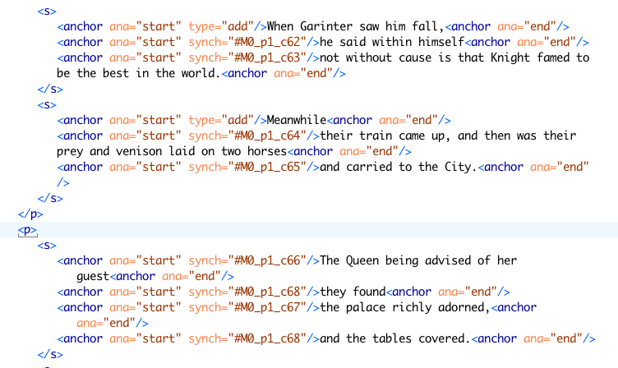
Notes:
Alignment coding: Southey aligned to Montalvo with self-closing anchor elements. These mark with @synch alignment points with Montalvo. (ELISA: We aren’t using xml:ids on Southey’s sentences, but we use this markup to “tether” passages of the Southey text with Montalvo. We find there are often multiple units per sentence, and we use the self-closing elements so that units can cross sentences boundaries.

Slide 11
Regex for Up-Conversion
To find ends of sentences: \.\s[A-Z] Same with capturing groups: (\.)\s([A-Z])
Replace with: \1</s><s>\2
Some tips:
1. Select the text of the transcription (so the regex is not applied to the header)
2. Open the find and replace dialogue (Ctrl + F) and select “Selected lines only”
3. Find: (\.|:|/|\?)\s
4. Replace with: \1</cl>\n<cl>
5. Add a <cl> just after the <p> element and delete the <cl> before the paragraph closing tag </p>
Other things to remember: When there is a new clause that begins with a capital letter but punctuation is absent.
Clause.....ends<choice><sic></sic><corr>.<corr></choice></cl><cl>New clause here...
Notes:
Elisa: Southey’s text is available from a GitHub source which we’ve been correcting against a published edition of his 1803 text. However, Montalvo’s text isn’t available in any machine readable format, so we’ve been transcribing that by hand. We then applied regular expressions to add <cl> elements at markable clause-like unit boundaries. (And of course we had an easier time with preparing <s> elements to Southey.

Slide 12
XSLT for Up-Conversion, adding xml:ids
<xsl:template match="cl[not(ancestor::argument)]"> <cl> <xsl:attribute name="xml:id"> <xsl:value-of select="./ancestor::div[@type='chapter']/@xml:id"/> <xsl:if test="./ancestor::floatingText"> <xsl:text>_ft</xsl:text> <xsl:number select="./ancestor::floatingText[1]" level="any"/> </xsl:if> <xsl:text>_</xsl:text> <xsl:value-of select="./parent::*/name()"/> <xsl:number select="./parent::*" level="any" count="//div[@type='chapter']//p[not(parent::argument)]"/> <xsl:text>_c</xsl:text> <xsl:number level="any" count="//div[@type='chapter']//cl[not(ancestor::argument)]"/> </xsl:attribute> <xsl:apply-templates/> </cl> </xsl:template>
Notes:
Elisa: We then wrote XSLT to construct human-readable XML:IDs sitting at the chapter and clause levels of the text. Floating texts were designated for representations of texts within the text, and they’re given distinct XML:ID to indicate their special status.

Slide 13
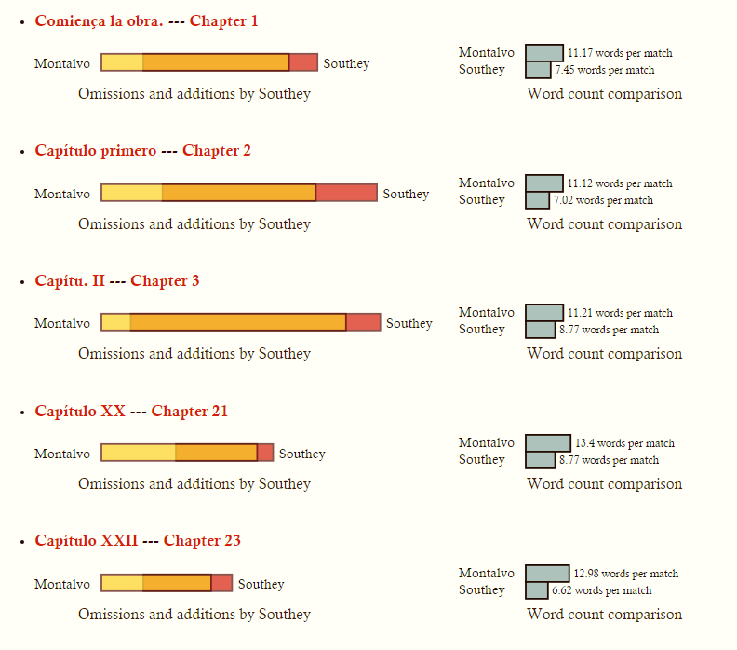
Notes:
Elisa: The next slides show our first results in comparing Southey’s translation to the Montalvo text. Here’s what we’re learning so far. As we are designing our website, we want to use this page as our table of contents, so that our site visitors can quickly identify the chapters most altered by Southey. The orange band in the center indicates the proportion of overlap. The word count comparisons interest us, though we are not sure how significant they are: We are interested in gauging the extent of Southey’s boasted “compression” of Montalvo, so we use XSLT to generate these graphs by counting white spaces for makeshift word counts in between <anchor/> elements of different kinds. Where Southey omitted passages we don’t apply tags, but we note where he skips over unit passages in Montalvo.

Slide 14
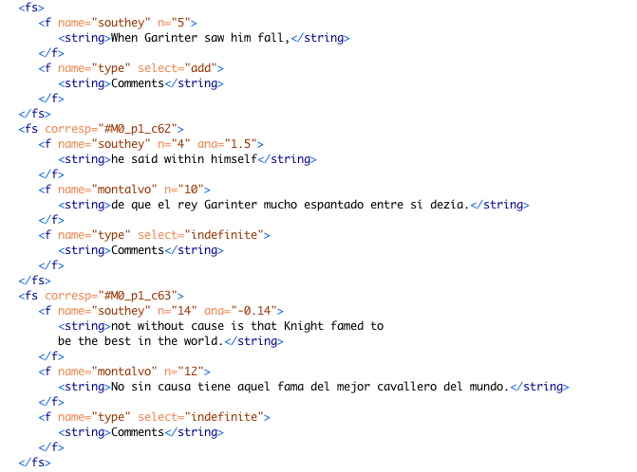
Notes:
To analyze the aligned passages further, and help Stacey to survey them to plot patterns, we make an additional TEI file corresponding to each chapter, using the TEI’s handy feature structures markup, to extract each Southey passage, and where it’s in sync, we set it next to the corresponding passage in Montalvo to produce one Feature Structure file for each chapter. @n indicates a word count, and @ana indicates by how much proportionally the passage was either compressed or expanded from a corresponding passage in Montalvo. Within an fs element we pull each “anchored event” (so to speak) from Southey,, and where these are not additions or omissions, they contain side-by-side units of matched text. We add a <string> element for writing in our comments on the translation, and we plan to develop a system of classifying the kinds of alterations Southey makes in his version of the translation. For example (though this is not shown), we find that frequently Montalvo represents every speech-act directly, while Southey turns this in to indirect discourse. He is likely making changes in the syntax, too.

Slide 15
A snippet of XSLT: Constructing the <f> element for Southey in a given <fs>
If an @synch attribute is present on an <anchor>, the passage is linked to Montalvo.
@ana is a calculation of the proportion by which Montalvo’s word count differs from Southey’s
<xsl:element name="f"> <xsl:attribute name="name">southey</xsl:attribute> <xsl:attribute name="n"> <xsl:value-of select="$southey-words"/> </xsl:attribute> <xsl:if test="@synch"> <xsl:attribute name="ana"><xsl:value-of select="round-half-to-even(($montalvo-words - $southey-words) div $southey-words, 2)" /> </xsl:attribute> </xsl:if>
Notes:
Generating Feature Structures markup: just the “f’ element and @ana: How we’re calculating @ana, our signal of proportional difference in size between Montalvo and Southey. (The function round-half-to-even() can take two arguments—the “2” at the end indicates the number of decimal places.)

Slide 16
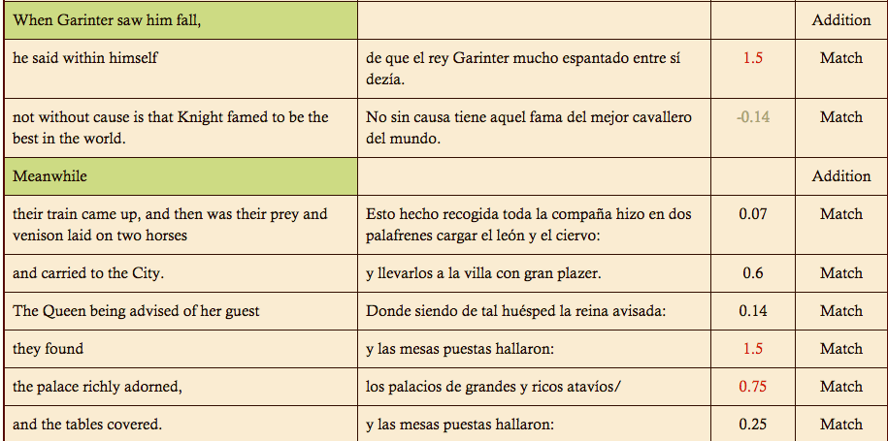
Notes:
Output table by Helena Bermúdez Sabel: This is an HTML view pulled from our feature structures markup for a chapter. The higher the number, the more compression Southey applied.
BACK to Stacey

Slide 17
Robert Southey on Amadís
“To have translated a closely printed folio would have been absurd. I have reduced it to about half its length, by abridging the words, not the story […] There is no vanity in saying, that this has improved the book, for what long work may not be improved by compression?”
Notes:
From the Preface (xxi)

Slide 18
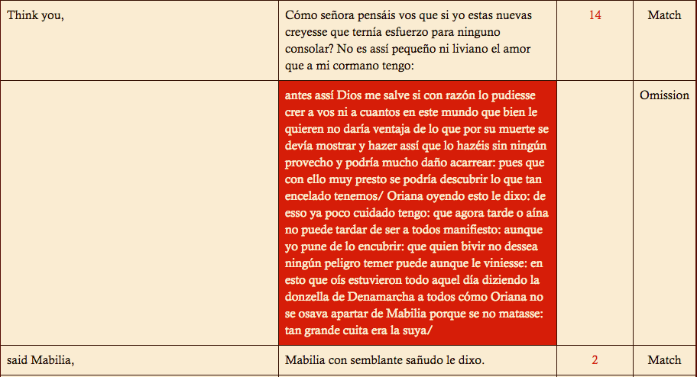
Notes:
Image 9: From Montalvo 20/ Southey 21. Show where this corresponds—this is typical of Southey’s omission criteria. Repetition, participation of minor characters.

Slide 19
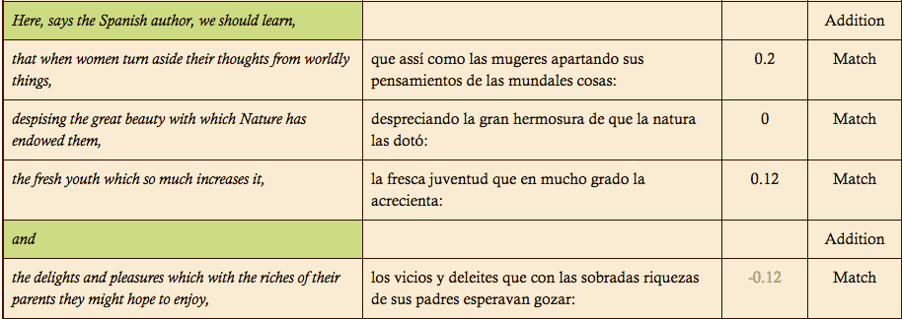
Notes:
**Stacey introduces this slide and the next, and then Elisa backtracks here.
Elisa: These notes recently sparked debate among our little project team, because we noticed that Southey sometimes positions short quotes from Montalvo’s Spanish with word-for-word translations in some of his notes: We questioned whether this constitutes an OMISSION of Montalvo’s text from the main text of Southey’s translation, OR if it’s a way of preserving the translation at a different level of the text. We decided that such passages constitute a transposed translation, and we want to collect and study them together…Southey’s annotations take the form of footnotes, and they often have a significant function as part of the main text

Slide 20
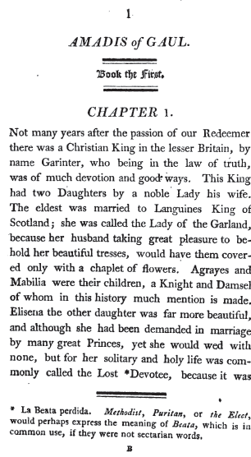
Notes:
The same note in the published 1803 Southey text.

Slide 21
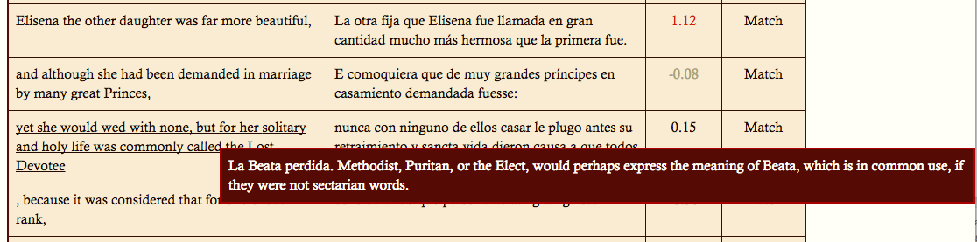
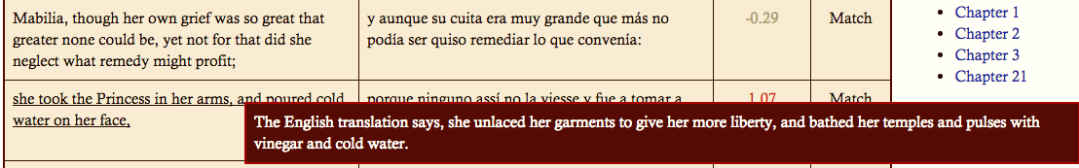
Notes:
First note references the Spanish. It’s one of the few examples we’ve found of a misreading or mistranslation by Southey. Second note references another translation.
Pass to Elisa: go to previous slide.

Slide 22
What’s Next?
Finish coding Montalvo’s Book I and “synch” with Southey encoding.
Classify the alterations Southey makes to Montalvo
Train an OCR method to assist us.
Then….
Code the two French and two English translations and apply the same markup to compare the kinds of change
Long-range question:
What does life cycle and translation cycle of Amadis tell us about the way fiction is translated across genres, cultures, centuries?

