Slide 1
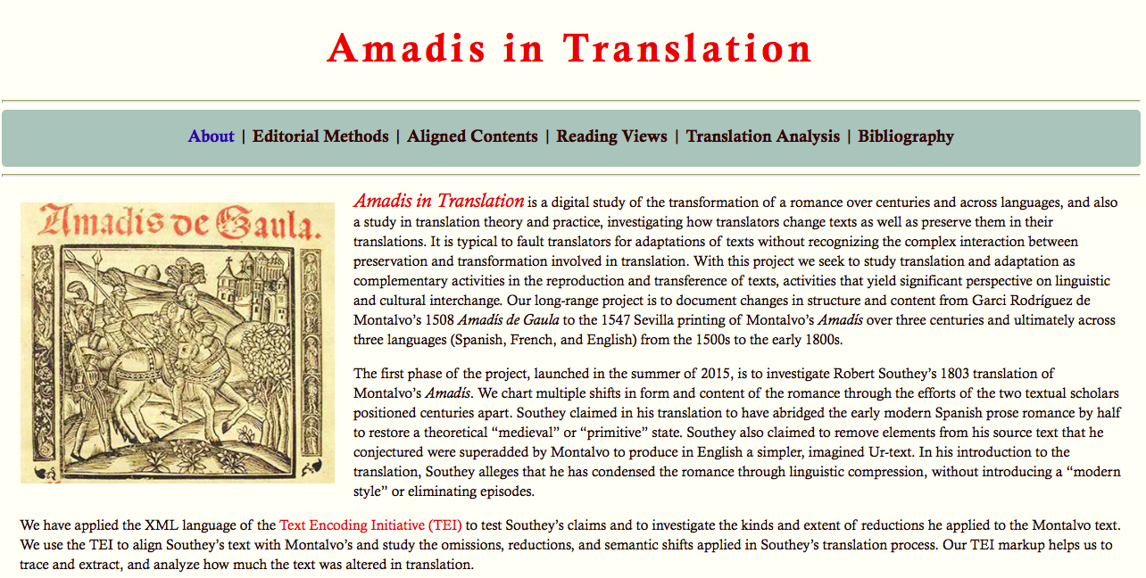

Slide 2
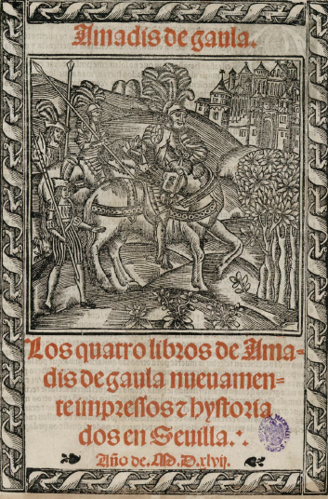
Notes:
Image one: title page
(nb: a frontispiece, not common with libros de caballerías, would be the verso facing the recto title page)

Slide 3
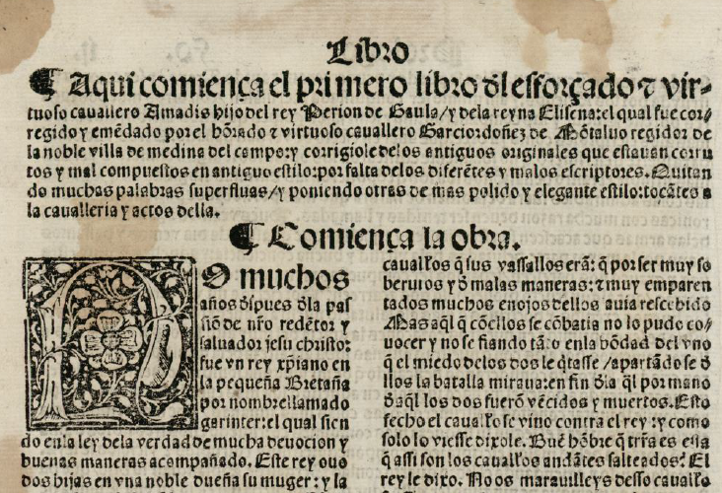
Notes:
Image Two. Beginning of Montalvo’s book one. Notable features: chapter summary, whitespace to introduce it, chapter heading, large initial letter, differences in type size. Folio size, two-column format.

Slide 4


The calderón,
paragraph symbol
The tironian sign symbol for “and” (y or et)
Notes:
Image Three: special symbols

Slide 5
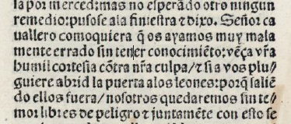
Punctuation
/ : .
Notes:
Image Four: punctuation
Afterward: Editorial declaration: https://github.com/ebeshero/Amadis-in-Translation/wiki/Editing-Methods-for-Amadis-in-Translation

Slide 6
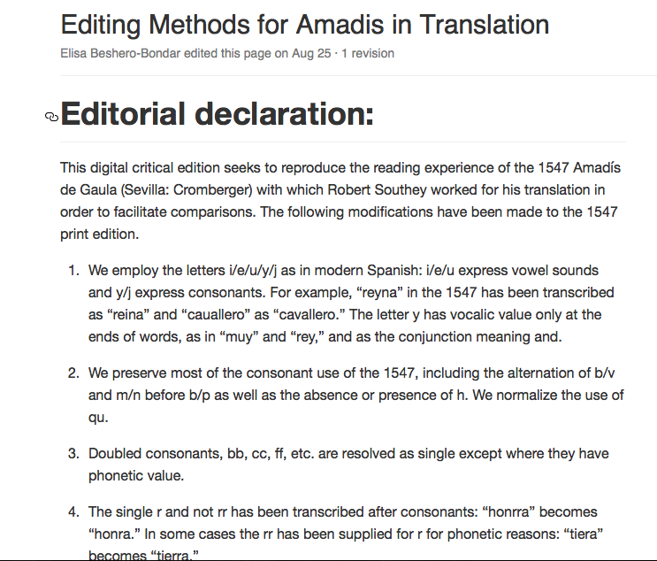

Slide 7
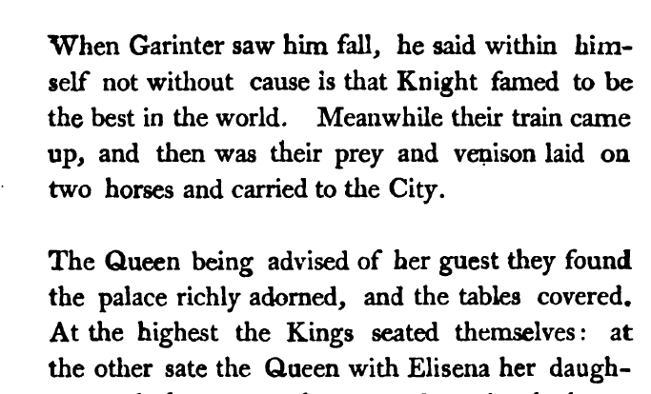
Notes:
Image 6: Southey’s internal divisions. From Chapter 1, in a place with no paragraph division in the MOntalvo

Slide 8
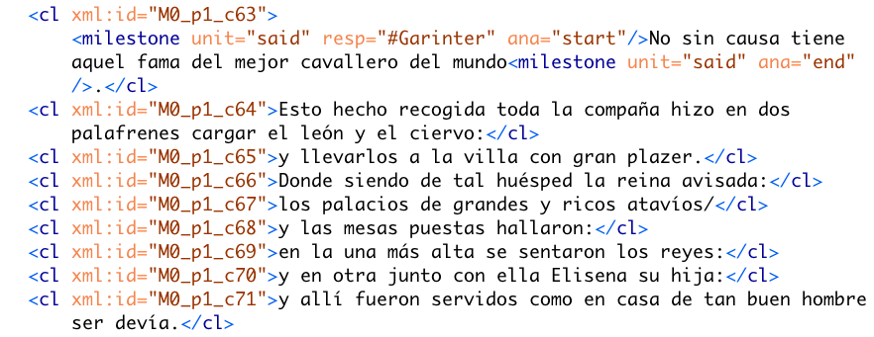
Notes:
Image 7: Corresponds to the same passage of text as in the previous Southey slide

Slide 9
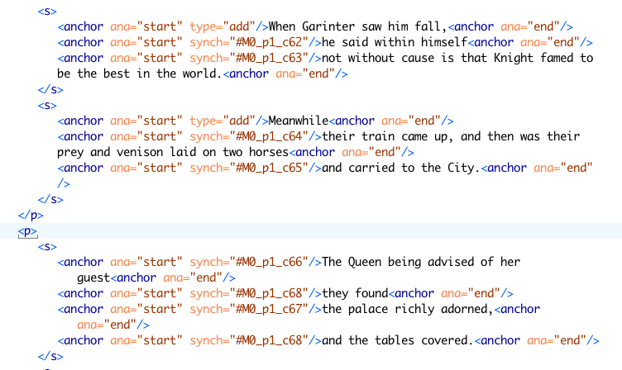
Notes:
Image 8: Alignment coding: Southey aligned to Montalvo with anchor tags. Reveals where texts match up and do not

Slide 10
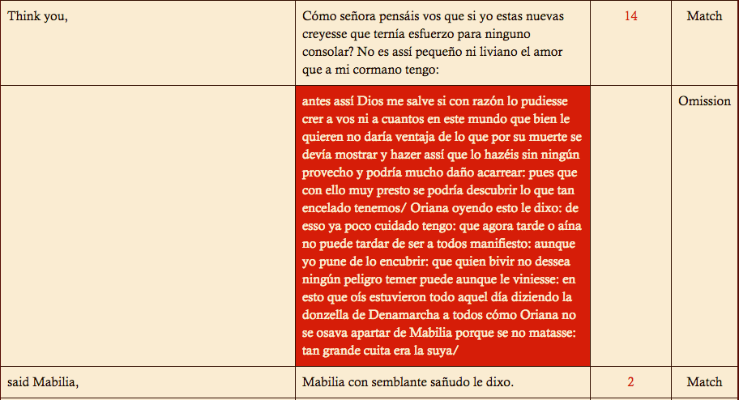
Notes:
Image 9: From Montalvo 20/ Southey 21. Show where this corresponds—this is typical of Southey’s omission criteria. Repetition, participation of minor characters.

Slide 11
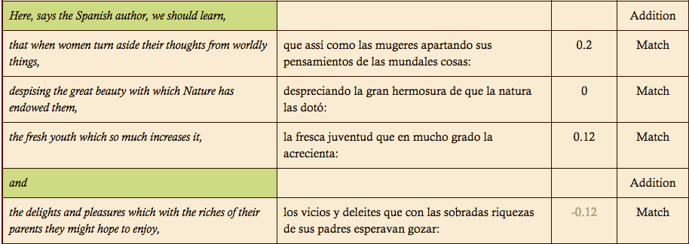

Slide 12
