Slide 1
Translation Analysis with TEI: Robert Southey’s Amadis of Gaul
Stacey Triplette
University of Pittsburgh at Greensburg
Elisa Beshero-Bondar
University of Pittsburgh at Greensburg
Helena Bermúdez Sabel
University of Santiago de Compostela

Slide 2
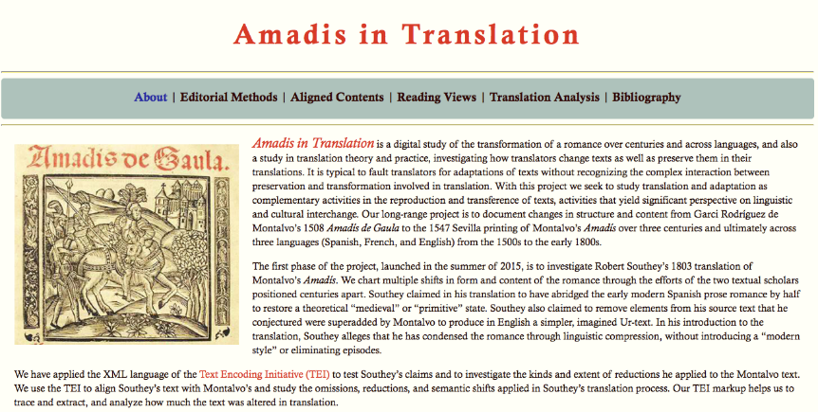
amadis.newtfire.org
https://github.com/ebeshero/Amadis-in-Translation
Notes:
Stacey and Elisa: Why do we work on this? How did we join this project
What does the life cycle and translation cycle of Amadis tell us about the way fiction is translated across genres, cultures, centuries?

Slide 3
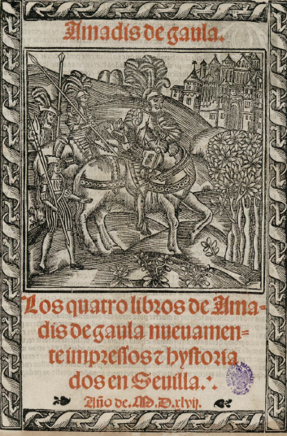
Texts:
15th c fragment
Garci Rodríguez de Montalvo, Amadís de Gaula (1508)
Spanish editions (1526, 1533)
Nicolas de Herberay, French translation (1540)
Anthony Munday, English translation (1590)
Louis-Élisabeth de la Vergne, Conte de Tressan, French translation (1779)
Robert Southey, English translation (1803)
Edwin Place, English translation (1974)
Notes:
Title page
(nb: this is not a frontispiece, not common with libros de caballerías, would be the verso facing the recto title page)
ELISA: Southey thinks he has an Ur-text from Portugal, and he is going to produce a translation that comes closer to an original and simpler (less corrupt) Spanish translation. Southey was shaping a professional writing career as an English Protestant historian and epic poet, in the tradition of John Milton, and he’s a student of Catholic Spanish and Portuguese culture as a study of literary tradition that is struggling against a Catholic Inquisition.

Slide 4
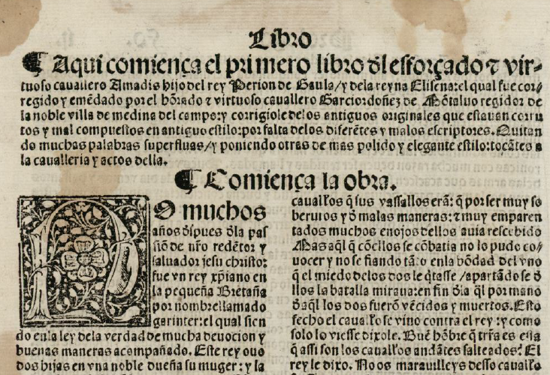
Notes:
Beginning of Montalvo’s book one. Notable features: chapter summary, whitespace to introduce it, chapter heading, large initial letter, differences in type size. Folio size, two-column format.

Slide 5


The calderón,
paragraph symbol
The tironian sign symbol for “and” (y or et)
Notes:
Special symbols

Slide 6
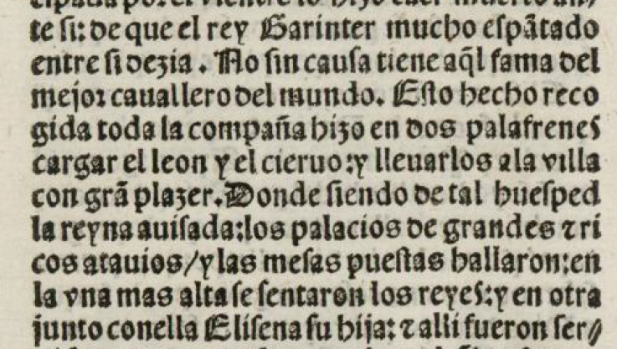
Punctuation
/ : .
Notes:
Punctuation
Afterward: Editorial declaration: https://github.com/ebeshero/Amadis-in-Translation/wiki/Editing-Methods-for-Amadis-in-Translation

Slide 7
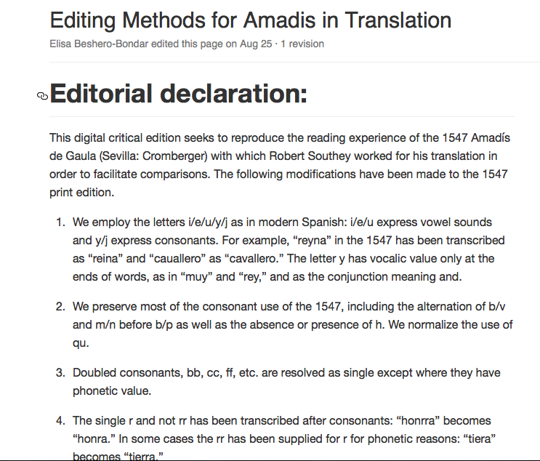
Notes:
Influenced by Pedro Sánchez-Prieto Borja, Cómo editar los textos medievales

Slide 8
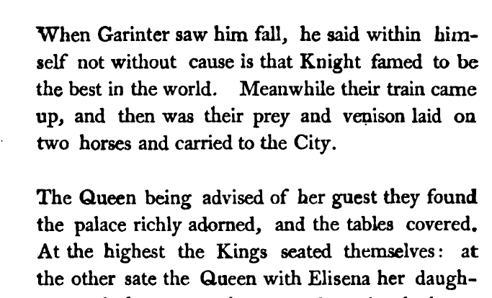
Notes:
From Southey’s 1803 edition of Amadís, sourced from Hathi Trust. Shows Southey’s internal divisions. From Chapter 1, in a place with no paragraph division in the Montalvo. Go back to slide 6: we can see how Southey has taken into account, at least as a baseline, the 1547 punctuation.

Slide 9
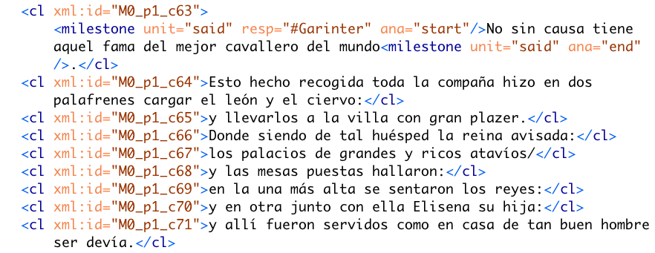
Notes:
Corresponds to the same passage of text as in the previous Southey slide. Elisa: We had a difficult decision to make about this clause markup when we started this project. We would often see dependent clauses within Montalvo that we wanted to nest, but we decided to AVOID generating nested hierarchies here: We sacrificed the preparation of accurate syntactical markup for our research question in favor of aligning the two texts. So each “clause-like” unit is a sibling in the XML hierarchy is a sort of geocoordinate reference to which we can map portions of Southey’s text. This makes it easier for us to reveal when Southey reverses clause order, weaves two of Montalvo’s units together, or jumps ahead or back in Montalvo’s text.

Slide 10
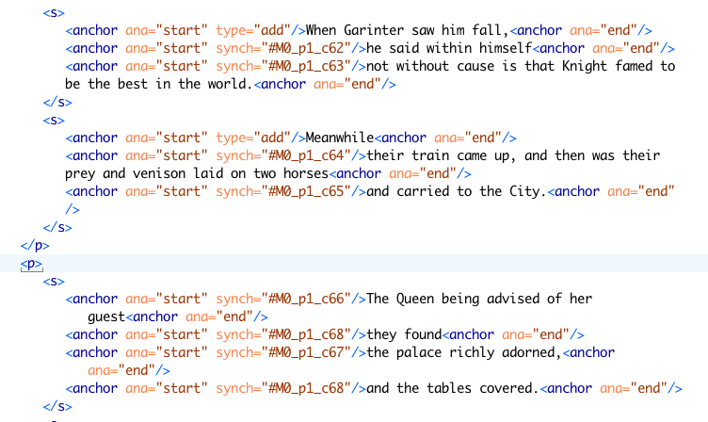
Notes:
Alignment coding: Southey aligned to Montalvo with self-closing anchor elements. These mark with @synch alignment points with Montalvo. (ELISA: We aren’t using xml:ids on Southey’s sentences, but we use this markup to “tether” passages of the Southey text with Montalvo. We find there are often multiple units per sentence, and we use the self-closing elements so that units can cross sentences boundaries.

Slide 11
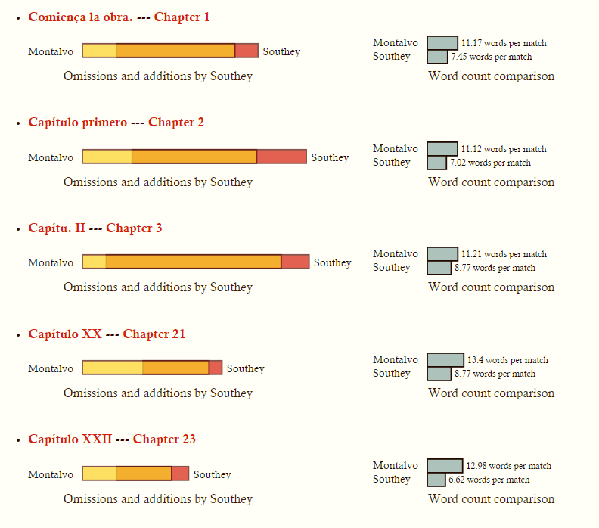
Notes:
Elisa: Southey’s text is available from a GitHub source which we’ve been correcting against a published edition of his 1803 text. However, Montalvo’s text isn’t available in any machine readable format, so we’ve been transcribing that by hand. We then applied regular expressions to add <cl> elements at markable clause-like unit boundaries. (And of course we had an easier time with preparing <s> elements to Southey.
Elisa: The next slides show our first results in comparing Southey’s translation to the Montalvo text. Here’s what we’re learning so far. As we are designing our website, we want to use this page as our table of contents, so that our site visitors can quickly identify the chapters most altered by Southey. The orange band in the center indicates the proportion of overlap. The word count comparisons interest us, though we are not sure how significant they are: We are interested in gauging the extent of Southey’s boasted “compression” of Montalvo, so we use XSLT to generate these graphs by counting white spaces for makeshift word counts in between <anchor/> elements of different kinds. Where Southey omitted passages we don’t apply tags, but we note where he skips over unit passages in Montalvo.

Slide 12
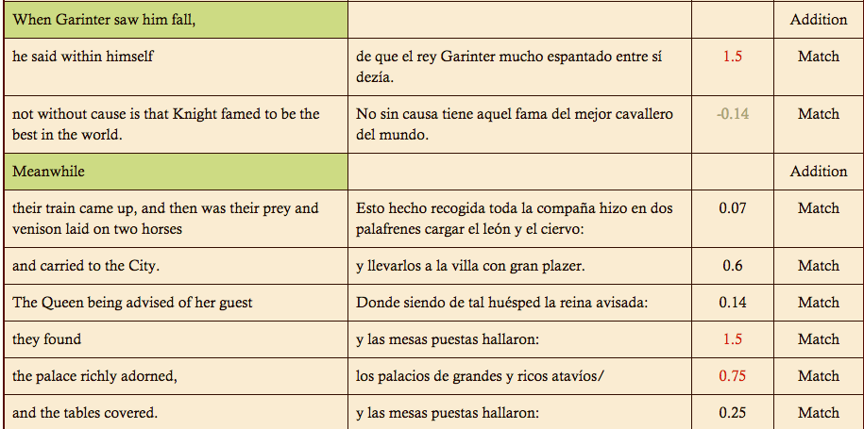
Notes:
Output table by Helena Bermúdez Sabel: This is an HTML view pulled from our feature structures markup for a chapter. The higher the number, the more compression Southey applied.
Elisa: To analyze the aligned passages further, and help Stacey to survey them to plot patterns, we make an additional TEI file corresponding to each chapter, using the TEI’s handy feature structures markup, to extract each Southey passage, and where it’s in sync, we set it next to the corresponding passage in Montalvo to produce one Feature Structure file for each chapter. @n indicates a word count, and @ana indicates by how much proportionally the passage was either compressed or expanded from a corresponding passage in Montalvo. Within an fs element we pull each “anchored event” (so to speak) from Southey,, and where these are not additions or omissions, they contain side-by-side units of matched text. We add a <string> element for writing in our comments on the translation, and we plan to develop a system of classifying the kinds of alterations Southey makes in his version of the translation. For example (though this is not shown), we find that frequently Montalvo represents every speech-act directly, while Southey turns this in to indirect discourse. He is likely making changes in the syntax, too.

Slide 13
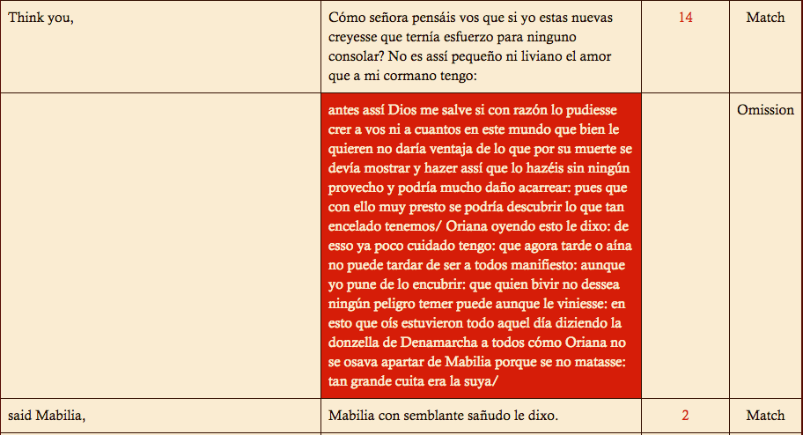
Notes:
Image 9: From Montalvo 20/ Southey 21. Show where this corresponds—this is typical of Southey’s omission criteria. Repetition, participation of minor characters.

Slide 14
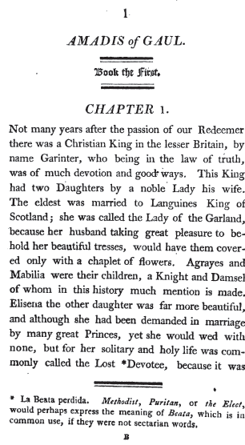
Notes:
The same note in the published 1803 Southey text.

Slide 15
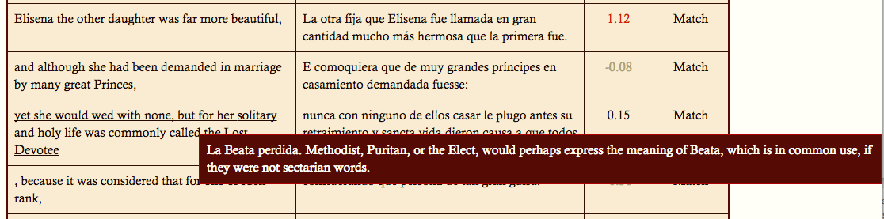
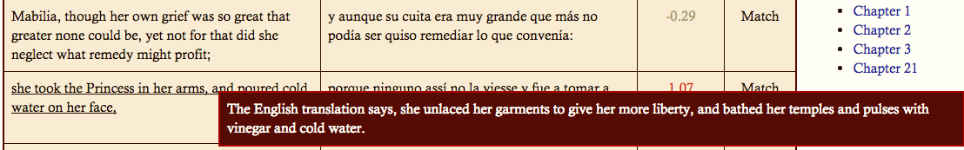
Notes:
First note references the Spanish. It’s one of the few examples we’ve found of a misreading or mistranslation by Southey. Second note references another translation.
Pass to Elisa: go to previous slide.

Slide 16
Robert Southey on Amadís
“To have translated a closely printed folio would have been absurd. I have reduced it to about half its length, by abridging the words, not the story […] There is no vanity in saying, that this has improved the book, for what long work may not be improved by compression?”
Notes:
From the Preface (xxi)
Talk about whether Southey is a good translator

Slide 17
What’s Next?
Finish transcribing Montalvo’s Book I and find correspondences with Southey
Classify the alterations Southey makes to Montalvo
Long-range questions:
How does Southey translate culture and ideology?
What is “English” about Southey’s text?
What is “French” or “Spanish” about other translations and adaptations?

