Slide 1
Investigating the Spanish to English Metamorphosis of Amadís de Gaula with TEI
Stacey Triplette
University of Pittsburgh at Greensburg
Elisa Beshero-Bondar
University of Pittsburgh at Greensburg
Helena Bermúdez Sabel
University of Santiago de Compostela

Slide 2
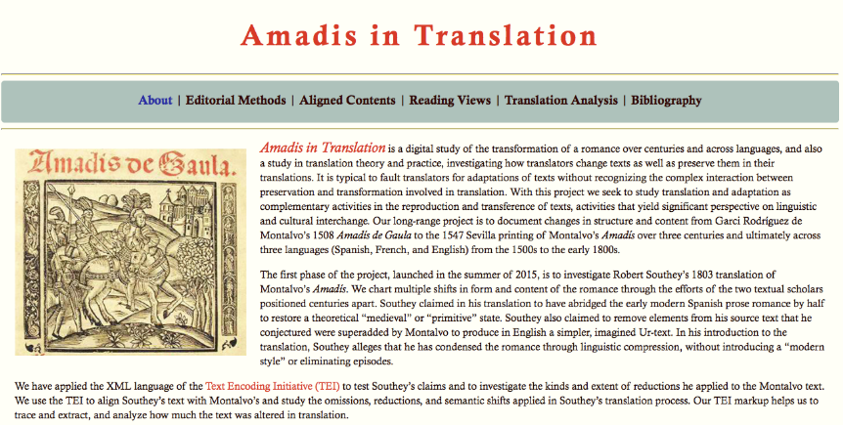
Notes:
About page from our website, which we are currently building

Slide 3
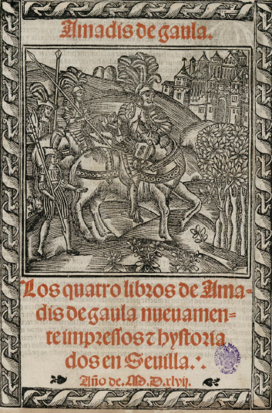
Texts:
15th c fragment
Garci Rodríguez de Montalvo, Amadís de Gaula (1508)
Nicolas de Herberay, French translation (1540)
Anthony Munday, English translation (1590)
Louis-Élisabeth de la Vergne, Conte de Tressan, French translation (1779)
Robert Southey, English translation (1803)
Edwin Place, English translation (1974)
Notes:
Title age
(nb: this is not a frontispiece, not common with libros de caballerías, would be the verso facing the recto title page)

Slide 4
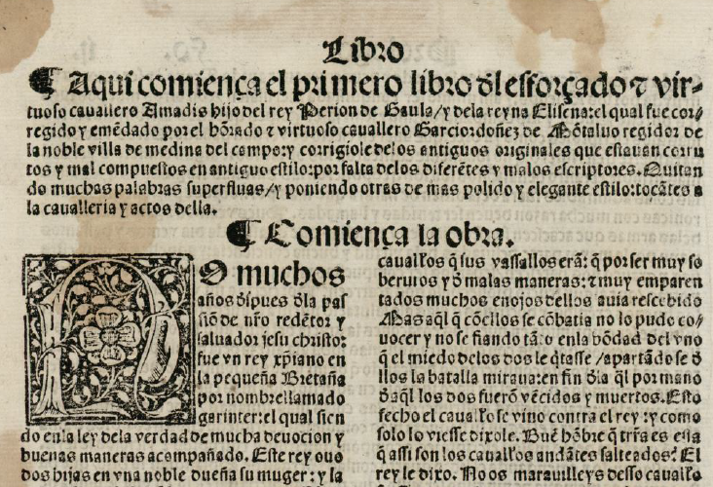
Notes:
Beginning of Montalvo’s book one. Notable features: chapter summary, whitespace to introduce it, chapter heading, large initial letter, differences in type size. Folio size, two-column format.

Slide 5


The calderón,
paragraph symbol
The tironian sign symbol for “and” (y or et)
Notes:
Special symbols

Slide 6
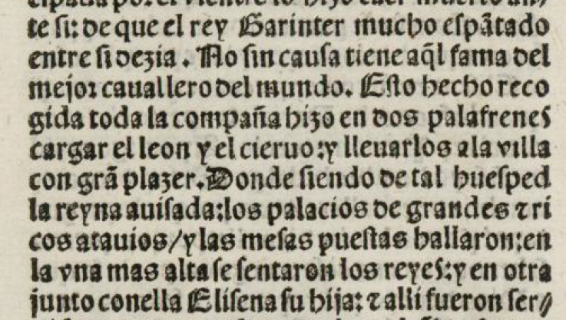
Punctuation
/ : .
Notes:
Punctuation
Afterward: Editorial declaration: https://github.com/ebeshero/Amadis-in-Translation/wiki/Editing-Methods-for-Amadis-in-Translation

Slide 7
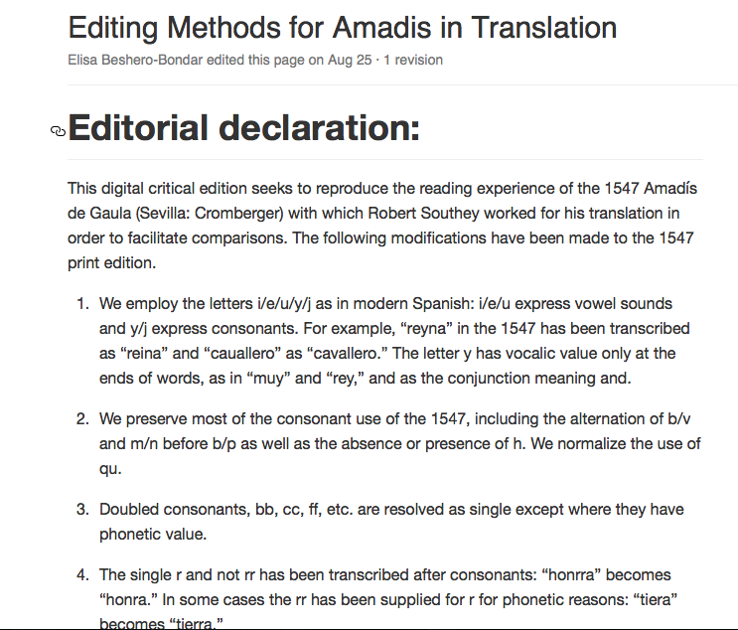
Notes:
Influenced by Pedro Sánchez-Prieto Borja, Cómo editar los textos medievales

Slide 8
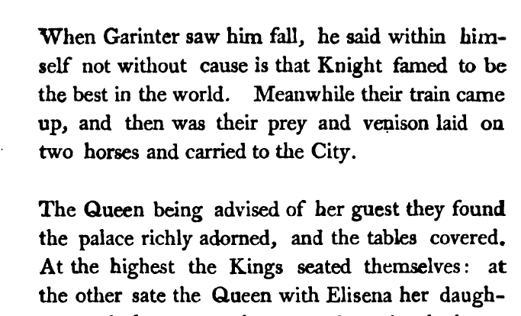
Notes:
From Southey’s 1803 edition of Amadís, sourced from Hathi Trust. Shows Southey’s internal divisions. From Chapter 1, in a place with no paragraph division in the Montalvo. Go back to slide 6: we can see how Southey has taken into account, at least as a baseline, the 1547 punctuation.

Slide 9
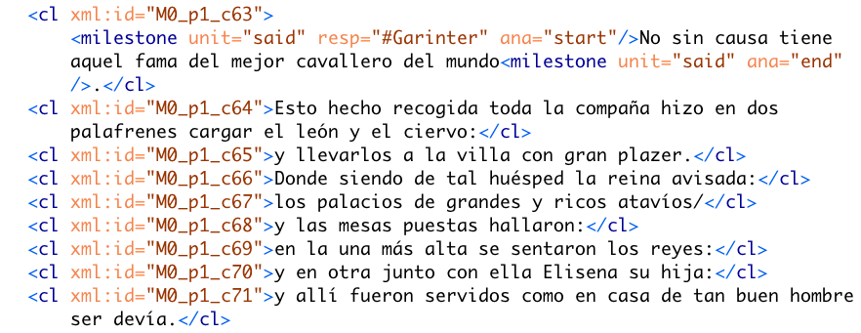
Notes:
Corresponds to the same passage of text as in the previous Southey slide. Elisa: Begin segment, explaining the reason why we coded this way—AVOIDING hierarchies of nested clauses even where we could spot dependent clauses: We sacrificed the preparation of accurate syntactical markup for our research question in favor of aligning the two texts. So each “clause-like” unit is a sort of geocoordinate reference to which we can map portions of Southey’s text.

Slide 10
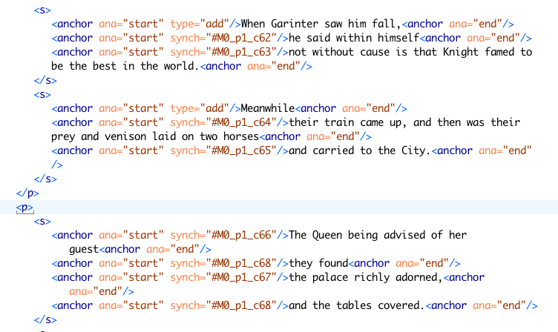
Notes:
Alignment coding: Southey aligned to Montalvo with anchor tags. Reveals where texts match up and do not

Slide 11
Regex for Up-Conversion
To find ends of sentences: \.\s[A-Z] Same with capturing groups: (\.)\s([A-Z])
Replace with: \1</s><s>\2
Some tips:
1. Select the text of the transcription (so the regex is not applied to the header)
2. Open the find and replace dialogue (Ctrl + F) and select “Selected lines only”
3. Find: (\.|:|/|\?)\s
4. Replace with: \1</cl>\n<cl>
5. Add a <cl> just after the <p> element and delete the <cl> before the paragraph closing tag </p>
Other things to remember: When there is a new clause that begins with a capital letter but punctuation is absent.
Clause.....ends<choice><sic></sic><corr>.<corr></choice></cl><cl>New clause here...
Notes:
Elisa Segment: Discuss how we prepared the text in TEI for alignment, using Regex to add <cl> to Montalvo and <s> to Southey

Slide 12
XSLT for Up-Conversion, adding xml:ids
<xsl:template match="cl[not(ancestor::argument)]"> <cl> <xsl:attribute name="xml:id"> <xsl:value-of select="./ancestor::div[@type='chapter']/@xml:id"/> <xsl:if test="./ancestor::floatingText"> <xsl:text>_ft</xsl:text> <xsl:number select="./ancestor::floatingText[1]" level="any"/> </xsl:if> <xsl:text>_</xsl:text> <xsl:value-of select="./parent::*/name()"/> <xsl:number select="./parent::*" level="any" count="//div[@type='chapter']//p[not(parent::argument)]"/> <xsl:text>_c</xsl:text> <xsl:number level="any" count="//div[@type='chapter']//cl[not(ancestor::argument)]"/> </xsl:attribute> <xsl:apply-templates/> </cl> </xsl:template>

Slide 14
TOC

Slide 15
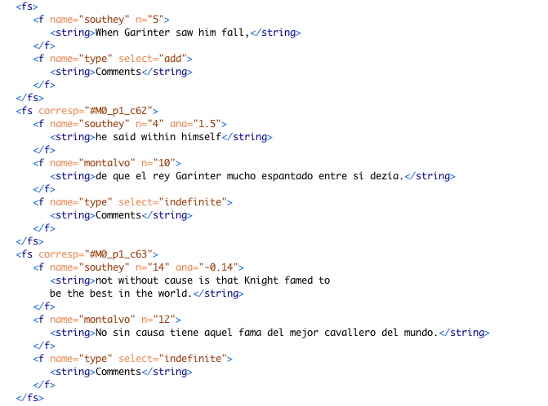
Notes:
Feature structure

Slide 16
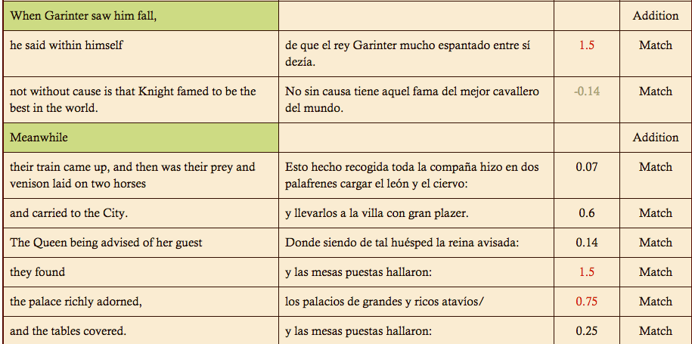
Notes:
Output table by Helena Bermúdez Sabel

Slide 17
Robert Southey on Amadís
“To have translated a closely printed folio would have been absurd. I have reduced it to about half its length, by abridging the words, not the story […] There is no vanity in saying, that this has improved the book, for what long work may not be improved by compression?”
Notes:
From the Preface (xxi)

Slide 18
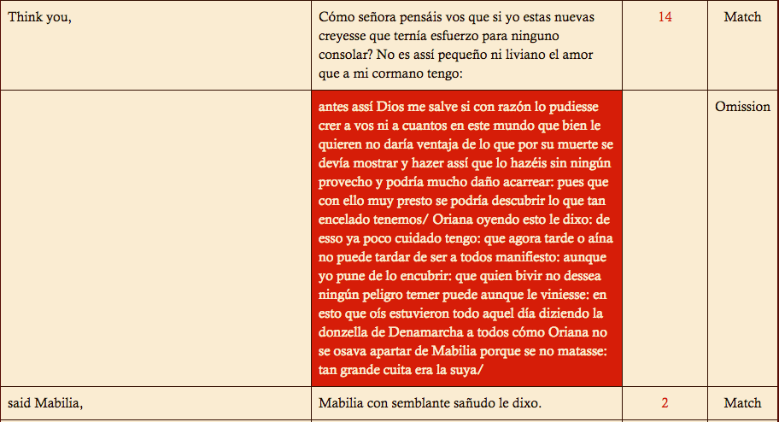
Notes:
Image 9: From Montalvo 20/ Southey 21. Show where this corresponds—this is typical of Southey’s omission criteria. Repetition, participation of minor characters.

Slide 19
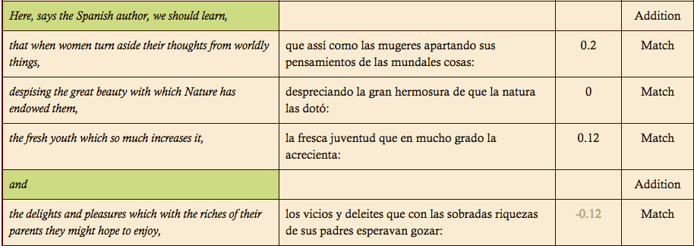

Slide 20
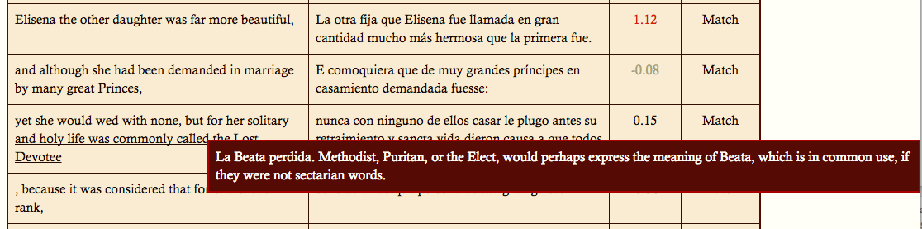
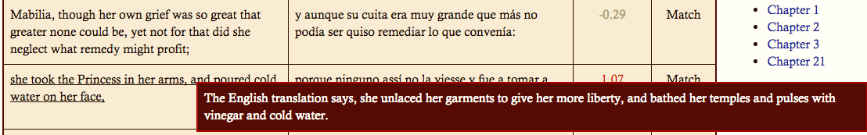
Notes:
First note references the Spanish. It’s one of the few examples we’ve found of a misreading or mistranslation by Southey. Second note references another translation.

