Slide 1
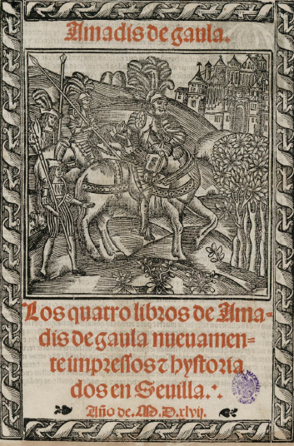
Notes:
Image one: title page
(nb: a frontispiece, not common with libros de caballerías, would be the verso facing the recto title page)

Slide 2
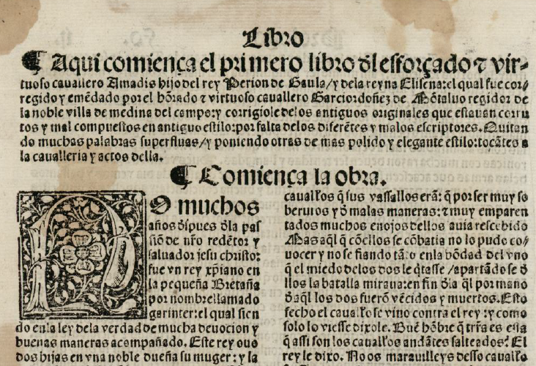
Notes:
Image Two. Beginning of Montalvo’s book one. Notable features: chapter summary, whitespace to introduce it, chapter heading, large initial letter, differences in type size. Folio size, two-column format.

Slide 3


The calderón,
paragraph symbol
The tironian sign symbol for “and” (y or et)
Notes:
Image Three: special symbols

Slide 4
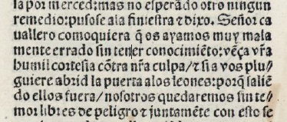
Punctuation
/ : .
Notes:
Image Four: punctuation
Afterward: Editorial declaration: https://github.com/ebeshero/Amadis-in-Translation/wiki/Editing-Methods-for-Amadis-in-Translation

Slide 5
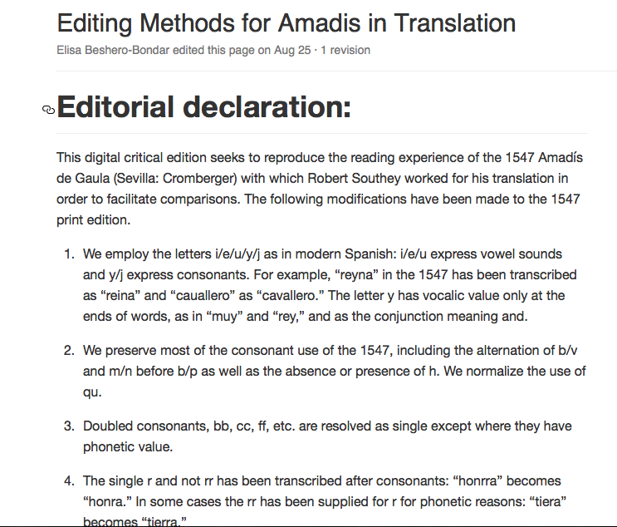

Slide 6
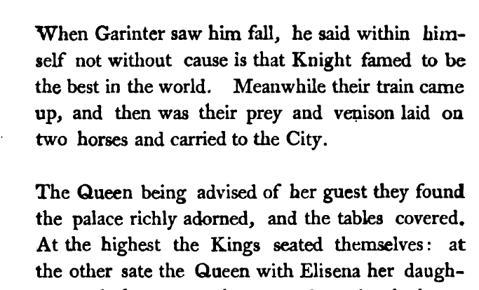
Notes:
Image 6: Southey’s internal divisions. From Chapter 1, in a place with no paragraph division in the MOntalvo

