Slide 1
Investigating the Spanish to English Metamorphosis of Amadís de Gaula with TEI
Stacey Triplette
University of Pittsburgh at Greensburg
Elisa Beshero-Bondar
University of Pittsburgh at Greensburg
Helena Bermúdez Sabel
University of Santiago de Compostela

Slide 2
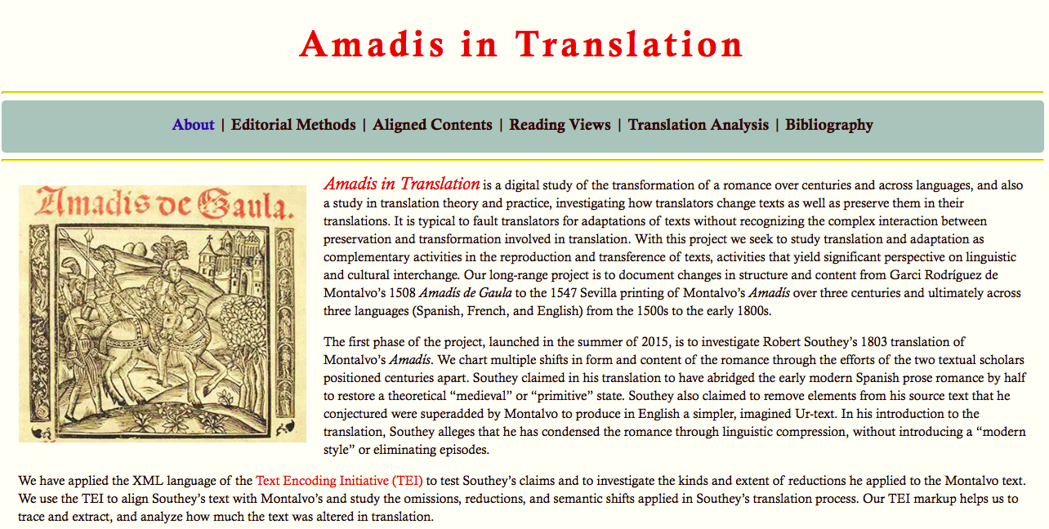
Notes:
About page from our website, which we are currently building

Slide 3
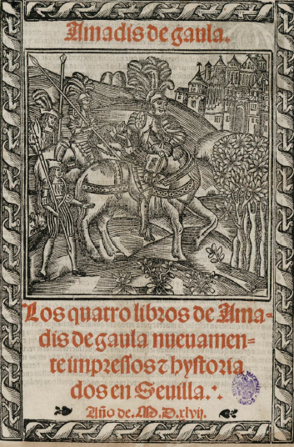
Texts:
15th c fragment
Garci Rodríguez de Montalvo, Amadís de Gaula (1508)
Nicolas de Herberay, French translation (1540)
Anthony Munday, English translation (1590)
Louis-Élisabeth de la Vergne, Conte de Tressan, French translation (1779)
Robert Southey, English translation (1803)
Edwin Place, English translation (1974)
Notes:
Title age
(nb: this is not a frontispiece, not common with libros de caballerías, would be the verso facing the recto title page)

Slide 4
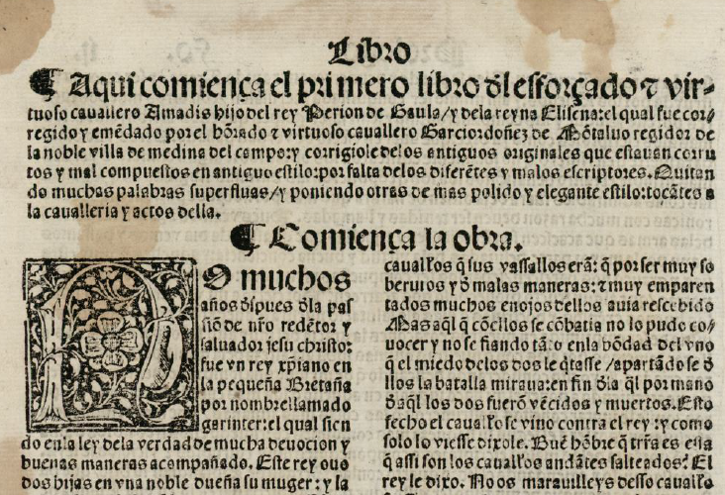
Notes:
Beginning of Montalvo’s book one. Notable features: chapter summary, whitespace to introduce it, chapter heading, large initial letter, differences in type size. Folio size, two-column format.

Slide 5


The calderón,
paragraph symbol
The tironian sign symbol for “and” (y or et)
Notes:
Special symbols

Slide 6
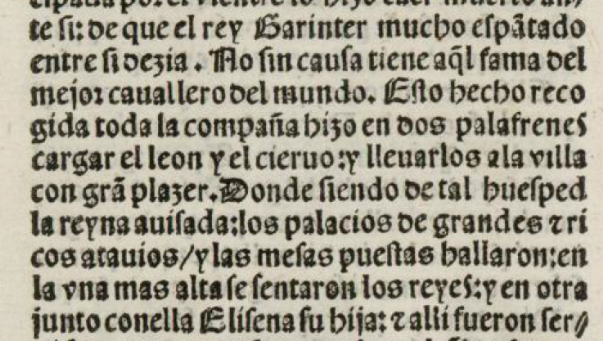
Punctuation
/ : .
Notes:
Punctuation
Afterward: Editorial declaration: https://github.com/ebeshero/Amadis-in-Translation/wiki/Editing-Methods-for-Amadis-in-Translation

Slide 7
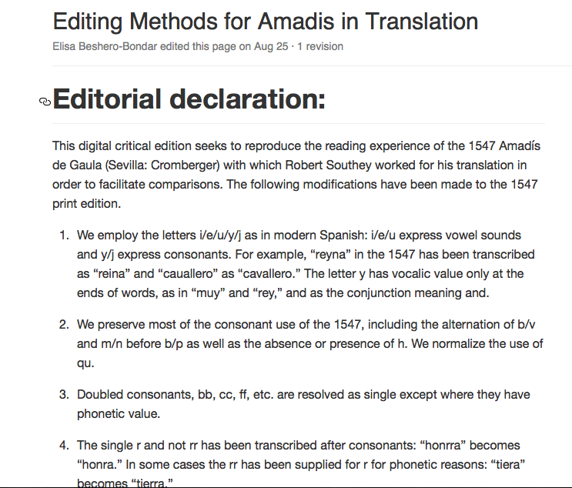
Notes:
Influenced by Pedro Sánchez-Prieto Borja, Cómo editar los textos medievales

Slide 8
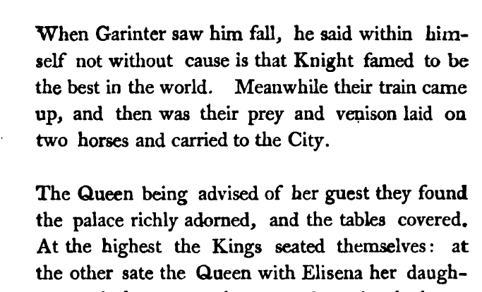
Notes:
From Southey’s 1803 edition of Amadís, sourced from Hathi Trust. Shows Southey’s internal divisions. From Chapter 1, in a place with no paragraph division in the Montalvo. Go back to slide 6: we can see how Southey has taken into account, at least as a baseline, the 1547 punctuation.

Slide 9
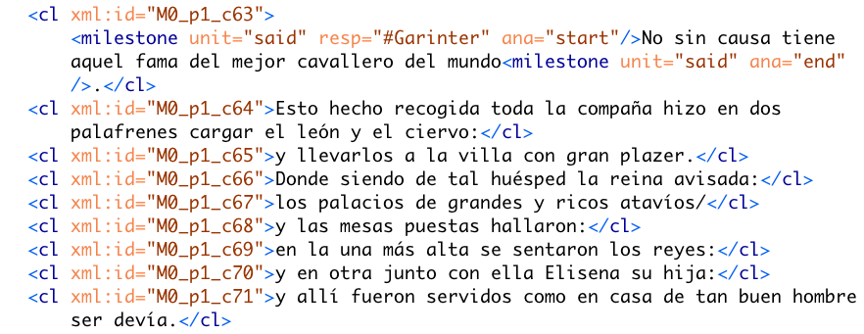
Notes:
Corresponds to the same passage of text as in the previous Southey slide

Slide 10
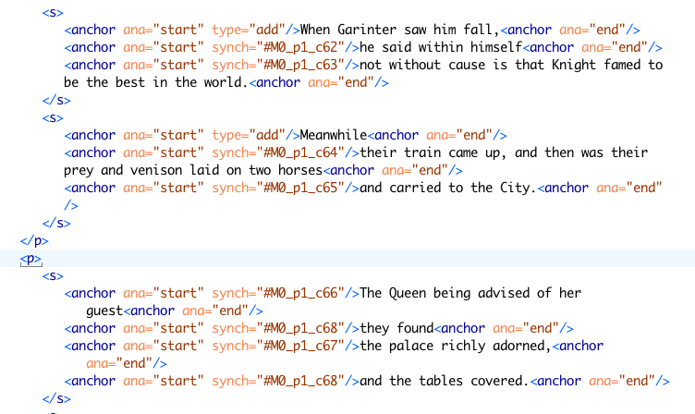
Notes:
Alignment coding: Southey aligned to Montalvo with anchor tags. Reveals where texts match up and do not

Slide 11
RegX and/or xslt

Slide 12
TOC

Slide 13
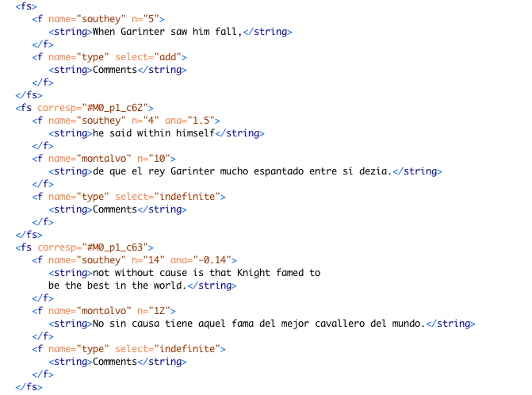
Notes:
Feature structure

Slide 14
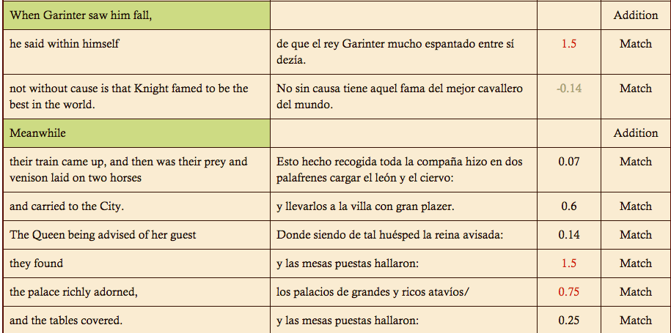
Notes:
Output table by Helena Bermúdez Sabel

Slide 15
Robert Southey on Amadís
“To have translated a closely printed folio would have been absurd. I have reduced it to about half its length, by abridging the words, not the story […] There is no vanity in saying, that this has improved the book, for what long work may not be improved by compression?”
Notes:
From the Preface (xxi)

Slide 16
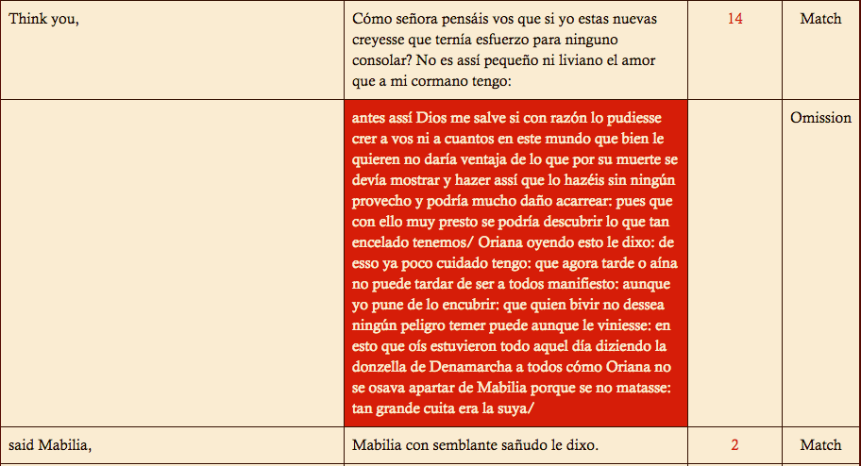
Notes:
Image 9: From Montalvo 20/ Southey 21. Show where this corresponds—this is typical of Southey’s omission criteria. Repetition, participation of minor characters.

Slide 17
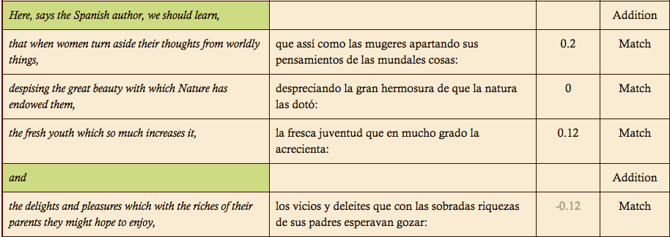

Slide 18
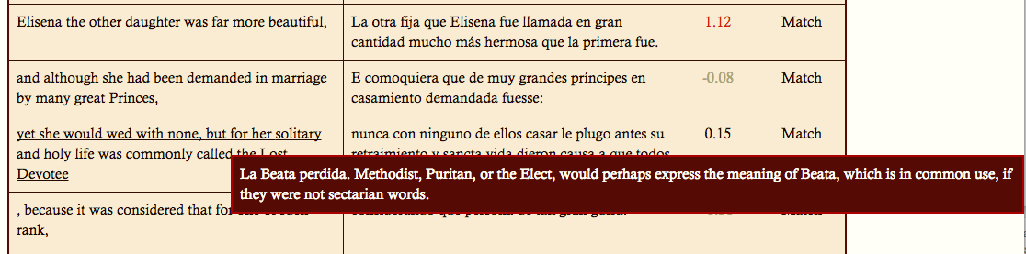
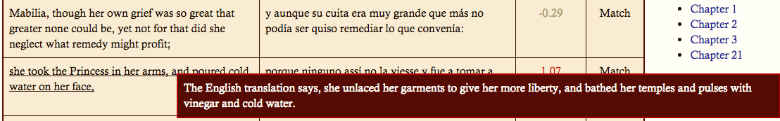
Notes:
First note references the Spanish. It’s one of the few examples we’ve found of a misreading or mistranslation by Southey. Second note references another translation.

