Slide 1
STAT GR5243 · Project 4 · May 2026
Predicting Daily Citi Bike Demand
An end-to-end machine learning pipeline for station-level demand forecasting in New York City
Helena Li (yl6029) · Wentao Zhong (wz2753) · Kevin Ma (km4189) · Ketaki Dabade (kvd2112)
Citi Bike Demand · STAT GR5243 Project 4
1 / 12

Slide 2
01 · MOTIVATION
Why Predict Citi Bike Demand?
▸ Citi Bike is NYC's largest bike-share system — millions of trips per year.
▸ Operations team must rebalance bikes across stations every day.
▸ Bad forecasts → empty docks at commuter hubs, full docks near parks.
▸ Demand is driven by weather, calendar, geography AND station identity.
▸ Goal: predict the number of trips per station per day, one day ahead.
THE PREDICTIVE QUESTION
Given a station and a date, how many trips will start there?
WHY IT'S HARD
• Right-skewed demand (long tail) • Weather × calendar × geography • Hundreds of heterogeneous stations • Strong temporal autocorrelation
Citi Bike Demand · STAT GR5243 Project 4
2 / 12

Slide 3
02 · APPROACH
End-to-End Pipeline
DATA
CLEAN
EDA
CLUSTER
FEATURES
MODEL
Trips + Weather + Station Context
Parse, dedupe, standardize
Trends, distributions, weather effects
K-Means on station profiles (k=4)
Lag, weather flags, cyclical calendar
Ridge / RF / GB + tuned RF
Time-based 80/20 split · metrics on the original (un-logged) trip-count scale
Each step feeds the next — clustering becomes a feature, lag demand becomes the strongest predictor.
Citi Bike Demand · STAT GR5243 Project 4
3 / 12

Slide 4
03 · DATA
Three Sources, One Analytic Table
SOURCES
ONE ROW PER STATION-DAY
▸ Citi Bike trips — monthly CSVs (Jan–Feb 2026).
▸ Daily NYC weather — Open-Meteo (temp, precip, wind).
▸ Station context — IDs, lat/lon, neighborhood flags (park, pier, plaza, square).
station_id · date · daily_trip_count casual_share / member_share classic_bike_share / electric_bike_share mean_temperature · precipitation_sum max_wind_speed start_lat · start_lng has_park · has_pier · has_plaza · has_square
CLEANING
▸ Parse timestamps; drop trips with invalid station IDs.
▸ Standardize station names; verify coordinates.
▸ Group by (station, date) → daily_trip_count.
▸ Merge weather (on date) and station context (on station_id).
Citi Bike Demand · STAT GR5243 Project 4
4 / 12

Slide 5
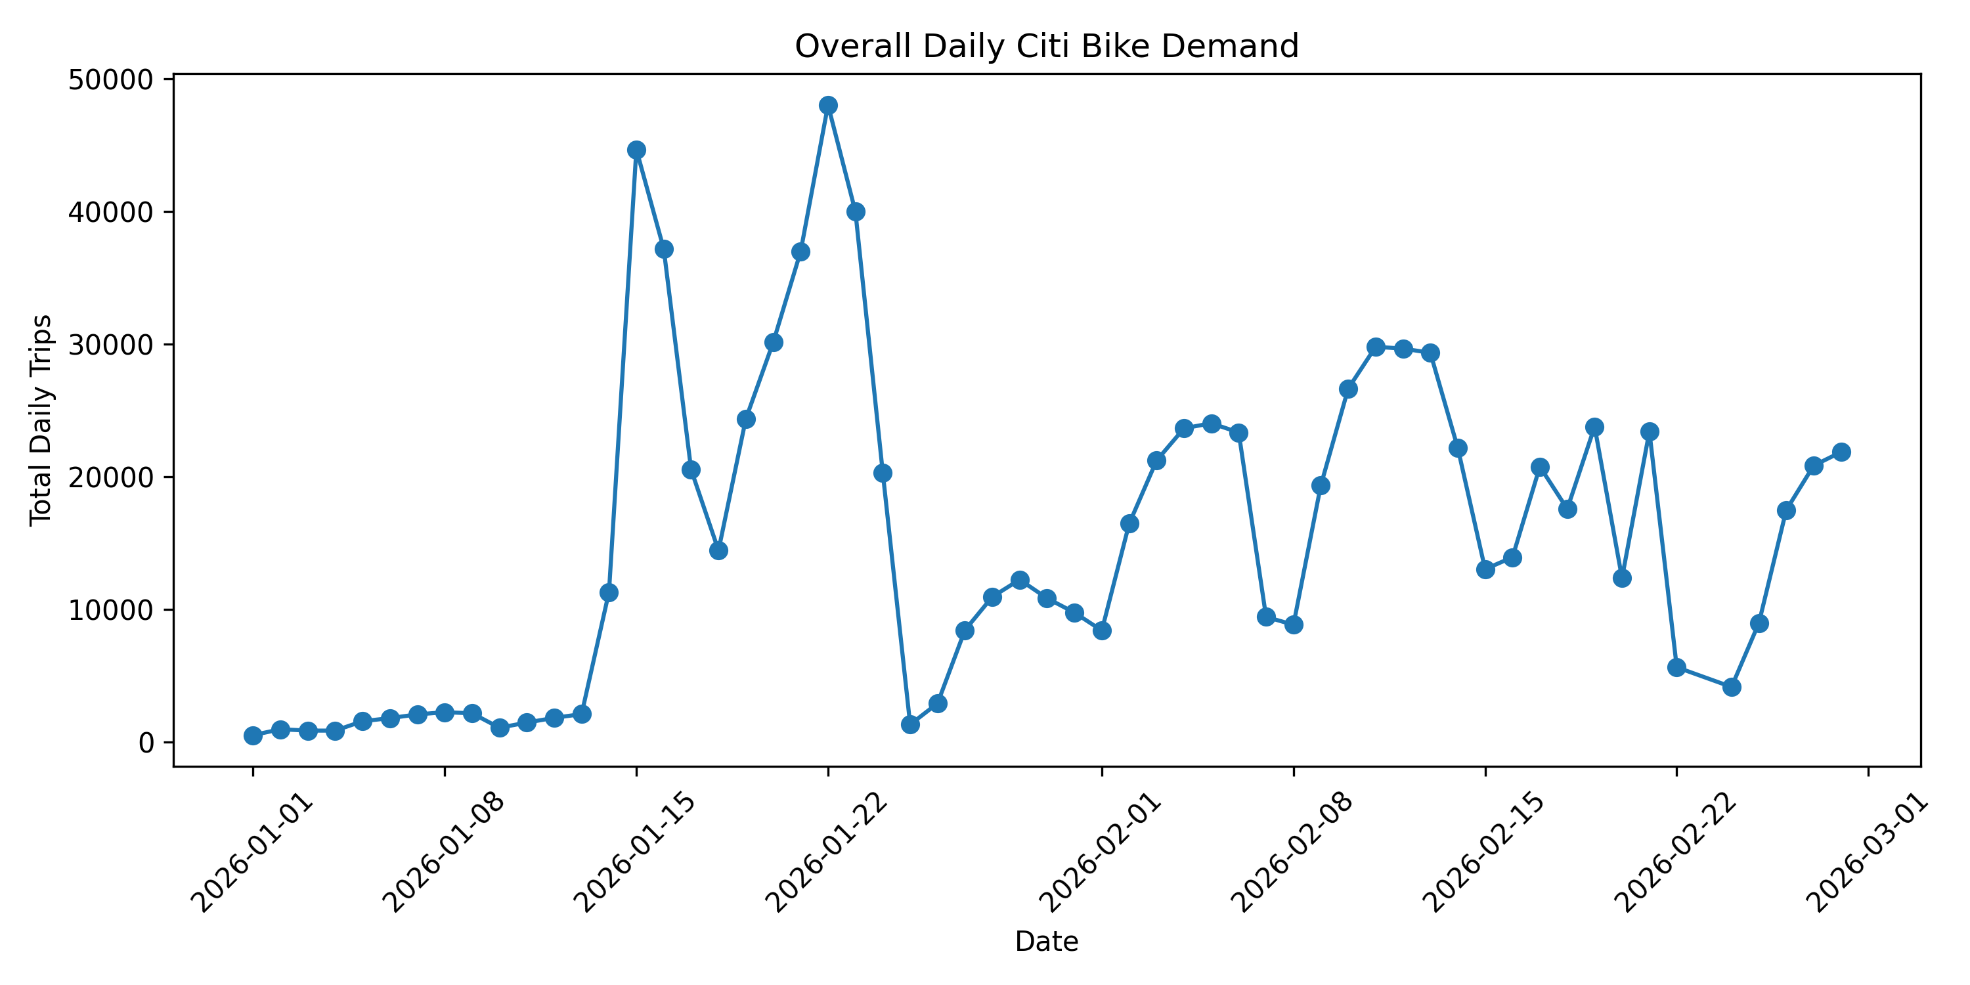
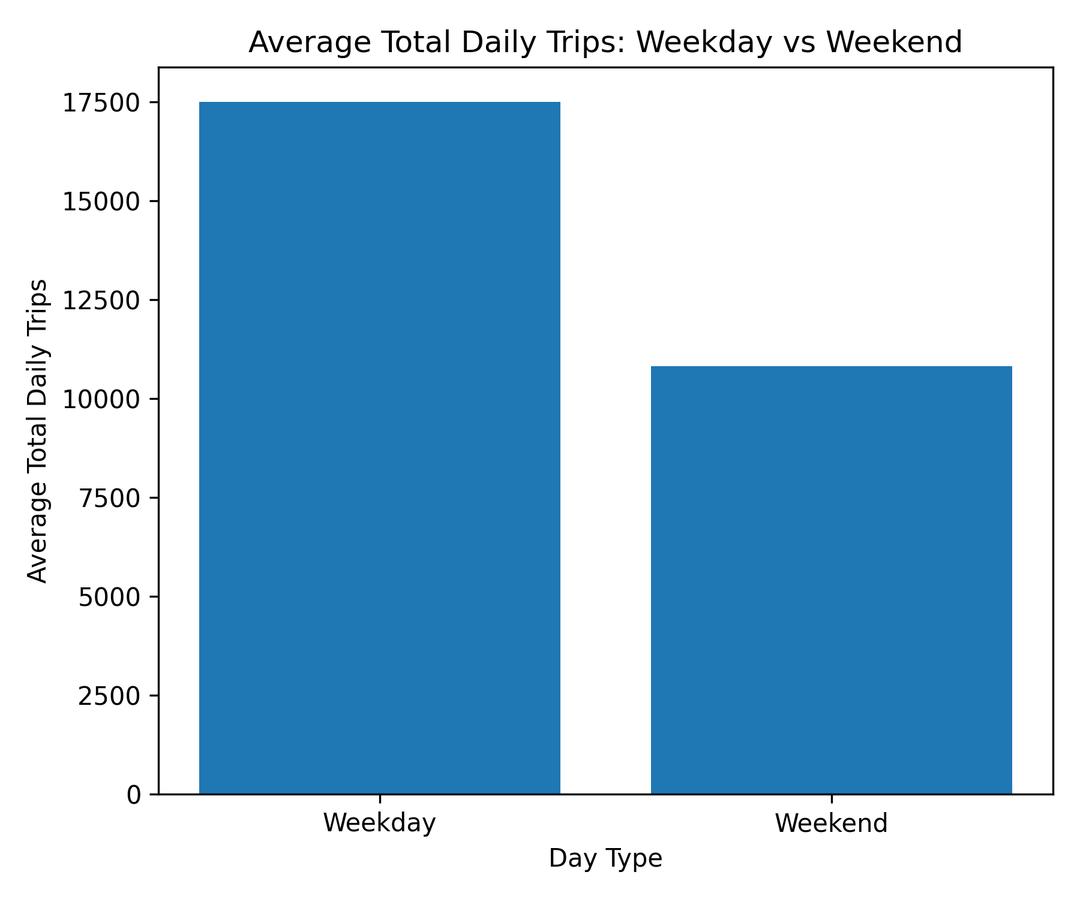
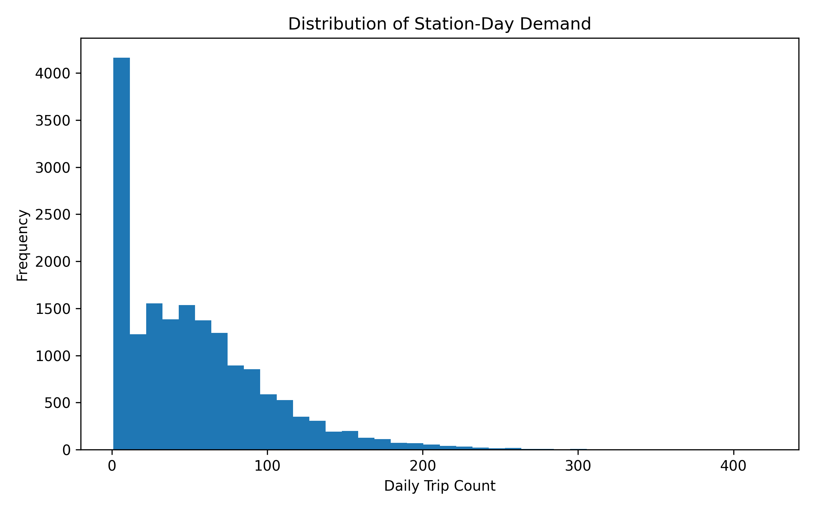
04 · EDA
Demand Has Strong Time & Weather Patterns
WHAT WE SEE
▸ System ramps from <2k to ~48k trips/day in mid-January.
▸ Weekday avg ≈ 17.5k trips · Weekend ≈ 10.8k (~60% premium).
▸ Station-day demand is heavily right-skewed → log-transform target.
▸ Median ≈ 40 trips/day, long tail past 400.
Citi Bike Demand · STAT GR5243 Project 4
5 / 12

Slide 6
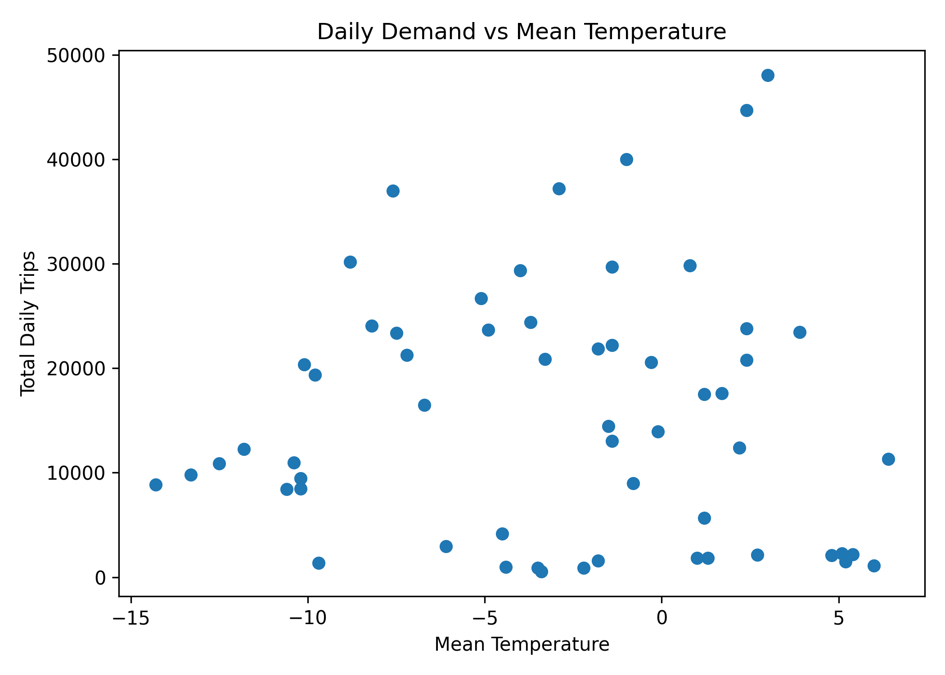
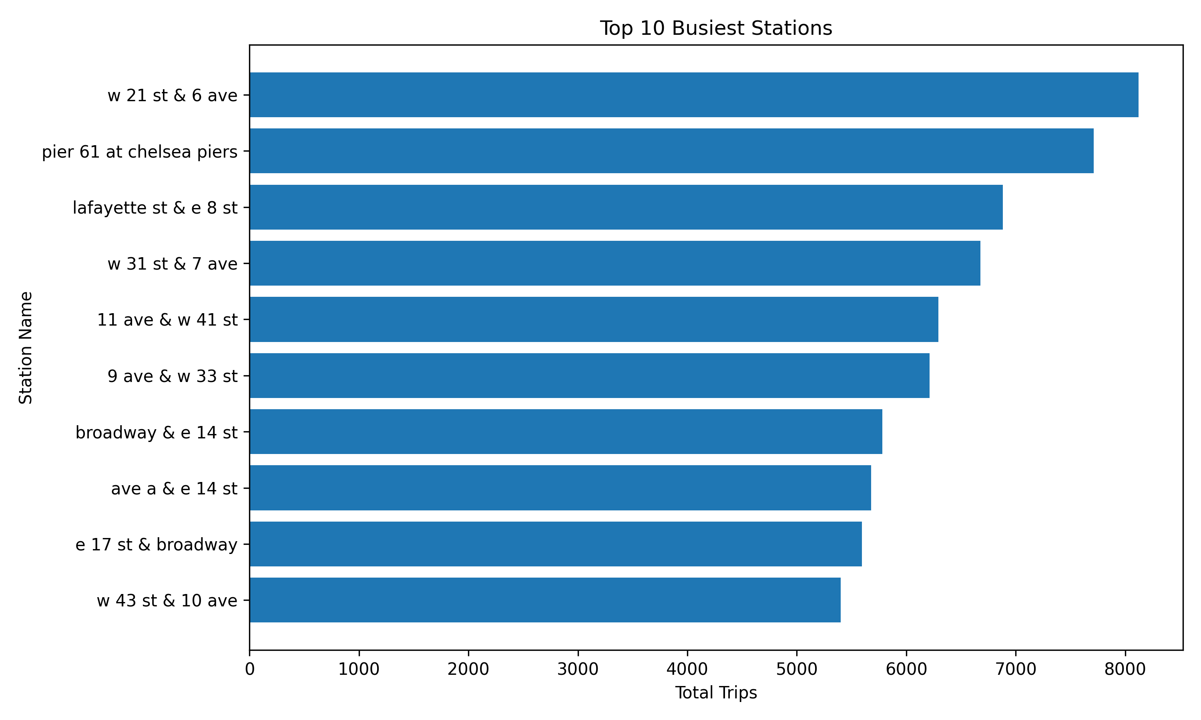
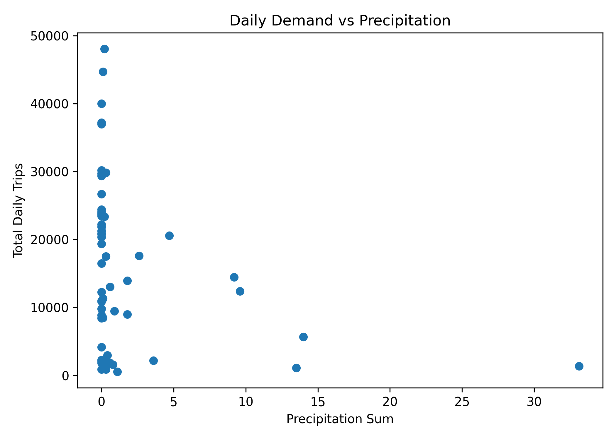
04 · EDA
Weather Suppresses Demand; Geography Concentrates It
TAKEAWAYS
▸ Highest-demand days cluster at warmer temps.
▸ Days with >10 mm precipitation almost always low-demand.
▸ Top stations: Chelsea, Midtown, Union Sq, Pier 61.
▸ Mix of commuter and leisure hubs → motivates clustering.
Citi Bike Demand · STAT GR5243 Project 4
6 / 12

Slide 7
05 · UNSUPERVISED
Stations Fall Into 4 Behavioral Clusters
▸ Aggregate to station-level profile (NOT station-day):
▸ avg / median / max demand, demand volatility (CV),
▸ casual vs. member share, electric-bike share,
▸ weekend-to-weekday ratio, lat/lon, neighborhood flags.
▸ Standardize → K-Means.
▸ Choose k = 4 via elbow + silhouette.
▸ Visualize in 2D with PCA.
Cluster A
Commuter hubs
high weekday volume, member-dominated
Cluster B
Leisure / waterfront
elevated casual share, weekend-heavy
Cluster C
Mixed-use
moderate demand across rider types
Cluster D
Low-demand
Citi Bike Demand · STAT GR5243 Project 4
7 / 12
low average and peak demand

Slide 8
06 · FEATURES
What We Feed the Model
CALENDAR
WEATHER
LAG DEMAND
LOCATION
• is_weekend
• dow_sin / dow_cos (cyclical day-of-week)
• mean_temperature
• precipitation_sum
• max_wind_speed
• has_precipitation
• heavy_precipitation (top decile)
• high_wind (top decile)
• lag_1_trip_count (yesterday)
• lag_7_trip_count (same weekday last week)
• start_lat / start_lng
• has_park / has_pier / has_plaza / has_square
• station_cluster (one-hot)
Target = log(1 + daily_trip_count) · Same-day rider/bike shares EXCLUDED to avoid leakage
Citi Bike Demand · STAT GR5243 Project 4
8 / 12

Slide 9
07 · MODELING
Four Models, One Clear Winner
MODELS COMPARED
Model
MAE
RMSE
R²
▸ Ridge Regression — linear baseline (α=1).
▸ Random Forest — 300 trees, depth 12, leaf 5.
▸ Gradient Boosting — 300 trees, lr 0.05, depth 3.
▸ Tuned Random Forest — 3-fold GridSearchCV (n=300, depth=None, leaf=3).
Tuned Random Forest
19.75
28.13
0.289
Random Forest
21.23
29.70
0.207
Gradient Boosting
24.70
32.71
0.038
Ridge Regression
25.85
35.78
−0.151
Tuned RF wins on every metric — picked as the final model.
Time-based holdout — most recent 20% of dates.
Citi Bike Demand · STAT GR5243 Project 4
9 / 12

Slide 10
08 · WHAT THE MODEL LEARNED
Lag Demand & Weather Drive Predictions
TOP FEATURE IMPORTANCES
ERROR BY DEMAND QUARTILE
lag_1_trip_count
0.506
Group
Actual
Predicted
MAE
mean_temperature
0.194
Low
17.0
25.2
14.3
max_wind_speed
0.075
precipitation_sum
0.061
Medium-Low
41.2
47.0
16.6
lag_7_trip_count
0.056
Medium-High
61.5
60.7
16.0
dow_sin
0.020
High
99.9
83.1
32.6
start_lat
0.019
start_lng
0.018
Model is well-calibrated except for the highest-demand quartile, where it under-predicts (≈ −17 trips on avg). A known cost of log-transform + tree smoothing on heavy-tailed targets.
heavy_precipitation
0.017
station_cluster_0
0.011
Citi Bike Demand · STAT GR5243 Project 4
10 / 12

Slide 11
09 · HONEST
Limitations & What We'd Do Next
LIMITATIONS
NEXT STEPS
▸ Only 2 months of data — no seasonal cycle.
▸ Under-prediction at peak-demand stations.
▸ No holiday or special-event indicators.
▸ Weather is daily — sub-day patterns lost.
▸ Span a full year to capture seasonality.
▸ Quantile regression / two-stage surge model for peak days.
▸ Add holidays, NYC events, transit disruptions.
▸ Deploy as a Streamlit station-day demand dashboard.
Citi Bike Demand · STAT GR5243 Project 4
11 / 12

Slide 12
10 · WRAP-UP
Thank you · Questions?
KEY TAKEAWAY
A tuned Random Forest on lag demand + weather + clusters predicts station-day Citi Bike demand with MAE ≈ 20 trips on a true future holdout — strong enough to support rebalancing decisions.
TEAM CONTRIBUTIONS
Helena Li (yl6029)
Data acquisition & cleaning · station-day analytic table
Wentao Zhong (wz2753)
Exploratory data analysis · figures & summary tables
Kevin Ma (km4189)
Clustering · feature engineering · supervised models · evaluation
Ketaki Dabade (kvd2112)
Final report · README · evaluation interpretation · slides
github.com/Helenaliyz/5243Project4
Citi Bike Demand · STAT GR5243 Project 4
12 / 12

