Slide 1
Startup success prediction
Helena Schick
Programming Languages for Data Science, SoSe2023

Slide 2
AGENDA
Use Case
Data
Data Analysis
Classification Model
Deployment
Conclusion

Slide 3






USE CASE
Which startup to invest in?
Investor

Slide 4
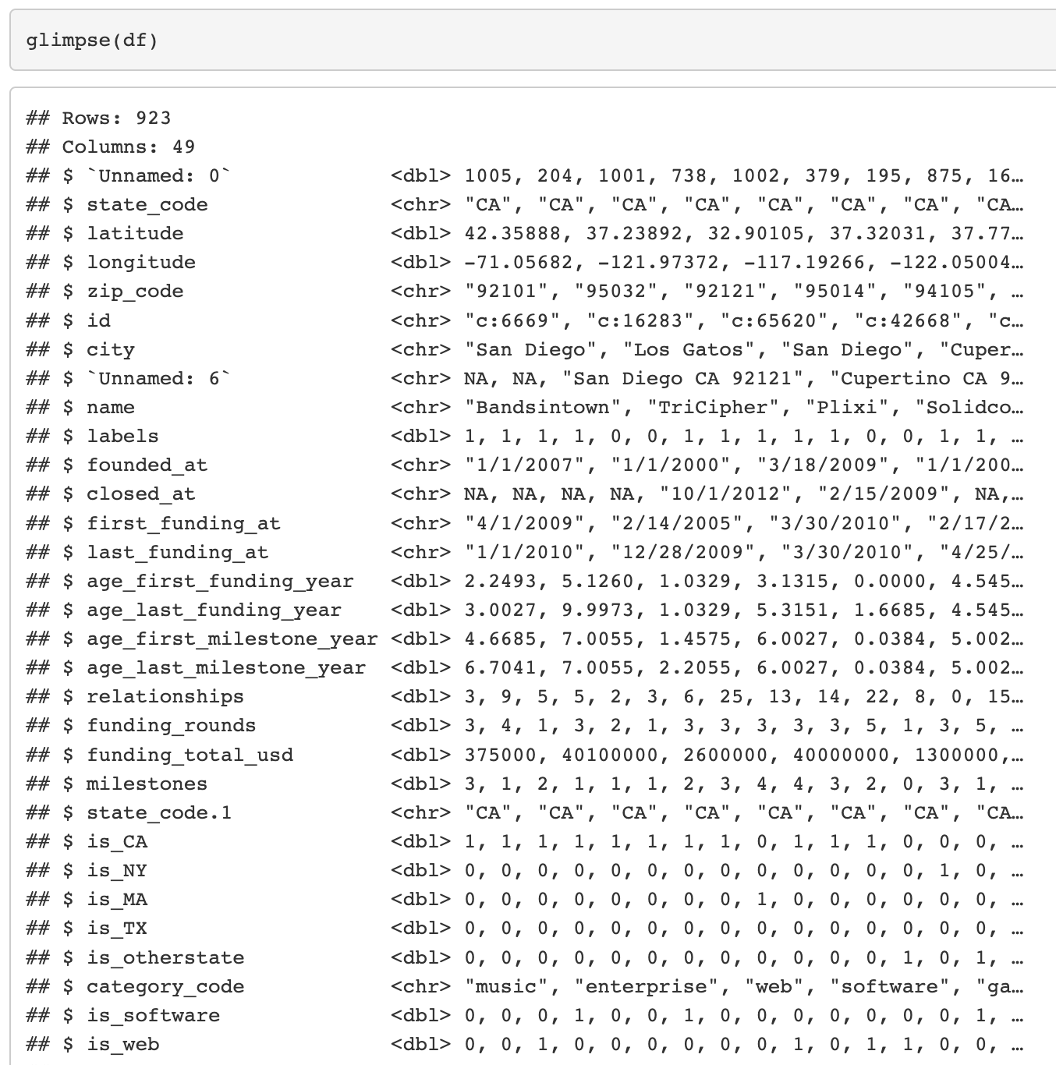
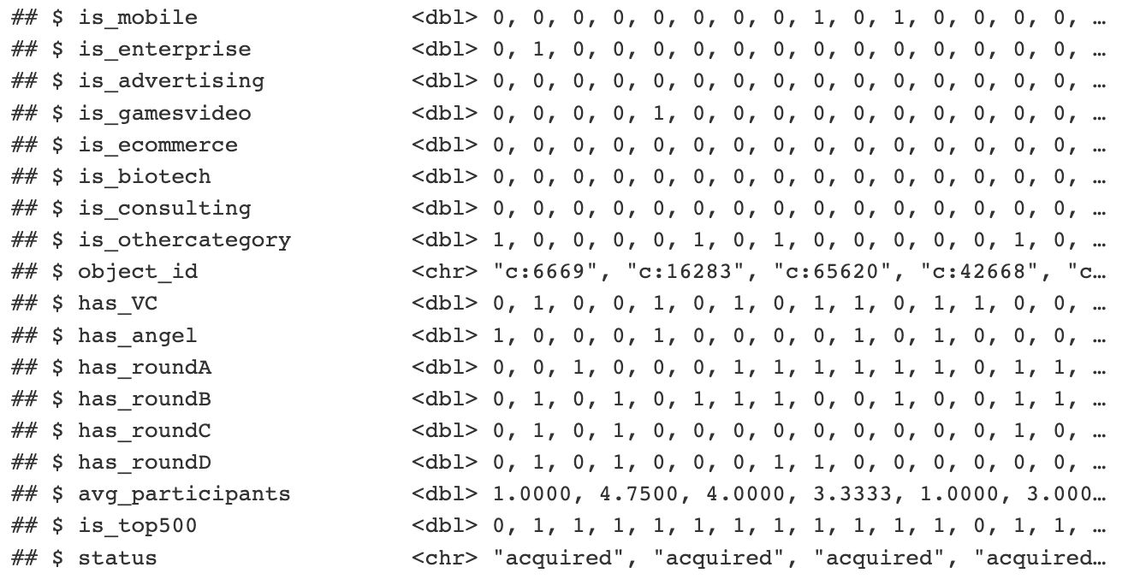
DATA
923 rows x 49 columns
Data corrections
Data type
Remove unnecessary variables
df contains all variables

Slide 5

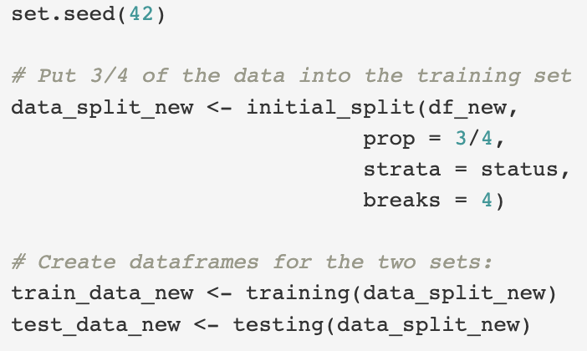
DATA
Create df_new for new startups
Training and test set for df and df_new

Slide 6
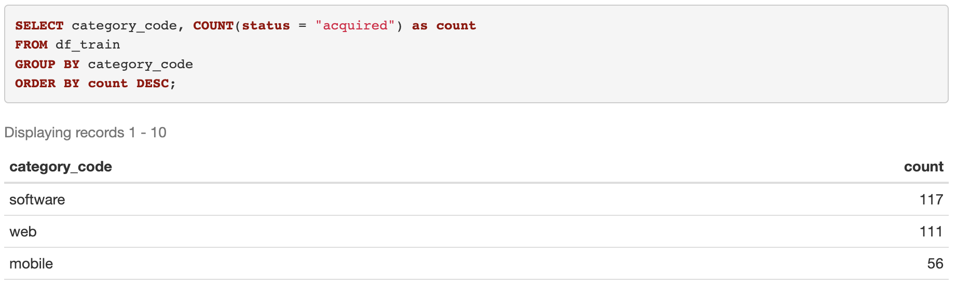
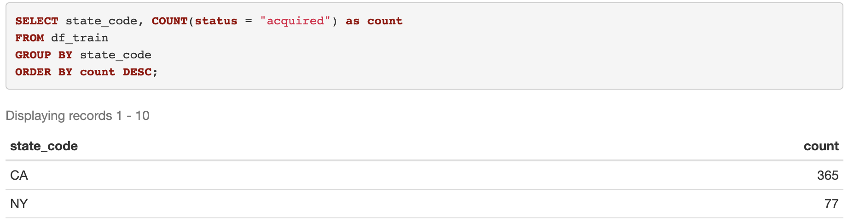
Data Analysis in SQL

Slide 7
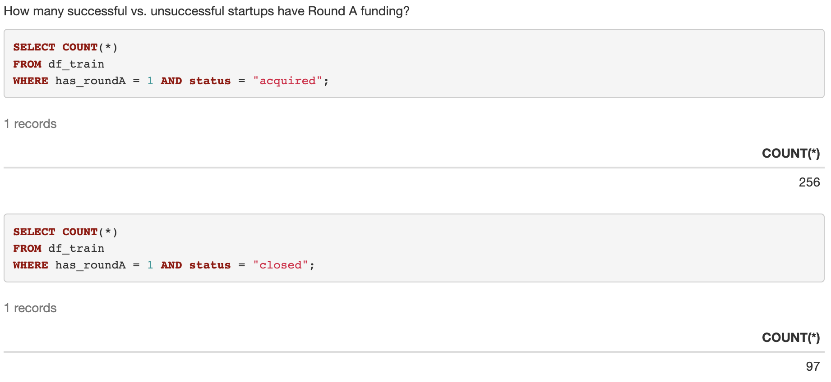
DATA ANALYSIS IN SQL

Slide 8
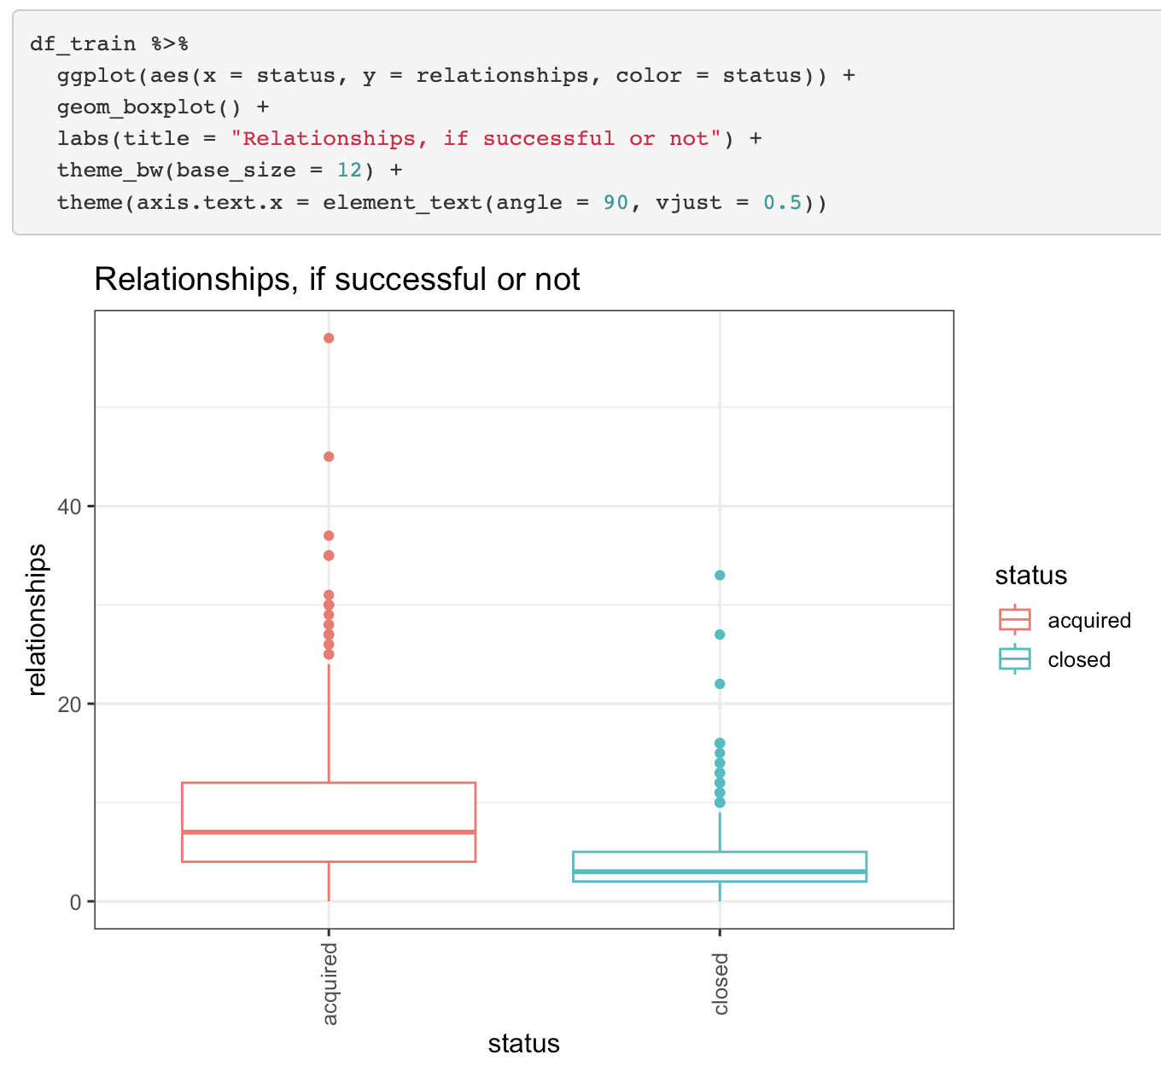
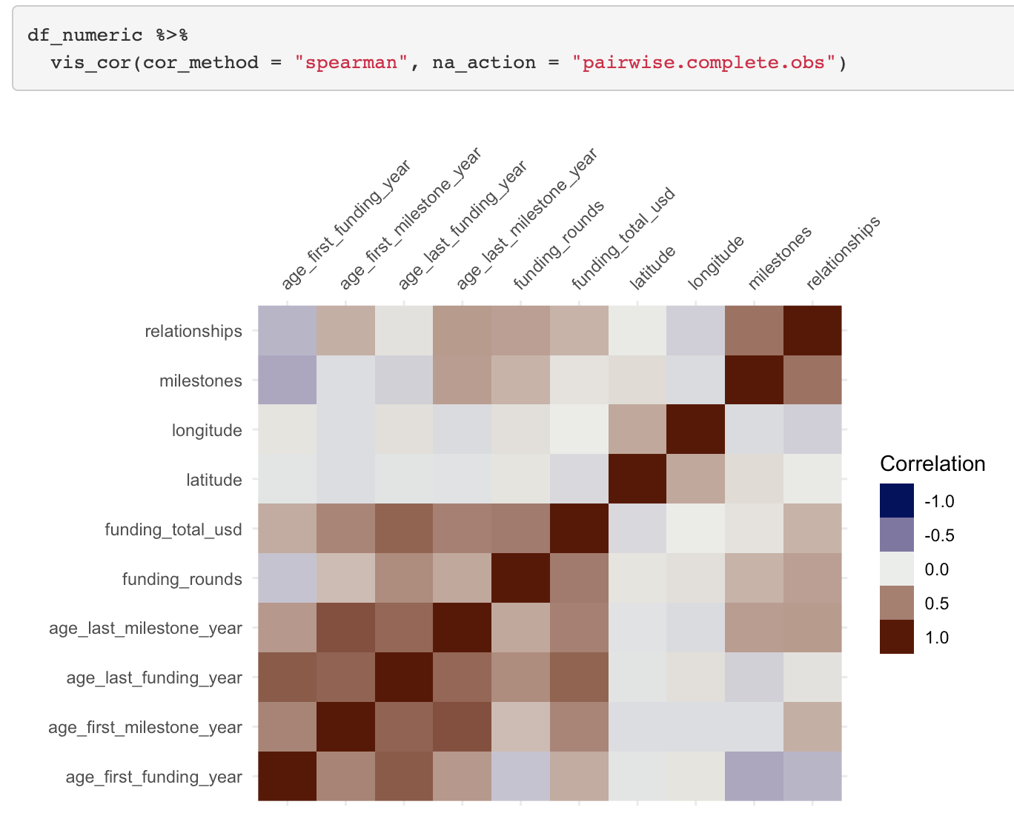
DATA ANALYSIS IN R

Slide 9
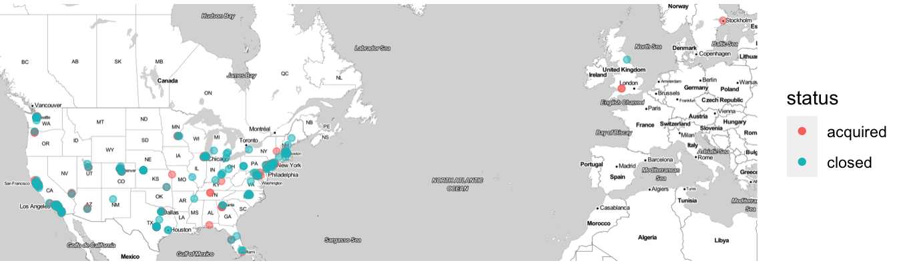
DATA ANALYSIS IN R

Slide 10
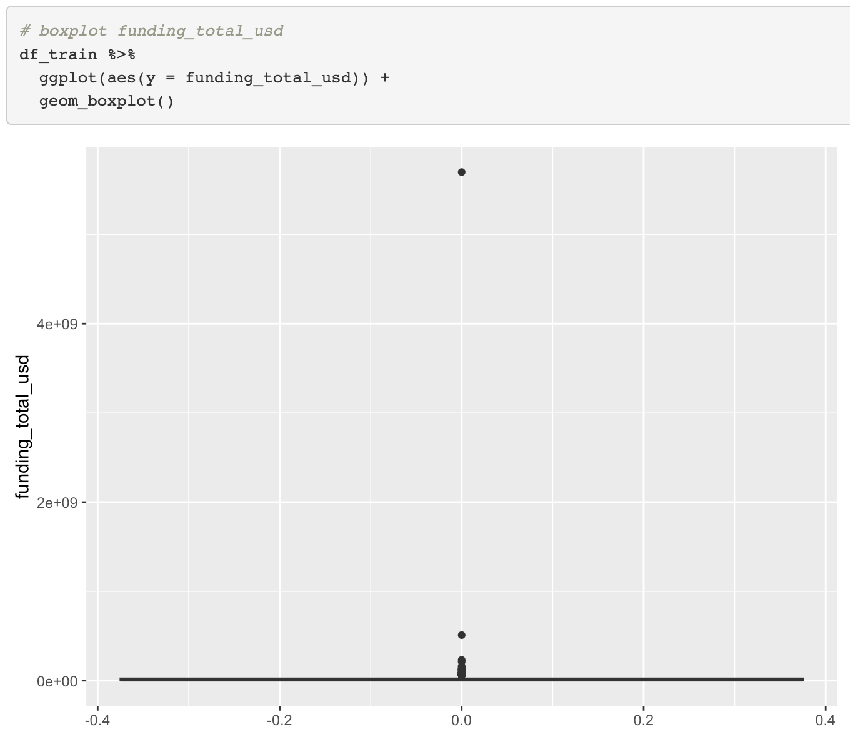
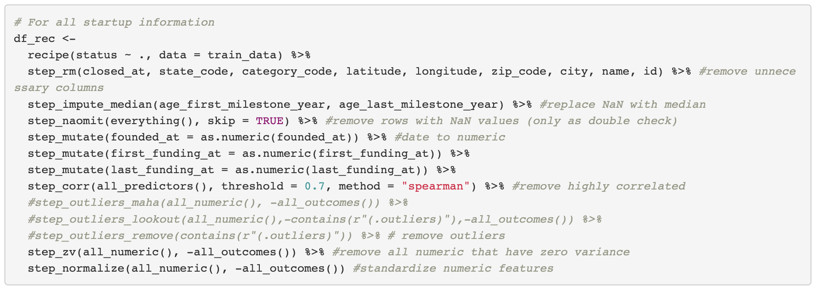
FEATURE ENGINEERING

Slide 11

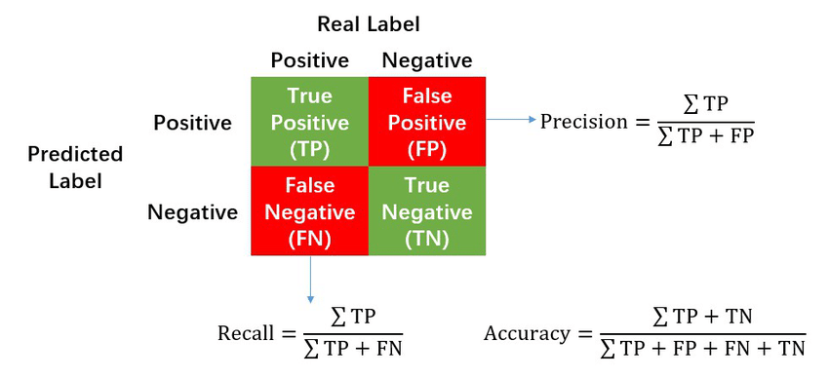
CLASSIFICATION MODEL
> 80%
> 80%
Logistic Regression
Gradient Boosted Trees

Slide 12
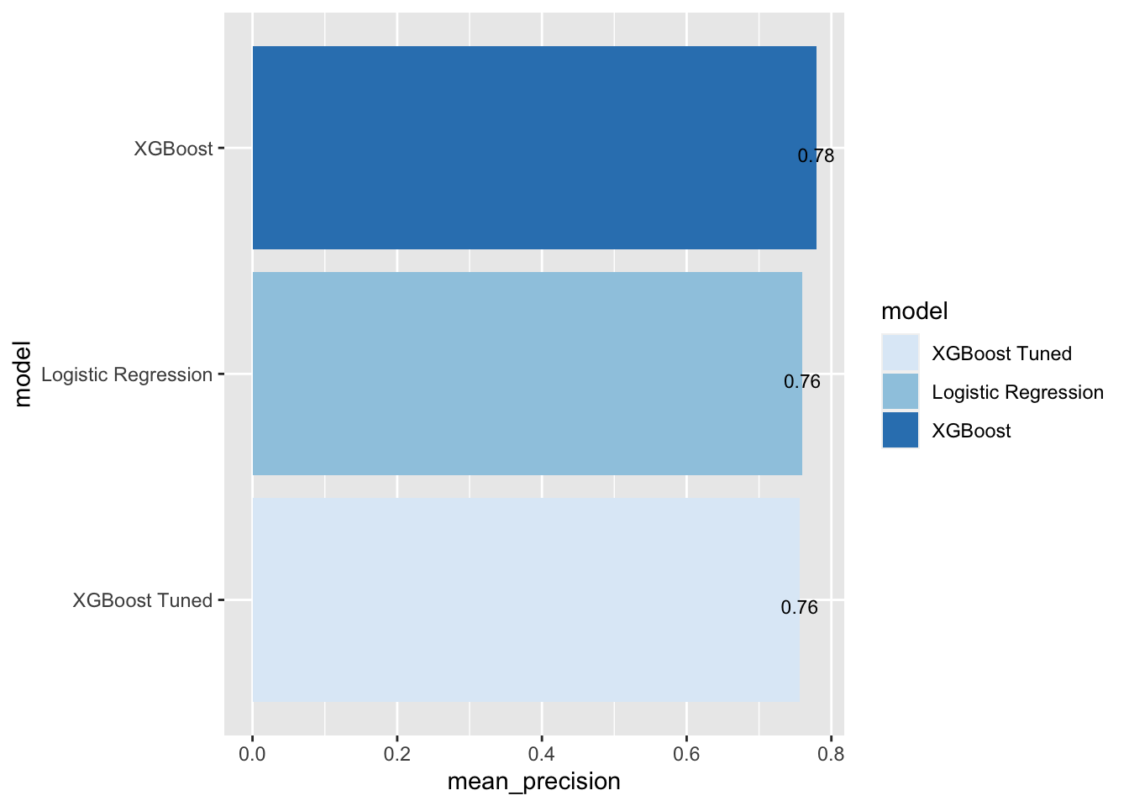

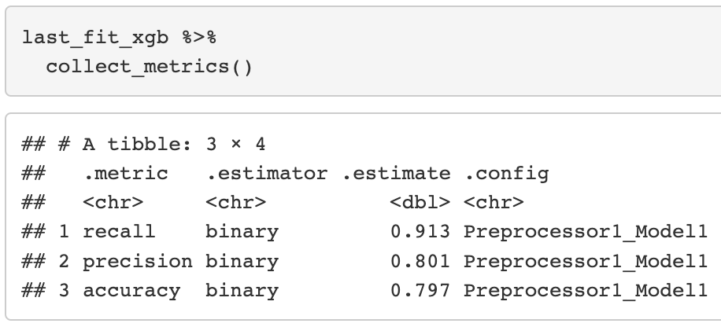
CLASSIFICATION ALL INFORMATION
Create Model
Tune Hyperparameters
Compare
Evaluate on Test Data

Slide 13
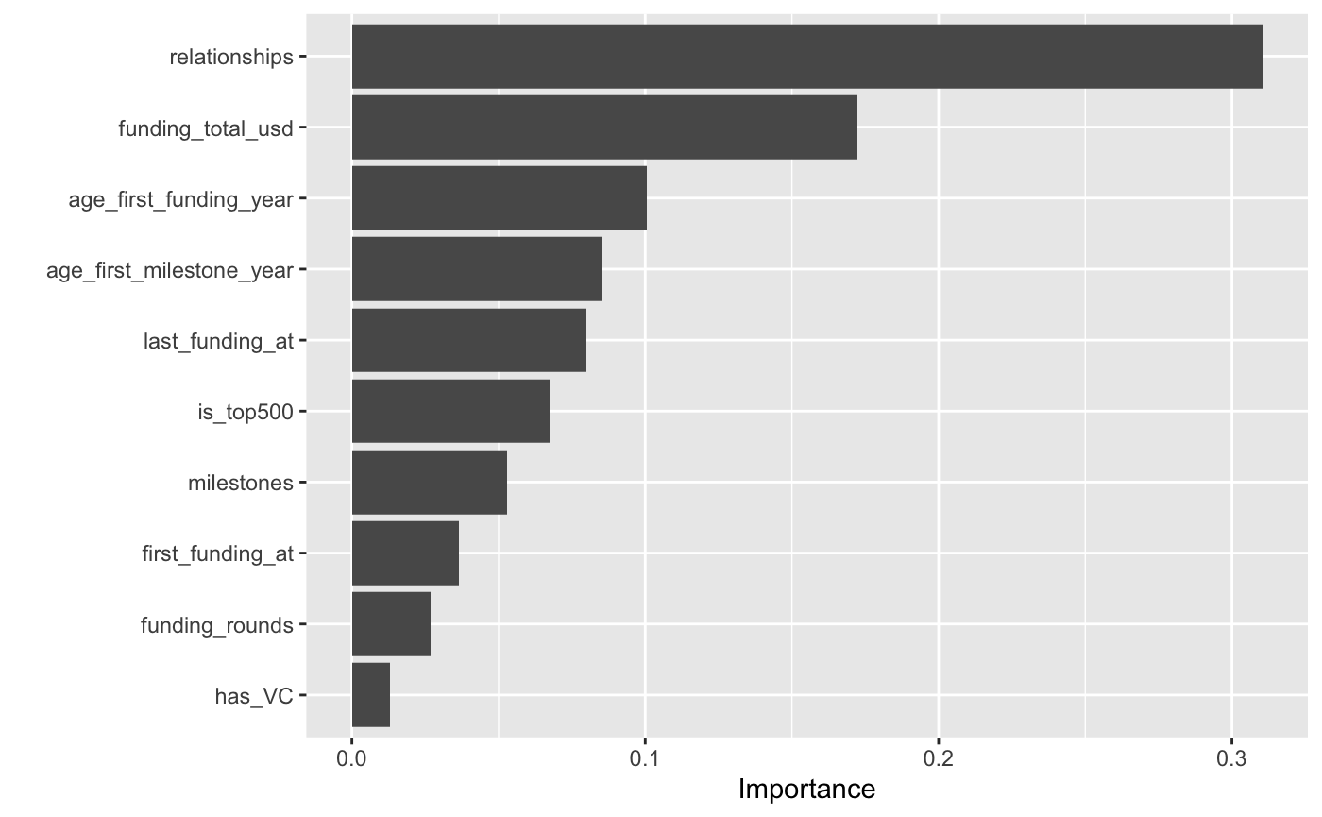
CLASSIFICATION ALL INFORMATION
Most important features

Slide 14
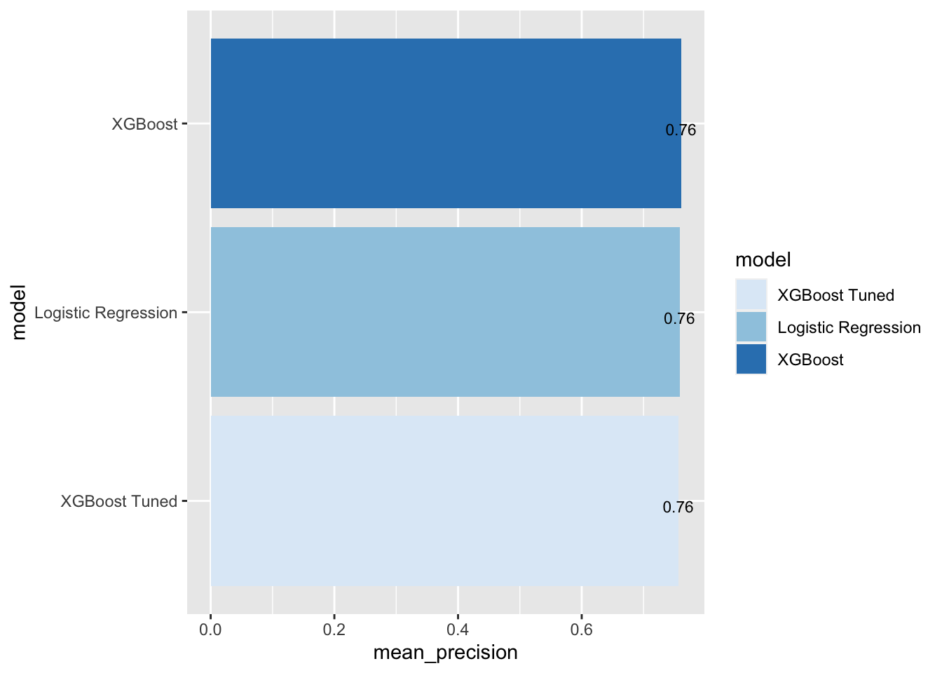
CLASSIFICATION NEW STARTUPS
Create Model
Tune Hyperparameters
Compare

Slide 15

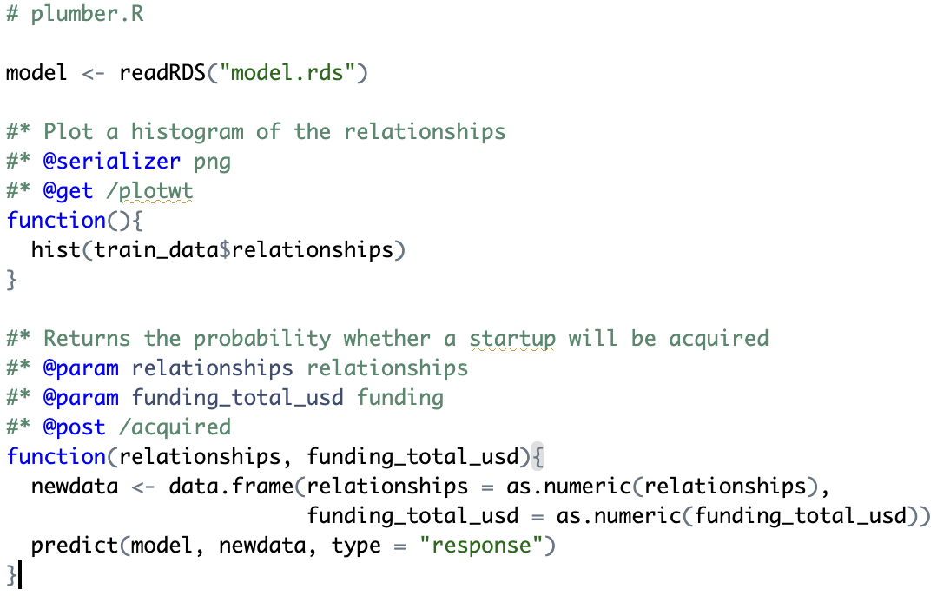


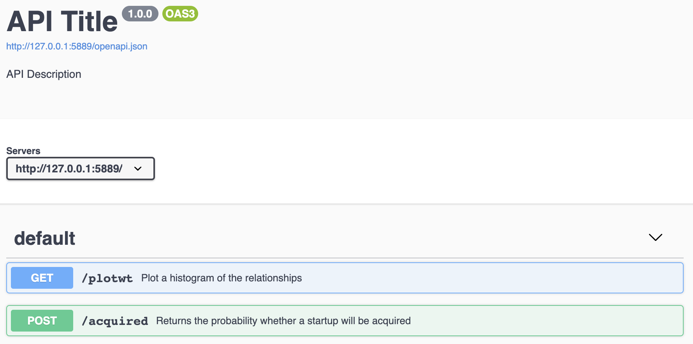
DEPLOYMENT
Posit Connect
Tensorflow
Plumber

Slide 16
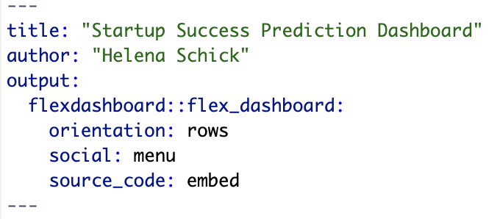
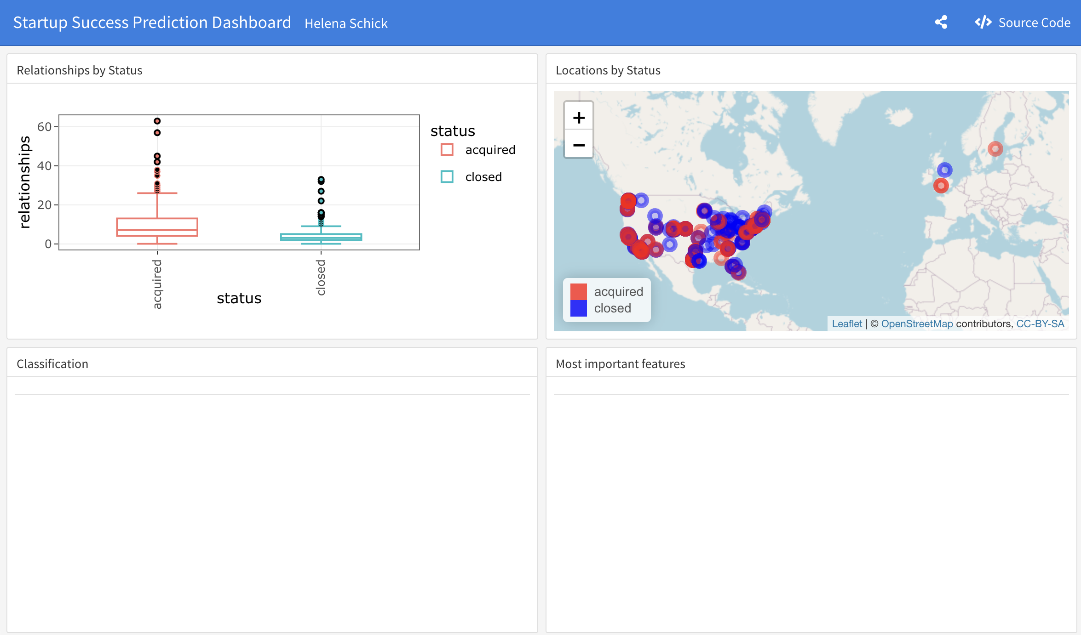
DEPLOYMENT

Slide 17
CONCLUSION
Challenges
Removal of outliers in recipe
Hyperparameter optimization takes very long to run
Tuned decision tree for new startups could not be validated
Deployment of the model
Highlights
Confidence in R and SQL
Understand success factors for startups
Performance metrics almost achieved

