Slide 1


Slide 2
INTRODUCTION
Ololade Awodipe and Helene Barrera

Slide 3
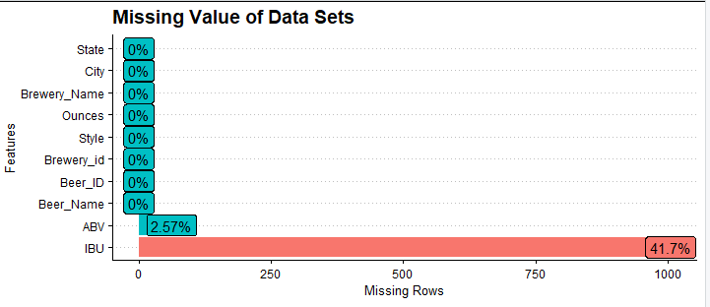
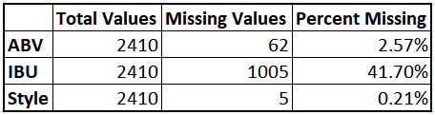
Missing Values
Variables used to predict ABV:
IBU
Style
Ounces
State
Variables used to predict IBU:
ABV
Style

Slide 4
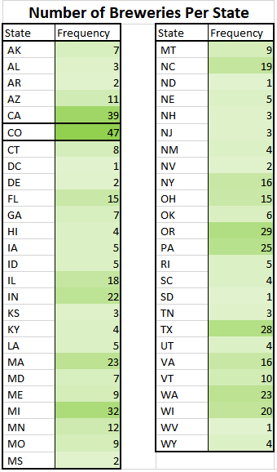
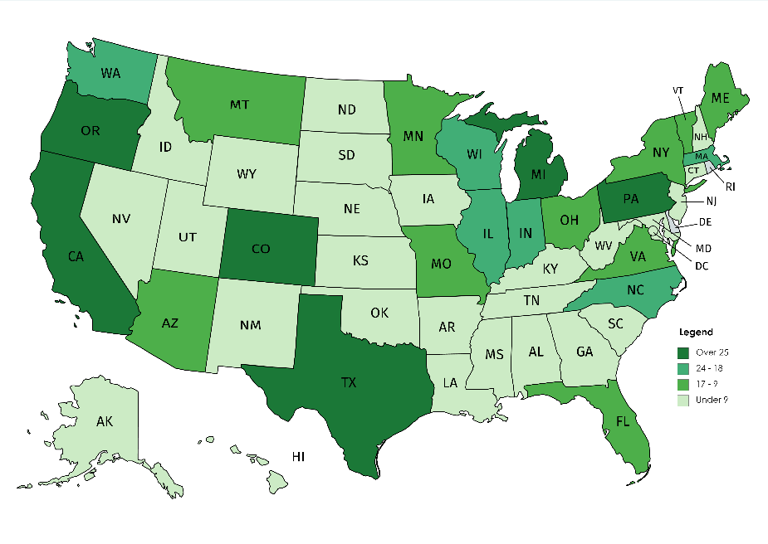
Colorado - The state with the largest number of breweries
DC, ND, SD, WV - The states with the lowest number of breweries.

Slide 5
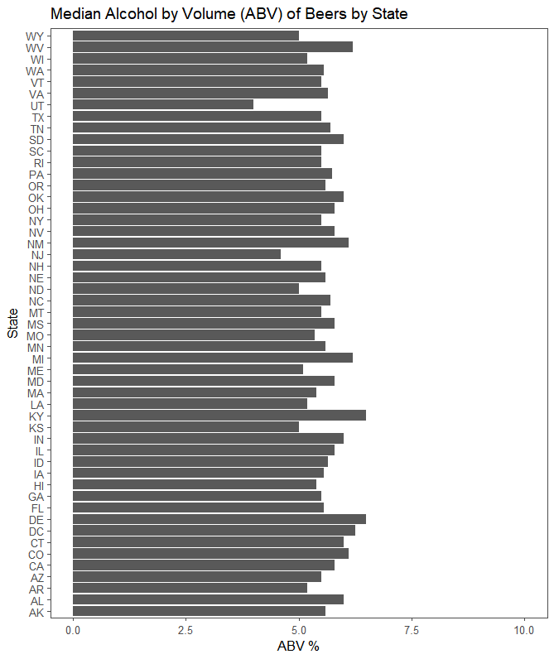
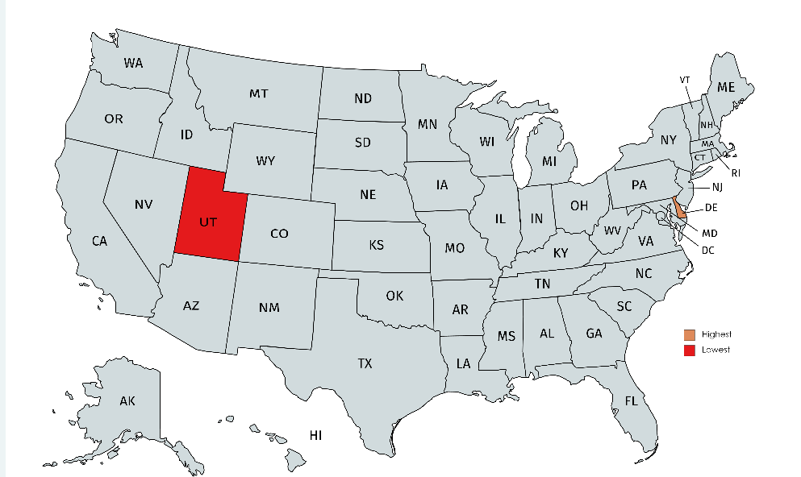
Median Alcohol by Volume (ABV) of Beers by State
Lowest Median ABV %:
Utah (4.0%)
Highest Median ABV %:
Delaware (6.5%)

Slide 6
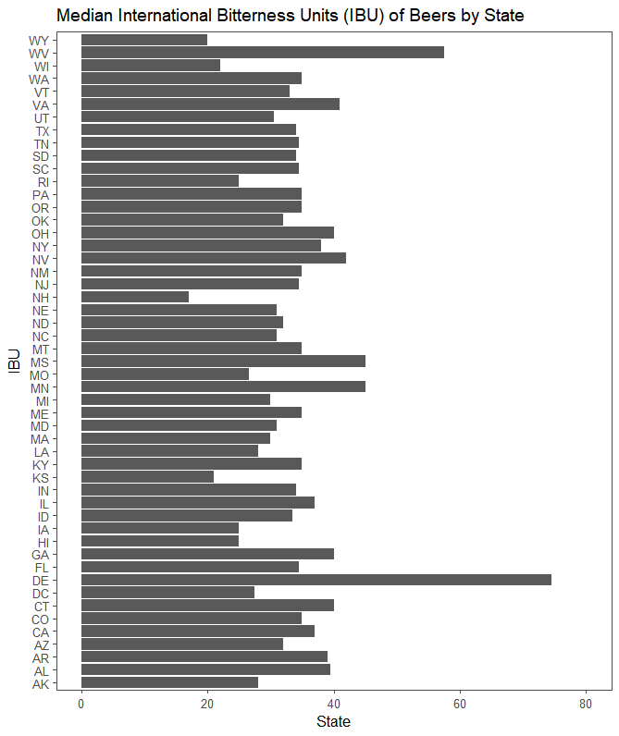
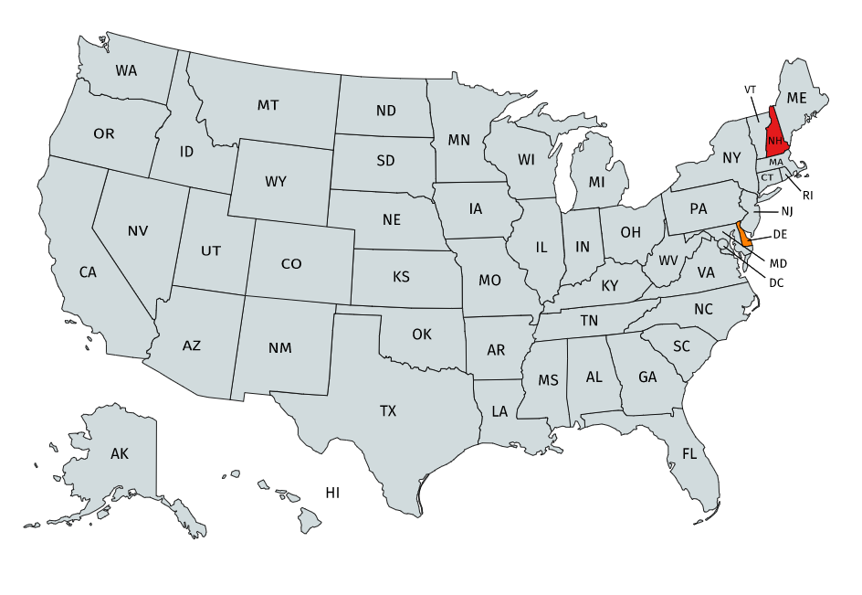
Median Alcohol by Volume (IBU) of Beers by State
Lowest Median IBU:
New Hampshire (17.0)
Highest Median IBU:
Delaware (74.5)

Slide 7

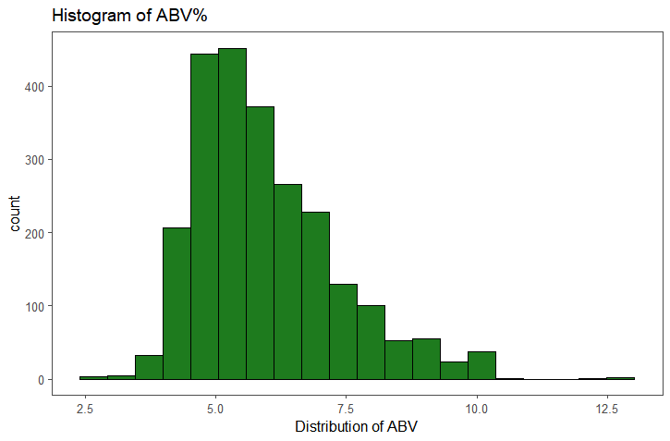
Summary Statistics and Distribution
Bikini Beer
American IPA
Evil Twin Brewing
Brooklyn, New York
ABV: 2.7%
IBU: 36
Ounces: 12
Lee Hill Series Vol. 5
Quadrupel Ale
Upslope Brewing Company
Boulder, Colorado
ABV: 12.8%
IBU: 42
Ounces: 19.2

Slide 8
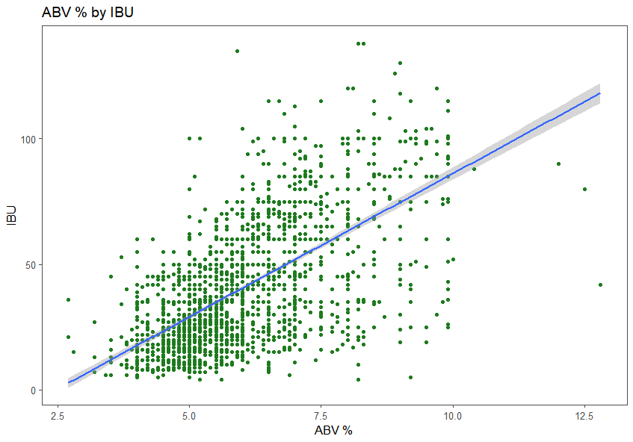
Relationship Between IBU and ABV

Slide 9
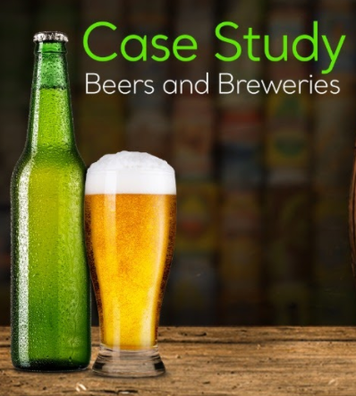
THANK YOU!

