Slide 1
ANOVA
Analysis of Variance
Chhaya Chaudhary

Slide 2
Need for ANOVA
A t-test is appropriate for comparing mean values of two treatments.
When we want to compare several treatments.
ANOVA helps determine if treatments are different.
The ANOVA test is a statistical test that can be done in place of multiple T-tests when comparing the means of more than two groups at a time. ​

Slide 3
ANOVA
An analysis of variance (ANOVA) compares the variance associated with treatments to that variance which occurs naturally between experimental units (usually plots).
Can solve deciphering of variance by partitioning the total variance into discrete variances associated with our treatments and by lumping all the unexplained variance into a single term we call error.
The error mean square actually describes the natural and unexplained variation among our experimental units

Slide 4
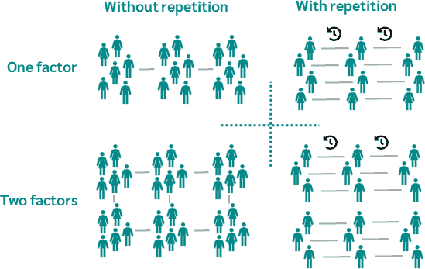
Types of ANOVA
One-factor (or one-way) ANOVA
Two-factors (or two-way) ANOVA
One-factor ANOVA with repeated measurements
Two-factors ANOVA with repeated measurements

Slide 5
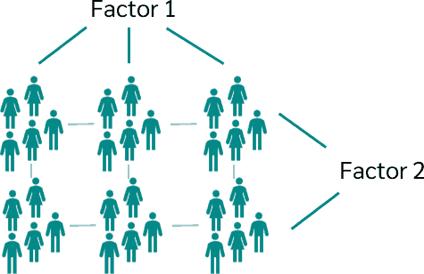
Types of ANOVA
One-way ANOVA | Two-way ANOVA
Does a person's place of residence (independent variable) influence his or her salary? | Does a person's place of residence (1st independent variable) and gender (2nd independent variable) affect his or her salary?
Two-way analysis of variance tests whether there is a difference between more than two independent samples that are split between two variables or factors.

Slide 6

What is a factor?
A factor is, for example, the gender of a person with the characteristics male and female, the form of therapy used for a disease with therapy A, B and C or the field of study with, for example, medicine, business administration, psychology and math.

Slide 7
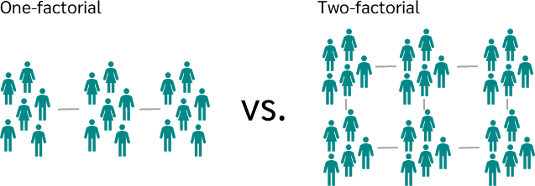

Slide 8
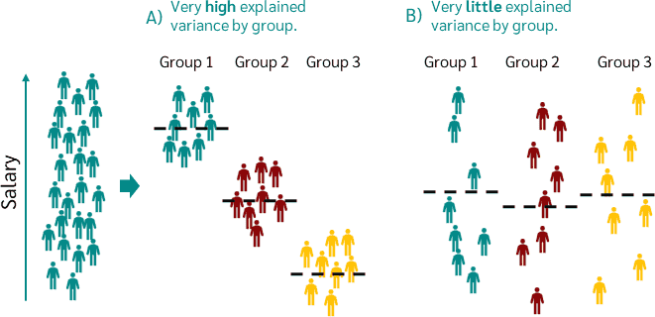
One-way ANOVA

Slide 9
Assumptions of the one-way analysis of variance
1. Level of scale
The scale level of the dependent variable should be metric; that of the independent variable nominally scaled.
2. Independence
The measurements should be independent, i.e. the measured value of one group should not be influenced by the measured value of another group.
3. Homogeneity
The variances in each group should be approximately equal. This can be checked with the Levene test.
4. Normal distribution
The data within the groups should be normally distributed.
What if the prerequisites are not met? If the scale level of the dependent variable is not metric and not normally distributed, then the Kruskal-Wallis test can be used. If the data is a dependent sample, then analysis of variance with repeated measures must be used.

Slide 10
Analysis of variance hypotheses
Just like the T-test, the ANOVA tests the null and alternative hypothesis:
Null Hypothesis: "There is not a significant difference between the groups; any observed differences may be due to chance and sampling error." For example: There is no significant difference between the number of birds at the different locations; the differences we see in the means of the groups may be due to chance and sampling error. | Alternative Hypothesis: "There is a significant difference between the groups; the observed differences are most likely not due to chance or sampling error." For example: There is a significant difference between the number of birds at the different locations; the difference we see in the means of the groups is mostly likely not due to chance or sampling error.

Slide 11
Analysis of variance hypotheses
The null hypothesis and the alternative hypothesis result from a one-way analysis of variance as follows:
Null hypothesis H₀: The mean value of all groups is the same.
Alternative hypothesis H₁: There are differences in the mean values of the groups.
 | Dependent variable | Independent variable
Level of measurement | An metric-scaled variable | A nominally scaled variable with more than two levels
Example | Weekly coffee consumption | Subject (math, psychology, economics)

Slide 12
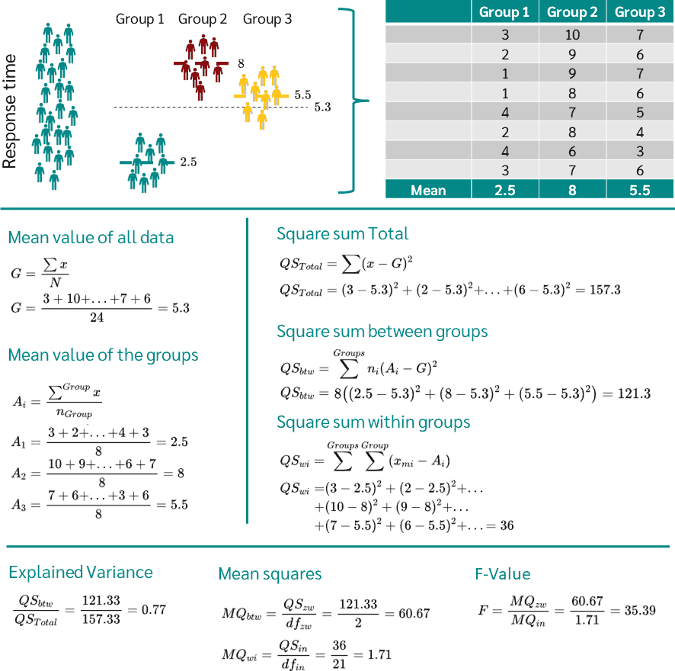
The p-value can then be calculated from the F-value and the degrees of freedom using the F-distribution.
p-value >0.05 (null hypothesis accepted)
p-value <0.05 (null hypothesis rejected)

Slide 13
F-statistic: The F-statistic measures the ratio of between-group variation to within-group variation. A higher F-statistic indicates a more significant difference between group means relative to random variation.
P-value: The p-value determines whether the differences between group means are statistically significant. If the p-value is below a predefined threshold (commonly 0.05), reject the null hypothesis and conclude that at least one group has a significantly different mean.

Slide 14
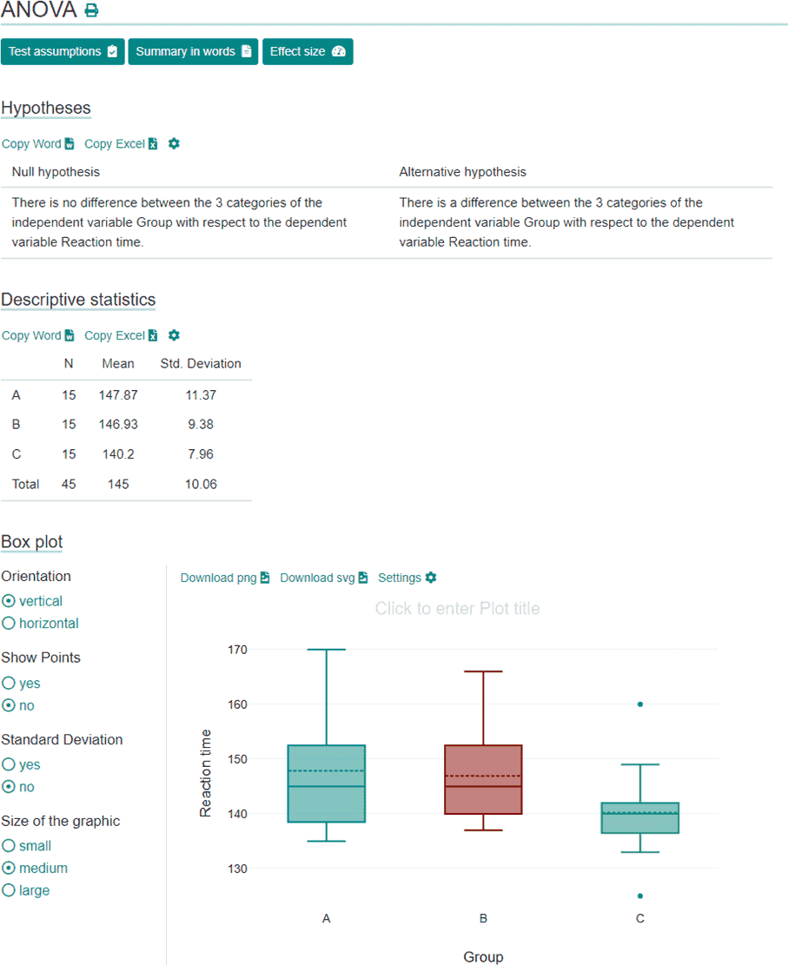
Interpreting ANOVA

Slide 15
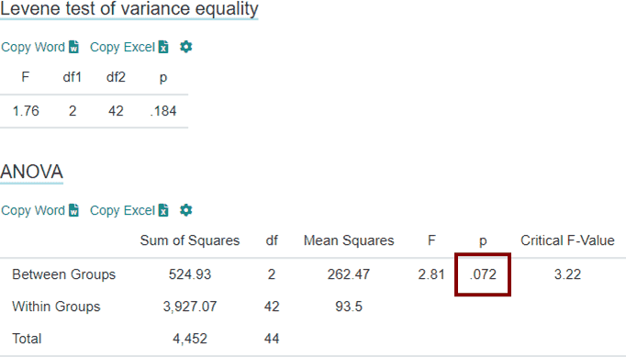
The Levene test yields a p-value of 0.184, which is greater than the significance level of 0.05. Thus, the null hypothesis is confirmed, which indicates that the variances of the different groups are equal and, hence, the variance homogeneity is present.
If the condition of variance homogeneity is not fulfilled, Welch's ANOVA can be calculated instead of the "normal" ANOVA

Slide 16
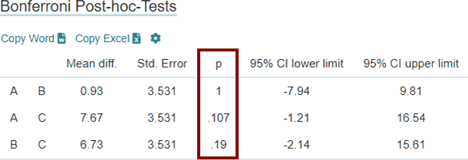
Bonferroni post-hoc tests
If the p-value of the analysis of variance is less than 0.05, it can be assumed that at least two groups differ in mean value. With the help of the Bonferroni post-hoc test, it can now be checked which of the groups differed.

Slide 17
Post hoc tests
Tukey's HSD (Honestly Significant Difference):
Purpose: Compares all possible pairs of means to determine which are significantly different.
Strengths: Powerful for pairwise comparisons, especially when sample sizes are equal.
Weaknesses: Can be less powerful when sample sizes are unequal.
Bonferroni Correction:
Purpose: Adjusts the significance level (alpha) to account for multiple comparisons, reducing the chance of Type I errors.
Strengths: Simple to implement and controls well for Type I errors.
Weaknesses: Can be overly conservative, potentially reducing statistical power and increasing the chance of Type II errors (false negatives).

Slide 18
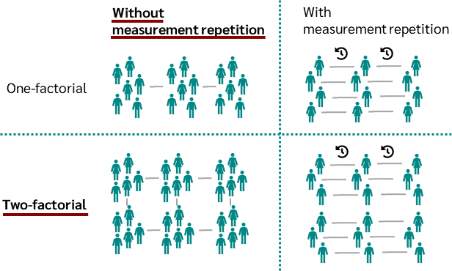
Two-way (or two factor) ANOVA
Two-way (or two factor) analysis of variance tests whether there is a difference between more than two independent samples split between two variables or factors.

Slide 19
Sources
https://datatab.net/tutorial/anova
https://www.datacamp.com/tutorial/anova-test
https://bio.libretexts.org/Bookshelves/Agriculture_and_Horticulture/Quantitative_Methods_for_Plant_Breeding_(Suza_and_Lamkey)/01%3A_Chapters/1.08%3A_The_Analysis_of_Variance_(ANOVA)

