Slide 1
Regression Trees
Chhaya Chaudhary

Slide 2
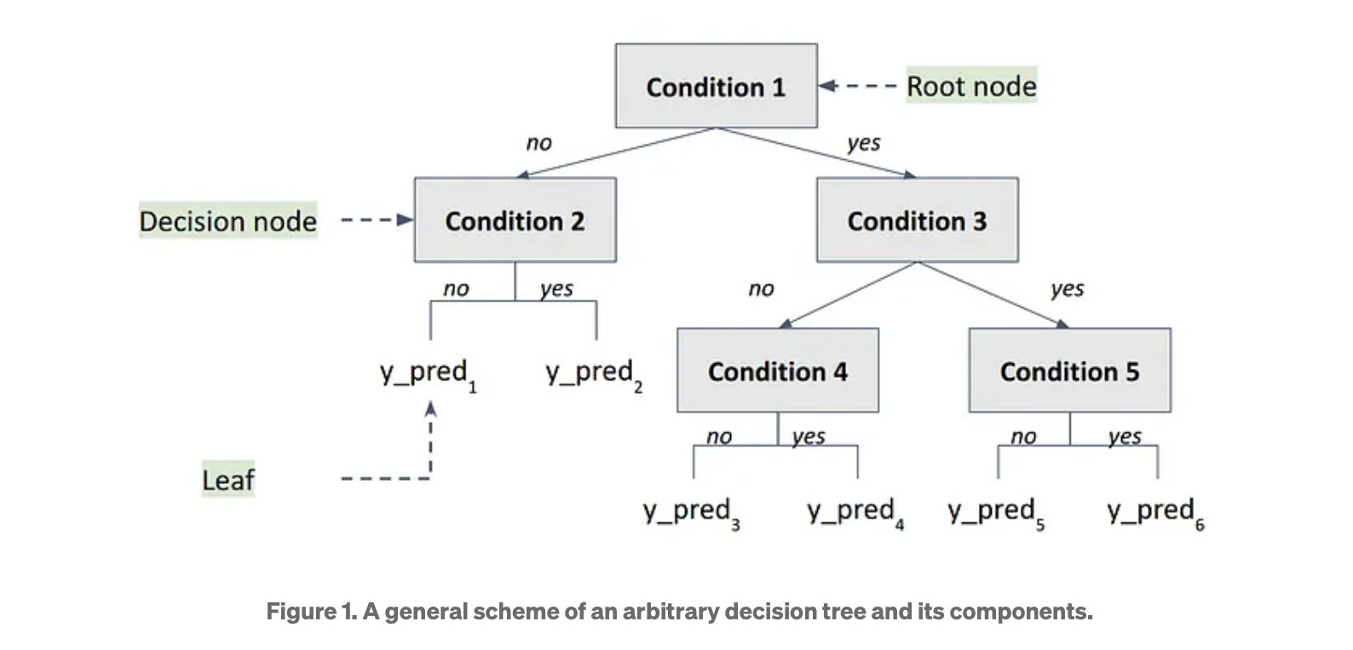
A tree is a graph-based model where each node represents a decision split
https://medium.com/@alexroz/regression-trees-explained-the-most-intuitive-intoduction-dffca74252f4

Slide 3
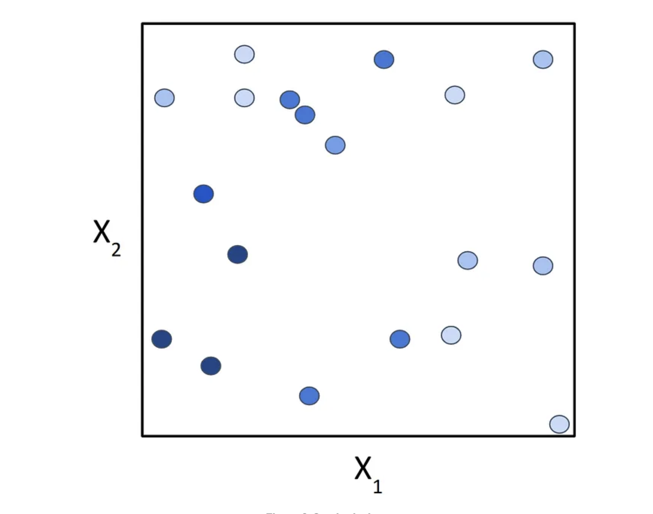
Data representation
We can represent it as a 2D plot, where the x and y axis represent X₁ and X₂, and the color of the objects represents their value of Y.
The goal of our decision tree is to split the feature space into a set of subspaces where the data points within each subspace are as similar to each other as possible
https://medium.com/@alexroz/regression-trees-explained-the-most-intuitive-intoduction-dffca74252f4

Slide 4
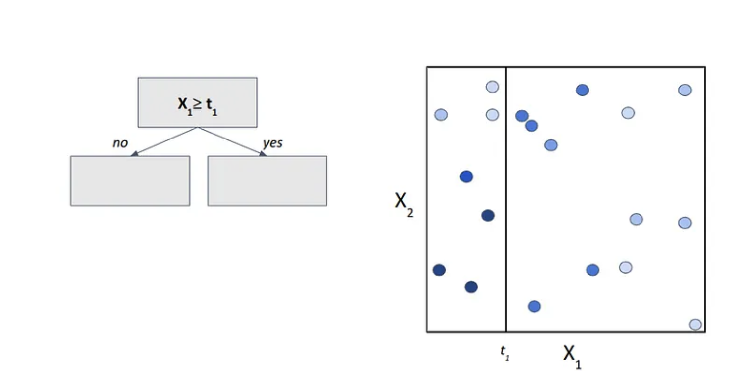
Splitting the feature space
Step 1. We start with a root node and define our first condition: if the value of feature X₁ is greater than some threshold t₁.
https://medium.com/@alexroz/regression-trees-explained-the-most-intuitive-intoduction-dffca74252f4

Slide 5
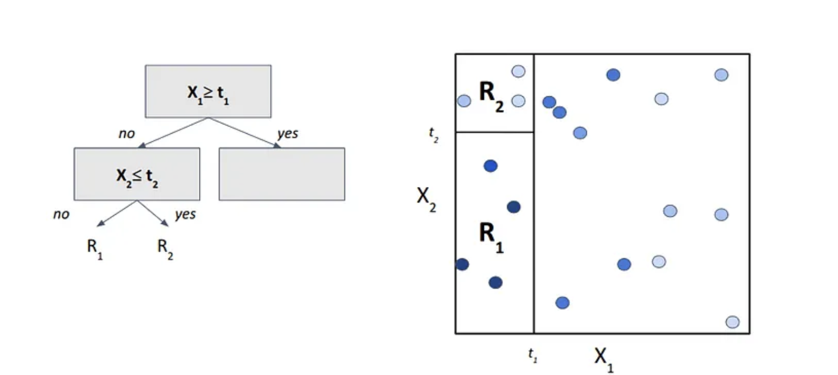
Splitting the feature space
Step 2. Now let’s zoom into region left region. Within this subspace, we introduce a new condition — this time for feature X₂ with threshold t₂.
https://medium.com/@alexroz/regression-trees-explained-the-most-intuitive-intoduction-dffca74252f4

Slide 6
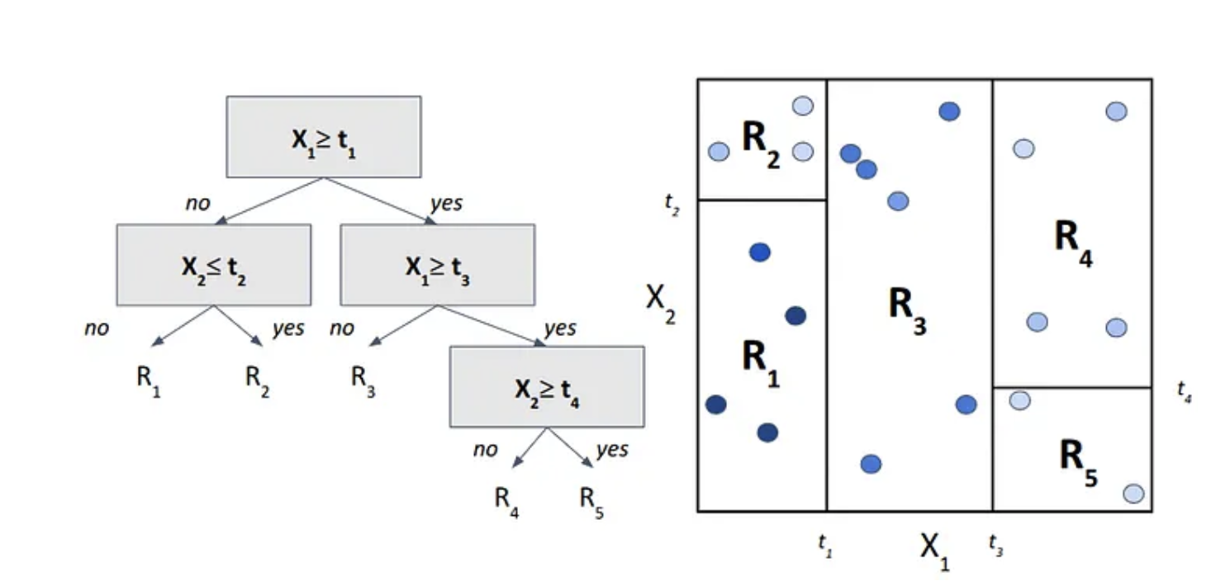
Splitting the feature space
Step 3. By applying this process recursively, i.e. splitting each region using simple threshold-based conditions , we keep dividing the space into smaller and more homogeneous subregions (resulting in R₁-R₅). The number of such splits is governed by the tree’s depth, which corresponds to how many levels of decisions we make from root to leaf.
https://medium.com/@alexroz/regression-trees-explained-the-most-intuitive-intoduction-dffca74252f4

Slide 7
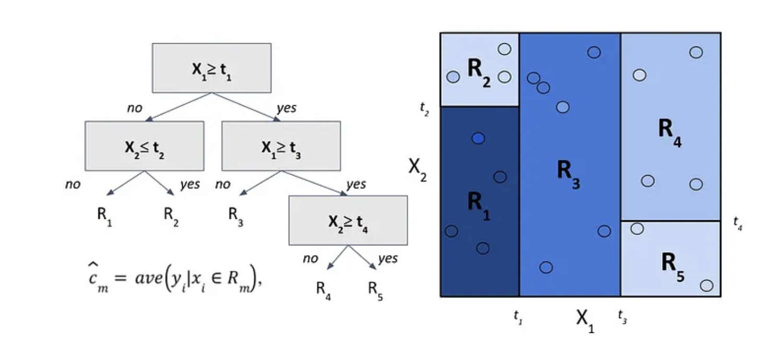
Data splitting
Original dataset
Training data- those regions define the model’s predictions.
- contains training points with known values of the target variable Y. So when a new test point falls into one of those regions, the tree predicts its value as the average of Y values from the training points in that same region
Testing data
https://medium.com/@alexroz/regression-trees-explained-the-most-intuitive-intoduction-dffca74252f4

Slide 8
Core concept behind Regression trees
Instead of fitting a smooth curve, we’re carving up the feature space into chunks where the target values are as homogeneous as possible. The tree learns to minimize variance within each region, making sure that the points grouped together are similar in value.
https://medium.com/@alexroz/regression-trees-explained-the-most-intuitive-intoduction-dffca74252f4

Slide 9
Three things to keep in mind
How do we choose the variable to split by, and where exactly to place the threshold?
When should the tree stop growing?
What are the limitations of this architecture? Can a tree really approximate complex, non-linear functions?
https://medium.com/@alexroz/regression-trees-explained-the-most-intuitive-intoduction-dffca74252f4

Slide 10
Splitting
Mean Squared Error (MSE)
At each step in building a regression tree, the model asks a simple question: If we split the data at this point, will the overall MSE decrease? In other words, does dividing the data create a better, more informative structure , or are we better off stopping here and turning this node into a leaf?
https://medium.com/@alexroz/regression-trees-explained-the-most-intuitive-intoduction-dffca74252f4

Slide 11
Regularization
To keep our tree in check, we introduce a set of parameters that control its growth and complexity:
Maximum Tree Depth: Limits how deep the tree can go. Deeper trees can model more complex patterns but are more likely to overfit.
Minimum Samples per Leaf: Specifies the minimum number of training samples required for a node to become a leaf. This prevents the tree from creating tiny, overly specific leaves.
Minimum Samples per Split: Ensures that a node must have a certain number of training samples before it’s even considered for splitting.
Minimum Information Gain: Sets a threshold for how much the MSE must decrease to justify a split. If the improvement is negligible (say, just 1e10−101) we skip the split to avoid unnecessary complexity.
https://medium.com/@alexroz/regression-trees-explained-the-most-intuitive-intoduction-dffca74252f4

Slide 12
Methods for splitting in R
method = “argument” can be modified and selection depends on the type of response variable. It is
class for categorical/factor
anova for numerical
poisson for count
exp for survival data
cp = “value” is the assigned a numeric value that will determine how deep you want your tree to grow. The smaller the value (closer to 0), the larger the tree. The default value is 0.01, which will render a very pruned tree
https://rpubs.com/camguild/803096

Slide 13
Decision Tree terminology and output items in R
Root Node: Represents the entire sample population and is further divided into two or more homogenous groups.
split: The criterion used to divide a node into two or more sub-nodes.
n: The number of observations in a node.
loss: This is the total number of rows that will be misclassified if the predicted class for the node is applied to all rows.
yval: The overall prediction for the branch (Yes or No). In general, this is the mean response value for that subset.
yprob: The fraction of obervations in that branch that take on values of Yes and No.
Pruning: The process of removing sub-nodes from a decision node. Pruning is a fix for the problem of overfitting.
Complexity: The complexity parameter is used to establish a control level that determines whether a split contributes to a better model fit. Any split that increases the model fit by a factor greater than the defined complexity factor is attempted. The best cp value has the lowest cross-validtion error (xerror).
https://rpubs.com/camguild/803096

Slide 14
Advantages of Decision Trees
Consider All Possible Decisions: Decision trees evaluate all potential decisions and create a comprehensive model for predictions.
Easy to Use: Simple to implement and interpret for both classification and regression tasks.
Handles Missing Values: Decision trees can manage datasets with missing values without requiring special preprocessing.

Slide 15
Disadvantages of Decision Trees
No extrapolation: Decision trees can’t predict beyond the range of the training data.
Step-wise approximation: The output of a regression tree isn’t smooth — it looks more like a staircase. That’s because the tree partitions the space into rectangular regions and assigns the average target value within each region. This step-wise prediction can be a poor fit for underlying continuous or smooth trends.
Overfitting risk: Without regularization, a decision tree can easily overfit.
Computationally Intensive: For large datasets, decision trees can be slow to compute.
Limited Learning Capability: Decision trees may not perform well with complex data. Techniques like Random Forests can be used for improved performance.

Slide 16
References-
https://medium.com/@alexroz/regression-trees-explained-the-most-intuitive-intoduction-dffca74252f4
https://rpubs.com/camguild/803096
https://www.geeksforgeeks.org/r-language/decision-tree-for-regression-in-r-programming/
https://datajobs.com/data-science-repo/CART-Guide-[CMU].pdf

