Slide 1
Generalized additive models and non-linear regressions
iMARSYS-05 – 17.06.2026
Helene Gutte

Slide 2
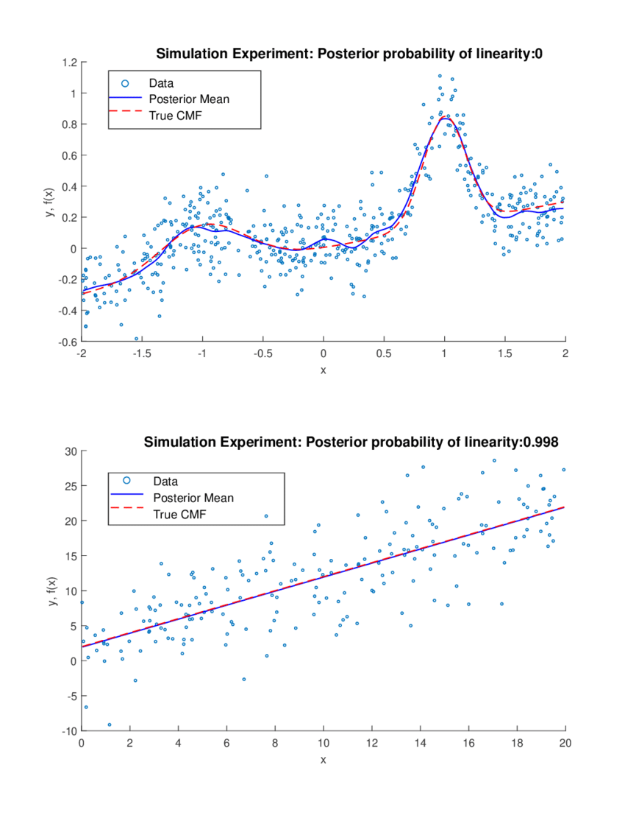
What to do when data is non-linear?
Linear
Non-Linear
https://www.researchgate.net/profile/Joshua-Chan-4/publication/336651720/figure/fig1/AS:827026202169345@1574189820497/Results-of-Linear-and-Nonlinear-Generated-Data-Experiments.png

Slide 3
Short recap of the different approaches
More explanatory variables
Interaction terms
Transformations
Polynomials
Non-linear regressions
Generalized additive models
Lecture GLMs (06.05.)
Lecture multivariate regression (28.05)

Slide 4
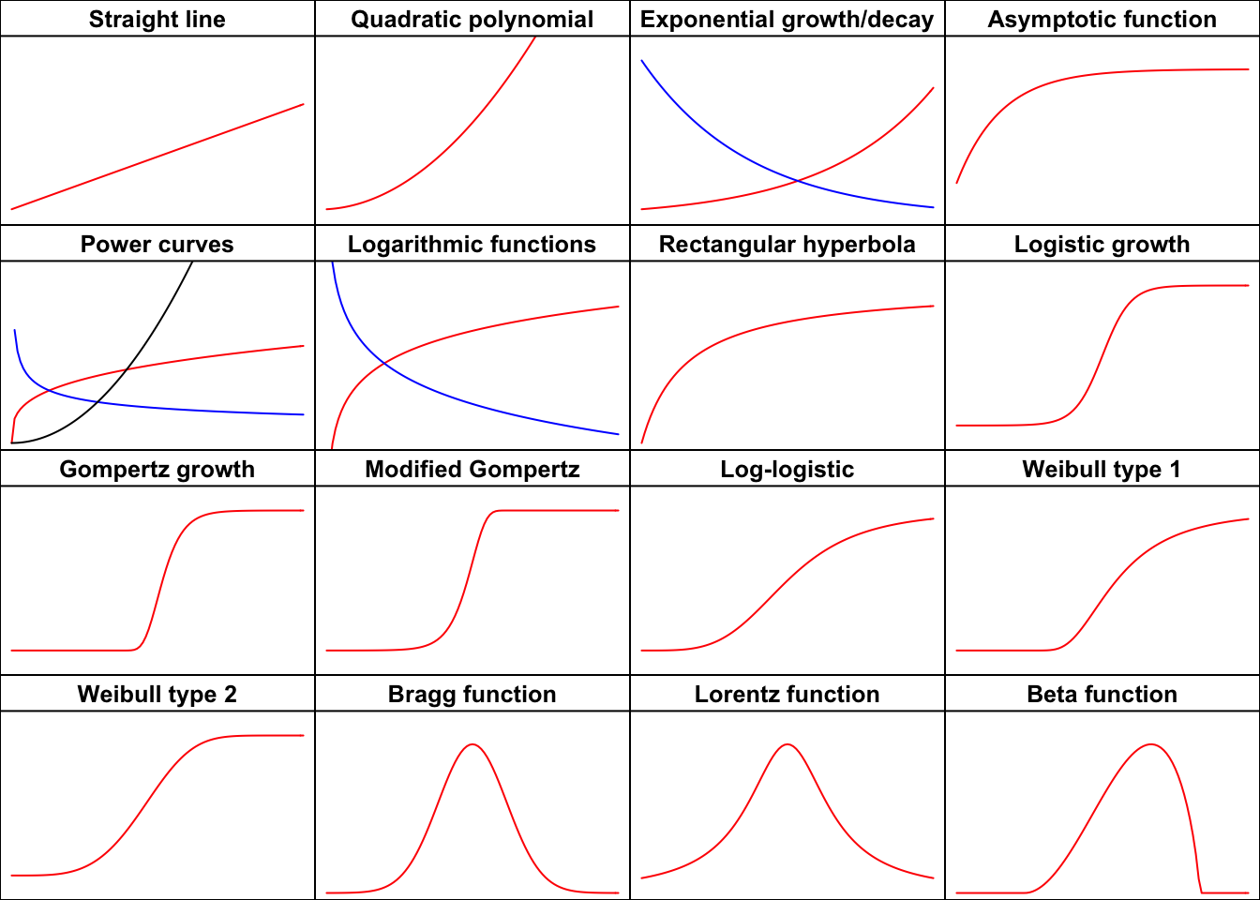
Non-linear regressions
Also called non-linear least squares
Usage of a non-linear function:
Linear f(x) = m*x + b
Asymptotic curves
S-shaped functions
Bell-shaped curves
Fig. 4. Nonlinear regression functions classified according to their shape. Summarized by Onofri A. based on Ratkowsky (1990) https://www.statforbiology.com/2020/stat_nls_usefulfunctions/.

Slide 5
Non-linear regressions
Pros
Cons
Function can be defined by user
Prior knowledge can be integrated
Function and starting value must be supplied by user

Slide 6
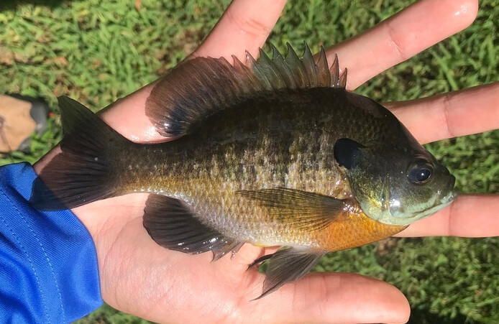
Non-linear regressions – Example
Weight as function of of total length:
W = a * TL^{b}
In R: nls(wght ~ a*(tl^b, data, start = list(a = 1, b = 3))
https://en.wikipedia.org/wiki/Bluegill

Slide 7
Example in R
Bluegills

Slide 8
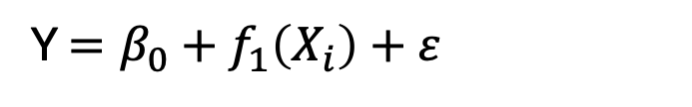
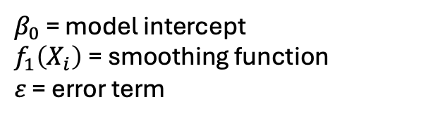
Generalized additive models – GAMs
Data driven approach rather than model driven
No mechanistic model required beforehand
Flexible approach to model non-linear data
Response variable Y is modelled with a smoothing function of X
$β_{0}$ = model intercept
$f_{1}\left(X_{i}\right)$= smoothing function
$ε$ = error term
Y $=β_{0}+f_{1}\left(X_{i}\right)+ε$

Slide 9
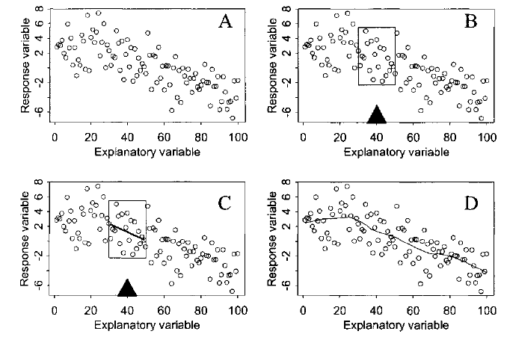
What is smoothing?
Running mean smoother
LOESS
Running line smoother
Notes:
Running mean = moving a box along x and calculating in each box the expected mean value
Running line = apply a linear regression on the values in the box and calculate for each value the expected value based on the lm
LOESS = locally weighted regression smoother, similar to the running line smoother but with weights for how far a value is from the target x value

Slide 10
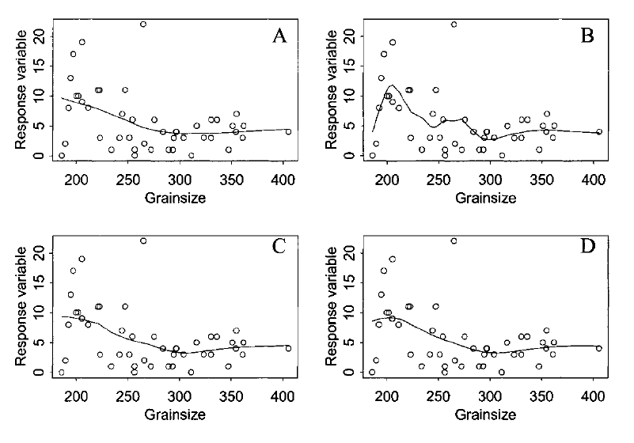
Moving window smoothers
Optimal box width or span width?
What happens at the edges of the boxes?
0.7
0.3
0.5
span width = 0.7 → width of the box contains 70% of the data
→ small variances but fit is not good

Slide 11
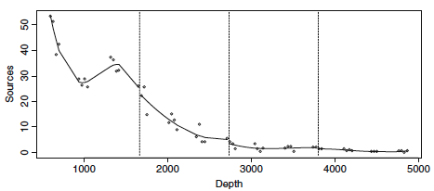
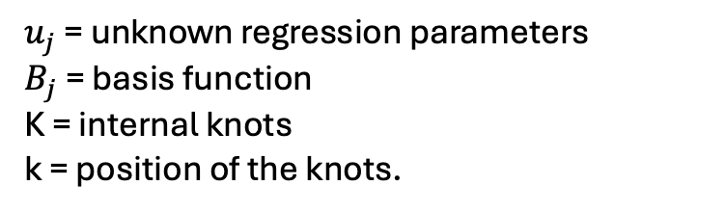
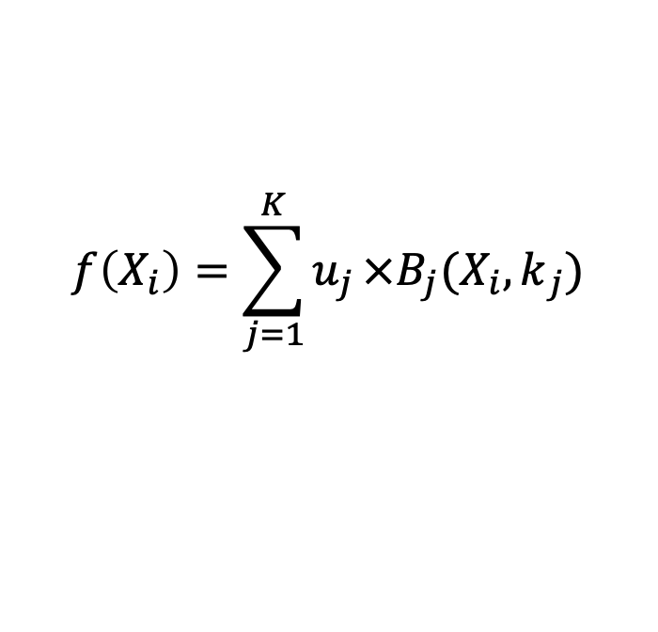
Regression splines
Piecewise polynomial functions (basis functions) joined at “knots”
Overfitting is avoided by applying penalty terms and least squares
Combined to one single smoothing function
$$f\left(X_{i}\right)={\sum_{j=1}^{K}{u_{j}}×{B_{j}(X}_{i},k}_{j})$$
$$u_{j}\text{ = }\text{unknown} \text{regression} \text{parameters}$$
$B_{j}$ = basis function
K = internal knots
k = position of the knots.
Notes:
$$u_{j}\text{ = }\text{unknown} \text{regression} \text{parameters}$$
$B_{j}$ = basis function
K = internal knots
k = position of the knots.

Slide 12
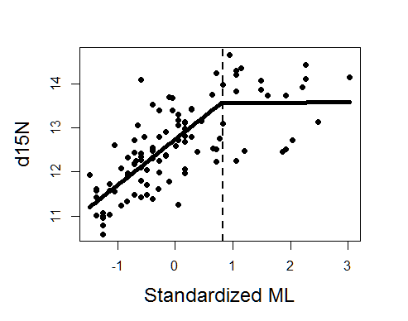
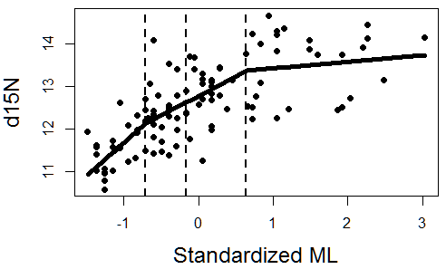
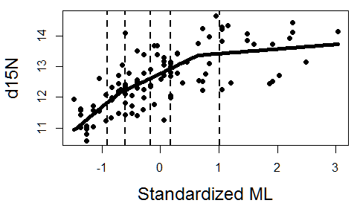
Influencing parameters – Knots
Number and position?
More points = more wiggliness
K = 1
K = 3
K = 5
Fig. 8. Plot of the relation between isotopic ratio and mantle length with different number of knots.

Slide 13
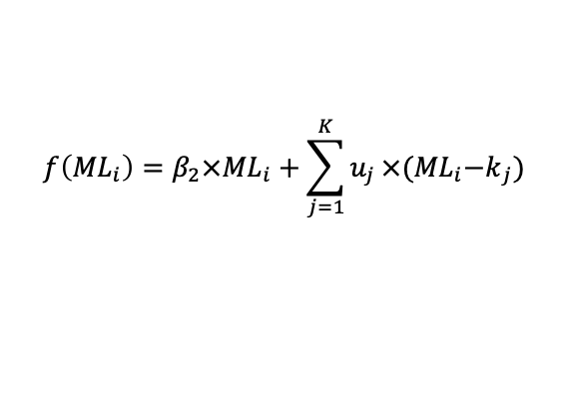
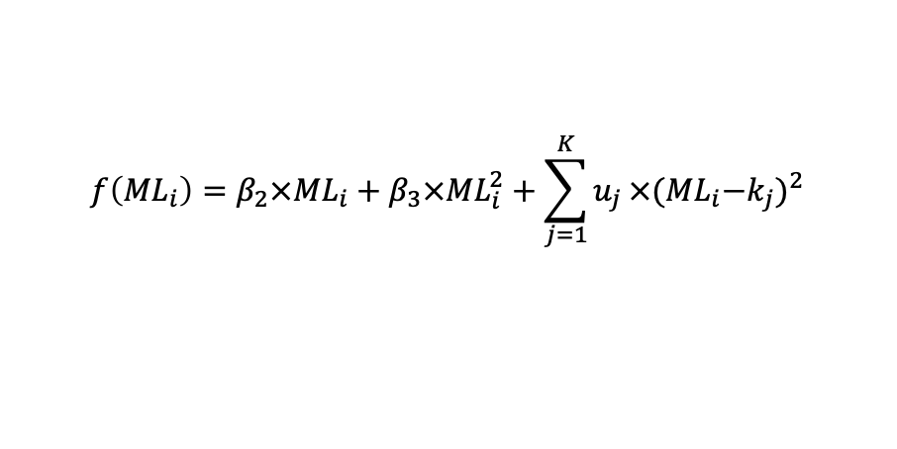
Influencing parameters – Type of basis function
$$f\left({ML}_{i}\right)=β_{2}×{ML}_{i}+{\sum_{j=1}^{K}{u_{j}}×{(ML}_{i}−k}_{j})$$
Linear splines
Quadratic splines
Cubic regression splines
Third-order polynomials
Computationally very efficient
Number of knots must be chosen
Special case: cyclic cubic regression splines (value at the far left = value at the far right), good to model seasonal cycles
Other spline types: B-splines, natural splines, P-splines, thin plate splines
$$f\left({ML}_{i}\right)=β_{2}×{ML}_{i}+β_{3}×{ML}_{i}^{2}+\sum_{j=1}^{K}{u_{j}}×{{(ML}_{i}−k_{j})}^{2}$$

Slide 14
EDFs – Measure smoothness
Effective degrees of freedom
Amount of smoothing of each smoothing functions
Edf = 1 → straight line
Edf > 2 → non-linear
Edf > 8 → highly non-linear
Choose the amount of smoothing with cross-validation automatically

Slide 15
Cross validation
Generalized cross-validation criterion (GCV)
Principle:
Leave out observation i
Estimate smoothing curve with the rest (n – 1 observations)
Predicted the observation i
Compare the predicted observation i to the observed i (residual)
Repeat for each observation
Add up all squared residuals → cross-validation error this will be minimized
GCV applies this for varying degrees of smoothness
Automatically applied in R, smaller values → better

Slide 16
Model validation
Modelfit: fitted vs. observed values
Normality check: histograms and QQ plot of residuals
Spread of residuals vs. fitted values → should be even
Independence check : residuals vs. predictor
Autocorrelation
Check for influential observations (e.g. cooks distance)

Slide 17
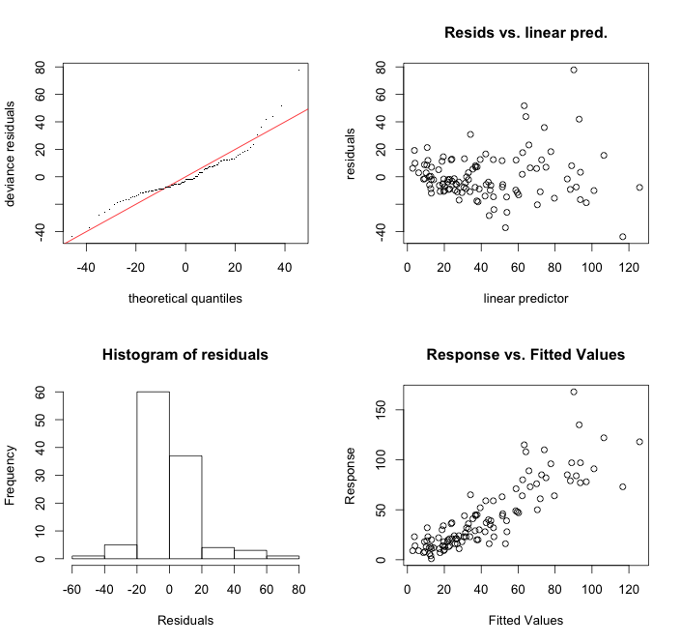
Diagnostic plots
Q-Q Plot
Check for homogeneity
Check for normal distribution
= fitted values
Model fit (ideally a straight line)

Slide 18
Model selection
More parameters → more model possibilities
Compare with GCV or AIC
Compare graphically!
Occam´s Razor:
Few parameters as possible
Simple explanations are preferred if they have a similar fit
For many explanatory variables: forward vs. backward selection

Slide 19
Pros & Cons of GAMs
Pros
Cons
Flexible approach
No mechanistic prior knowledge
Capture the shape of the relationship without prejudging
Can also verify results of linear models
Same error functions as GLMs
Coefficients need to be graphically examined
Not so easily transferrable
Sensitive to gaps and outliers

Slide 20
GAMs in R
Package mgcv
gam(formula,family=gaussian(),data=list(), weights=NULL, subset=NULL, na.action, offset=NULL, method="GCV.Cp”, optimizer=c("outer","newton"),control=list(), scale=0, select=FALSE,knots=NULL, sp=NULL, min.sp=NULL,H=NULL,gamma=1,fit=TRUE, paraPen=NULL, G=NULL,in.out,...)
formula(Y~s(X))
s(X, k=-1,fx=FALSE,bs="tp",m=NA,by=NA,xt=NULL, id=NULL,sp=NULL)

Slide 21
GAMs in R
Error structure comparable to GLMs
Provided with the argument family
Gaussian is the default
Use gam.check to get diagnostic plots
The formula can contain non-parametric smoother functions and parametric coefficients at the same time:
Three continuous explanatory variables linked to Y through non-parametric smoothing functions:
y~s(x)+s(w)+s(z)
Mix with parametric parameters and non-parametric smoothing functions:
y~x+s(w)+z

Slide 22
Example in R
Isotope ratio of squids

Slide 23
Break 15 minutes

Slide 24
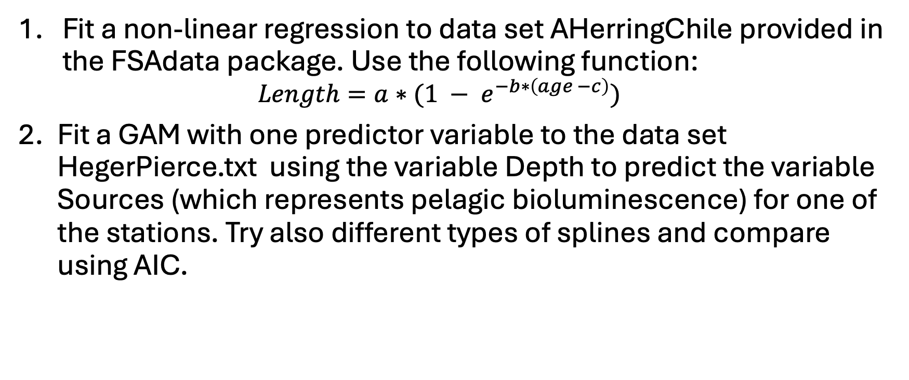
First exercise round
Fit a non-linear regression to data set AHerringChile provided in the FSAdata package. Use the following function:
$$Length=a∗(1 − e^{−b∗\left(age −c\right)})$$
Fit a GAM with one predictor variable to the data set HegerPierce.txt using the variable Depth to predict the variable Sources (which represents pelagic bioluminescence) for one of the stations. Try also different types of splines and compare using AIC.

Slide 25


GAMs with more variables
Add fixed and smoother terms to your formula
$$d15N=β_{0}+f\left({ML}_{i}\right)+ε$$
$$d15N=β_{0}+β_{1}×Lat+f\left({ML}_{i}\right)+ε$$
fixed
smoothing function

Slide 26
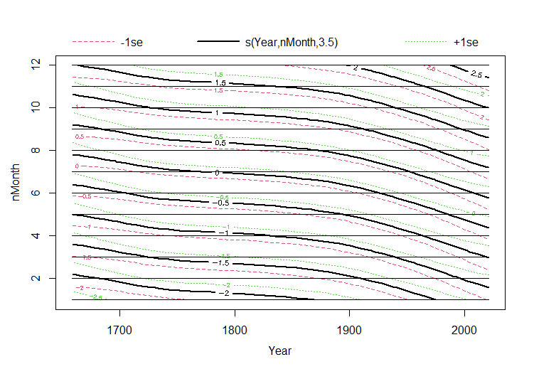
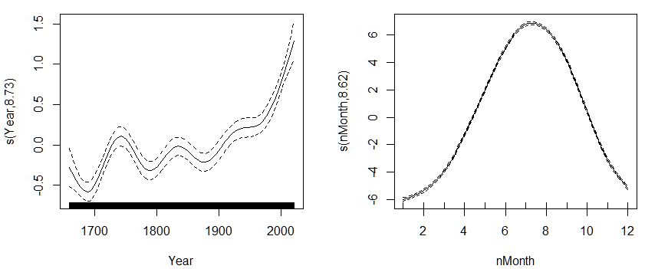
Interactions
Unnested
Nested
Temperature ~ s(Year) + s(nMonth)
Temperature ~ s(Year, nMonth)

Slide 27
More advanced techniques
GAMMs = generalized additive mixed models
Useful for autocorrelated data
Implemented in the mgcv package
tGAMs = threshold GAMs
Either use the by = argument in the smoothing formula
Or use the thresh_gam() function form the package INDperform

Slide 28
Example in R
Temperature from 1659 to today
Data from Hadley Centre

Slide 29
Break 15 minutes

Slide 30
Exercise 2
Use again the Heger Pierce data
Sources is the response variable
Add Stations as a fixed factor term (actually convert the Stations variable to a factor!)
Try other variables of your choice and compare your models
Try also unnested and nested interactions

