Slide 1
Linear Models
i-MARSYS-05, 29.04.2026

Slide 2
Why to useLinear Regression
To estimate a relationship between two variables that can be used for prediction.
Types of variables-
Response variable
Explanatory / predictor variable
Data type- continuous values

Slide 3
What is Simple Linear Regression?
Relates one continuous response Y to one predictor X via a linear function
Partitions Y into a systematic component E[Y|X] and random noise ε
Makes inference about the population parameter β₁ from sample data
Foundation for multiple regression, GLMs, and mixed-effects models
Why "simple"?
One predictor only. "Linear" refers to linearity in the parameters(β₀, β₁), not necessarily in X — so log(X) as a predictor is still a linear model.

Slide 4
Notation and parameter meaning
Response variable
The outcome we model; random
Predictor
Explanatory variable
may be fixed or random
Y = β₀ + β₁X + ε
ε
Error term
All unmodelled variation; ε ~ N(0, σ²)
Intercept
E[Y] when X = 0; not always meaningful
Slope
Change in E[Y] per unit increase in X

Slide 5
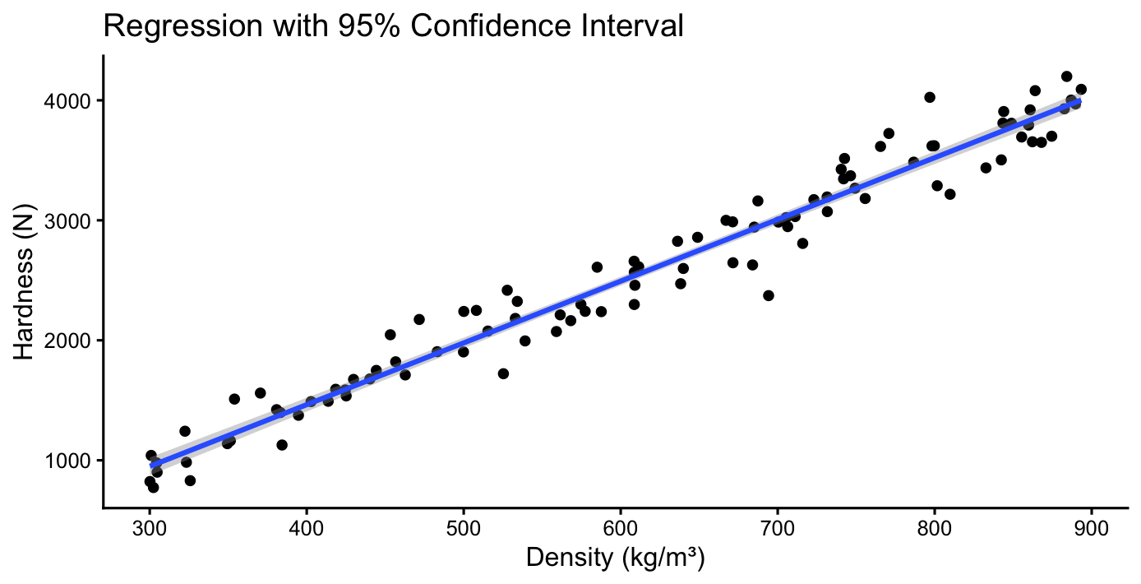
Plotting
model <- lm(Hardness ~ Density, data = data)

Slide 6
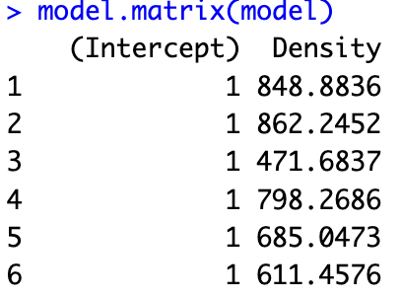
Standard regression intercept (the value of y for x = 0)
The density coefficient tells us the increase in hardness for every unit increase in wood density.
R calculates the fitted values (predictions) by combining these estimates of the coefficients with the model matrix.

Slide 7
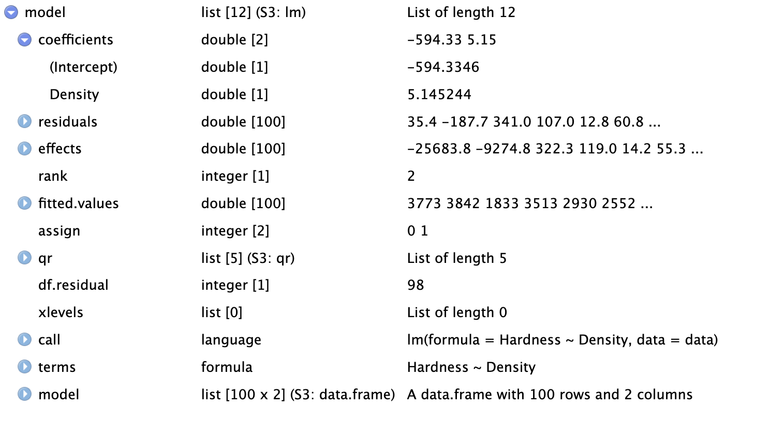
The Model
Difference between the observed and fitted values

Slide 8
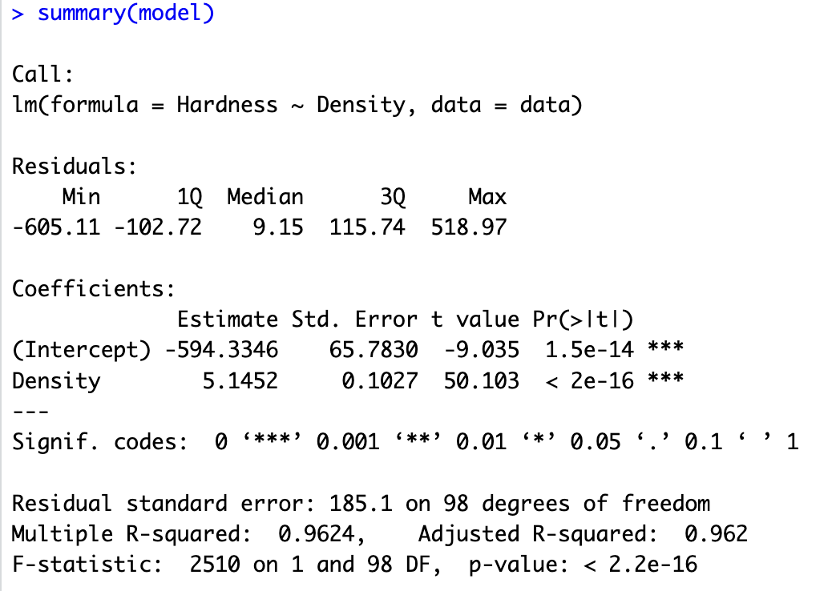
Intercepts in linear models

Slide 9
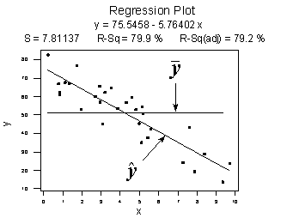
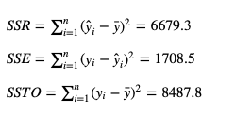

The Coefficient of Determination, r-squared
The "coefficient of determination" or "r-squared value," denoted r², is the regression sum of squares divided by the total sum of squares. Alternatively, as demonstrated in this screencast below, since SSTO = SSR + SSE, the quantity r² also equals one minus the ratio of the error sum of squares to the total sum of squares:
https://online.stat.psu.edu/stat462/node/95/

Slide 10
Basic characteristics of r²
Since r² is a proportion, it is always a number between 0 and 1.
If r² = 1, all of the data points fall perfectly on the regression line. The predictor x accounts for all of the variation in y!
If r² = 0, the estimated regression line is perfectly horizontal. The predictor x accounts for none of the variation in y!

Slide 11
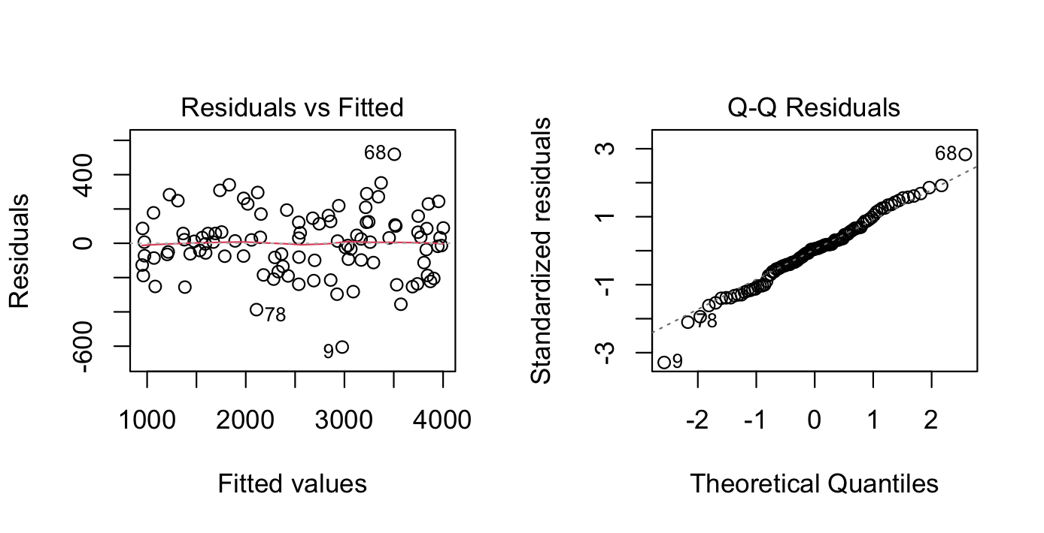
Residual plots

Slide 12
Questions to ask from a residual plot?
Do the residuals exhibit a clear pattern?
Do the residuals increase or decrease in variance in a systematic way?
The answer should be NO
Should be no Heteroscedasticity- situation in which the variability of a dependent variable is unequal across the range of values of an independent variable.

Slide 13
Good and bad residual plots

Slide 14
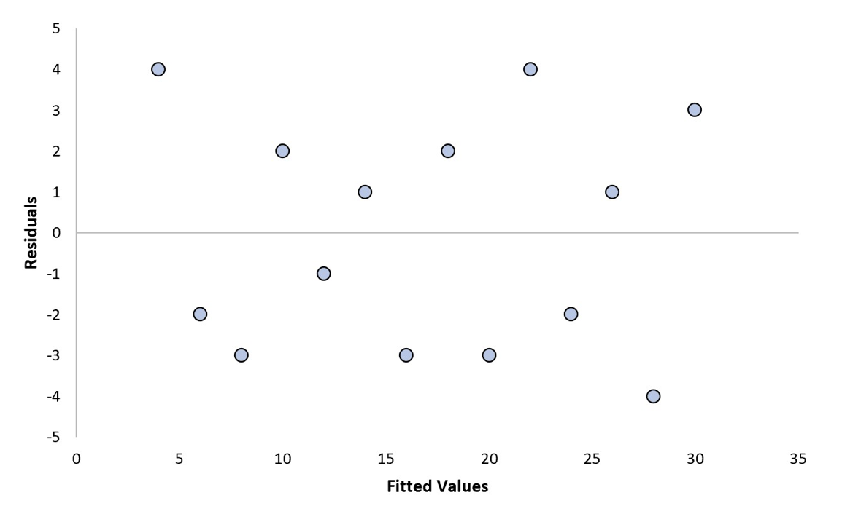
Good vs Bad residual plot

Slide 15
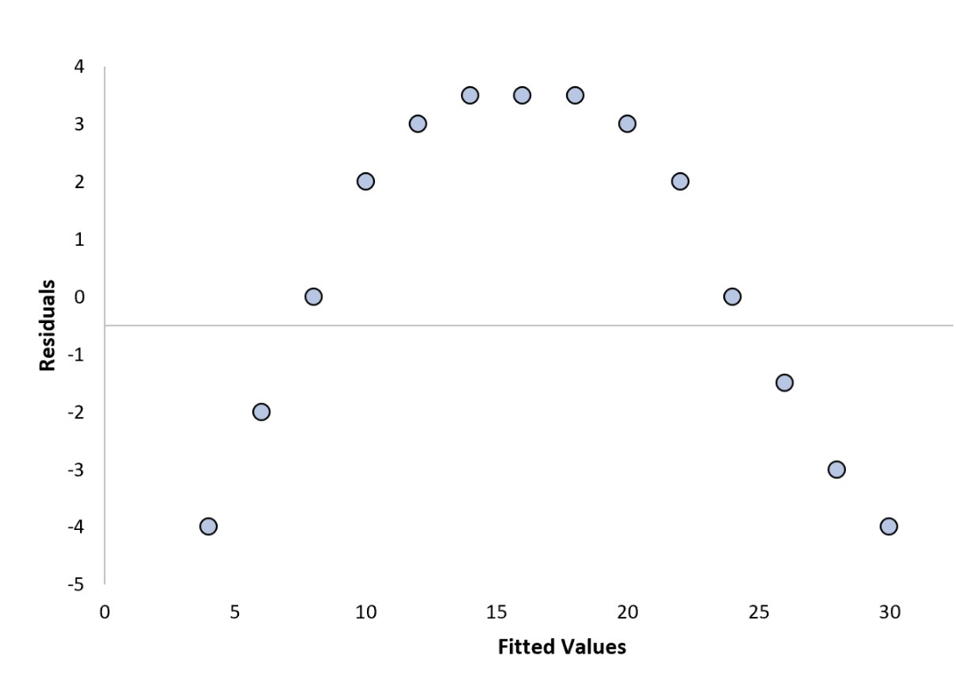
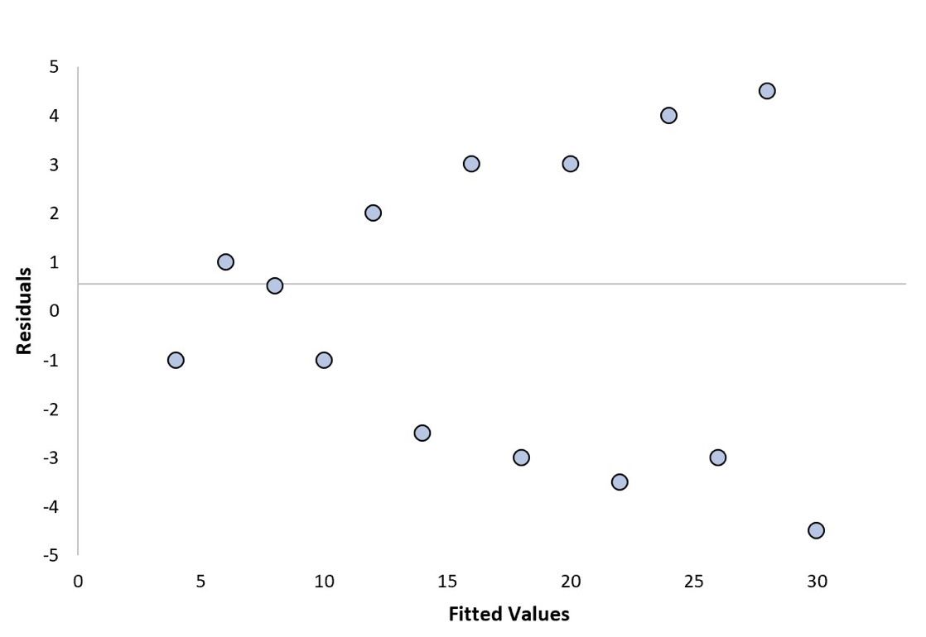
Good vs Bad residual plot
The plot has a "funneling" effect. That is, the residuals are spread out for small x values and close to 0 for large x values
The plot has a "fanning" effect. That is, the residuals are close to 0 for small x values and are more spread out for large x values.
The residual vs. fits plot suggests that the error variances are not equal.

Slide 16
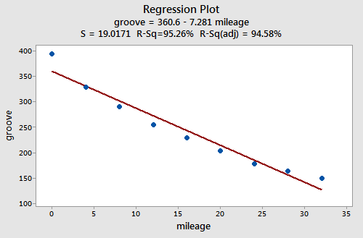
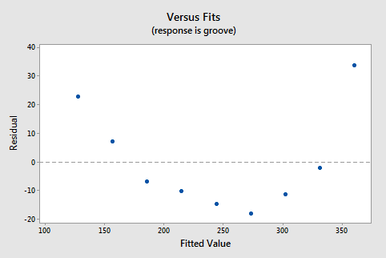
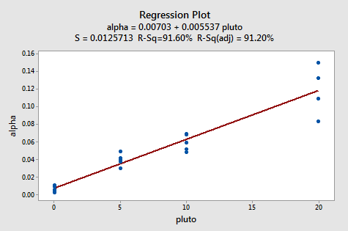
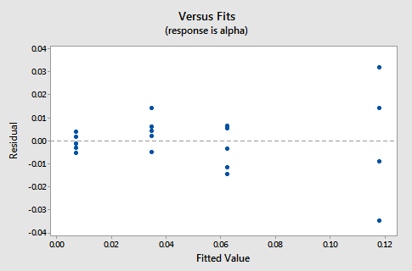
Another example- Funneling and Fanning

Slide 17
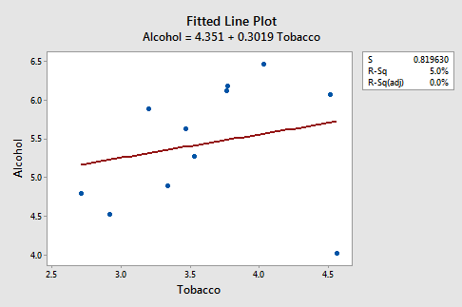
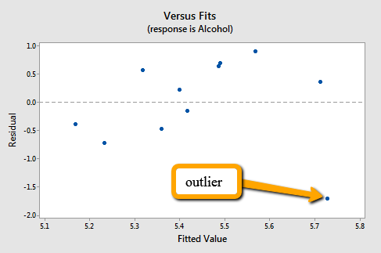
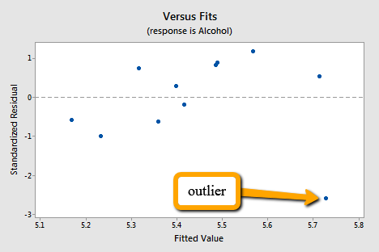
Outliers and Standardised residuals
Q- How large a residual has to be before a data point should be flagged as being an outlier?
A- No straightforward answer- as the residual depends on the units. So it would vary with the magnitude of the variable measure in a certain unit
For data that are normally distributed, 95% of the measurements fall within 2 standard deviations of the mean. Therefore, any observations with a standardized residual greater than 2 or smaller than -2 might be flagged for further investigation.
Solution- make the residuals unitless by dividing them by their standard deviation

Slide 18
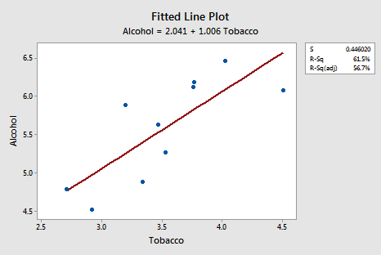
Change in r² after removing the outlier

Slide 19
In your Rstudio Standardized residuals-

Slide 20
References
https://bookdown.org/peter_neal/math4081_notes/Sec_LinearI.html
https://www.statology.org/good-vs-bad-residual-plot/
https://www.sciencedirect.com/topics/engineering/heteroscedasticity#:~:text=Heteroscedasticity%20re…
https://online.stat.psu.edu/stat462/node/120/
https://online.stat.psu.edu/stat462/node/118/
https://online.stat.psu.edu/stat462/node/95/

