Slide 1
Programming basics & case study topics
i-MARSYS-05 – 24.06.2026

Slide 2
Why do programming?
Automated workflows
Improved readability → less code → less places to update
Easier to transfer
Less copy-paste errors
Example: Repeat the same steps of analysis for several fish species. How do you do it?

Slide 3
Functions
Same code more than 3 times → write a function
Name <- function(arguments) {
body
}
R automatically gives back the value of the last expression
Use meaningful names for the name and the arguments (!) Future you and others will be thankful
New functions appear in your environment

Slide 4
Functions II
Name <- function(arguments) {
temporary_calc
return()
}
Use return
When last call is not the desired output
When the output is composed of several objects → connect e.g. in a list, this improves readibility
You want to have an early exit (example on slide 5)

Slide 5
If-Else
Similar to case_when from the tidyverse
If(this is TRUE){
then do that
}
If needs a logical question → answer is TRUE or FALSE
You can connect multiple if – else statements
If(this is TRUE){
then do that
}else{
do something else
}

Slide 6
Iterations
For – loops tell R to repeat an action for every element of input
for(value in that){
do this
}
Whatever happens in the loop stays in the loop unless you save it
Choose the names again carefully to avoid overwriting stuff, that is already in your environment

Slide 7
Other useful things
Print messages to get progress or else
print(“Hello world”)
print(paste(“Hello i-MARSYS cohort”, 2025) this pastes together several elements and prints them to the console
while() creates a loop so long as a certain condition is TRUE
break and next are control flow statements used in loops
break exits the loop, when a test results in TRUE
next skips the current iteration step and moves directly to the next one

Slide 8
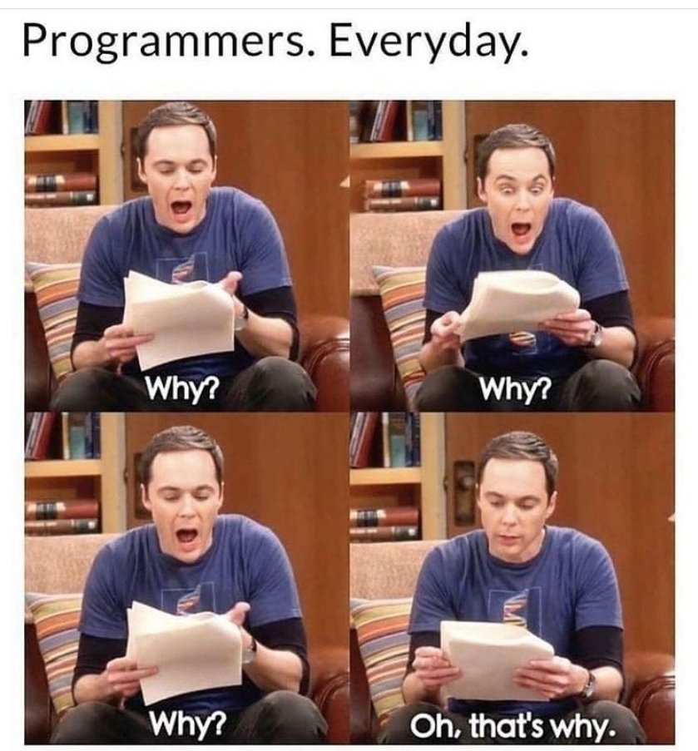
Debugging functions and loops

Slide 9
Debugging functions and loops
Inspect the error messages, if you do not understand them google them or ask AI
Use traceback to inspect which function evoked the error
Use print in loops to see at which element the error occurred → inspect this element manually

Slide 10
Further reading
Hands on programming with R: https://rstudio-education.github.io/hopr/
Chapter 2 for functions
Chapter 9 for if and else
Chapter 11 for Loops
Appendix for Debugging
https://www.datamentor.io/r-programming/break-next

Slide 11

Break: 15 minutes
Exercises are in the script
Half an hour
Solutions will be uploaded to Github

Slide 12
Case study topics

Slide 13
Reverse causality in fish stock data
Is SSB driving catch or catch SSB?
Is recruitment driving SSB or the other way around?
Jan
https://doi.org/10.1016/j.fishres.2019.01.007

Slide 14
Spatial distribution of fish
Western Baltic Sea fish species
Analyse spatial distribution changes and / or
Influence of environmental variables
Download data from the ICES data base?
Helene

Slide 15
Marine heatwaves
Western Baltic Sea
Time series analysis
Changes in seasonality
Influence on fish community
Helene

Slide 16
Continuous Plankton Recorder
CPR data from North Sea
Influence of environmental variables
Development over time
Helene

Slide 17
Continuation of OBIS case study
Choose topic of one of your group members
Reanalyse and extend the research question using the tools of this semester
Chhaya

Slide 18
Technical infos
4 groups with 4 members
Each topic can only be done by one group
Submit groups and the topics on 26.6.2026
Next two course dates work from wherever you are or come to uni if you have questions
Send a brief update with your progress each week
Collaborate in your group via Teams, R-Server or Github
Submit your code by 12.7.2026 23:59
Presentation are on the 15.7.2026

Slide 19
Presentation
Each group member has to present ~5 minutes, all together ~20 min
Presentations are 20 % of your grade
Potential contents
What case study did you choose?
How did your collaboration go? How did you share code, ideas? Set up of the project? Did you assign roles? Did you use a time plan? What are your experiences / learnings?
Presentation of the data, preliminary exploration + visualization (knowledge of the variables...)
Which analysis did you apply and why?
What are the results? How did you decide on your graphics?
How do you ensure robustness of your findings?
Interpretation of the results
Outlook

Slide 20
Exam
22.7.2026 9am
Pen & Paper
Multiple choice and free text questions
Mix of knowledge, interpretation of code, outputs and graphics

