Slide 1
Data Analysis and Modelling
iMARSYS-05; 15.04.2025

Slide 2
Plan for this semester
Week 1 – 2
Github
Recap descriptive stats
Distributions
Hypothesis building
Significance testing
Correlation
Week 3 + 4
Linear models
Generalized linear models
Week 5 Holiday
Week 6 – 7
Analysis of variance
Multiple linear regression
Week 8 + 9
Mixed effect models
Regression trees
Week 10 + 11
Generalized additive models
Functions and loops
Intro case studies
Week 12 + 13
Work on case studies
Week 14
Presentations (20% of Grade)
Exam
Any wishes / ideas?

Slide 3

E-book available for free via UHH:
https://link.springer.com/book/10.1007/978-3-030-55020-2
Todays topics: Chapter 1, 3 and 13
Practice in Chapter 2, 4 and 14

Slide 4

Linear regression, ANOVA, Mixed-effect models
Chhaya has a copy
Second hand copy ~25€ (e.g., medimops)

Slide 5
Recap descriptive stats
Measures of
Location → center of the data
Spread → variation of the data
Shape → how is the data distributed around the center

Slide 6
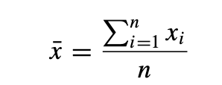
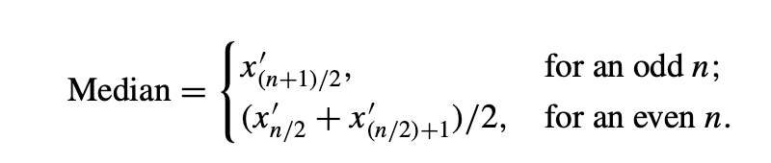
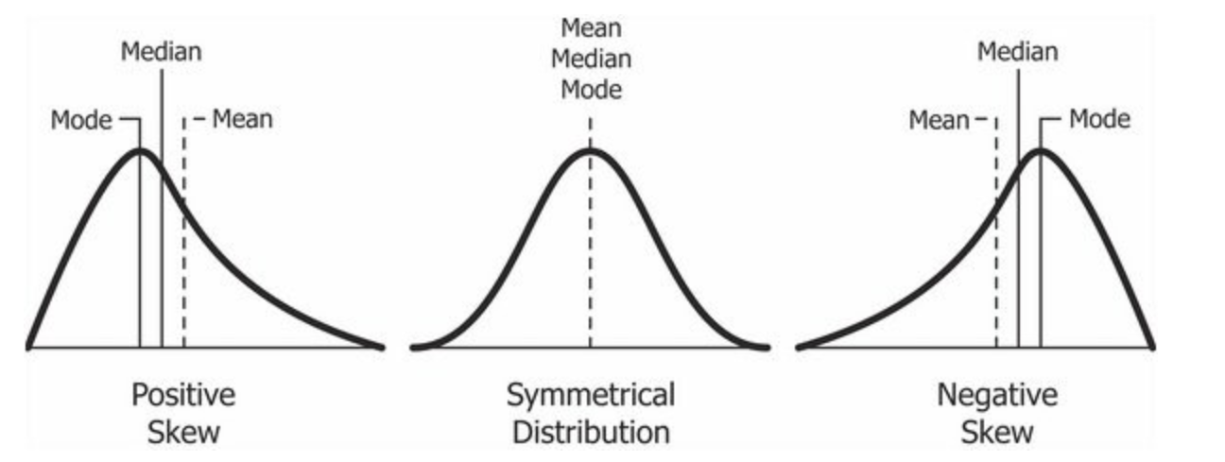
Location
Mean = average value of the data
Median = value in the middle of the data
Mode = most often occurring value
https://en.wikipedia.org/wiki/Skewness#/media/File:Relationship_between_mean_and_median_under_different_skewness.png

Slide 7
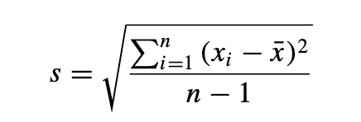
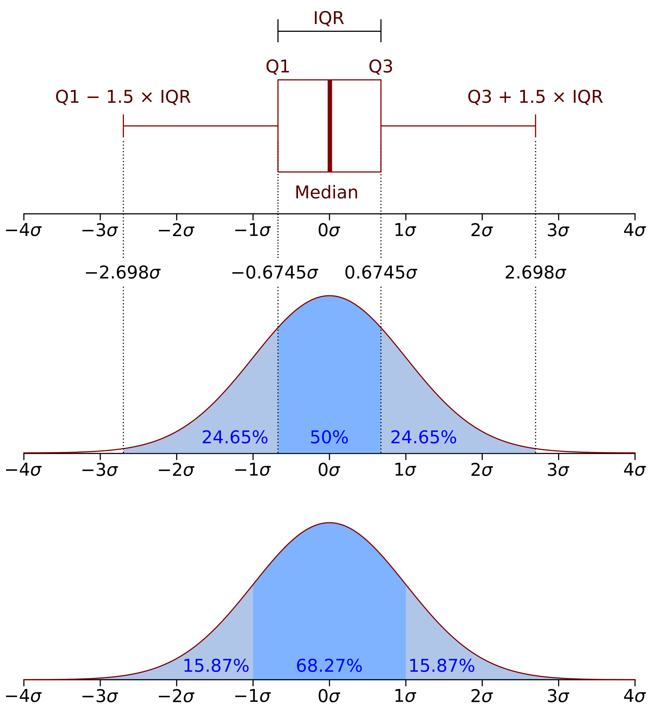
Scale
Standard deviation = spread around the mean
https://en.wikipedia.org/wiki/Interquartile_range#/media/File:Boxplot_vs_PDF.svg

Slide 8
Scale
Range = from lowest to highest value
Quartiles = separate the data into four equal parts
Interquartile range (IQR) = range between Q1 and Q3
Percentiles = separate the data into 100 equal parts
P25 = Q1
https://en.wikipedia.org/wiki/Interquartile_range#/media/File:Boxplot_vs_PDF.svg

Slide 9
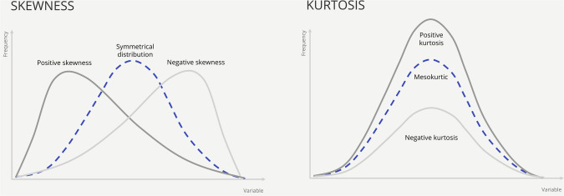
Shape
Skew = how asymmetrical are the values distributed?
Positive skew = right skewed
Negative skew = left skewed
Kurtosis = how pointy is the peak?
Values close to 0 indicate a normal distribution
One example in R
https://ars.els-cdn.com/content/image/3-s2.0-B9780128207178000087-f05-03-9780128207178.jpg

Slide 10
Distributions

Slide 11
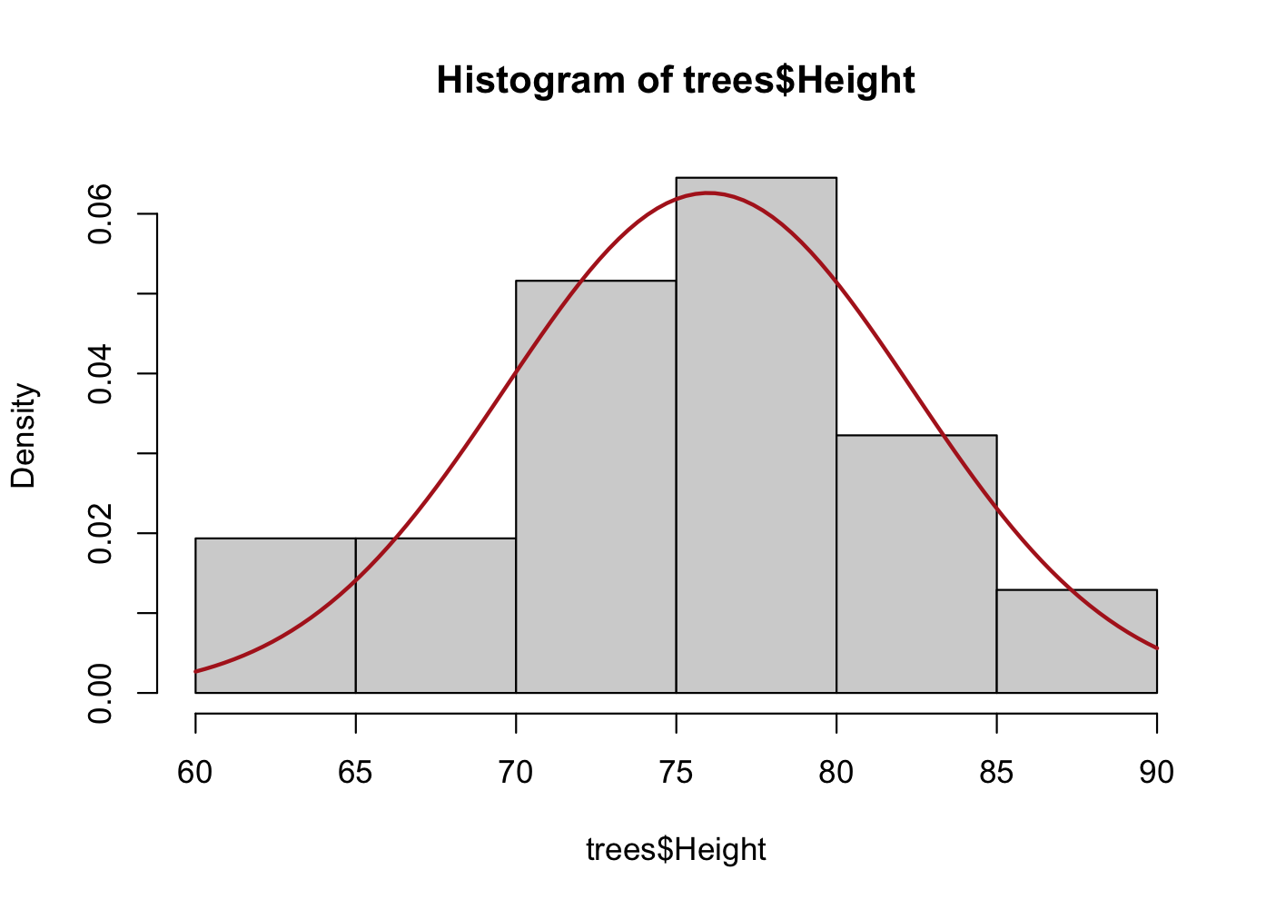
Distributions
Every sample comes from an underlying distribution
Histograms are frequency distributions and we can describe them with theoretical probability distributions
All probability distributions have some common features
Each can be described with a density function (also referred to as distribution function)
Each distribution describes the probability of independent events (each value is independent from the others)
The area under the curve is 1
They are continuous or discrete
Many, many distributions…
Some examples:
Notes:
Add a histogram overlaid with a normal distribution

Slide 12
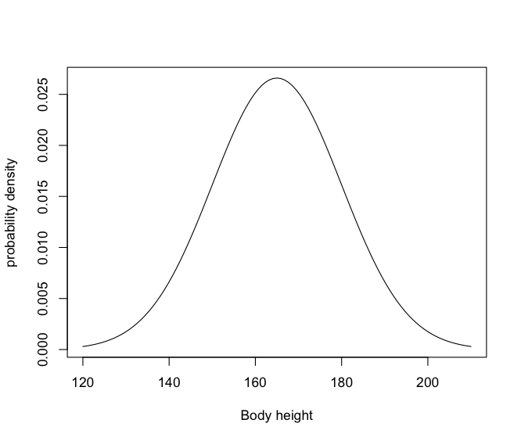
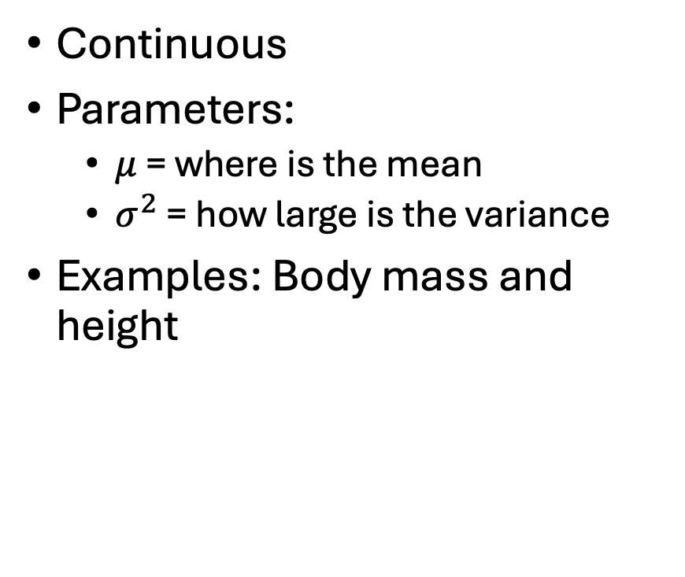

Normal distribution
$$μ=165, σ=15$$
Continuous
Parameters:
$μ$ = where is the mean
$σ^{2}$ = how large is the variance
Examples: Body mass and height
Notes:
Central limit theorem?

Slide 13
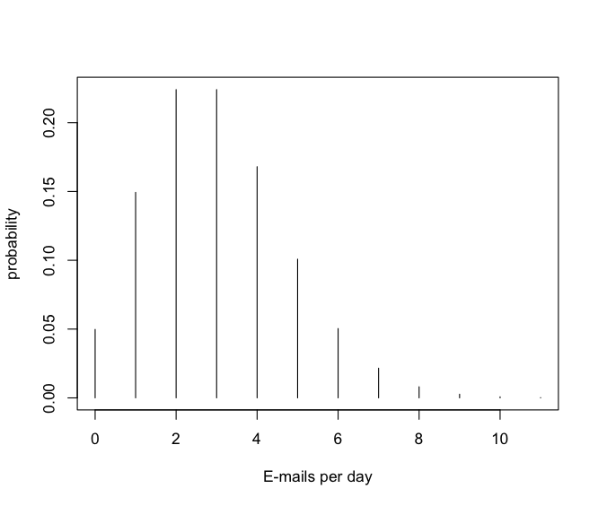

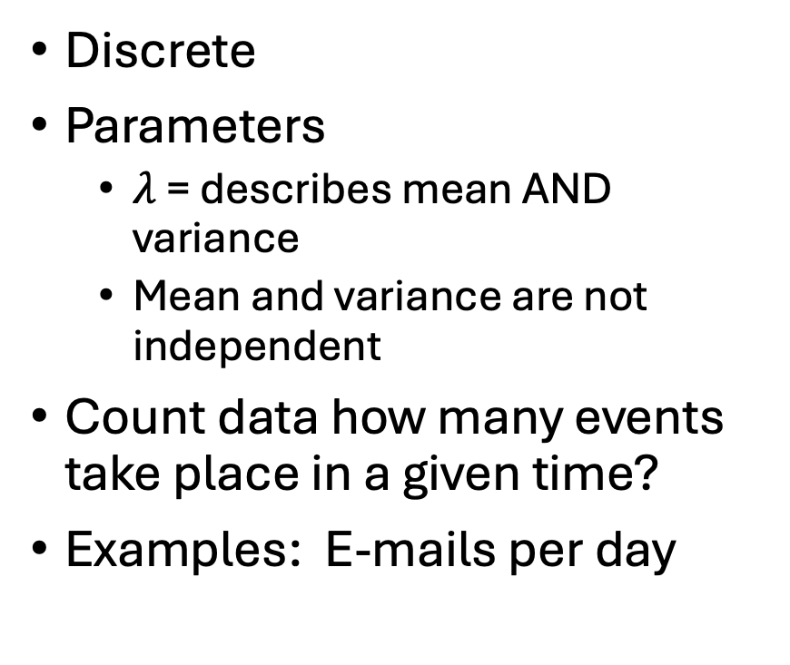
Poisson
$$λ=3$$
Discrete
Parameters
$λ$ = describes mean AND variance
Mean and variance are not independent
Count data how many events take place in a given time?
Examples: E-mails per day

Slide 14
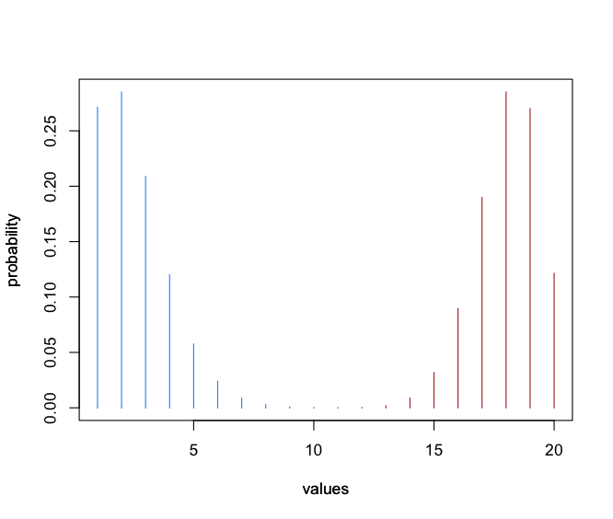
Binomial (red) / negative binomial (blue)
N / R = 20, p = 0.9
Discrete
Binomial: How many successes will occur in n trials?
N = number of trials
P = probability of success [0,1]
Example: how many rats survive the experiment given a specific survival rate?
Negative binomial: How many trials until a n successes are reached?
R = number of successes
P = probability of success [0, 1]
Example: How many experiments do I need until 20 rats survive?
Bernoulli as special case with N = 1

Slide 15
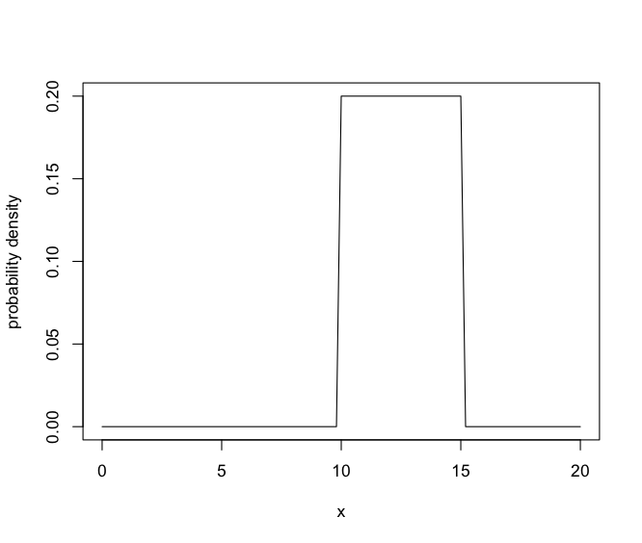
Uniform
A = 10, B = 15
Continuous
Parameters:
A = lower limit
B = upper limit
All values in the interval have the same probability
Example: duration of a bus ride

Slide 16
More useful distributions
Log-normal
Beta
Gamma
Weibull
Cauchy
Geometric
See Chapter 3 & 4 in Environmental Data Analysis

Slide 17
Fit a distribution
Best combination of distribution parameters
Maximum likelihood or log-likelihood to compare fit
The higher the value the better the fit
Notes:
Log likelihood because calculating likelihood means multiplying many values, which leads to very small numbers, by using the log we are calculating the sum

Slide 18

15 minutes

Slide 19
Hypothesis building, significance testing, p-values

Slide 20
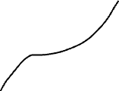


Why a hypothesis?
To test whether an idea is supported or not
Observation
Question + Theory
Hypothesis
Why are the trees distributed like this?
Are all acorns on the right and all pines on the left?
All acorns are on the right side of the river.

Slide 21
From questions to hypotheses
Are all orcas black and white?
All Orcas are black and white.
Does the stock-recruitment-relationship of cod follow the Beverton-Holt model?
The SRR of cod follows the Beverton-Holt model.
Are tunas bigger than dolphins?
Tunas are bigger than dolphins.
How do we verify this? Can we verify this?

Slide 22
The null hypothesis
Every working hypothesis (H₁) gets a complementary null hypothesis (H₀)
H₀ is the testable negation of H₁
H₁ = All Orcas are black and white.
H₀ = There are non black-white Orcas.
H₁ = The SRR of cod follows the Beverton-Holt model.
H₀ = ?
H₁ = Tunas are bigger than dolphins.
H₀ = ?

Slide 23
And then?
Test the null hypothesis with statistics
If the null hypothesis can be rejected the working hypothesis is supported.
Observe 100 Orcas, if all are black and white we have to reject H₀, thus H₁ is supported.

Slide 24
P-value
Significance level
Rejection of H₁ if p > 0.05
Support for H₁ if p < 0.05
Be careful with the interpretation
If we cannot find a significant effect given our data, it does not mean that there is no effect at all
Rather it means we do not have enough support to reject H₀
The value of 0.05 is an arbitrary convention
It does not measure the strength of an effect (!)

Slide 25
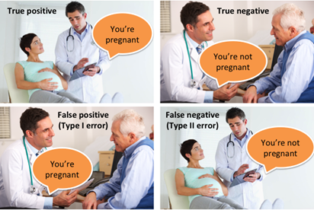
Types of errors
Type 1 error = falsely reject the null hypothesis (false positive)
Type 2 error = falsely accept the null hypothesis (false negative)
The p-value determines the probability for making a type I error
H₀ is true
H₁ is true
H₀ is accepted
H₁ is accepted

Slide 26
Tests for normality
Many statistical methods rely on normally distributed data
Shapiro-Wilks Test, Anderson-Darling, Lillefors
H₁ = The data is different from a normal distribution
H₀ = the data is not different from a normal distribution

Slide 27

Github

Slide 28

Github – What and why?
https://www.youtube.com/watch?v=a9u2yZvsqHA

Slide 29
Github – in Science
Share code and data associated with articles
Reproducibility
Transparency
Knowledge sharing
Host R packages, as a second platform next to CRAN
And more…

Slide 30
Connect Github and your local R Studio
Directly from R Studio you can control repos
Writing commit messages
Push & Pull
Stashing

Slide 31
Exercises
Get Git and Github
Connect Github to your local R Studio
Connect to the course repository
Open the folder with today's script and find in there further exercises.
Play the game “Oh my git”
Follow the guidelines on: https://happygitwithr.com
Find the task list with more links on Teams :)

