Slide 1
Reconstruct the wiring between neurons from fluorescence imaging of neural activity
Helga Mazyar & Kirsten Lynch

Slide 2
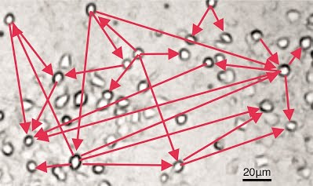
Effective Connectivity
Brain structural connectivity important for:
Study of epilepsy, Alzheimer’s disease, and other neuropathologies
General brain function and learning capabilities
Traditional neuroanatomical methods of axonal tracing cannot scale up to very large networks
100 billion neurons, with 7000 synapses per neuron in brain (Sounds like a big data problem!)
Alternative: reverse-engineer the structure of neural networks given time series of neuronal activity (effective connectivity)
Purpose: Reconstruct the effective connectivity between neurons from fluorescence imaging of neural activity

Slide 3
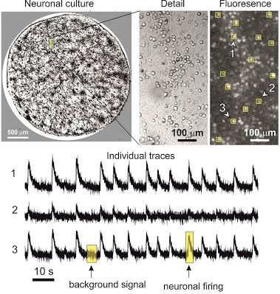
Optical Imaging Methods
Calcium fluorescence imaging: Shows calcium (Ca²⁺) status within cell cytoplasm using fluorescent protein-based indicators
Ca²⁺ as ubiquitous intracellular messenger : indicator of neural activity
Fluorescent contrast intensity as variable of interest
Good temporal resolution allows for collection of time-series data for dynamic network development

Slide 4
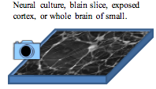


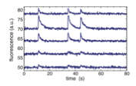

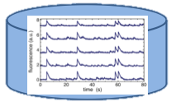
Generating Data
Dataset is re-simulation of Ca²⁺ fluorescent optical recording
Video recording at 50 fps
Location of neurons
Extraction of time series
(1 channel per neuron)
Neural network modeling reproducing real data
Generation of challenge test data by re-simulation

Slide 5
Data Organization
File Types
Fluorescence: Neural activity time series data from (t x n)
Training and Test
Network Position: (X,Y) spatial location for each neuron (n x 2)
Training and Test
Network: Directed connectivity from neuron I to neuron J with weight W (n x 3)
Training only
Data Types
Normal: Network constructed similarly to “test” network
Small: Network constructed similarly to “test” network with N=100
High Rate: Increased firing frequency
Low Noise: Fluorescent signal has better SNR
High CC: Higher clustering coefficient
Low CC: Lower clustering coefficient
High Con: Higher number of connections per neuron
Low Con: Lower number of connections per neuron

Slide 6
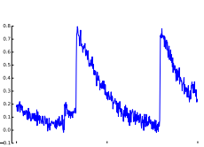
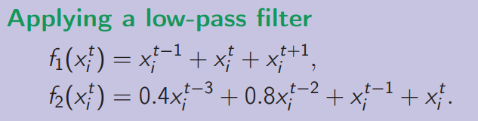
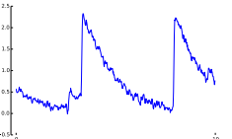
Why this is a difficult problem
Why is this a difficult problem?
Very noisy signals due to light scattering artifacts
Computationally intensive
180 K samples of 1000 neurons, 180 million data points
Framework of our solution
Preprocess: Deal with noisy calcium fluoresce signals
Inference: Find the network
Approach 1: Extract features from signals and learn a classifier
Approach 2: Dynamic Bayesian Networks

Slide 7
Approach 1: : Extract features from signals and learn a classifier
Discretize data
For each pair of neurons
Compute scores for neuron i -> neuron j using
Cross correlation
Generalized transfer entropy: measures the association between two neurons. Proposed by the challenge
Granger causality statistics
Combine several scores used as “features" to train a classifier
0 : No connection
1 : connection
Classifiers
Naïve Bayes
Not a good option given that the network is sparse. Biased towards reporting 0.
Logistic regression
Evaluate the classifier using AUROC as requested by the contest

Slide 8
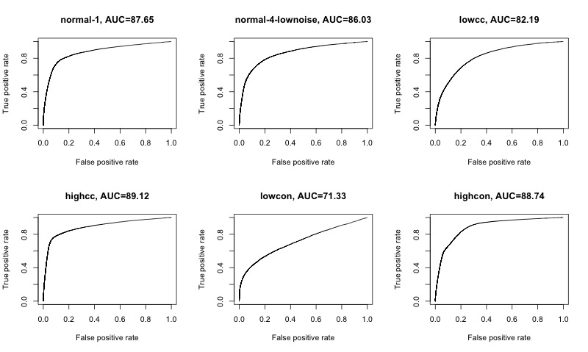
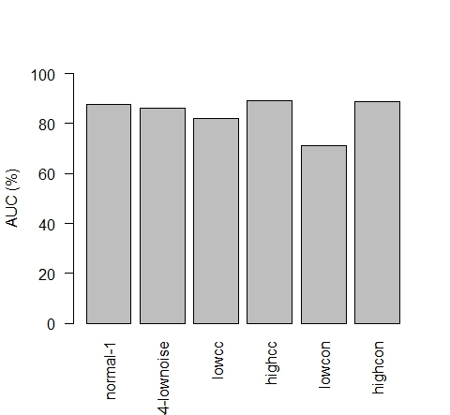
Approach 1 - Results

Slide 9
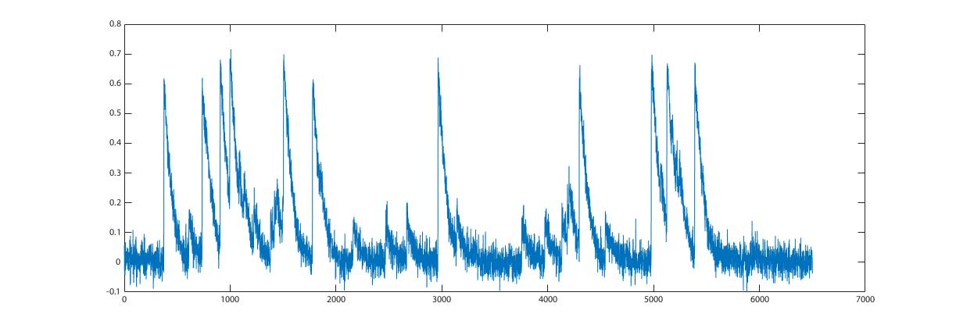
Time Series Data

Slide 10
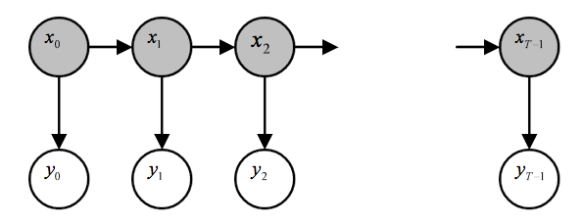
Dynamic Bayesian Networks (DBN)
Dynamic Bayesian Network: A Bayesian network which relates variables (calcium fluorescence signal) to each other over adjacent time steps
Represented as a directed acyclic graph
Infer causality through spike timing
The states of any system described as a DBN satisfy the Markovian condition: The state of a system at time t depends only on its immediate past, i.e. at time t-1

Slide 11
DBN Approaches
LASSO learning-based Modular Networks (implemented with Statistical Inference for MOdular Networks – SIMoNe)
Produces coefficients that are exactly zero by applying an L1 norm penalty to their sum – model selection via dimensionality reduction
SIMoNe selects arcs through adaptive L1 penalization of model likelihood using VAR(1) processes
Arcs can be weighted by pre-defined latent clustering
First-Order Conditional Dependencies Approximation (implemented with G1DBN)
Uses low-order conditional dependence graph to infer connectivity
First, model learns a directed acyclic graph encoding first-order partial dependence relationships
Second, it infers the real network structure of the DBN using the graph from the previous step
James-Stein Shrinkage Estimator (implemented with GeneNet)
Estimates covariance matrix by “shrinking” the empirical correlation coefficients towards zero and empirical variances to the median

Slide 12
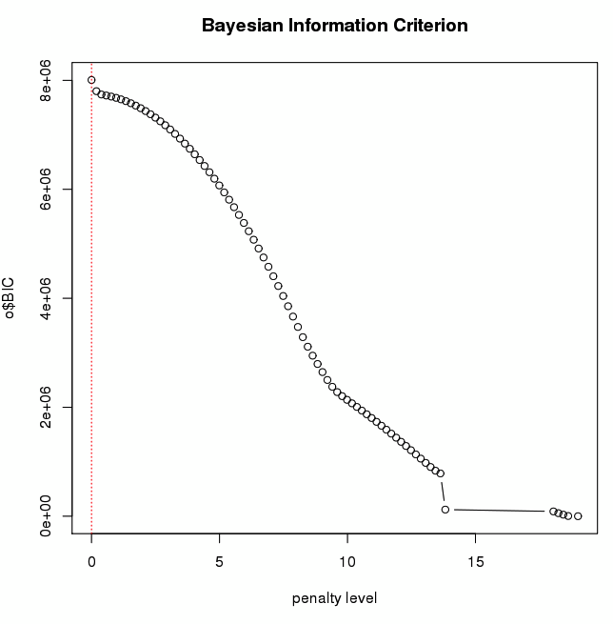
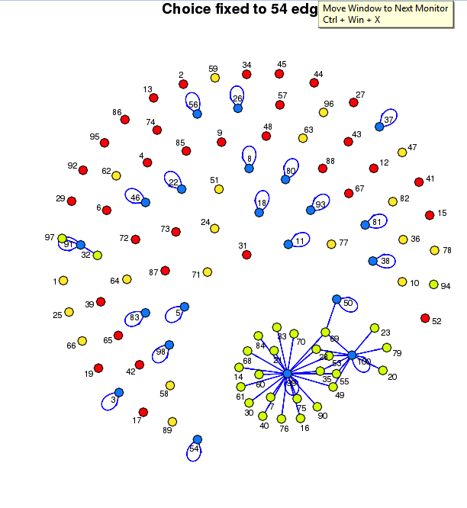
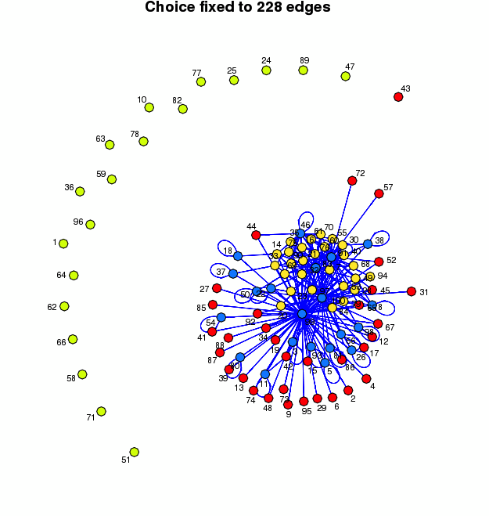
Simone
Choice fixed to 54 edges
Choice fixed to 228 edges
*
*

Slide 13
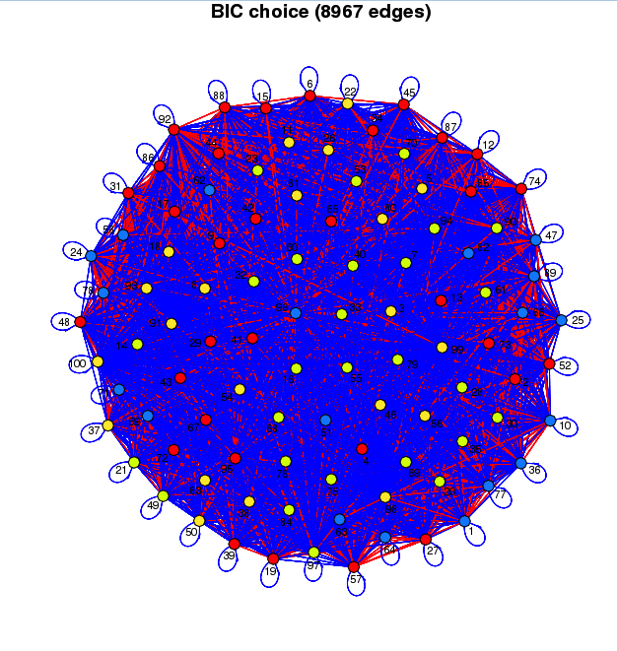
Simone Model Selection (BIC)
Simone BIC model selection chooses maximum number of edges

Slide 14
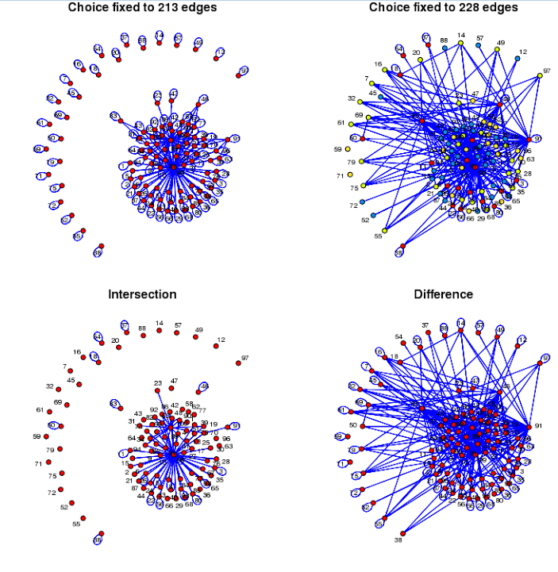
Comparing Networks
Can be used to compare network against ground truth

Slide 15
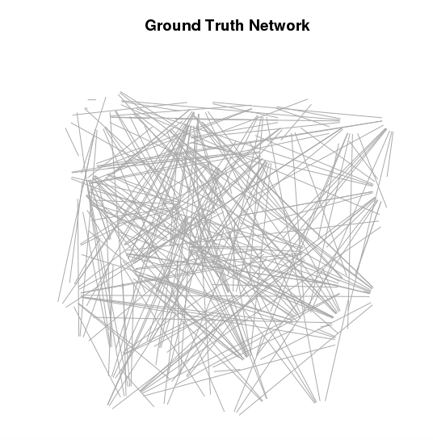
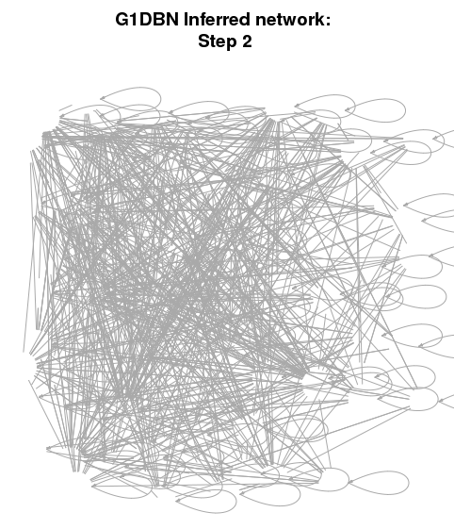
G1DBN
1007edges
5845 edges

Slide 16
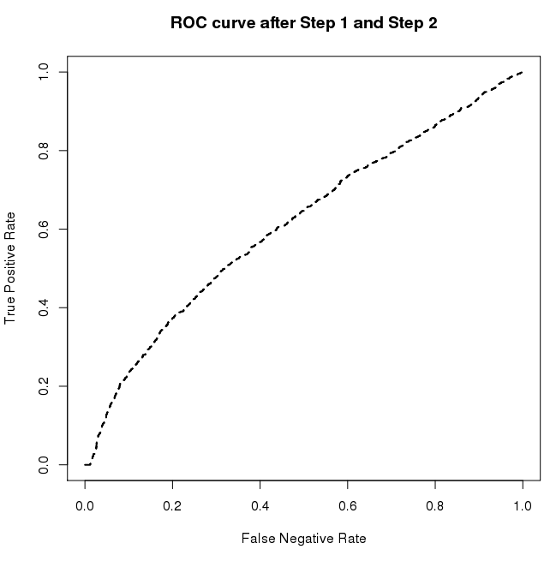
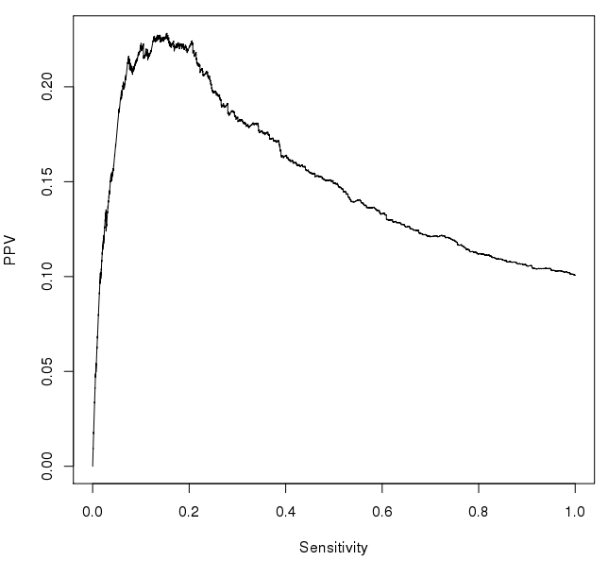
Performance
PPV: True positive edges out of selected edges
Sensitivity: True positive out of true edges
Precision-Recall Curve
Positive Predictive Value (PPV)

