Slide 1
Python II
Final Project Description
Chair of Remote Sensing and Landscape Information Systems – FeLis
University of Freiburg

Slide 2
Logistics
The project will be executed by the whole class.
Deadline: 28.07.2017
Upload link: https://www.dropbox.com/request/3eZH1uZFY20M26tizfB3

Slide 3
Task
During the semester, you were asked to solve a few project, which now will be enveloped in a Graphical User Interface (GUI). Your task is to create this GUI within the PEP 8 style rules.

Slide 4
Project execution
Design
Who should the GUI look like?
What are the main elements?
Implementation
Who should do what?
What do you have already?
Error handling
What can go wrong regarding packages and dependencies?
What are possible errors regarding my functions?
What is the final product?
What needs to be implemented?
What can the user do wrong?

Slide 5
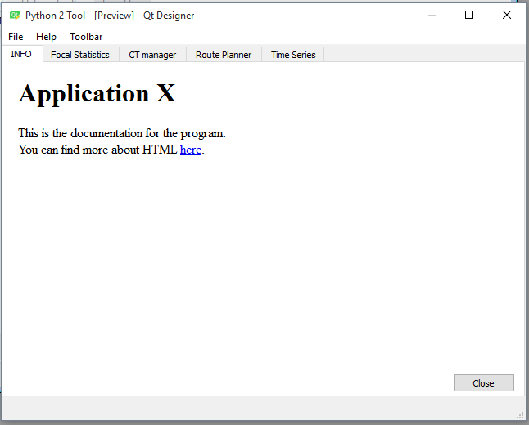
GUI obligatory elements
The GUI should have a tab system, containing:
Info tab
Focal Statistics
CT manager
Route Planner
Time Series
HTML
“off board”

Slide 6
GUI obligatory elements
The GUI should also have a menu bar, containing:
File
Help
Toolbar

Slide 7
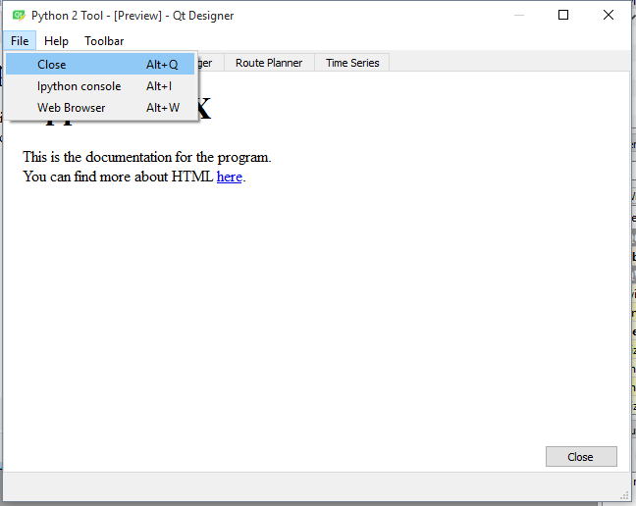
GUI obligatory elements
File menu bar should contain:
Close
Ipython console
Web browser

Slide 8
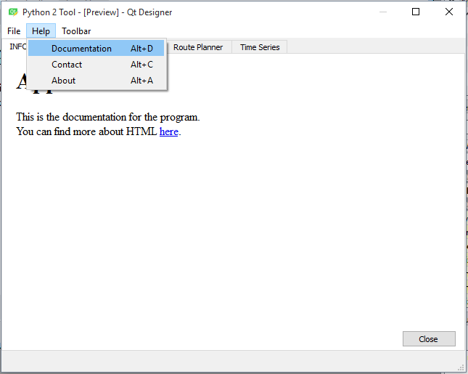
Task
Help menu bar should contain:
Documentation
Contact
About

Slide 9
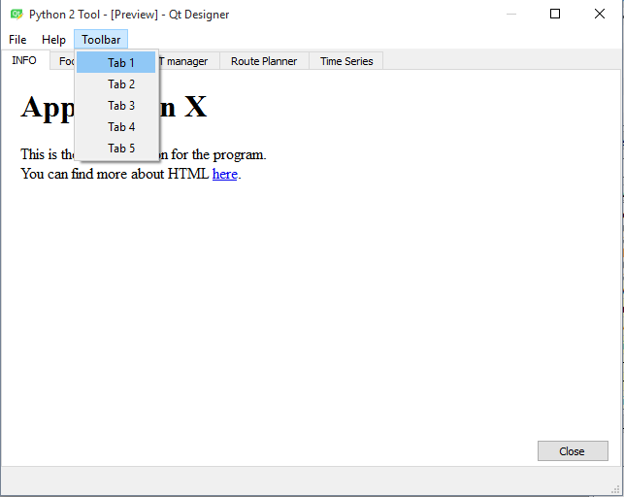
GUI optional elements (BONUS)
Toolbox menu bar should contain:
Tab 1
Tab 2
Tab 3
Tab 4
Tab 5

Slide 10
Tabs assignments
The GUI should have a tab system, containing:
Info tab
Focal Statistics
Image_Processing_2.pdf
CT manager
CT_manager.pdf
Route Planner
05_Scipy.ipynb
Time Series

Slide 11
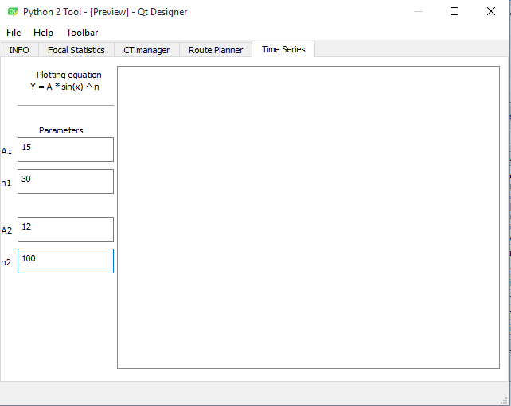
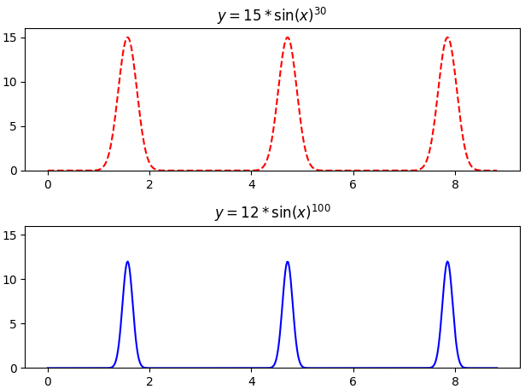
Time Series

Slide 12
To hand in…
.ui from QtDesigner
.py with the GUI and functions
.qrc / .py resources folder
.html from the INFO Tab

Slide 13

Questions

