Slide 1

POO / UML Project – A1 - Boulderdash
The project
The group
Group 4
Conclusion
UML
POO / Java
AMARY Clément
ALBERT Naomie
MOENCH Baptiste
MONTEMONT Théophile

Slide 2
Group Members & role
AMARY Clément (Group manager) : organization, code and diagrams
ALBERT Naomie : code and diagrams
MOENCH Baptiste : code and database
MONTEMONT Théophile : code
The project
POO / Java
Conclusion
UML
The group

Slide 3
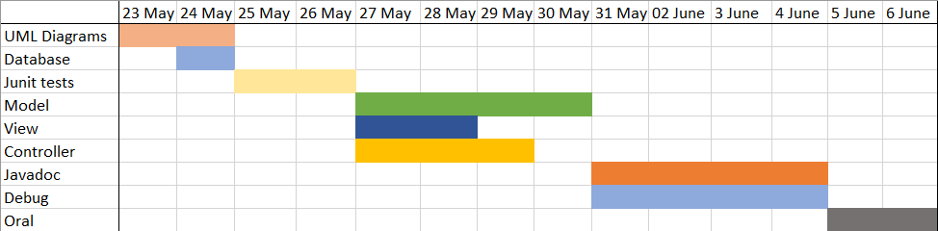
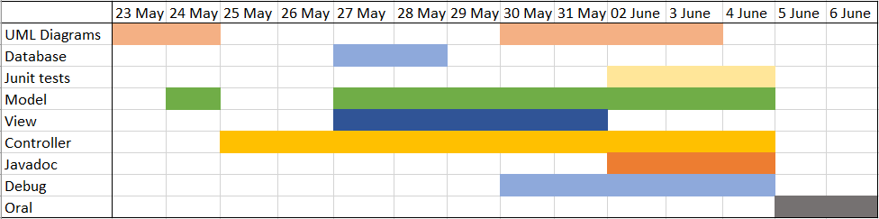
Schedule
The project
POO / Java
Conclusion
UML
The group

Slide 4




Software used
Discord :
Communication
The project
POO / Java
Conclusion
UML
IntelliJ :
IDE for the code
The group
Visual Paradigm :
Diagrams
GitHub :
Group repository and collaborative work

Slide 5
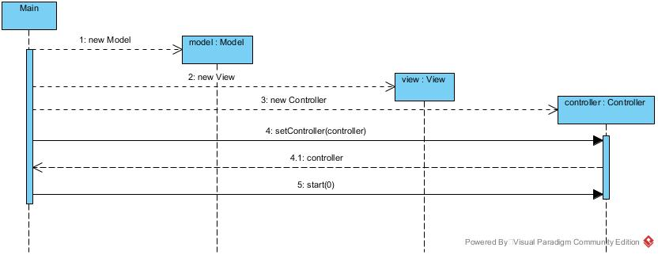
Definition
A design and description design used to build the architecture of a program or an application.
Example :
Conclusion
The group
The project
POO / Java
UML

Slide 6

Definition
It is a type of programmation in which we instanciate objects with different attributes and manipulate them in different classes with methods.
Particularities :
- Use classes
- Use methods
- Very powerful
- Used to build a lot of applications
Conclusion
POO / Java
The group
The project
UML
Java
A programming language that uses the POO and which is the first POO programming language that we have learned this year.

Slide 7
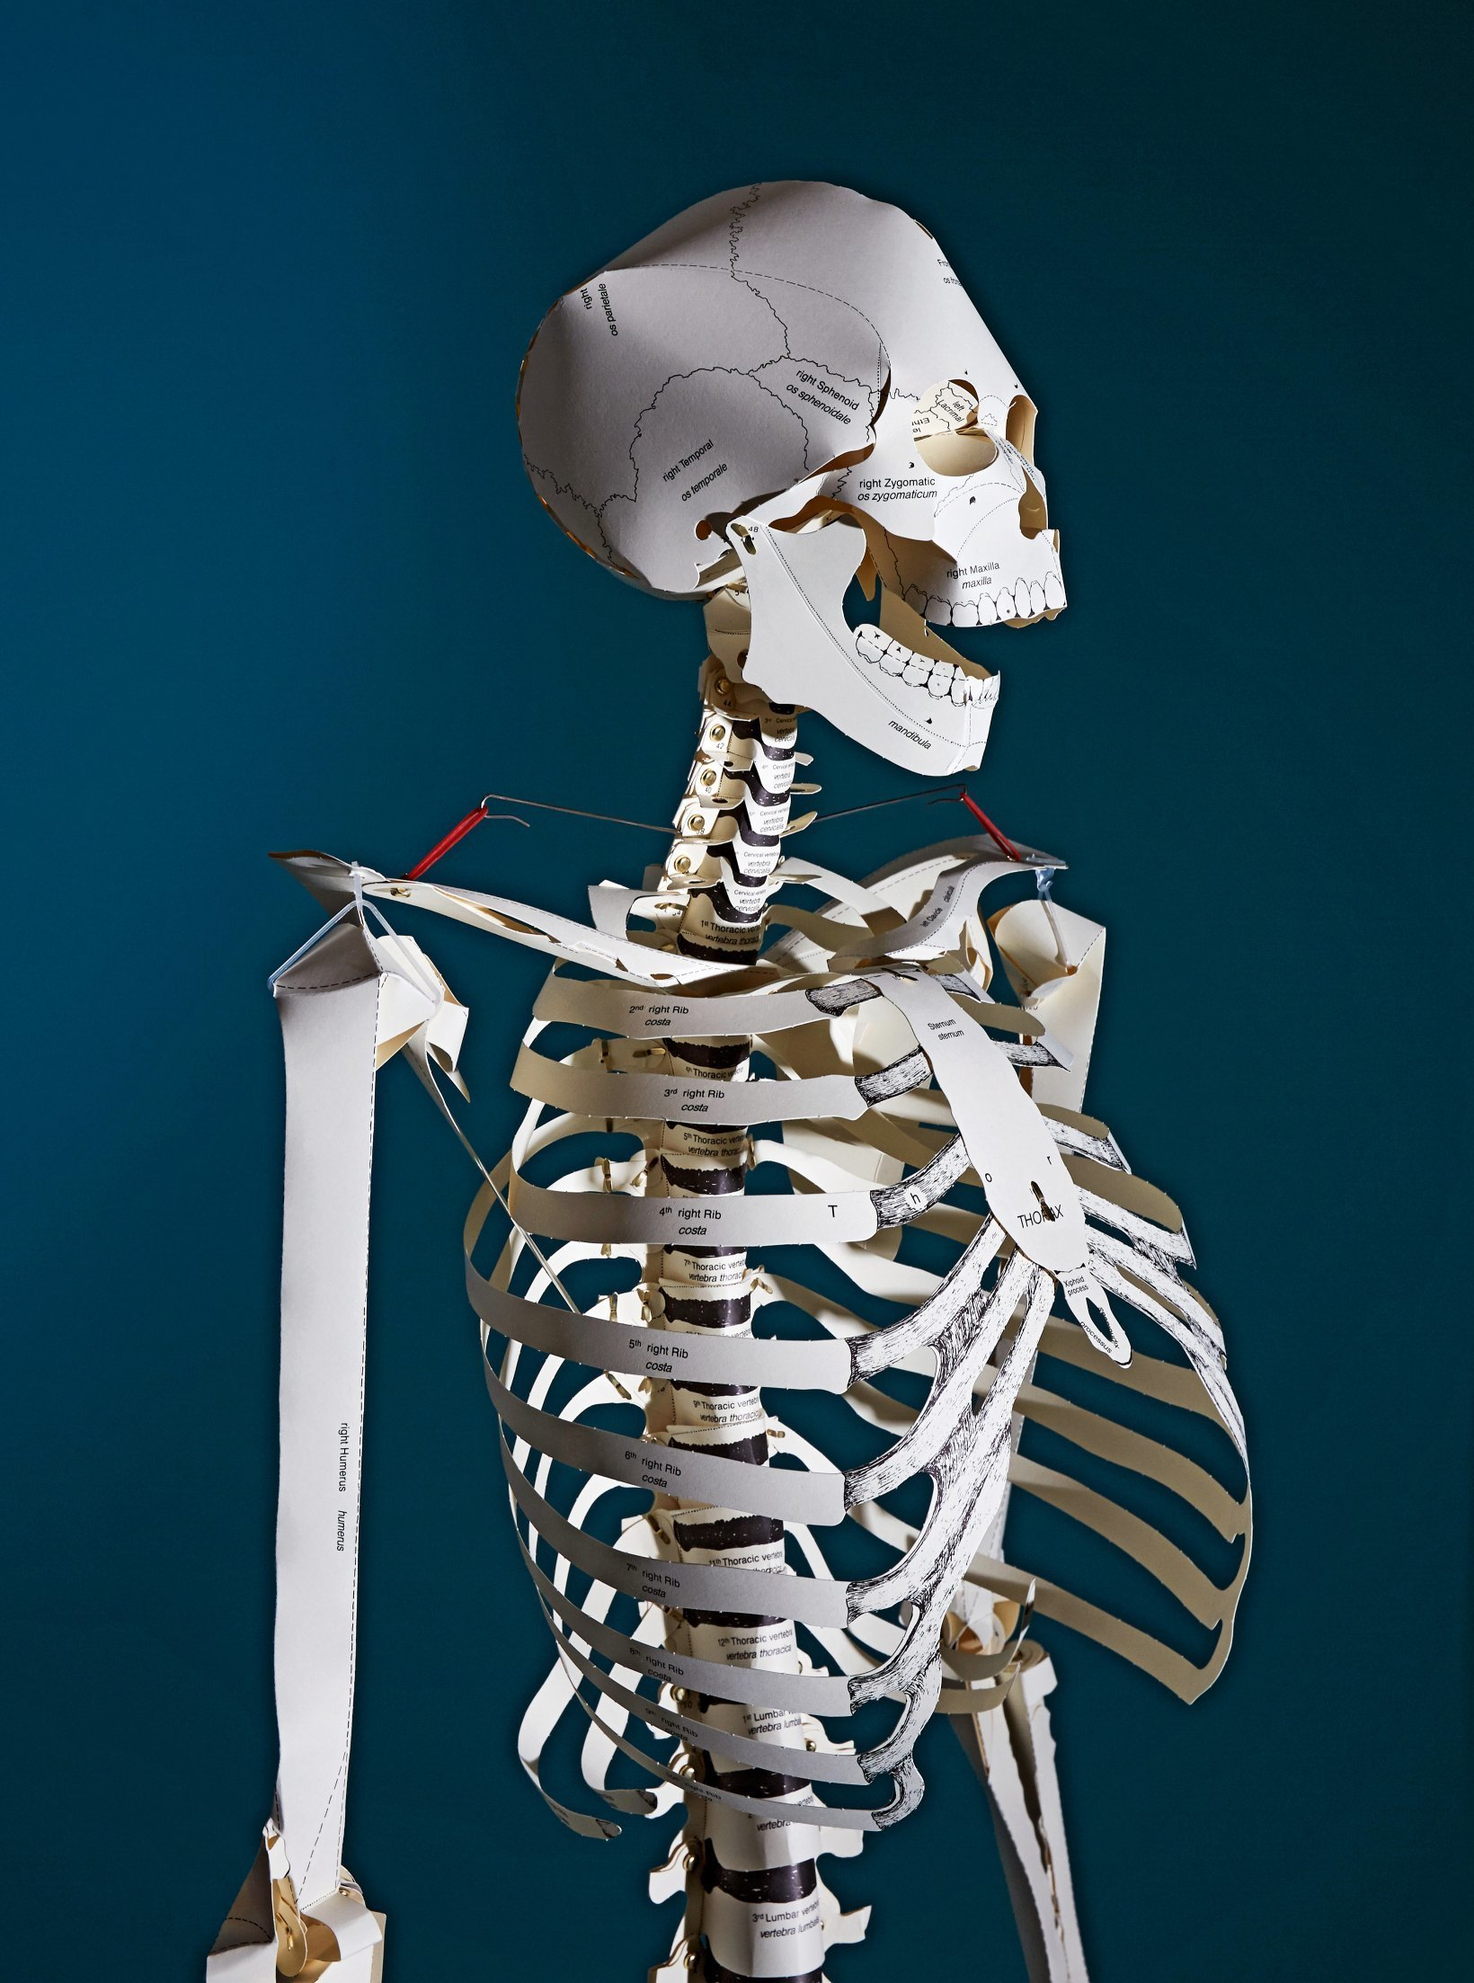
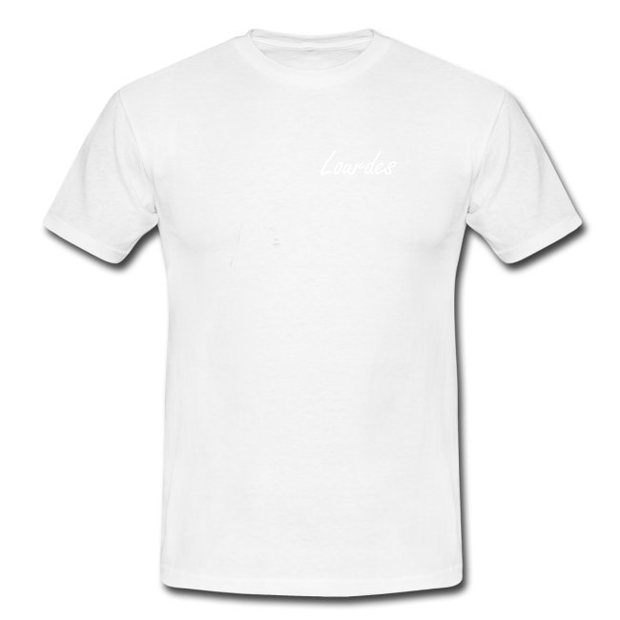

MVC
Model
View
Controller
Conclusion
POO / Java
The group
The project
UML

Slide 8
BoulderDash
The game :
The player controls a miner that must collect diamonds without beeing crushed by the rocks or killed by the monsters.
The group
Conclusion
The project
UML
Features :
POO / Java
Control the miner with ZQSD or the control arrows on your keyboard.
The rocks and diamonds fall, roll or crush the ennemy or the player.
The ennemies move in a random direction.
The player can collect diamonds to win the level.
The number of diamonds collected is indicated in a bar on the board
The levels are stored in a database.
There are different screens that will depends if the player is dead, or won the level.

Slide 9
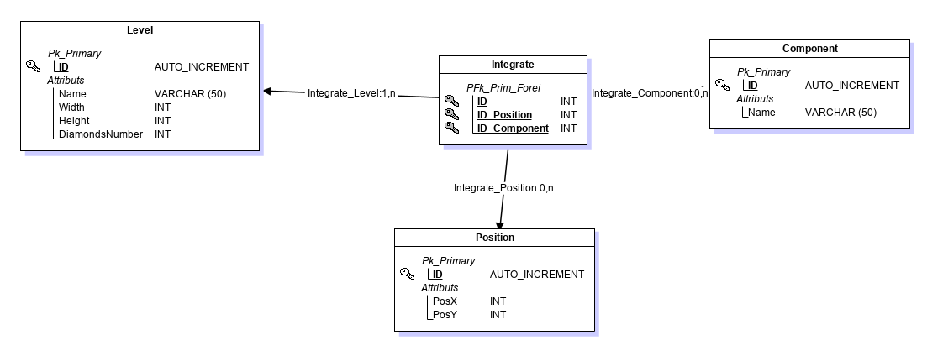
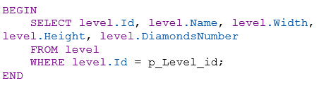
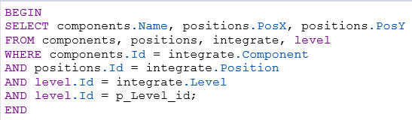
The database
The group
Conclusion
The project
UML
POO / Java

Slide 10
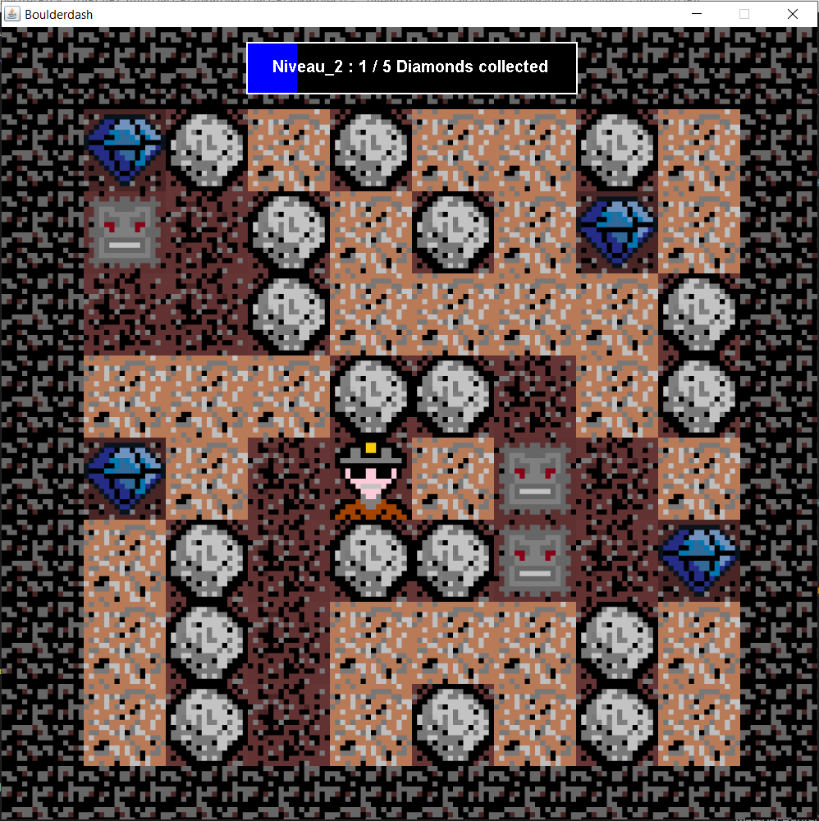
Final result
The group
Conclusion
The project
UML
POO / Java

Slide 11
Personnal feedback
Naomie
Baptiste
Théophile
Clément
UML
Conclusion
POO / Java
The group
The project

Slide 12

Conclusion
We had a lot of difficulties during this project and we couldn’t implement all the features we wanted and we couldn’t fix all the bugs.
There are a lot of ways to improve !
Thanks for your listening !
UML
Conclusion
POO / Java
The group
The project
Any questions ?
AMARY Clément / ALBERT Naomie / MOENCH Baptiste / MONTEMONT Théophile

