Slide 1

POO / UML Project – A1 - Boulderdash
The project
The group
Group 4
Conclusion
UML
POO / Java
AMARY Clément
ALBERT Naomie
MOENCH Baptiste
MONTEMONT Théophile

Slide 2
Group Members & role
AMARY Clément (Group manager) : organization, code and diagrams
ALBERT Naomie : code and diagrams
MOENCH Baptiste : code and database
MONTEMONT Théophile : code
The project
POO / Java
Conclusion
UML
The group

Slide 3
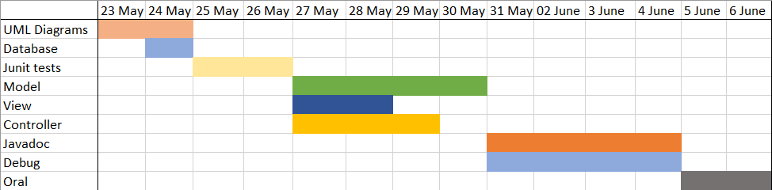
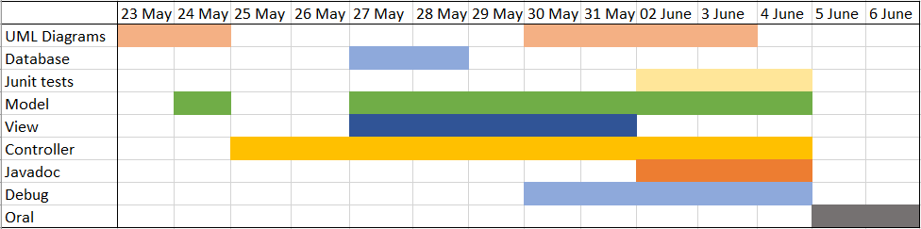
Schedule
The project
POO / Java
Conclusion
UML
The group

Slide 4




Software used
Discord :
Communication
The project
POO / Java
Conclusion
UML
IntelliJ :
IDE for the code
The group
Visual Paradigm :
Diagrams
GitHub :
Group repository and collaborative work

Slide 5
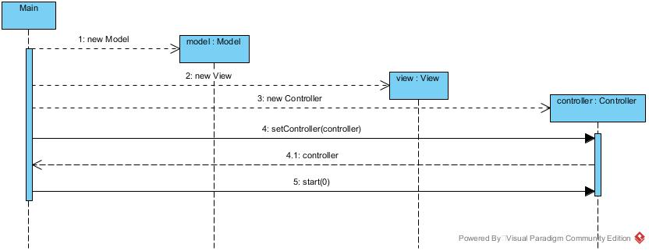
Definition
A design and description design used to build the architecture of a program or an application.
Example :
Conclusion
The group
The project
POO / Java
UML

Slide 6

Definition
It is a type of programmation in which we instanciate objects with different attributes and manipulate them in different classes with methods.
Particularities :
- Use classes
- Use methods
- Very powerful
- Used to build a lot of applications
Conclusion
POO / Java
The group
The project
UML
Java
A programming language that uses the POO and which is the first POO programming language that we have learned this year.

Slide 7
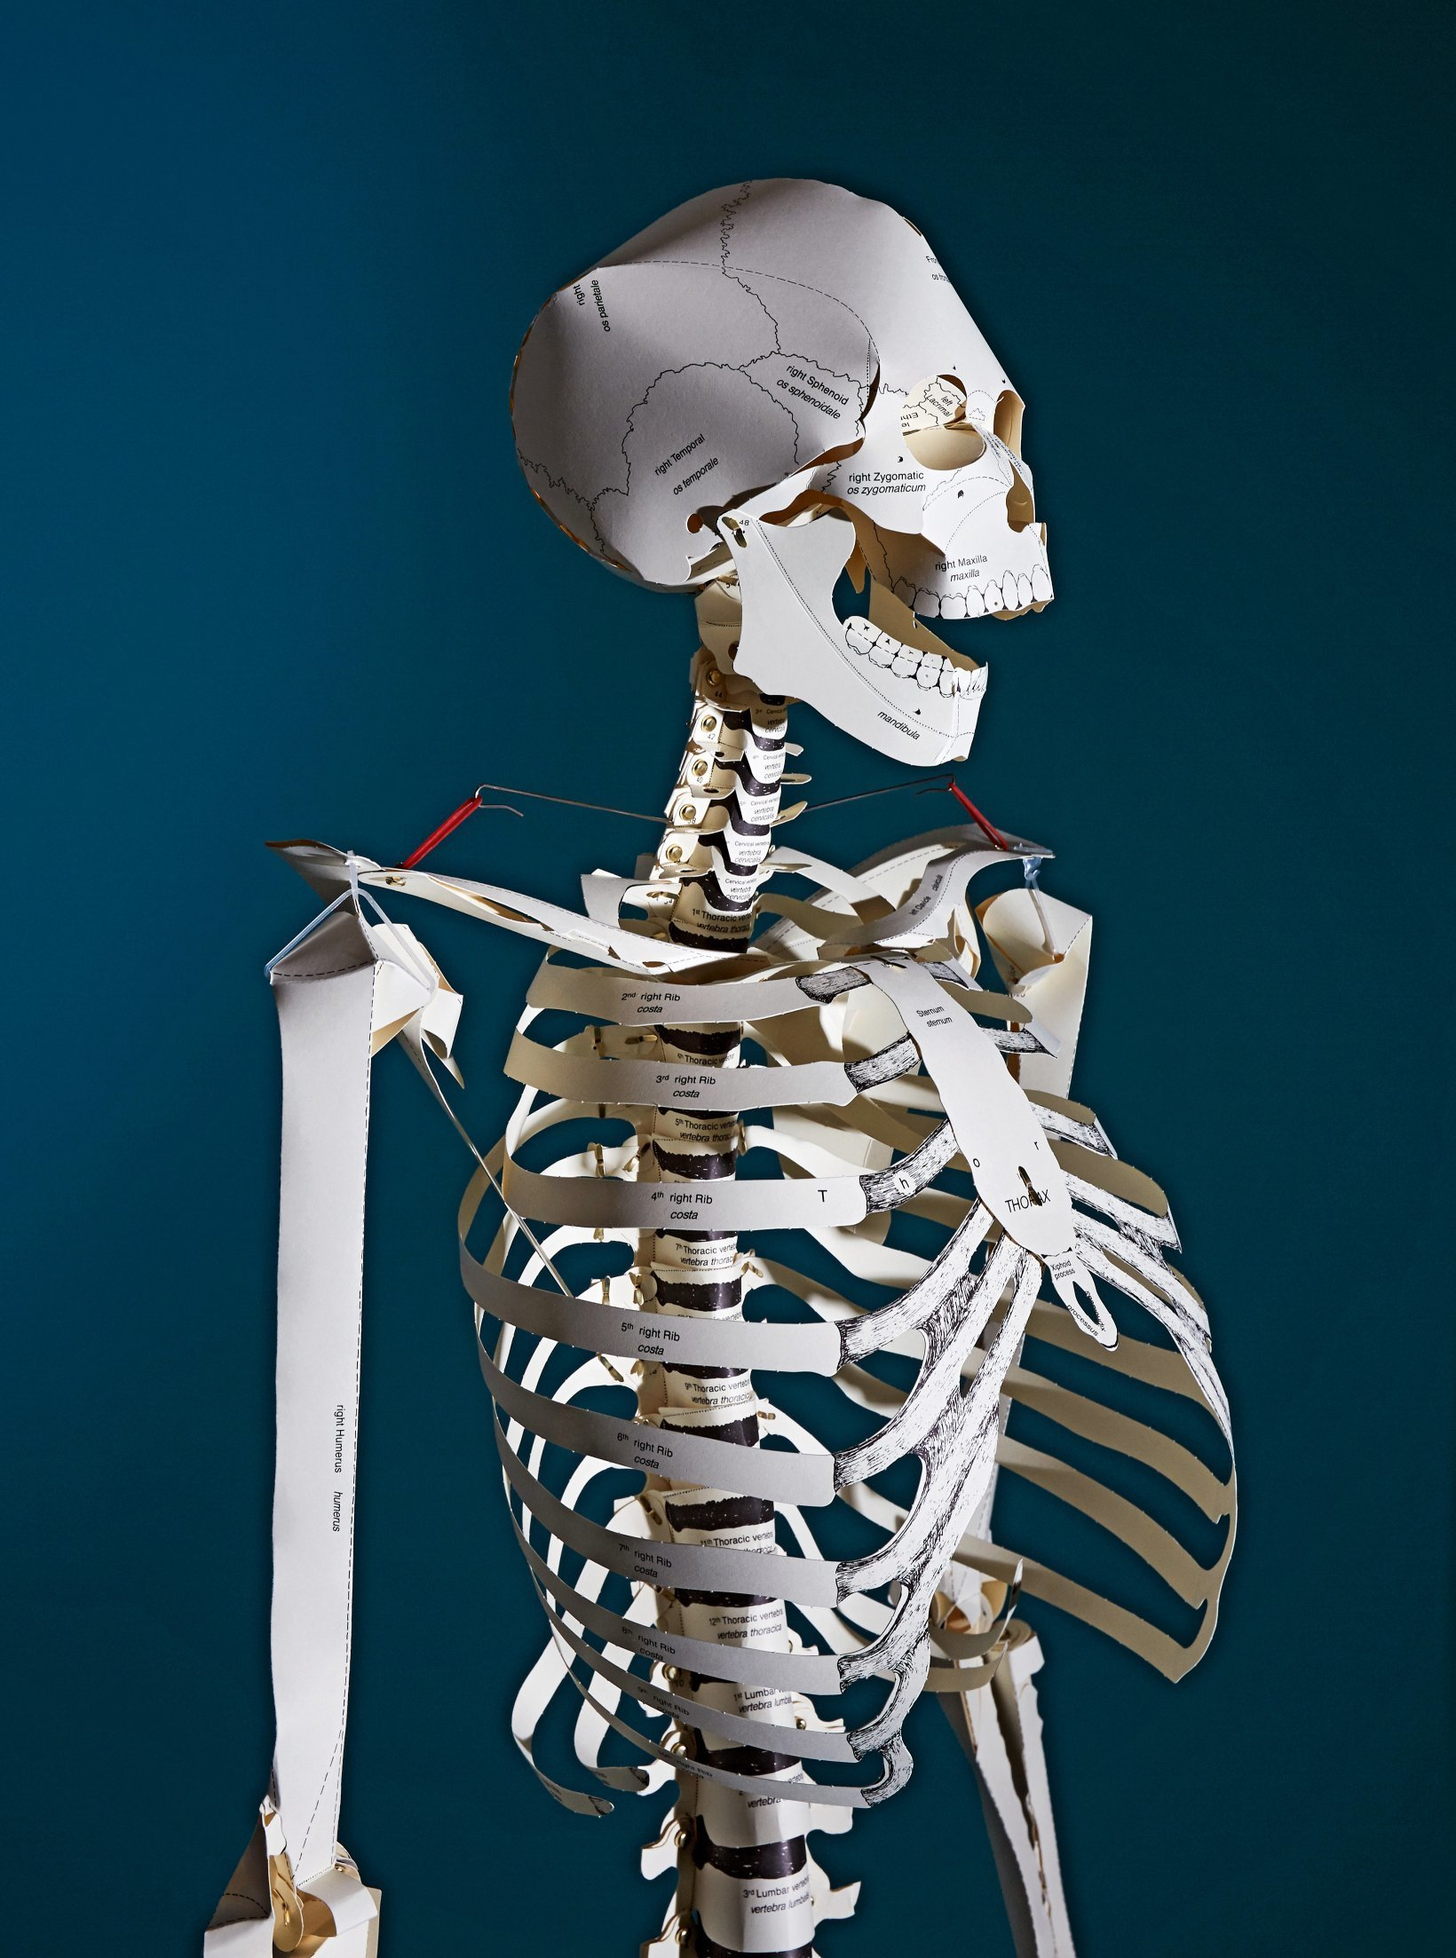
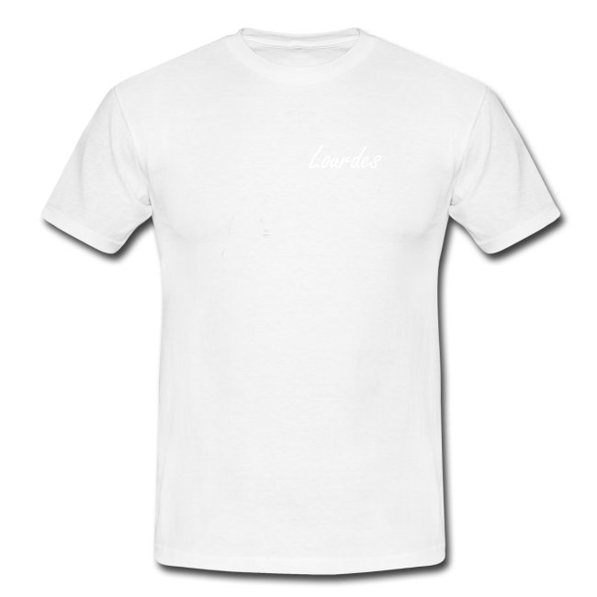

MVC
Model
View
Controller
Conclusion
POO / Java
The group
The project
UML

Slide 8
BoulderDash
The game :
The player controls a miner that must collect diamonds without beeing crushed by the rocks or killed by the monsters.
The group
Conclusion
The project
UML
Features :
POO / Java
Control the miner with ZQSD or the control arrows on your keyboard.
The rocks and diamonds fall, roll or crush the ennemy or the player.
The ennemies move in a random direction.
The player can collect diamonds to win the level.
The number of diamonds collected is indicated in a bar on the board
The levels are stored in a database.
There are different screens that will depends if the player is dead, or won the level.

Slide 9
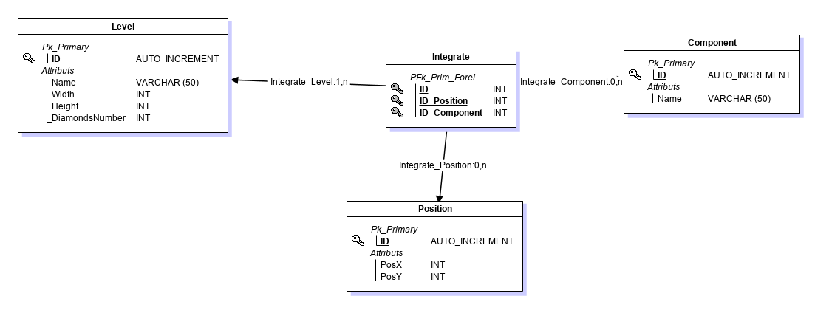
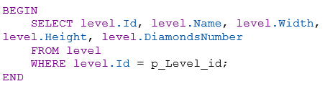
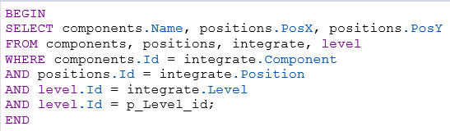
The database
The group
Conclusion
The project
UML
POO / Java

Slide 10
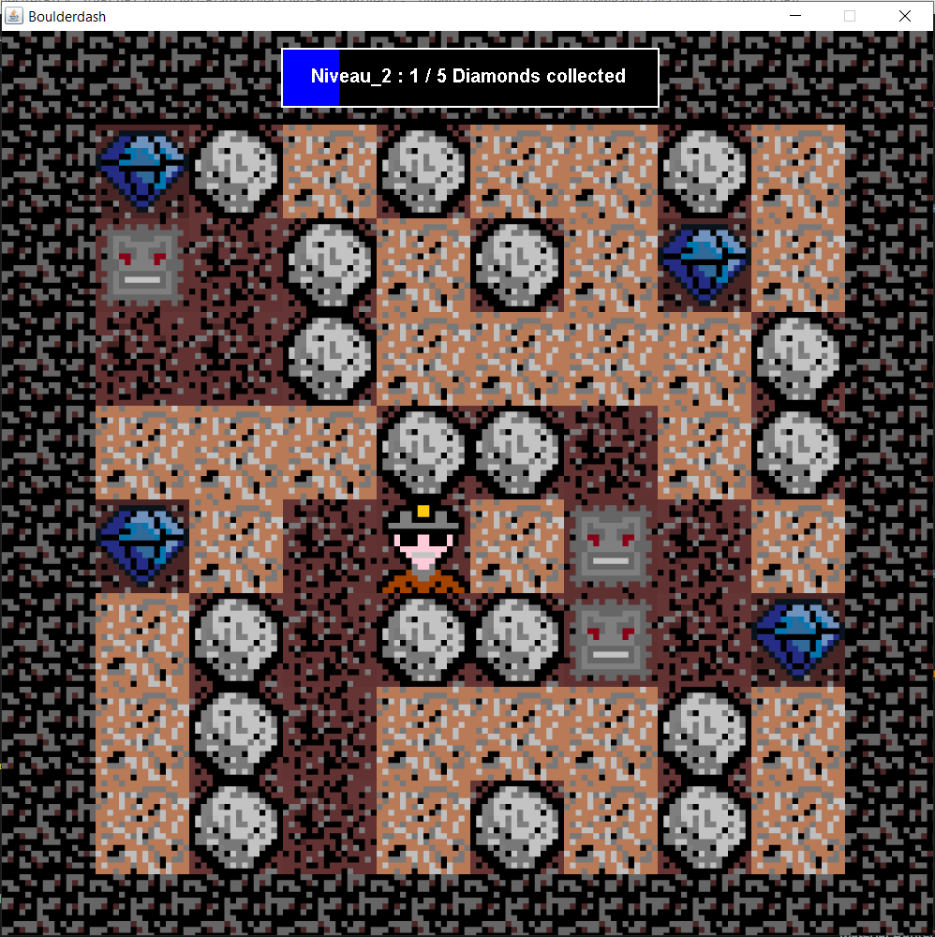
Final result
The group
Conclusion
The project
UML
POO / Java

Slide 11
Personnal feedback
Clément :
I don’t totally agree with my mates because I think that the work atmosphere wasn’t as good as possible, we were late on a lot of tasks.
For the project, I liked it because it was very understanding and formative.
Baptiste :
Clément and Théophile were more comfortable than us about the project. Naomie and I had more difficulties to code the project. I think that the work atmosphere was good in the group. Clément and Théophile worked hard on the project trying to code without bugs. I was blocked several times on what I had to do during these past weeks. I also struggled a bit with the Git.
In a general way I think this project was acceptable. Hopefully, we didn’t have another main problem like the previous one. I have nothing bad to say about the project.
Naomie :
This project was interesting and having the architecture of HelloWorldMvc helped us with the orientation of the code. Despite some errors in the JDK during the first day of the project we managed to quickly get going. I found that the group atmosphere was good, despite a small lack of communication the first days and the fact that I took time to do some diagrams.
Théophile :
A great deal of difficulty in organizing the distribution and placement of tasks, which has created a delay in overall progress and technical compatibility issues : for the members of the group workload poorly distributed according to the capacity of each.
UML
Conclusion
POO / Java
The group
The project

Slide 12

Conclusion
We had a lot of difficulties during this project and we couldn’t implement all the features we wanted and we couldn’t fix all the bugs.
There are a lot of ways to improve !
Thanks for your listening !
UML
Conclusion
POO / Java
The group
The project
Any questions ?
AMARY Clément / ALBERT Naomie / MOENCH Baptiste / MONTEMONT Théophile

