Slide 1
xamarin
Team – Star
Tony Ngyyen, Weiming Ruam, Xiang Yu, Xinyu Hu, Yan He, Yihao Fu

Slide 2
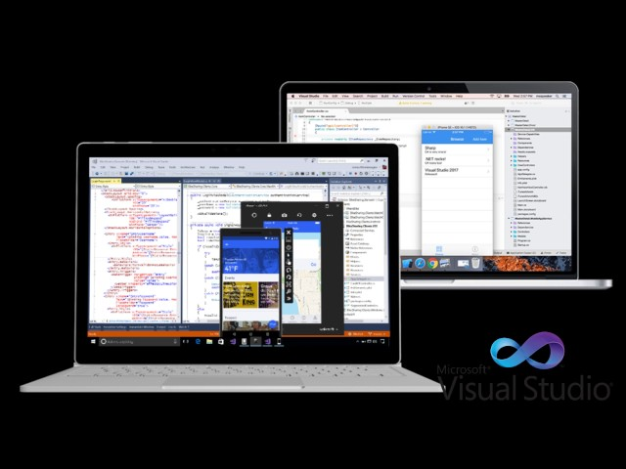
Problem!!!
Windows vs Linux
Mac vs Windows
Linux vs Mac

Slide 3
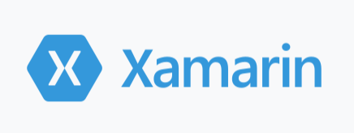

C#

Slide 4
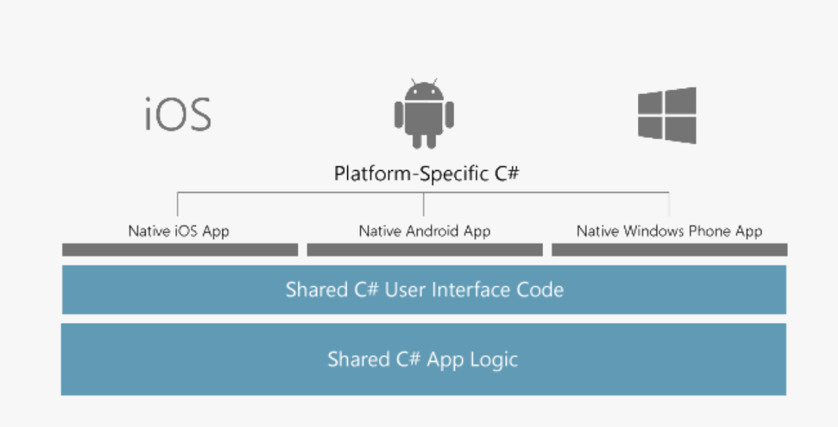
Visual Studio TOOLS FOR XAMARIN
Deliver native Android, IOS, and Windows apps with a single shared .NET code base.

Slide 5
Advantages of apps built using Xamarin
Native User Interfaces
Standard UI with different platform
Native API Access
Platform-specific capabilities!
Native Performance
Hardware acceleration

Slide 6
Our app

