Slide 1




Modern Web Application Development in Angular
CORS

Slide 2

Summary
Same-Origin policy?
What is CORS
How CORS works
Preflight Request
Interfaces
Classes and OOP
Generics
Modules
Namespaces
Useful links

Slide 3
Same-Origin Policy
The same-origin policy is an important concept in the web application security model. Under the policy, a web browser permits scripts contained in a first web page to access data in a second web page, but only if both web pages have the same origin. An origin is defined as a combination of protocol, host name, and port number. This policy prevents a malicious script on one page from obtaining access to sensitive data on another web page through that page's Document Object Model.

Slide 4
What is CORS ?
CORS (cross origin resource sharing) is a mechanism to allow client web applications make HTTP requests to other domains.
Describes new HTTP headers which provide browsers and servers a way to request remote URLs only when they have permission. Although some validation and authorization can be performed by the server, it is generally the browser's responsibility to support these headers and honor the restrictions they impose.

Slide 5
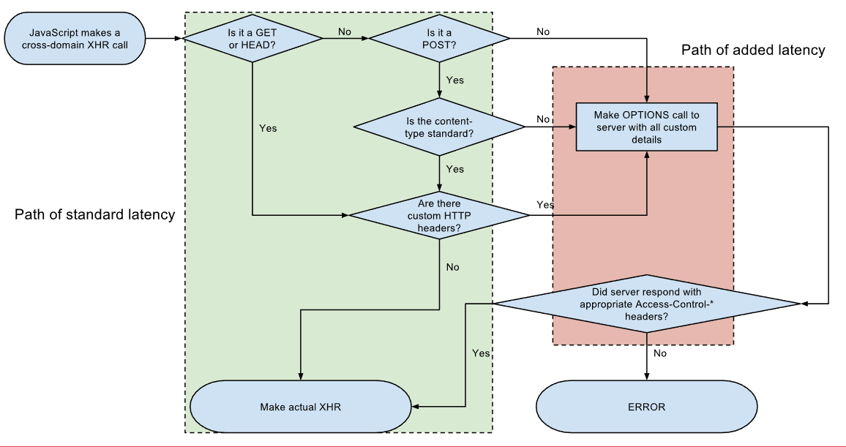
How CORS works ?

Slide 6
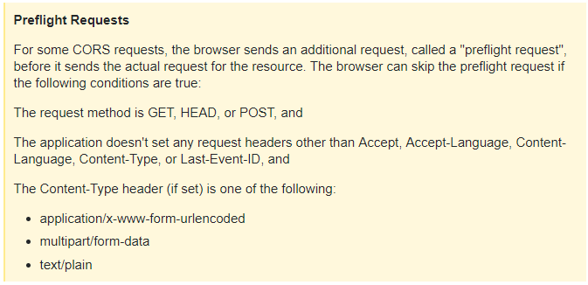
Preflight request
Access-Control-Allow-Origin: http://www.example.com
Access-Control-Allow-Methods: PUT, DELETE

