Slide 1




Modern Web Application Development in Angular
Introduction

Slide 2



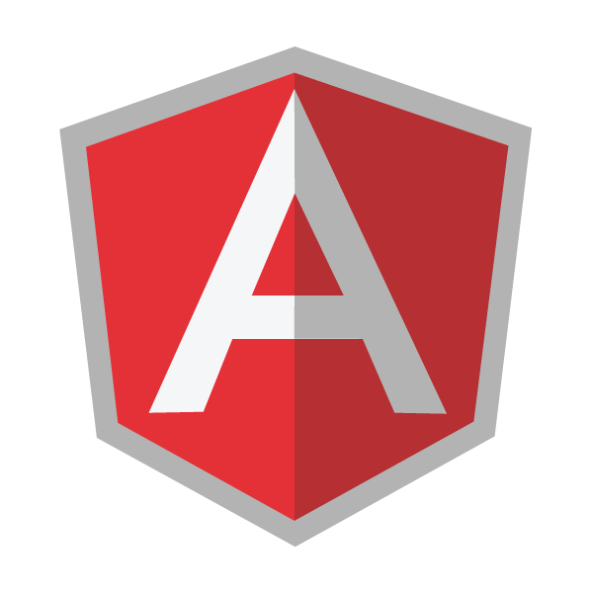
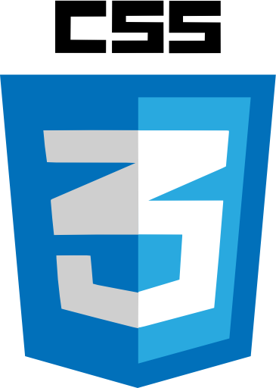
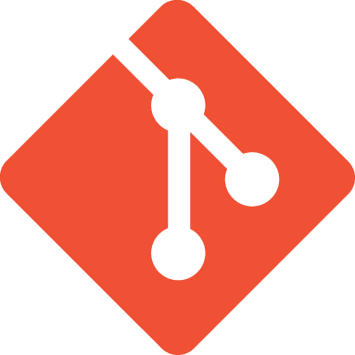
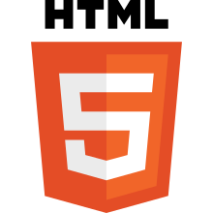
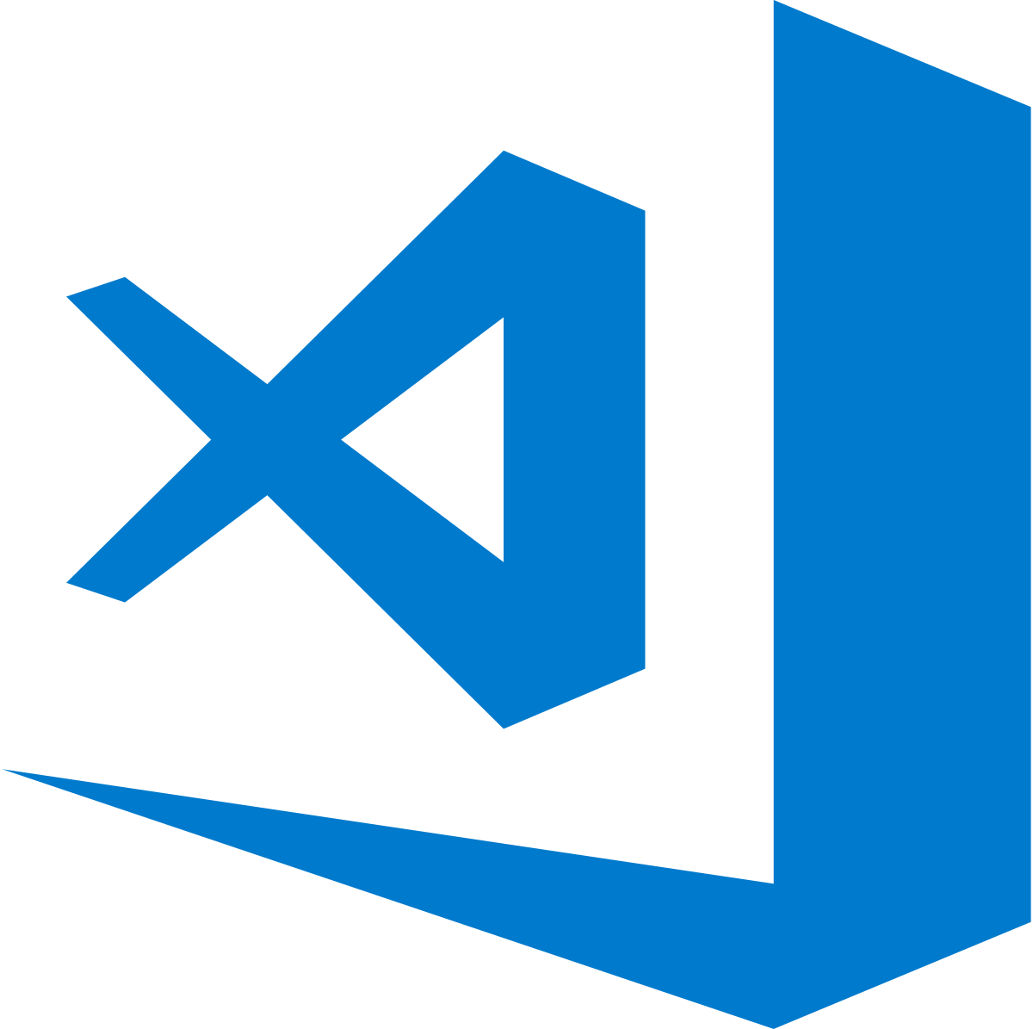




Wellcome

Slide 3
NodeJS
Node.js® is a JavaScript runtime built on Chrome's V8 JavaScript engine. Node.js uses an event-driven, non-blocking I/O model that makes it lightweight and efficient. Node.js' package ecosystem, npm, is the largest ecosystem of open source libraries in the world.
https://nodejs.org/en/

Slide 4
NPM
npm is the package manager for JavaScript and the world’s largest software registry. Discover packages of reusable code — and assemble them in powerful new ways.
https://www.npmjs.com/

Slide 5
GIT
Git is a free and open source distributed version control system designed to handle everything from small to very large projects with speed and efficiency.
https://git-scm.com/

Slide 6

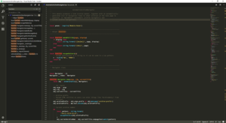
vscode
Visual Studio Code is a source code editor developed by Microsoft for Windows, Linux and macOS
https://code.visualstudio.com

Slide 7
Typescript
TypeScript is a typed superset of JavaScript that compiles to plain JavaScript
https://www.typescriptlang.org/

Slide 8
SASS
Sass is a preprocessor scripting language that is interpreted or compiled into Cascading Style Sheets (CSS).
https://sass-lang.com/

Slide 9
Webpack
Webpack is an open-source JavaScript module bundler. Webpack takes modules with dependencies and generates static assets representing those modules
https://webpack.js.org/

